Slide 1

My Project
Software engineering
Presenter: Mahdiye Rashidi

Slide 2

My project vision
Why should this project be done?
What is the purpose of doing it?
How does it help the current system?
What problems does it solve?
What is the project perspective?

Slide 3

Business case My project
Investigating the consequences of doing the project from a commercial point of view
Profit from the project
What costs do I deduct?
What are the advantages and disadvantages compared to similar products?
Specify project cost and execution time

Slide 4

My Datasets
Mobile App Statistics (Apple iOS app store)
from https://www.kaggle.com/ramamet4/app-store-apple- data-set-10k-apps
The ever-changing mobile landscape is a challenging space to navigate.
With million of apps around nowadays, the following data set has become very key to getting top trending apps in iOS app store

Slide 5
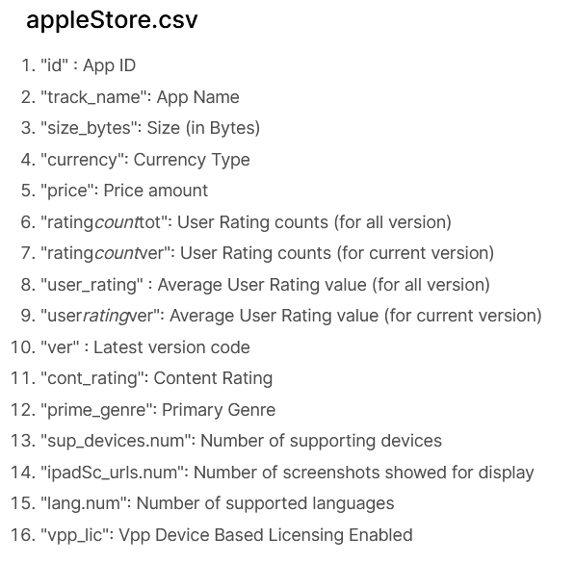
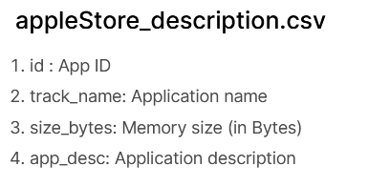
Content

Slide 6

The programming language for site implementation
+ Python
+ Html + CSS
+ JavaScript

Slide 7
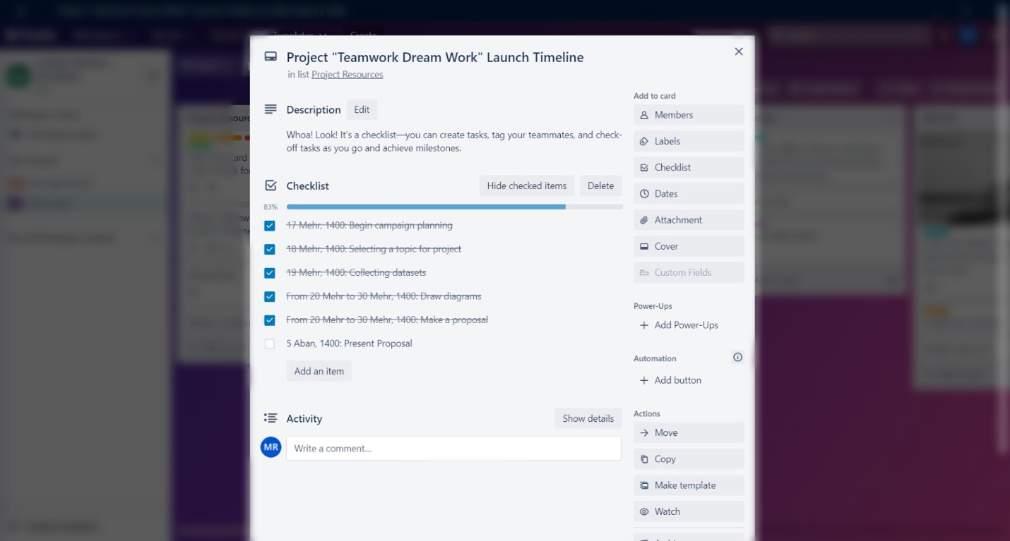
My project in Trello

Slide 8

Thank you for your attention

