Slide 1
Parallel Programing
Decision tree algorithm

Slide 2
Introduction
Decision Tree algorithm belongs to the family of supervised learning algorithms. Unlike other supervised learning algorithms, the decision tree algorithm can be used for solving regression and classification problems too.
The goal of using a Decision Tree is to create a training model that can use to predict the class or value of the target variable by learning simple decision rules inferred from prior data (training data).

Slide 3
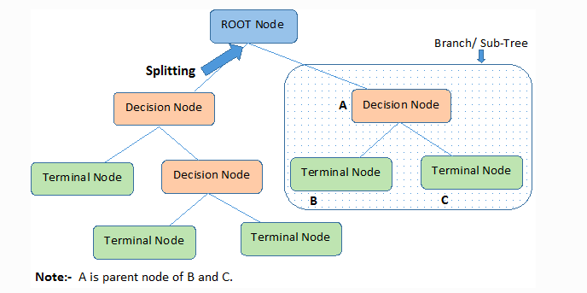
Important Terminology related to Decision Trees:
It represents the entire population or sample, and this further gets divided into two or more homogeneous sets.
It is a process of dividing a node into two or more sub-nodes.
A subsection of the entire tree
When a sub-node splits into further sub-nodes
Nodes do not split.

Slide 4
How Decision Tree classification algorithm work
Salary is between
$50000-$80000
Yes
No
Office near to home
Declined offer
Yes
No
Provides Cab facility
Declined offer
Yes
No
Accepted offer
Declined offer

Slide 5
Creating The Decision Tree

Slide 6
v1
v2
If number of samples < minimum number of samples
Or length of the tree = maximum length of the tree
Make this node a terminal node.
Root
v3
v4
Left
Right
For each value in the dataset split the samples then find the best split with maximum information gain
Recursively apply these steps for the left and right nodes

Slide 7
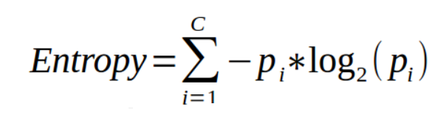
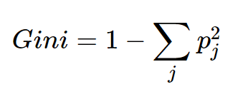

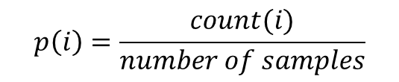
Information gain
$$p\left(i\right)=\frac{count(i)}{number of samples}$$
The gain from a split :
Entropy( or Gini) [parent] –
(Entropy( or Gini) [left node] * weight [left node] + Entropy( or Gini) [right node])* weight [right node])
Weight(node) $=\frac{size(node)}{size(parent)}$

Slide 8
Algorithm
Start with the root node:
If the number of samples < min_samples or the length of the tree is equal max_depth:
max_class = the class with the bigger number of samples.
make this node a terminal node with class max_class.
Else:
max_gain = - infinity, best_left =?, best_right =?.
best_threshold =?, best_feature =?
for every feature in features:
for every threshold in feature values:
left,right= split the samples with this threshold
gain = calculate information gain from this splitting
if gain > max_gain:
max_gain = gain, best_left = left, best_right = right
best_threshold =threshold, best_feature =feature.
Make this node Decision node with (best_threshold, best_feature)
Recursively apply the algorithm for the best_right and best_left.
We can parallelize this part
We can apply this algorithm for the 2 nodes simultaneous.

Slide 9
How to parallelize the decision tree algorithm
f1 | f2 | f3
Thread 1 | Thread 2 | .. | .. | .. | .. | .. | Thread n
Thread n+1 | … | .. | .. | .. | .. | .. | ..
.. | .. | .. | .. | .. | .. | .. | ..
.. | .. | .. | .. | .. | .. | .. | ..
.. | .. | .. | .. | .. | .. | .. | ..
.. | .. | .. | .. | .. | .. | .. | ..
.. | .. | .. | .. | .. | .. | .. | Thread nXm
Get the max of this array, and the index of the max, the threshold at this index is the best threshold to split.
Split the data with this threshold and apply the algorithm on the left and right node on different streams.

Slide 10
Algorithm
Start with the root node:
If the number of samples < min_samples or the length of the tree is equal max_depth:
max_class = the class with the bigger number of samples.
make this node a terminal node with class max_class.
Else:
Create Threads more or equal the dataset size.
Result = copy of the dataset.
Thread number i:
If i > size: die.
Threshold = Dataset[i]
Split and calculate gain.
Result[i] = gain
Max = max(Result)
[best_threshold, best_feature] = index_of (Max, Dataset)
Left, right = split with threshold = data[best_threshold, best_feature].
Recursively apply the algorithm for the right and left on different streams.

