Slide 1
Introduction to Embedded System
Mr. A.Baskar
Assistant Professor( Sr. Gr)
Department CSE.
Amrita Vishwa Vidyapeetham

Slide 2
What is an Embedded System?
An embedded system is a special-purpose computer system designed to perform certain dedicated functions. It is usually embedded as part of a complete device including hardware and mechanical parts.
An embedded system is a computer system designed to do one or a few dedicated and/or specific functions often with real‐time computing constraints. It is embedded as part of a complete device often including hardware and mechanical parts.
Embedded systems (ES) = information processing systems embedded into a larger product

Slide 3
What is an Embedded System?
Embedded : means hidden inside so one can’t see it .
System : means multiple components interfaced together for do special purpose .
Embedded System : is a special-purpose computer system designed to perform certain dedicated functions.
Functionalities : are done by dedicated HW and SW with limited resources.
On average, a person interacts with 100s of embedded systems on daily basis.
Any Hardware System which is intended to do a specific task can be called as an Embedded System

Slide 4
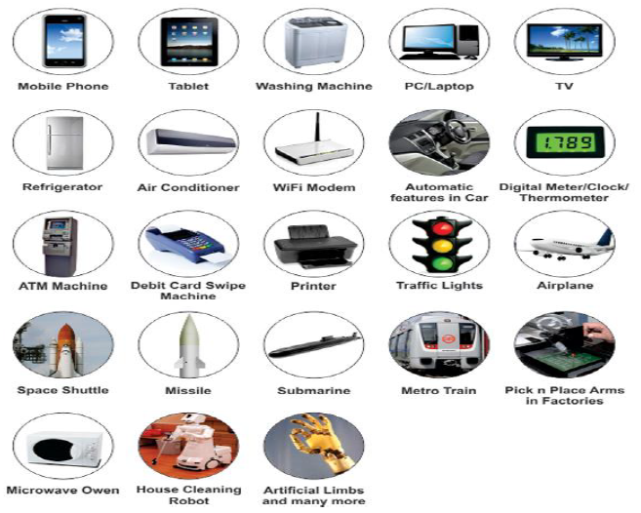
Embedded Systems Applications

Slide 5
General Purpose processors vs Embedded Processors,
Processors and Controllers,
Evolution of Micro-Processors,
Architecture Vs. Organization,
Embedded Architecture,
Embedded Systems,
Characteristics of Embedded Systems,
Von- Neumann vs Harvard Architecture,
RISC and CISC,
Memory Oganization,
Little Endian and Big Endian,
Byte Organized Memory,
Revision of Number system – Decimal, Hexadecimal, BCD and ASCII representation

