Slide 1
ARM – Session – 1
SHRIRAM K VASUDEVAN

Slide 2
AGENDA (For FIVE sessions)
Features and Basics
Architecture.
Programming Model.
Instruction Set.
Thumb Mode.
Few Sample Codes.

Slide 3
Introduction
ACORN RISC MACHINE (Some calls it Advanced RISC Machine)
What is RISC? (Reduced Instruction Set Computer)
32 bit processor. High end applications. Can withstand high pressure applications. (8051 and PIC microcontrollers were discussed which are primarily meant for low end applications)
ACORN Computer Limited, Cambridge caused this revolution.
It is not a processor! It is an idea. Means, it is a core. Licensed to many manufacturers. (Means, I tell you how to make, you make it in your name!)

Slide 4
Contd.,
So, now the focus is not on family of processors, but conceptually a CPU architecture which may figure in number of different chips intended for embedded applications.
RISC, But not PURELY RISC..
Can be enhanced.
This is versatility.
Supports:
High code density.
Low power consumption.
Smaller size (Silicon foot print)

Slide 5
FEATURES
ARM has got lot of interesting features. ARM processor has a large uniform register file.
It is basically a LOAD-STORE architecture, where data processing operations are only between registers and does not involve any memory operations.
It is a 32 bit processor and also has variants of 16 bit and 8 bit architectures.
So, there are 16 bit and 8 bit variants embedded into a 32 bit processor. 16 bit and 8 bit variants also called as THUMB and Jazelle architecture.
ARM has got a very good speed Vs power consumption ratio and high code density as required by embedded applications.
It has got barrel shifter in the data path, which can maximize the hardware usage available on the chip.
It has also got auto increment and auto decrement addressing modes to optimize program loops; this is not very common with RISC processor.
Also ARM supports LOAD and STORE of multiple data elements through a single instruction.
ARM has also got a feature named ‘conditional execution’, where an instruction gets executed only when a condition is being met, which maximizes the execution throughput.

Slide 6
Basic ARM Architecture
Any architecture is not only characterized by its data path, but also by its control path.
This data path is organized in such a way that the operands are not directly fetched from memory, and a basic feature of RISC is that operands get fetched from registers and not from memory.
Instructions typically use two source registers and single result/destination register.
The more interesting facts are the presence of the ’barrel shifter’ and the ‘increment/decrement’ logic.
The barrel shifter on the data path can preprocess the data before it enters the ALU.
It is basically a combinational circuit that can shift a data bit to the left or to the right by an arbitrary number of positions in the same cycle itself. (This feature is not supported in many of the other processors)

Slide 7
CONTD.,
In classical shift register, the number of shifts requires an equivalent number of clocks because, the shifting takes place based on clocks.
In barrel shifter, Combinational circuit is used, where the shifting takes place in a single attempt itself.
In fact, the shift takes place in the same instruction itself. This is a very basic enhancement present in the ARM data path.
The other interesting feature is the increment and decrement logic which can operate on the registers that are independent of the ALU.
This facilitates the implementation of auto-increment and auto-decrement features in the ARM, where it is used for movement of blocks of data between the memory and registers.

Slide 8
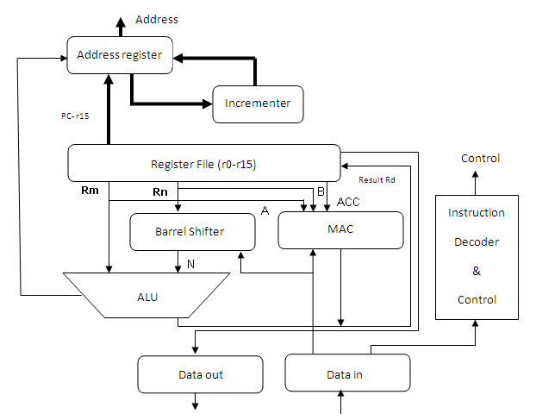
ARM organization core data flow model
The arrows represent the direction of data flow, and the lines represent the buses and the boxes represent either a storage unit or an operation unit.

Slide 9
ARM organization core data flow model
Instruction decoder:
It decodes the instruction before execution is carried out.
There are three kinds of instruction set supported in ARM core.
They can be ARM instruction set; Jazelle Instruction set and THUMB instruction set.
With the CPSR one can set the operation state and accordingly instruction set can be selected.

Slide 10
ARM organization core data flow model
Load and Store architecture:
ARM falls in the RISC category which follows the Load and Store architecture.
Means, with Load and Store architecture in place, registers will be mandatory for processing to be carried out.
Without registers one cannot do any sort of operation with ARM core.
ARM has 2 source registers Rm and Rn and one destination register which carries the result. The destination register is named as Rd.
A and B are the two buses that will help in reading the source operands.
Rm and Rn values will be fetched from the buses A and B and computation will be carried out in the ALU or MAC (Multiplication and Accumulate unit). Address registers are used to hold the address and address bus will facilitate the storage action.
Barrel shifter is a kind of support which is very useful in association with ALU for expression evaluation and address calculation.
After going through the steps and sequences the result will be moved to the Register Rd.

Slide 11
END OF SESSION – 1
SHRIRAM K VASUDEVAN
LET’S LEARN REGISTER RELATED INFORMATION IN SESSION 2

Slide 12
ARM REGISTER ORGANIZATION – SESSION 2
SHRIRAM K VASUDEVAN
WELCOME BACK! ☺

Slide 13
REGISTER ORGANIZATION
Every microcontroller must be having lot of registers.
A register is used to store information.
For the reader to understand in a simpler way, when two numbers are to be added, the numbers to be added are stored in the mind of the person performing addition.
With respect to processors, the area where the numbers are stored can be called as registers.
And, the result of the addition will also be stored, that again should be register.
All the microprocessors or microcontrollers will have some number of registers.
The count may vary from architecture to architecture.

Slide 14
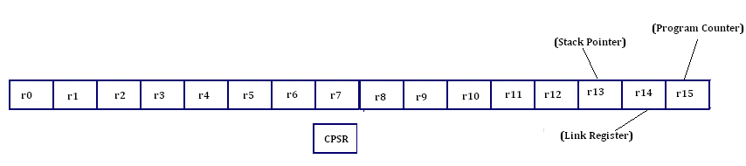
Contd.,
There are 13 general purpose registers (r0 - r12) available for the programmers to use.
They are all referred with a prefix r like, r0, r1 etc, which means the RAM location and also register.
All the registers are 32 bits in their size.
There are some special function registers available here as well. They are r13, r14 and r15.
Each of these three registers have a specific function being assigned and are summarized below.

Slide 15
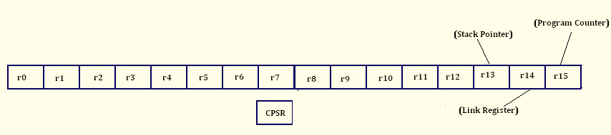
Contd.,
Stack pointer (SP, r13) - Every microcontroller or a processor will have a stack area for temporary storage purpose. And one can access the stack through the stack pointer. It is similar to the one reader has gone through in 8051. It will hold the address of the top of the stack.
Link register (LR, r14) - The name itself reveals the story behind the register. When a subroutine is called, the return address will be put in here and when the subroutine execution is over, this register will be used for fetching the address back from where the control of execution has been initiated.
Program counter (PC, r15) - Well, reader is already aware of what a PC does. It is born special register. It has got no address. The purpose of PC is to keep a paper mark. Simple, where should the control go next is the idea; the address of next instruction to be executed will be kept in PC.

Slide 16
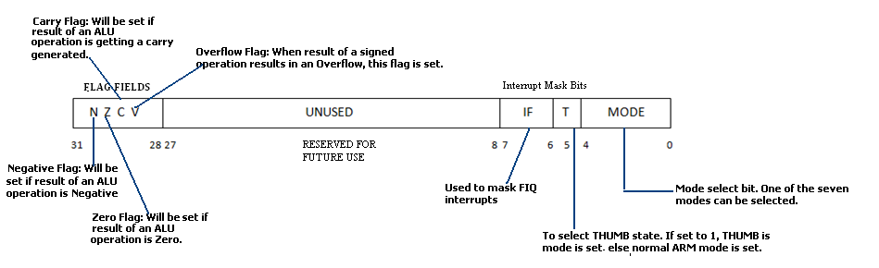
CPSR (Current program status register)
The immediate action is to learn something about a born special, more privileged register called as C P S R.

Slide 17
Contd.,
This is referred to be a status register or a flag register.
It can be compared to PSW (program status word) of 8051.
One major difference is that here CPSR is a 32 bit register.
There are 4 flags supported in the form of Negative flag, Zero flag, Carry flag and Overflow flag.
Since there is a lot of room for extension few bits are reserved and kept for future usage or for the moment they can be referred to be as unused.
There are 2 fields which are meant for interrupt masking purpose. Where with I one can mask or unmask the IRQ interrupts. (we shall see this later)
Meanwhile with F one can mask or unmask the FIQ interrupts.
Then comes the THUMB field, it helps in enabling or disabling the THUMB mode. With this knowledge on the CPSR one can now navigate to the next title on modes of the operation supported with ARM. (An example follows shortly!!)
LETS MEET IN THE NEXT SESSION!!! ☺

Slide 18
ARM MODES – SESSION 3
SHRIRAM K VASUDEVAN
WELCOME BACK! ☺

Slide 19
Modes of operation
ARM architecture supports two types of modes on a broad classification.
They are privileged and non-privileged mode.
Privileged is powerful mode which has got a wide level of access permissions and non-privileged is not so.
There are total of seven modes supported with ARM, all of them fall in either privileged or non-privileged mode.
In privileged mode the access permissions to the CPSR register is full.
But, non-privileged mode will not permit this.
The access permissions are restricted with respect to non-privileged mode. Modes can be set and changed with the mode bits of the CPSR. It is of 5 bits wide

Slide 20
Contd.,
Abort mode
Fast interrupt request mode
Interrupt request
Supervisor mode
System mode
Undefined mode and
User mode
From these list of available modes only one mode falls into the category of Non-privileged mode. It is user mode. It is categorized as an under-privileged mode. Its access permissions are limited and restricted.

Slide 21
Mode explanation
User mode – Used by programmer for programs and applications. Name itself makes the fact clear on what the mode is meant for.
Abort mode will be entered when there is memory access failure.
Fast interrupt request – Support for interrupt is provided in this mode.
Interrupt request - Support for interrupt is provided in this mode.
Supervisor mode – When the processor goes in for a reset or a restart the mode of supervisory control will be set.
System mode – This is very much similar to the user mode. Only difference is that, it can have complete access to the CPSR without restrictions.
Undefined mode – When the processor encounters an undefined instruction which is totally not known to the processor, then the undefined mode will be entered

Slide 22
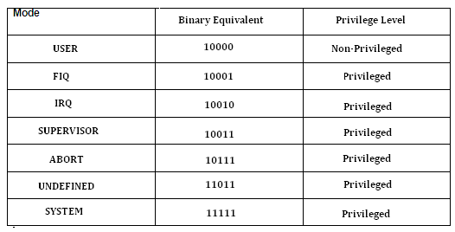
CONTD.,
Well, how can the modes be selected? The mode bits in the CPSR helps the programmer in accomplishing this task.

Slide 23
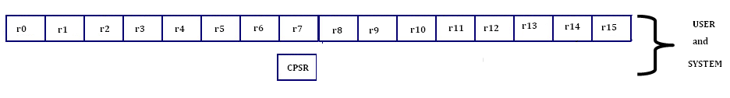
Register Banks (Mode switch)
Where, for the USER and SYSTEM mode, the access permissions are there for all the15 registers and CPSR as well
But there are some special, additional registers made available for the modes. We shall see that now, folks!

Slide 24
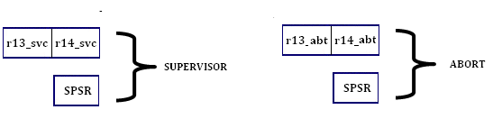
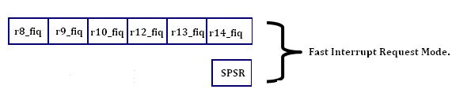
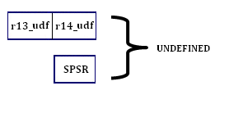
Contd.,
For an instance if the processor moves to the Abort mode, the registers r13_abort and r14_abort will be made available along with an abort_SPSR register. (What is SPSR, We shall see that, don’t worry)

Slide 25
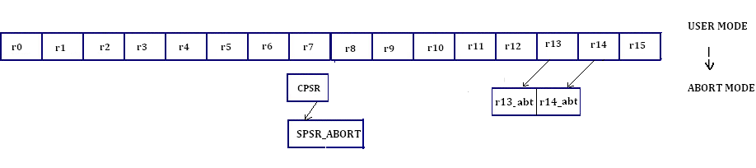
Contd.,
one can understand from the above picture that when the abort mode is called, r13 and r14 are replaced with banked registers r13_abt and r14_abt.
Also, CPSR is replaced with a SPSR_abort. It would be apt for the reader to now understand on what is SPSR.

Slide 26
SPSR!
SPSR is expanded as Saved Program Status Register. It is specially meant for privileged modes of operation.
There is an exception here; System mode does not have support for SPSR.
Other five modes (privileged) have all support for SPSR. SPSR is used to hold the status of the CPSR. So it is a storage register which can hold the current state of CPSR.
LETS MEET IN THE NEXT SESSION!!! ☺
THANK YOU!

Slide 27
ARM STATES – SESSION 4
SHRIRAM K VASUDEVAN
WELCOME BACK! ☺

Slide 28
Here you go!
An ARM core supports three states of operation namely
ARM (Default)
THUMB (ARM7TDMI)
Jazalle (I HAVE NO EXPERIENCE IN THIS)
Each of these modes will have their own instruction set and the choice can be made with CPSR as usual.
There is a T bit in the CPSR if that bit is set then, the mode of operation is referred to be as THUMB mode and THUMB instruction sets will be used for the same.
Similarly if the T bit is 0 then, the mode ARM is selected.
There ARM instruction set is used. Other instruction set will not be useful for ARM mode of operation.
Jazelle is a state which helps in increasing the efficiency of JAVA based operations when run with ARM core.
With Jazelle mode in place, the operations based on Java would be executed in an efficient manner. All Jazelle instructions are 8 bit instructions. J bit will be found in the CPSR flag area. (BUT CORE SHOULD SUPPORT)
Along with the co-flags N,Z, V and C the J bit will be available. Based on the selection / enabling state can be selected. An example would help the reader with a clear understanding.

Slide 29
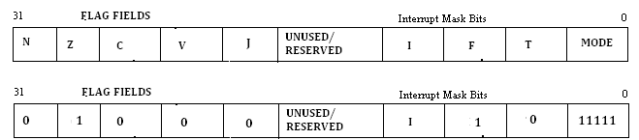
Lets answer this question
From the figure below, reader should convey on what is the mode that the ARM Core will be operated on setting the values as shown.
Jazelle state is not set and so is THUMB state since T=0. And hence the state selected is ARM. And the mode value is set as 11111. (Table presented early!, System Mode)

Slide 30
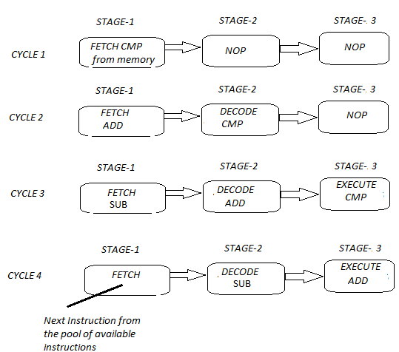

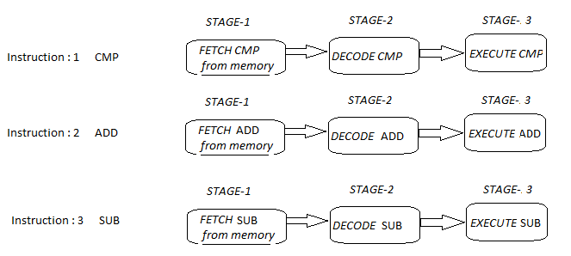
PIPELINING IN ARM 7

Slide 31
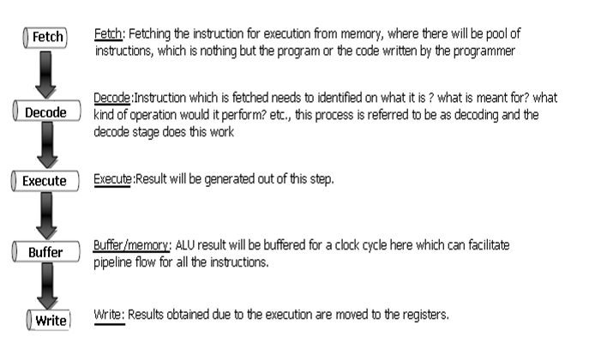
5 stage pipelining (Though not to worry much, it is good to know)

Slide 32
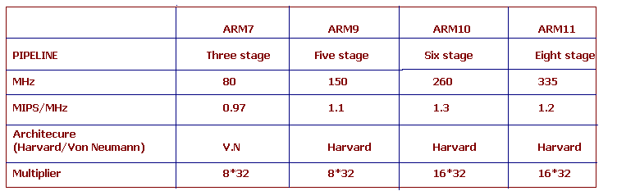
A Comparison till now!

Slide 33
LET US GET TO NEXT LEVEL SOON!
Shriram K Vasudevan

