Slide 1
Introduction to Embedded Systems.
Shriram K Vasudevan

Slide 2
Agenda
Introduction to Embedded Systems
Characteristics of Embedded Systems
Components of Embedded Systems - OS Will come as a part
OS – Heart of any system
Difference between RTOS and OS.
Queries.

Slide 3
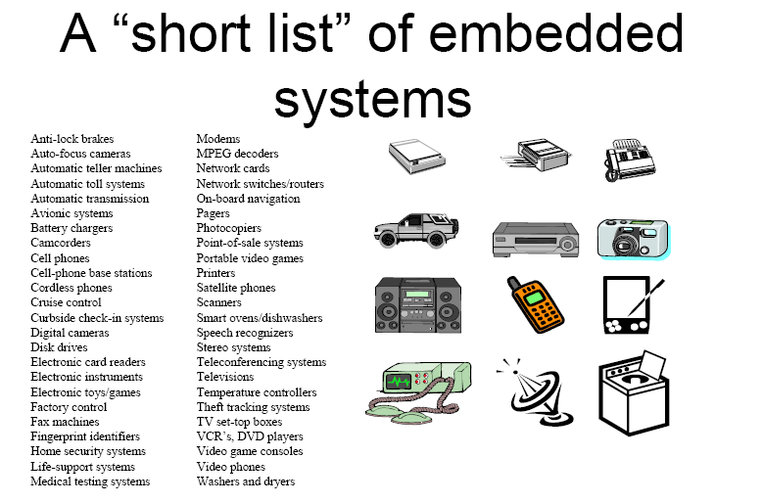
Lets define.
What is a System ?
Simple. Anyone can say! Input + processing + output.
What is embedded system?
Computing system other than desktop computers
An embedded system is the one that has computer hardware with software embedded in it as one of its most important components
It is any device that includes a programmable computer but is not itself intended to be a general purpose computer.
Example will make life easier! Air conditioner!

Slide 4
Characteristics of embedded systems
All Embedded Systems have certain common characteristics. They can be listed as follows:
Single Functioned
Tightly Constraint
Real Time & Reactive
Complex Algorithms
User Interface
Multi rate
Manufacturing Cost
Power
Let’s see about all these in a detail.

Slide 5
A Diagrammatic representation of Embedded Systems Architecture – Presented here!
TYPICALLY : COMPARE, SIGNAL PROCESS (VOICE/PROCESS)
A
C
Q
U
I
R
E
A
N
A
L
Y
Z
E
CO
N
T
R
O
L
D
I
S
P
L
A
Y
ACTUATORS
DISPLAYS
ALARMS
INDICATORS
OUTPUT
SENSORS
KEY
SWITCHES
INPUT

Slide 6
A Diagrammatic representation of Embedded Systems Architecture – Presented here!
Sensors
KEY, SWITCHES, INPUTS
Compare Signal process
(Voice Image)
ACQUIRE
Wired / Wireless/ Mobile
ANALYZE
(PROCESS)
Communicate
ACTUATORS, DISPLAYS, ALARMS, INDICATORS,
OUTPUTS
DISPLAY
CONTROL

Slide 7
Challenges in Embedded System Design
There are many challenges in designing an embedded system. Let us discuss them as follows in detail:
How much hardware do we need?
How do we meet deadlines?
How do we minimize power consumption?
How do we design for upgradeability?
Does it really work?
How does the nature of ES make their design more difficult?
Does it optimize the design metrics?
Let’s pick each of the above challenges and discuss!

Slide 8
Conflicting requirements
Metrics usually compete one with another, improving one will affect Other metric.
For example if we reduce size, it may affect performance.

Slide 9
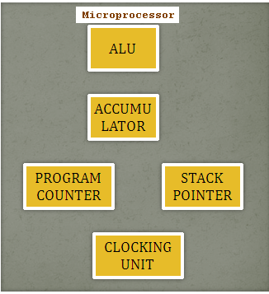
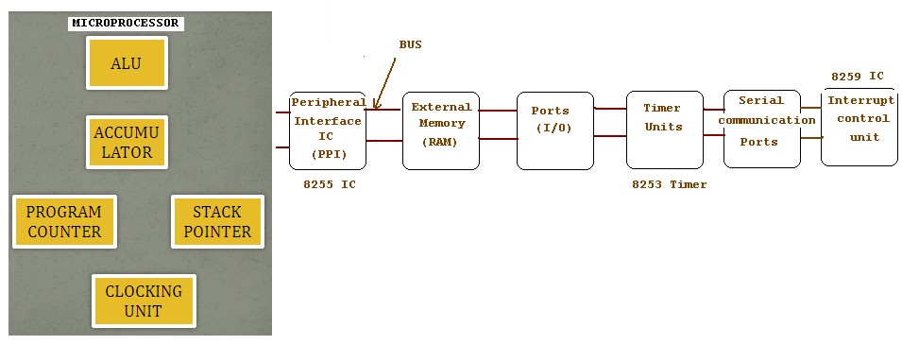
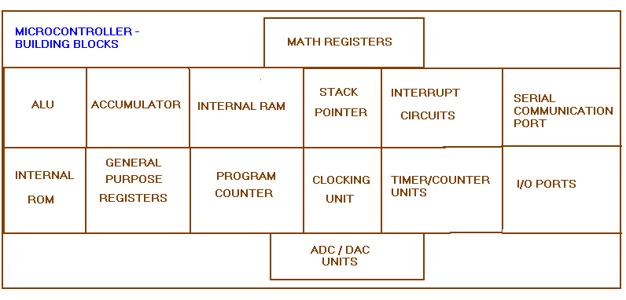
MUP Vs. MUC
Micro-Controller.

Slide 10
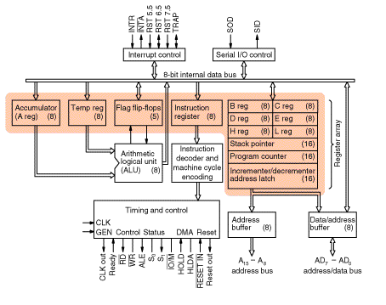
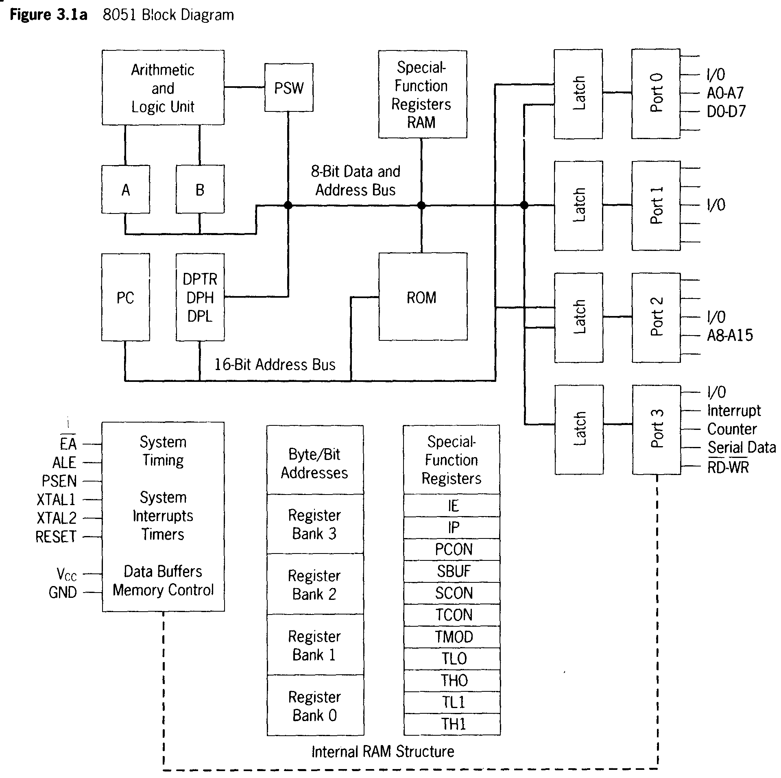
Mup vs. MUC

Slide 11
Summary
System
Embedded System
Characteristics
Challenges

