Slide 1
Embedded Systems - Prelims
UNIT – I
Prelims
Shriram K Vasudevan
Embedded Systems

Slide 2
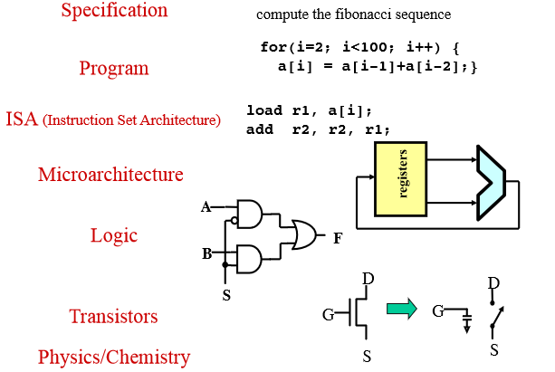
What is a computer system?
Embedded Systems

Slide 3
What is Computer Architecture and Organization?
  Architecture will always concerned with what to do?
  Organization will take care of how to do?
  In simple terms, architecture is concerned with the design and organization is concerned with the building process.
  Architecture shall carry out the analysis and zeroing in about the instructions, modes of addressing and usage of registers.
  Computer architecture carries the precedence than Computer organization.
  I.e. only after the design, the implementation can be done.
  It is to be compared with high level design.
  For example, if a calculator is built, it is to be decided if it will support the division operation is an architectural analysis. Likewise, all the features which a computer has are defined at architectural phase.
Embedded Systems

Slide 4
Organization Vs. Architecture
Architecture refers to how various components in a computer are organized & the design aspect of a computer.
Computer Organization is how features are implemented, typically hidden from the programmer. E.g. control signals, interfaces, memory technology etc.
It is basically concerned with the way the hardware components operate and the way they are connected together to form the computer system.
Embedded Systems

Slide 5
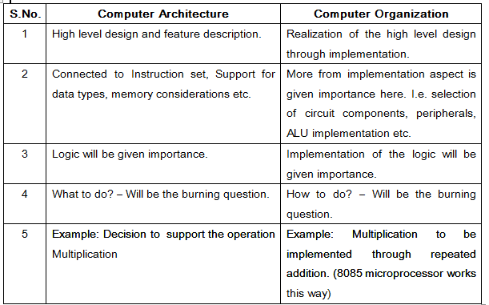
Embedded Systems

Slide 6
What is an instruction?
ADD A, B
Here we tell the microprocessor to add the contents of two registers A and B. That is it! This forms the baseline!
It is like you giving an order to your subordinate! It has to be obeyed!
Embedded Systems

Slide 7
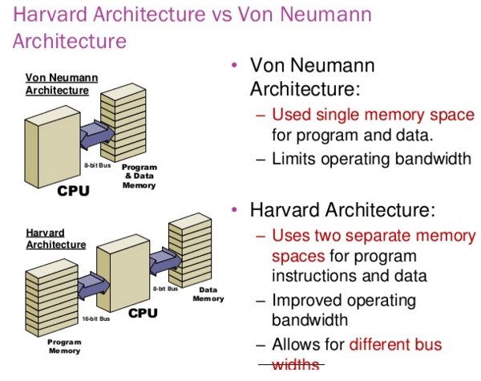
Von Neumann Vs. Harvard Architecture.
Embedded Systems

Slide 8
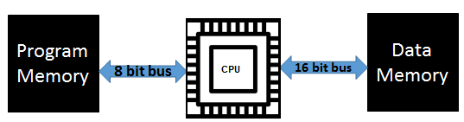
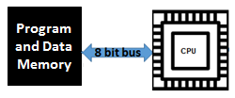
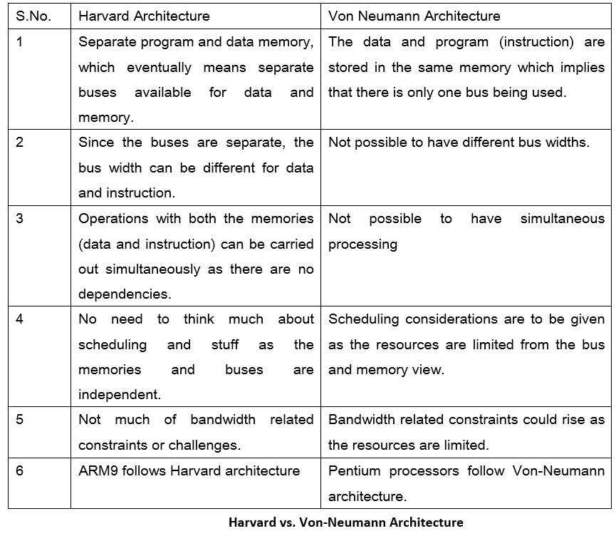
Harvard Architecture – A diagrammatic representation Von Neumann Architecture – A diagrammatic representation.
Embedded Systems

Slide 9
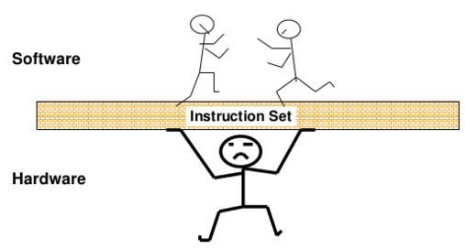
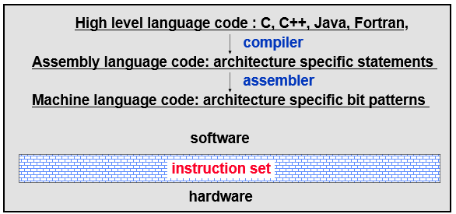
Instruction Set Architecture
Serves as an interface between software and hardware.
Provides a mechanism by which the software tells the hardware what should be done (i.e. instructs the hardware to do the right thing)
Embedded Systems

Slide 10
Contd.,
A good interface:
  Lasts through many implementations (portability, compatibility)
  Is used in many different ways (generality)
  Provides convenient functionality to higher levels
  Permits an efficient implementation at lower levels
Embedded Systems

Slide 11
What do instructions provide?
Which operation to perform – add r0, r1, r3 // operation code
Where to find the operand or operands – add r0, r1, r3 // source operands
Place to store result – add r0, r1, r3 // destination
Location of next instruction – add r0, r1, r3
br endloop
Embedded Systems

Slide 12
What is instruction?
It is nothing but a command that can make the microprocessor perform a specific function.
All the instructions are collectively grouped as instruction set.
An Instruction is basically a combination of two parts one is operation code and the next is operands.
Operation code is also called as opcode.
Operands can be one or two based on the instruction.
The opcode will be used to identify on what kind of operation needs to be performed like, addition or subtraction or data movement and so on. And operands will be used to spot the source and destination. An operand can be any of the following:
    Registers (like Accumulator, B register and so on)
    Immediate value (Say 10H, 010101B)
    An address, i.e. memory location. (Say 30H)
    Any of the supported input or output ports.
Embedded Systems

Slide 13
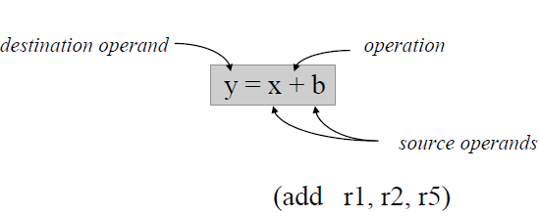
Common design issues
  Where are operands stored?
    registers, memory, stack, accumulator
  How many explicit operands are there?
    0, 1, 2, or 3
  How is the operand location specified?
    register, immediate, indirect, . . .
  What type & size of operands are supported?
    byte, int, float, double, string, vector. . .
  What operations are supported?
    add, sub, mul, move, compare . .
Embedded Systems

Slide 14
Byte Ordering
Byte ordering, or endianness, is another major architectural consideration.
If we have a two-byte integer, the integer may be stored so that the least significant byte is followed by the most significant byte or vice versa.
  In little endian machines, the least significant byte is followed by the most significant byte.
  Big endian machines store the most significant byte first (at the lower address).
Embedded Systems

Slide 15
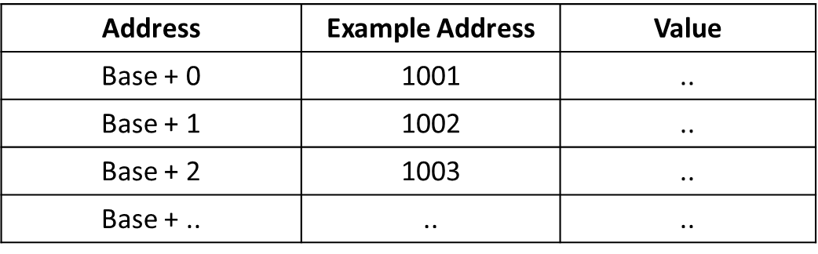

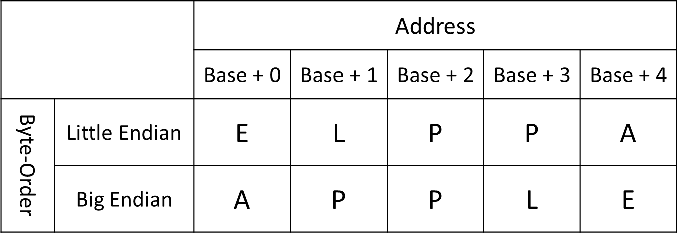
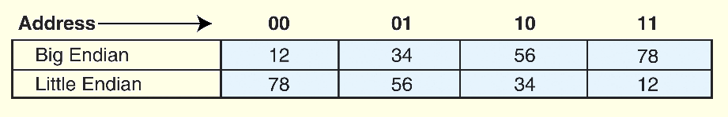
Contd.,
Ex. Represent the String
APPLE
Embedded Systems

Slide 16
Contd.,
Why is endianness so important?
  Suppose you are storing int values to a file, then you send the file to a machine which uses the opposite endianness and read in the value.
  You'll run into problems because of endianness. You'll read in reversed values that won't make sense.
Endianness is also a big issue when sending numbers over the network.
  Again, if you send a value from a machine of one endianness to a machine of the opposite endianness, you'll have problems.
  This is even worse over the network, because you might not be able to determine the endianness of the machine that sent you the data.
Embedded Systems

Slide 17
Contd.,
Where does this term "endian" come from? Jonathan Swift was a satirist (he poked fun at society through his writings).
His most famous book is "Gulliver's Travels", and he talks about how certain people prefer to eat their hard boiled eggs from the little end first (thus, little endian), while others prefer to eat from the big end (thus, big endians) and how this lead to various wars.
Embedded Systems

Slide 18
Contd.,
Endianness only makes sense when you want to break a large value (such as a word) into several small ones.
  You must decide on an order to place it in memory. However, if you have a 32 bit register storing a 32 bit value, it makes no sense to talk about endianness.
  The register is neither big endian nor little endian. It's just a register holding a 32 bit value.
  The rightmost bit is the least significant bit, and the leftmost bit is the most significant bit.
Embedded Systems

Slide 19
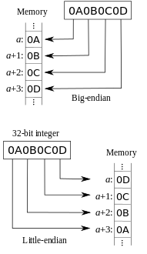
Contd.,
Big endian:
  Is more natural.
  The sign of the number can be determined by looking at the byte at address offset 0.
  Strings and integers are stored in the same order.
Little endian:
  Conversion from a 16-bit integer address to a 32-bit integer address does not require any arithmetic.
Embedded Systems

Slide 20
Contd.,
Examples of Little Endian
  BMP
  RTF
  MSPaint
Examples of Big Endian
  JPEG
  Adobe Photoshop
  MacPaint
Embedded Systems

Slide 21
CISC vs. RISC – A Very important interview question.
Which is better?
  Well, a big debate which can’t be answered so easily!
  Because, both are in existence and has not vanished completely.
Major Computer manufacturing firms Apple and Intel have always been arguing on importance of hardware and software in CPU architecture designs.
Intel supporters want the hardware to bear more responsibility and software on the easier side. This would impact the hardware designing to be more complex but software coding would be relatively easy.
On the other hand, Apple supporters want the hardware to be simple and easy and software to take the major role.
Intel’s hardware oriented approach is termed as Complex Instruction Set Computer while that of Apple is Reduced Instruction Set Computer
Embedded Systems

Slide 22
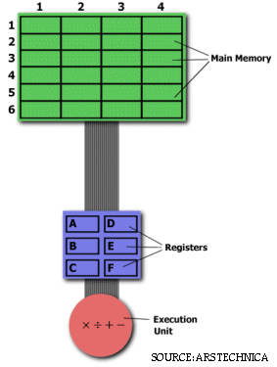
Contd.,
An Example..
Multiplying two numbers in memory
On the right is a diagram representing the storage scheme for a generic computer.
The main memory is divided into locations numbered from (row) 1: (column) 1 to (row) 6: (column) 4.
The execution unit is responsible for carrying out all computations.
However, the execution unit can only operate on data that has been loaded into one of the six registers (A, B, C, D, E, or F).
Let's say we want to find the product of two numbers - one stored in location 2:3 and another stored in location 5:2 - and then store the product back in the location 2:3.
Embedded Systems

Slide 23
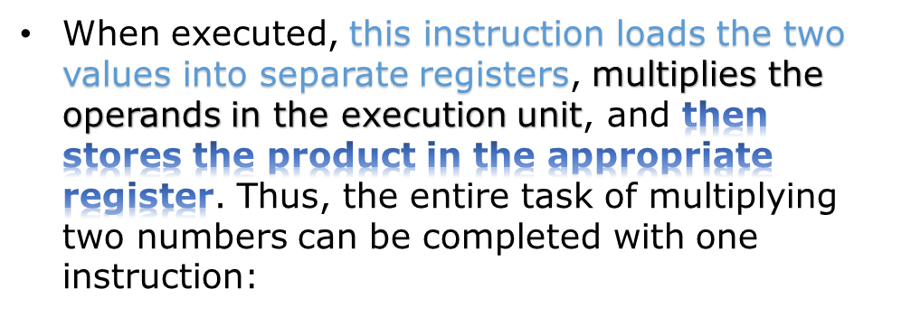
Contd.,
THE CISC APPROACH
The primary goal of CISC architecture is to complete a task in as few lines of assembly as possible.
This is achieved by building processor hardware that is capable of understanding and executing a series of operations. For this particular task, a CISC processor would come prepared with a specific instruction (we'll call it "MULT")
MULT 2:3, 5:2
MULT is what is known as a "complex instruction.“
It operates directly on the computer's memory banks and does not require the programmer to explicitly call any loading or storing functions.
It closely resembles a command in a higher level language
Advantages:
Because the length of the code is relatively short, very little RAM is required to store instructions.
The emphasis is put on building complex instructions directly into the hardware
Embedded Systems

Slide 24
Contd.,
The RISC Approach
RISC processors only use simple instructions that can be executed within one clock cycle.
Thus, the "MULT" command described above could be divided into three separate commands:
      "LOAD," which moves data from the memory bank to a register
      "PROD," which finds the product of two operands located within the registers
      "STORE," which moves data from a register to the memory banks.
LOAD A, 2:3
LOAD B, 5:2
PROD A, B
STORE 2:3, A
Is this less efficient?
More RAM is needed to store the assembly level instructions.
The compiler must also perform more work to convert a high-level language statement into code of this form.
Not actually, there are benefits!
These RISC "reduced instructions" require less transistors of hardware space than the
complex instructions, leaving more room for
general purpose registers.
Because all of the instructions execute in a
uniform amount of time (i.e. one clock),
pipelining is possible
Embedded Systems
Notes:
more RAM is needed to store the assembly level instructions. The compiler must also perform more work to convert a high-level language statement into code of this form.

Slide 25
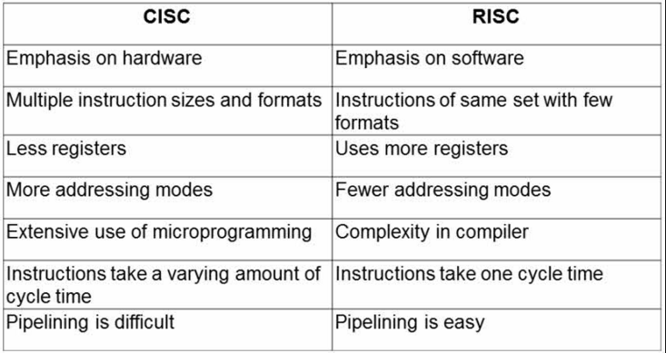
Summarize…
Embedded Systems

Slide 26
Agenda
Decimal systems
Binary systems
Octal systems
Hexadecimal systems
BCD
Gray code
Embedded Systems

Slide 27
Possible conversions
NUMBER LIST | CONVERSIONS
1 | Decimal to Binary
2 | Binary to Decimal
3 | Decimal to Octal
4 | Octal to Decimal
5 | Decimal to Hexadecimal
6 | Hexadecimal to Decimal
7 | Decimal to BCD
8 | BCD to Decimal
9 | Binary to Octal
10 | Octal to Binary
11 | Binary to Hexadecimal
12 | Hexadecimal to Binary
13 | Binary to BCD
14 | BCD to Binary
15 | Octal to Hexadecimal
16 | Hexadecimal to Octal
17 | Octal to BCD
18 | BCD to Octal
19 | Hexadecimal to BCD
20 | BCD to Hexadecimal
21 | BCD to Gray Code
22 | Successive multiplication (Not dealing this here)
You need not get tensed on seeing the list of 22 conversions. This is just to provide all possible combinations of conversions to the you.
The necessity to know code conversions comes into picture when we work with systems which can accept inputs only in certain number systems.
It becomes difficult to feed real time values into the system. Hence, it is immensely important to know code conversions to convert real time values into a number system which can be input into the system for further processing.
Embedded Systems

Slide 28
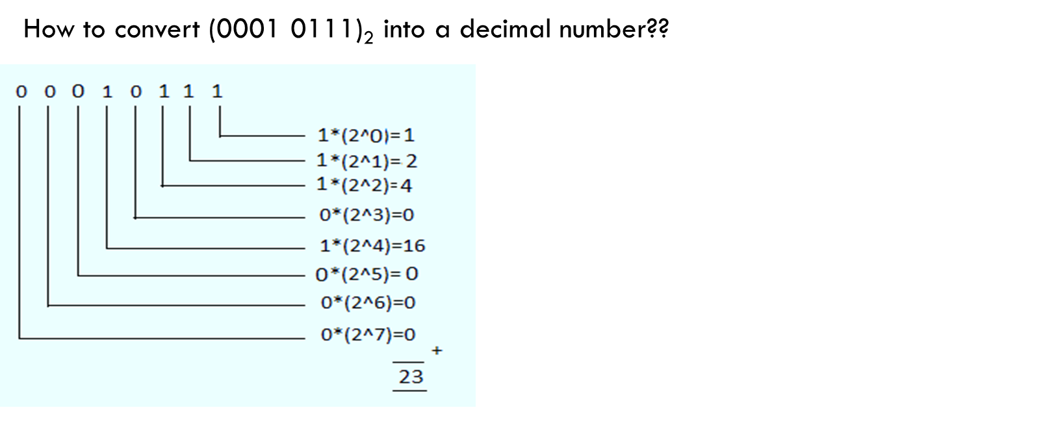
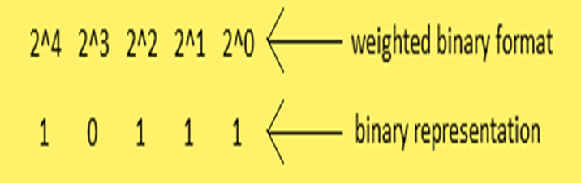
Conversions with respect to Decimal and Binary number systems
Decimal to Binary conversion and Vice versa
Let us take an example of (23)₁₀.
How to convert this into a binary number??
Hence, the binary representation of (23)₁₀ is (0001 0111)_{2.}
Embedded Systems

Slide 29
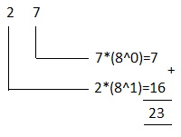
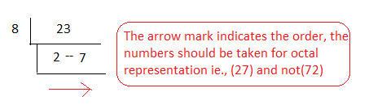
Conversions with respect to Decimal and Octal number systems
Decimal to Octal conversion
How to convert a decimal number say, (23)₁₀ into an octal number?
Method: Do L-Division by 8.
Octal to Decimal conversion
How to convert (27)8 into a decimal number?
Hence, decimal representation of (27)8 is (23)10.
Embedded Systems

Slide 30
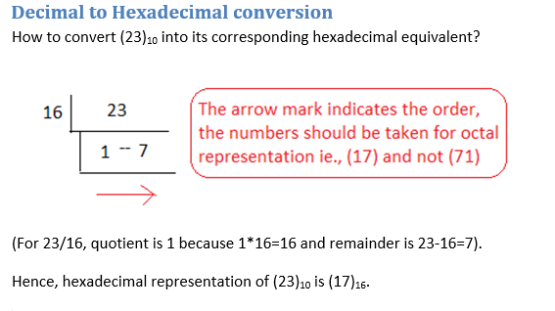
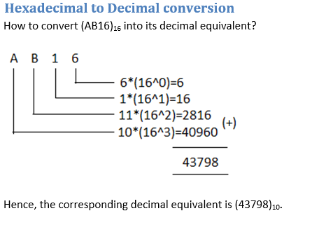
Conversions between Decimal and Hexadecimal number systems
Embedded Systems

Slide 31
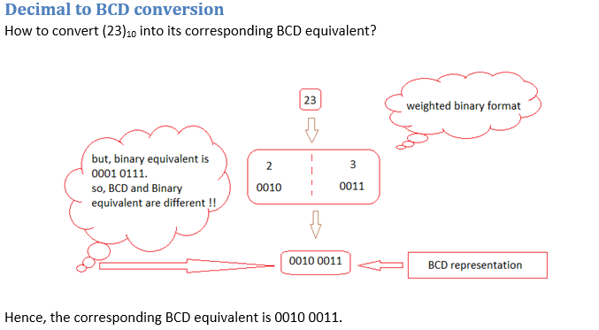
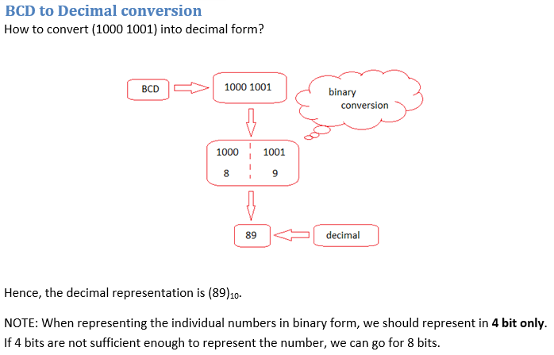
Conversions between BCD and Decimal number systems
Embedded Systems

Slide 32
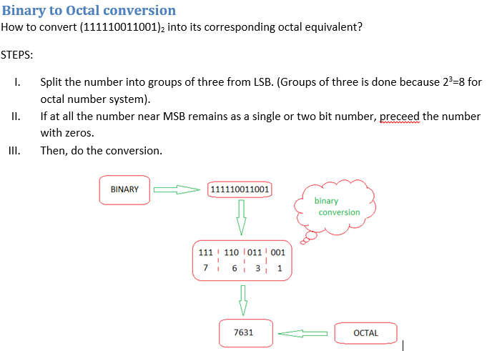
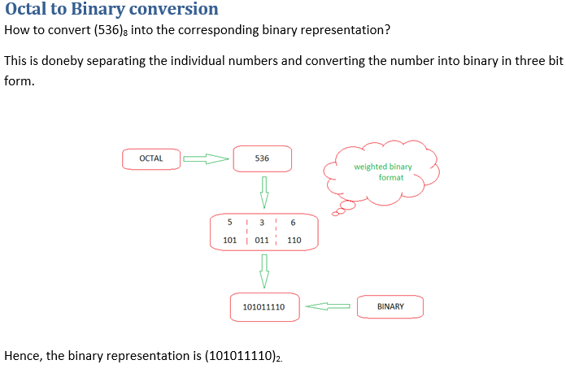
Conversions between binary and octal number systems
Embedded Systems

Slide 33
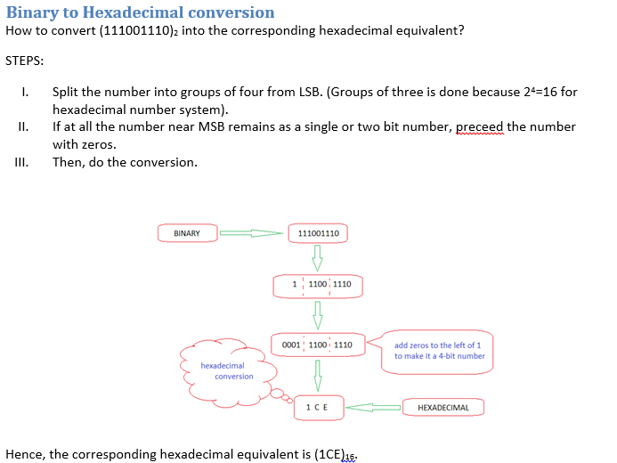
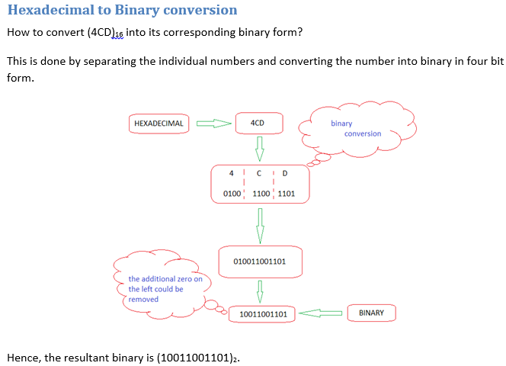
Conversions between Binary and Hexadecimal number systems
Embedded Systems

Slide 34
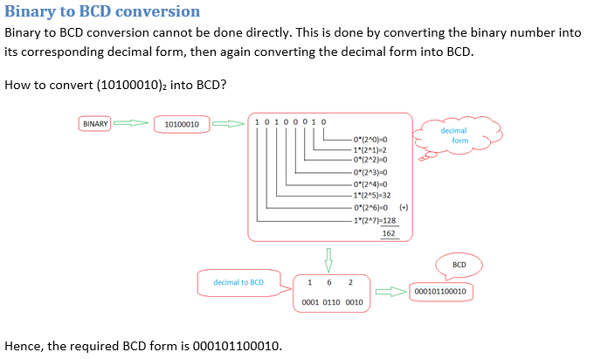
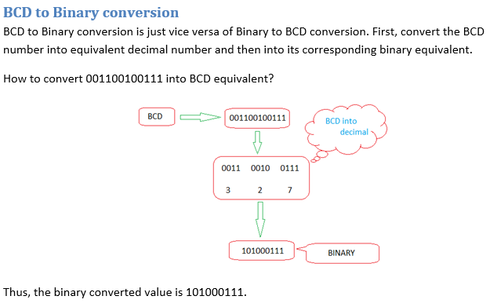
Conversions between BCD and Binary number systems
Embedded Systems

Slide 35
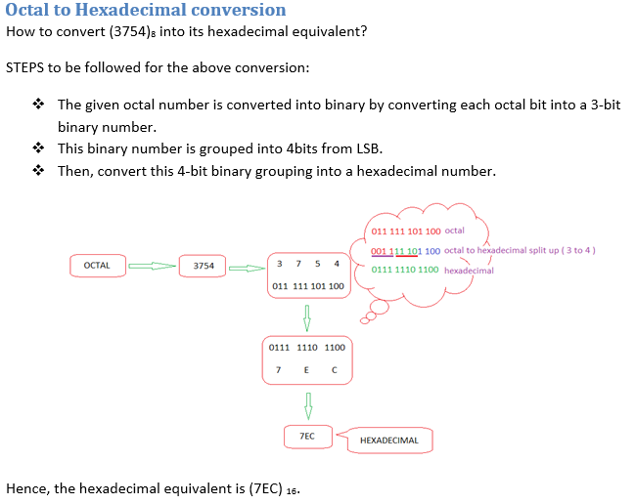
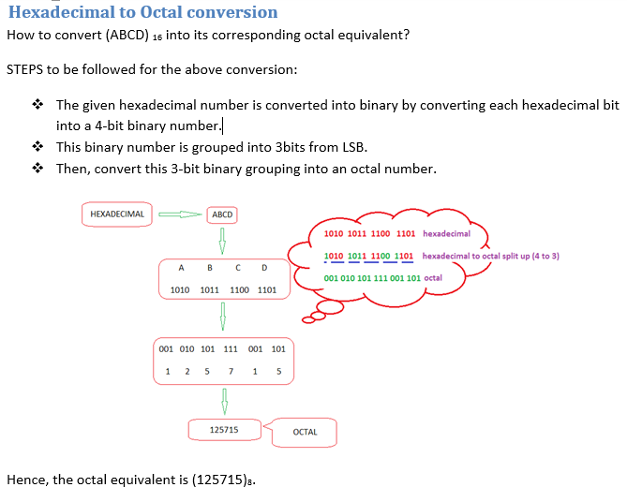
Conversions between Octal and Hexadecimal number systems
Embedded Systems

Slide 36
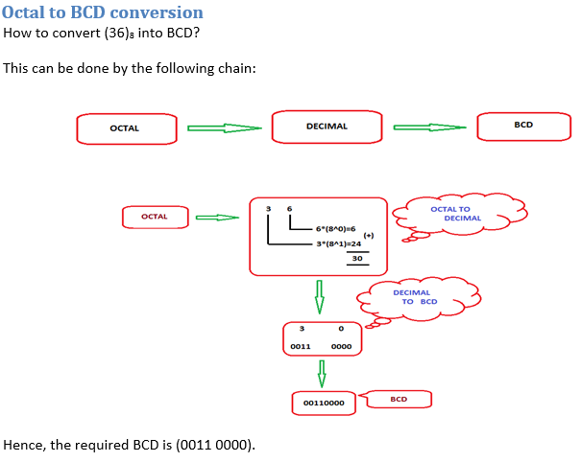
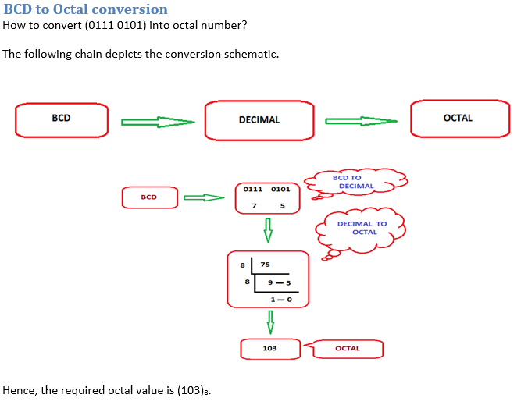
Conversions between BCD and octal number systems
Embedded Systems

Slide 37
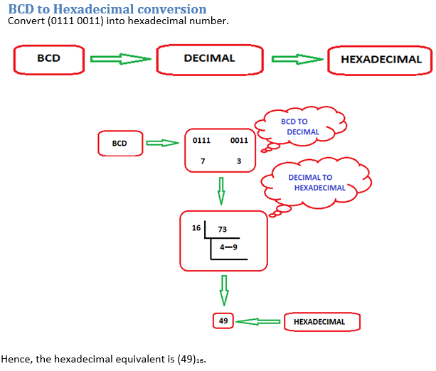
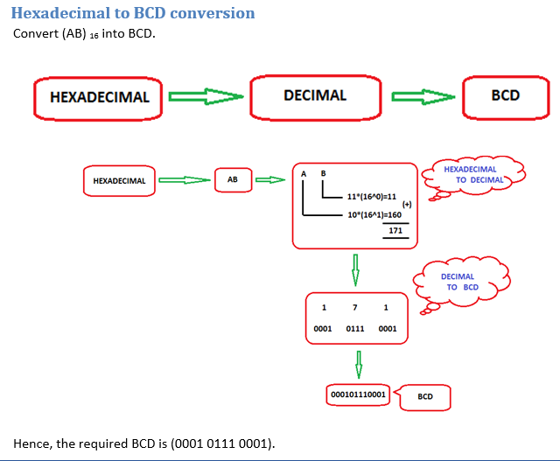
Conversion between BCD and Hexadecimal number system
Embedded Systems

Slide 38
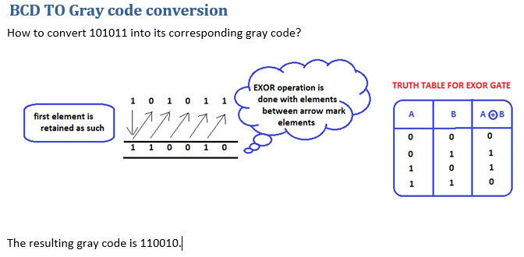
Embedded Systems

Slide 39
Points to remember
Nothing Really, Work out ☺
Embedded Systems

Slide 40
Lets Go Advanced…
Shriram K Vasudevan
shriramkv@gmail.com
Embedded Systems

