Slide 1
Operating System Services – A Very interesting Topic for Discussion!!
Shriram K Vasudevan

Slide 2
Objective!
To describe the services an operating system provides to users, processes, and other systems.
To discuss the various ways of structuring an operating system.
To explain how operating systems are installed and customized and how they boot.

Slide 3
OS Services
Operating systems provide an environment for execution of programs and services to programs and users
Are the services provided by UBUNTU and Windows the same??
Yes, to an extent. But, there are significant differences. It really matters, buddy!
All the services offered by OS are to make the life of the user convenient and make programming not daunting.
We should not learn theory, in OS! Let’s code is what the above line is saying!! ☺

Slide 4
Contd.,
One set of operating-system services provides functions that are helpful to the user:
User interface - Almost all operating systems have a user interface (UI).
Varies between Command-Line (CLI), Graphics User Interface (GUI), Batch
Command Line Interface:
CLI – Open the windows command prompt, that is it! (Best is to learn commands in Linux Shell Terminal)
GUI – Do not type any commands, use mouse! That is it.
Batch Interface:
When you type commands in a file along with details of the path, run the file instead of commands, it is batch! Shell scripting is the best example and we will do it shortly! Hold on!

Slide 5
Contd.,
Program execution - The system must be able to load a program into memory and to run that program, end execution, either normally or abnormally (indicating error)
WE DO IT OFTEN with CTRL + ALT + DEL ☺
I/O operations - A running program may require I/O, which may involve a file or an I/O device
Example ???? Can you guys ???
File-system manipulation - The file system is of particular interest. Programs need to read and write files and directories, create and delete them, search them, list file Information, permission management. Managing files is a tough task.
Let’s explore the file systems of Linux, now.

Slide 6
Contd.,
Communications – Processes may exchange information, on the same computer or between computers over a network
Communications may be via shared memory or through message passing (packets moved by the OS)
We shall learn on this in IPC.
Error detection – OS needs to be constantly aware of possible errors
May occur in the CPU and memory hardware, in I/O devices, in user program
For each type of error, OS should take the appropriate action to ensure correct and consistent computing
Debugging facilities can greatly enhance the user’s and programmer’s abilities to efficiently use the system

Slide 7
Contd.,
Another set of OS functions exists for ensuring the efficient operation of the system itself via resource sharing
Resource allocation - When multiple users or multiple jobs running concurrently, resources must be allocated to each of them
Many types of resources - Some (such as CPU cycles, main memory, and file storage) may have special allocation code, others (such as I/O devices) may have general request and release code.
CPU Scheduling, Printer Handling etc.
Example please??
Accounting - To keep track of which users use how much and what kinds of computer resources
Why to account?? For billing ☺
Example Please??

Slide 8
Contd.,
Protection and security - The owners of information stored in a multiuser or networked computer system may want to control use of that information, concurrent processes should not interfere with each other
Protection involves ensuring that all access to system resources is controlled
The owners of information stored in a multiuser or networked computer system may want to control use of that information.
When. several separate processes execute concurrently, it should not be possible for one process to interfere with the others or with the operating system itself
Security of the system from outsiders requires user authentication, extends to defending external I/O devices from invalid access attempts
If a system is to be protected and secure, precautions must be instituted throughout it. A chain is only as strong as its weakest link.

Slide 9
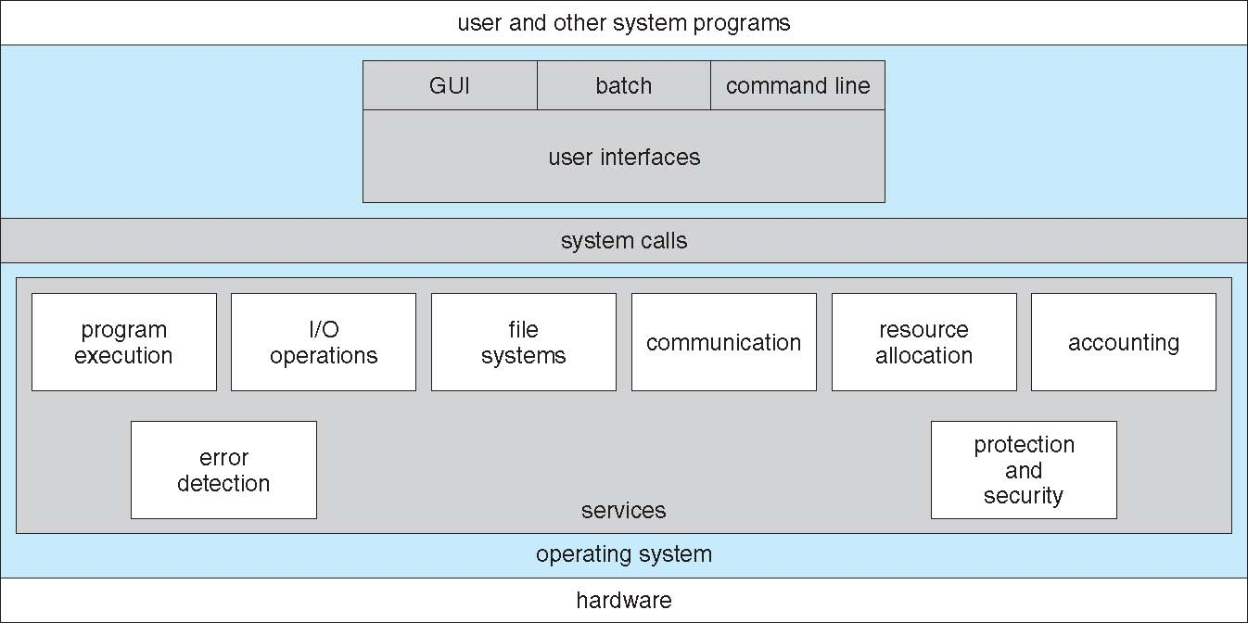
So here is it!

Slide 10
System Calls…
What is it?
Simple. It is like a function. You can use them whenever needed.
Why then called System call?
They are specific to the OS and so why we call it system call!! ☺ Let’s see few examples, we can then understand!

Slide 11
Contd.,
System calls provide an interface to the services made available by an operating system.
Typically written in a high-level language (C or C++)
Before seeing how to use system calls and available system calls in a glance, its important to understand how system calls work..

Slide 12
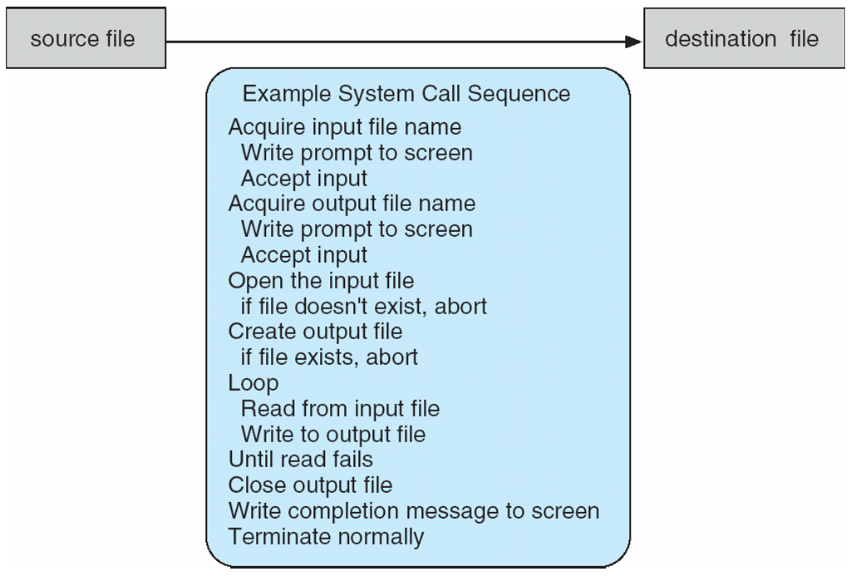
System call sequence to copy the contents of one file to another file

Slide 13
Contd.,
The first input that the program will need is the names of the two files: the input file and the output file. (you can get the name of the files in many ways, one such is to ask from the user)
Once the two file names are obtained, the program must open the input file and create the output file.
Each of these operations requires another system call.
There are also possible error conditions for each operation. We shall see a few!! ☺

Slide 14
One Example .. Plenty to Code..
What is a process? - Let’s answer this question!
Each process is allocated with a unique number, called process id or PID.
This number will be always a positive integer between 2 to 32,678.
When the process if started the next unused number in the sequence will be allocated.
KEEP LINUX READY! WE ARE READY TO CODE BUDDIES! ☺

Slide 15
You must practice these when you come to next session

Slide 16
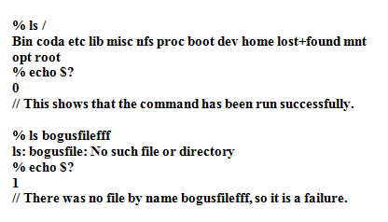
Exit codes
Whenever a program is executed on the completion of execution, it will return an exit code.
It is an indication to say if the execution was carried out successfully or not.
The code returned is a very small integer. It is like, if a zero is obtained as exit code, it indicates successful run.
Any non-zero value when returned as exit code is an indication of an error.

Slide 17
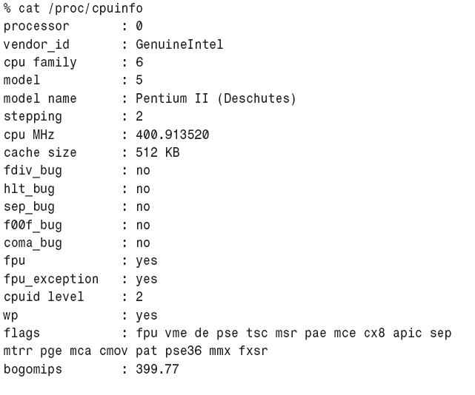
Proc File System

Slide 18
File Descriptor
OS maintains a database called Process Control Block which has details of file descriptors.
File descriptors are numbers allocated to all the files in Linux.
Since everything is file in Linux, Input, Output and Error messages are even denoted by a number and that is referred as file descriptor.
All the file descriptors are updated clearly in a table called file descriptor table in PCB.
Let’s See that now!!☺

Slide 19
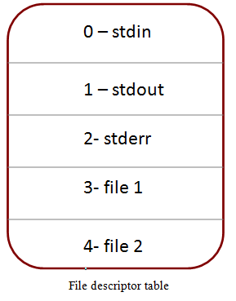
Contd.,
The PCB will have following information
Allocated addresses of the CPU register-save memory (Context Switch)
Process state signal mask (when mask is set to 0, the process is allowed to run, and when mask is set to 1, the process is set to run)
Signals
Security and access permissions
File Descriptors
Each process has its own file descriptor table.
Valid descriptor ranges from 0 and maximum number is configurable.
Standard Input – 0, Standard Output – 1 and Standard Error –2 will be present in FD table.

Slide 20
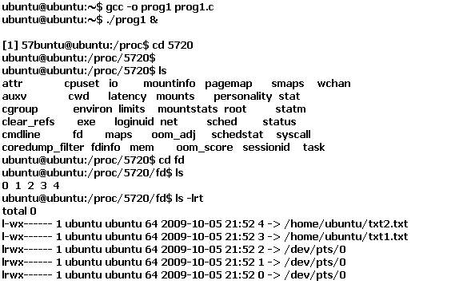
One example please!! Creat System Call..
# include <stdio.h>
int main ()
{
int fd1, fd2;
printf (" /n THIS WILL CREATE 2 FILES NOW");
fd1 = creat ("txt1.txt", 0777);
fd2 = creat ("txt2.txt", 0777);
while(1)
{
}

Slide 21
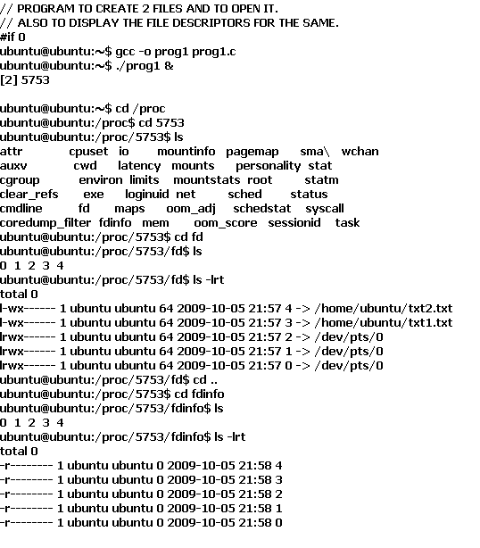
Open () System Call
# include <stdio.h>
# include <fcntl.h>
# include <unistd.h>
int main ()
{
int fd1, fd2;
fd1 = open ("txt1.txt",O_RDONLY|O_CREAT, 0777);
fd2 = open ("txt2.txt",O_RDONLY|O_CREAT, 0777);
while(1)
{
}
}

Slide 22
Dup ()
Dup System call helps you to duplicate the current FD and it will keep the first free spot of File descriptor table.
Normally fd table will have 0,1,2 occupied for i/p o/p and error.
We now are trying to change that. i.e. we are closing fd 2. and we are trying to put our file’s fd in that slot.

Slide 23
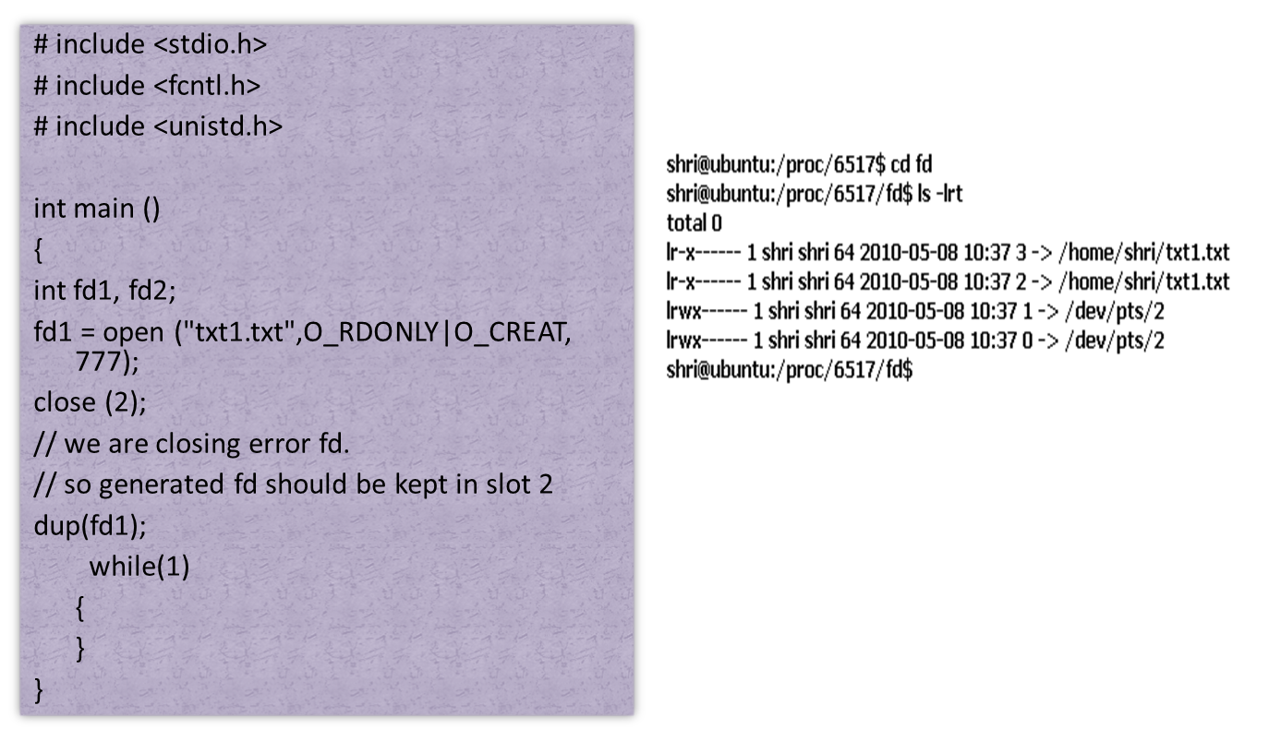
Contd.,

Slide 24
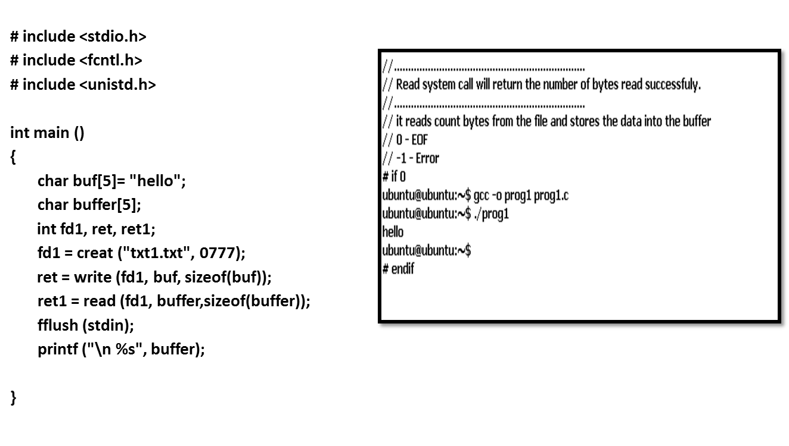
Read and Write System Calls.

Slide 25
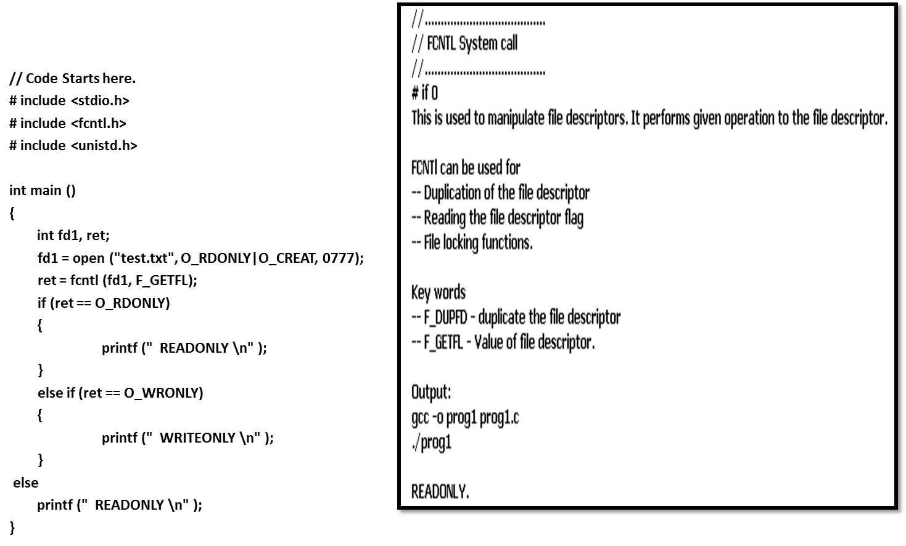
FCNTL System Call

Slide 26
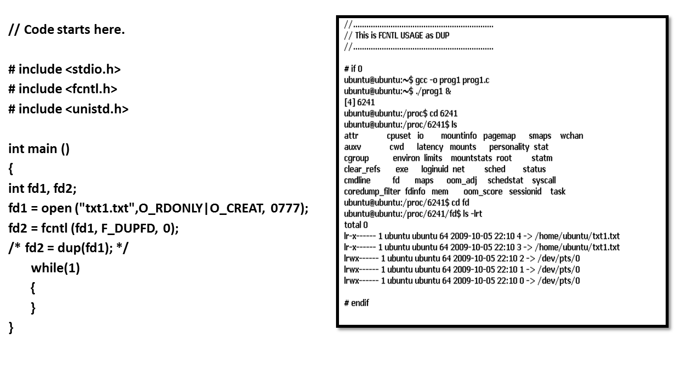
FCNTL as DUP ()

Slide 27
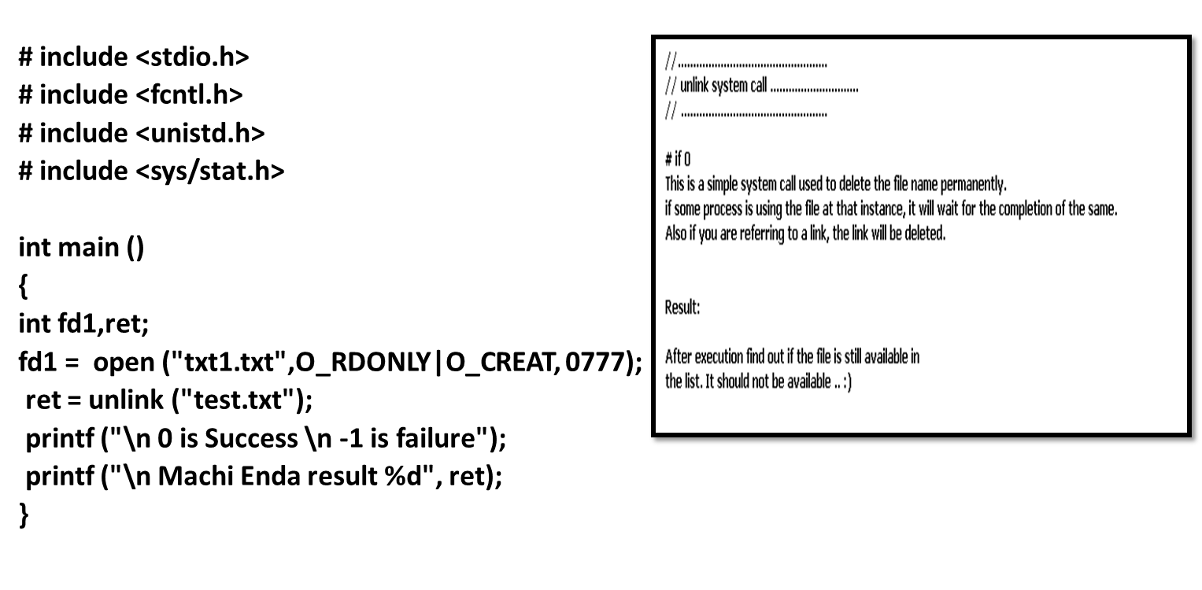
Unlink ()

Slide 28
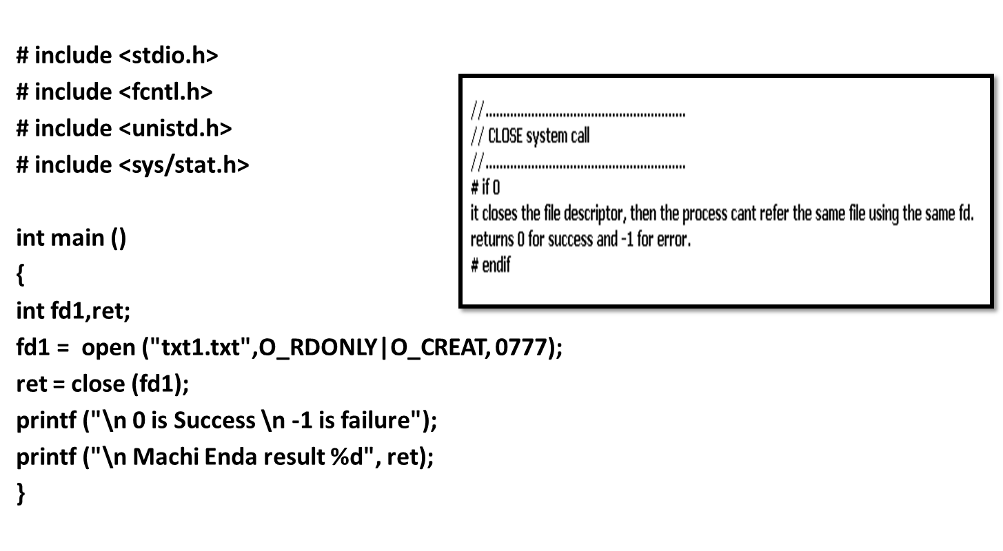
Close ()

Slide 29
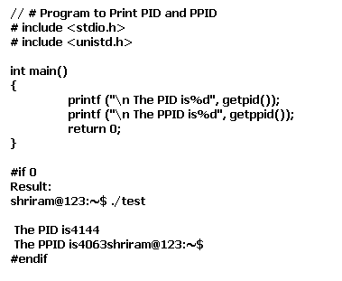
Getpid() and getppid ()

Slide 30
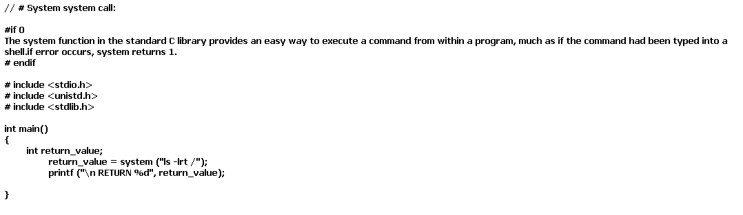
System () system call

Slide 31
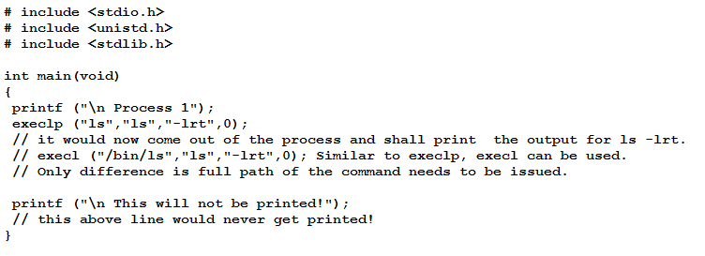

EXECL and EXECLP
This system call will replace the image the current process and shall execute the image of new process.
After transferring the control, the control will not come to previous process.
EXECL will need complete path of the image, where EXECLP would not require it.

Slide 32
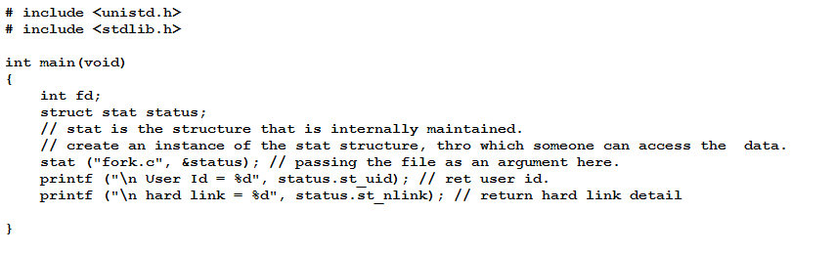
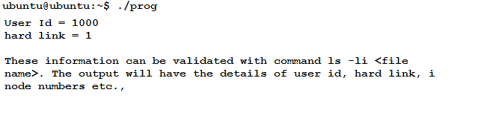
Stat ()

Slide 33
Types of System Calls
Process control
end, abort
load, execute
create process, terminate process
get process attributes, set process attributes
wait for time
wait event, signal event
allocate and free memory
File management
create file, delete file
open, close file
read, write, reposition
get and set file attributes

Slide 34
Types of System Calls (Cont.)
Device management
request device, release device
read, write, reposition
get device attributes, set device attributes
logically attach or detach devices
Information maintenance
get time or date, set time or date
get system data, set system data
get and set process, file, or device attributes
Communications
create, delete communication connection
send, receive messages
transfer status information
attach and detach remote devices

Slide 35
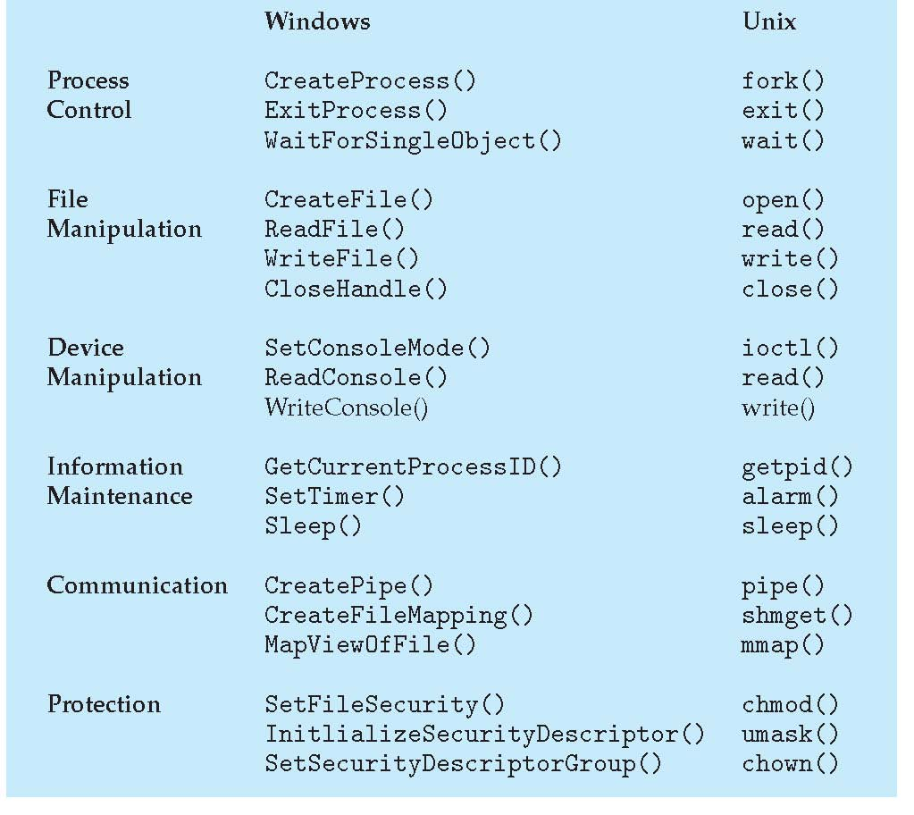
Examples of Windows and Unix System Calls

Slide 36
Codes…
Enough of System Calls.. Lets get to next topic . . .

Slide 37
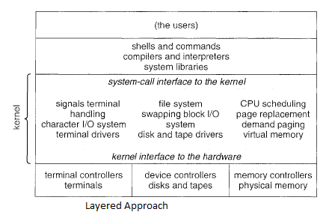
Virtual Machines
What is virtual machine?????
A virtual machine takes the layered approach to its logical conclusion
Enables creating an illusion that each separate
execution environment is running its own private computer.
The operating system host creates the illusion that a process has its own processor and (virtual memory).
Each guest provided with a (virtual) copy of underlying computer.

Slide 38
Contd.,
It is visualized that every user in Windows / Linux gets an account and they get copy of OS literally for everyone.

Slide 39
History is important as well..
First appeared commercially in IBM mainframes in 1972
Fundamentally, multiple execution environments (different operating systems) can share the same hardware
Protect from each other
Some sharing of file can be permitted, controlled
Commutate with each other, other physical systems via networking
Useful for development, testing (multiple OS can be used, Increased Portability check possible)
Consolidation of many low-resource use systems onto fewer busier systems
“Open Virtual Machine Format”, standard format of virtual machines, allows a VM to run within many different virtual machine (host) platforms

Slide 40
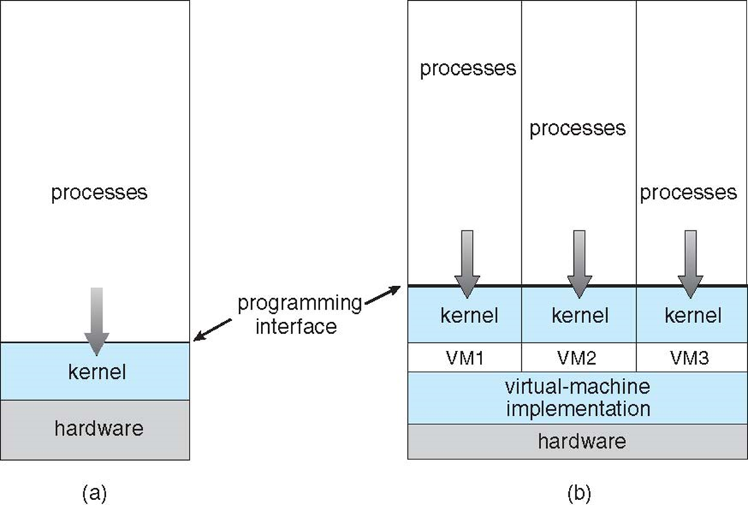
Contd.,
An operating system host can create the illusion that a process has its own processor with its own (virtual) memory.
The virtual machine provides an interface that is identical to the underlying bare hardware.
Each (guest) process is provided with a (virtual) copy of the underlying computer
Usually, the guest process is in fact an operating system, and that is how a single physical machine can run multiple operating systems concurrently, each in its own virtual machine.

Slide 41
More on VM
The operating system, however, runs on and controls the entire machine.
Current system must be stopped and taken out of use while changes are made and tested.
This period is commonly called system development time. Machine wont be available for users during that time..
So what is the solutions?? VM.
System programmers are given their own virtual machine, and system development is done on the virtual machine instead of on a physical machine.
Normal system operation seldom needs to be disrupted for system development.

Slide 42
Virtualization through Simulation
Host system has one system architecture and the guest system was compiled for a different architecture.
For example, suppose a company has replaced its outdated computer system with a new system but would like to continue to run certain important programs that were compiled for the old system.
The programs could be run in an “emulator” that translates each of the outdated system's instructions into the native instruction set of the new system.
Emulation can increase the life of programs and allow us to explore old architectures without having an actual old machine, but its major challenge is performance

Slide 43
Contd.,
it is difficult to create a correct emulator because, in essence, this involves writing an entire CPU in software.
Also it could be slow when the backward testing is being done!! ☹

Slide 44
Case Study..
VMWARE Architecture.
Installation of Linux as VM in Windows.
Try This.

