Slide 1
Chapter 1: Introduction

Slide 2
Chapter 1: Introduction
What Operating Systems Do
Computer-System Organization
Computer-System Architecture
Operating-System Structure
Operating-System Operations
Process Management
Memory Management
Storage Management
Protection and Security
Distributed Systems
Special-Purpose Systems
Computing Environments
Open-Source Operating Systems

Slide 3
What is an Operating System?
A program that acts as an intermediary between a user of a computer and the computer hardware
Operating system goals:
  Execute user programs and make solving user problems easier
  Make the computer system convenient to use
  Use the computer hardware in an efficient manner

Slide 4
Computer System Structure
Computer system can be divided into four components
  Hardware – provides basic computing resources
    CPU, memory, I/O devices
  Operating system
    Controls and coordinates use of hardware among various applications and users
  Application programs – define the ways in which the system resources are used to solve the computing problems of the users
    Word processors, compilers, web browsers, database systems, video games
  Users
    People, machines, other computers

Slide 5

Four Components of a Computer System

Slide 6
Operating System Definition
OS is a resource allocator
  Manages all resources
  Decides between conflicting requests for efficient and fair resource use
OS is a control program
  Controls execution of programs to prevent errors and improper use of the computer

Slide 7
Operating System Definition (Cont)
No universally accepted definition
The one program running at all times on the computer” is the kernel.
Everything else is either a system program (ships with the operating system) or an application program.

Slide 8

Computer System Organization
Computer-system operation
  One or more CPUs, device controllers connect through common bus providing access to shared memory
  Concurrent execution of CPUs and devices competing for memory cycles

Slide 9
Computer-System Operation
I/O devices and the CPU can execute concurrently
Each device controller is in charge of a particular device type
Each device controller has a local buffer
CPU moves data from/to main memory to/from local buffers
I/O is from the device to local buffer of controller
Device controller informs CPU that it has finished its operation by causing an interrupt

Slide 10
Computer Startup
bootstrap program is loaded at power-up or reboot
  Typically stored in ROM or EPROM, generally known as firmware
  Initializes all aspects of system including the CPU registers, device controllers, and memory contents
  Locates and loads operating system kernel and starts execution of the first process (such as “init”) and waits for events to occur.

Slide 11
Common Functions of Interrupts
Interrupt transfers control to the interrupt service routine generally, through the interrupt vector, which contains the addresses of all the service routines
Interrupt architecture must save the address of the interrupted instruction
Incoming interrupts are disabled while another interrupt is being processed to prevent a lost interrupt
A trap is a software-generated interrupt caused either by an error such as divide by 0 or a user request (system call).
An operating system is interrupt driven

Slide 12
Interrupt Handling
The operating system preserves the state of the CPU by storing registers and the program counter
Separate segments of code determine what action should be taken for each type of interrupt

Slide 13
I/O Structure
After I/O starts, control returns to user program without waiting for I/O completion
  System call – request to the operating system to allow user to wait for I/O completion
  Device-status table contains entry for each I/O device indicating its type, address, and state
  Operating system indexes into I/O device table to determine device status and to modify table entry to include interrupt

Slide 14
Direct Memory Access Structure
Used for high-speed I/O devices able to transmit information at close to memory speeds
Device controller transfers blocks of data from buffer storage directly to main memory without CPU intervention
Only one interrupt is generated per block, rather than the one interrupt per byte

Slide 15
Why is DMA?
It is wasteful to feed data into a controller register 1 bytes at a time. (PIO Programmed Input Output)
The DMA unit is word.
In the high loading environment, a system with DMA has better improvement.

Slide 16
DMA Progress (cont.)
The DMA controller proceeds to operate the memory bus directly without CPU help.
Handshaking exists between DMA controller and device controller.
When the entire transfer is finished, the DMA controller will interrupts the CPU.

Slide 17
Handshaking
DMA-request and DMA_acknowledge
  When a word of data is available, the device controller places a signal on the DMA-request bus.
  The signal causes the DMA controller to seize the memory bus,
    To place the desired address on the memory-address bus
    To place a signal on the DMA-acknowledge bus

Slide 18
Handshaking (cont.)
When the device controller receives the DMA-acknowledge signal,
  it transfer the word of data to memory
  and remove the DMA_request signal.

Slide 19

How a Modern Computer Works

Slide 20
Storage Structure
Main memory – only large storage media that the CPU can access directly
Programs and data cannot reside in main memory permanently because:
  Main memory is limited (too small) to store all programs and data permanently
  Main memory is volatile
So secondary storage is provided – extension of main memory that provides large nonvolatile storage capacity
Magnetic disks – rigid metal or glass platters covered with magnetic recording material
  Disk surface is logically divided into tracks, which are subdivided into sectors
  The disk controller determines the logical interaction between the device and the computer

Slide 21
Storage Hierarchy
Storage systems organized in hierarchy by
  Speed
  Cost
  Volatility
The higher levels in the hierarchy are expensive but fast. As we move down the hierarchy, the cost per bit generally decreases, whereas the access time generally increases.
Caching – copying information into faster storage system; main memory can be viewed as a last cache for secondary storage

Slide 22

Storage-Device Hierarchy

Slide 23
Caching
Important principle, performed at many levels in a computer (in hardware, operating system, software)
Information in use copied from slower to faster storage temporarily
Faster storage (cache) checked first to determine if information is there
  If it is, information used directly from the cache (fast)
  If not, data copied to cache and used there
Cache smaller than storage being cached
  Cache management important design problem
  Cache size and replacement policy

Slide 24
Computer-System Architecture
Most systems use a single general-purpose processor
  Most systems have special-purpose processors as well
Multiprocessors systems growing in use and importance
  Also known as parallel systems, tightly-coupled systems
  Advantages include
    Increased throughput
    Economy of scale
    Increased reliability – graceful degradation or fault tolerance

Slide 25
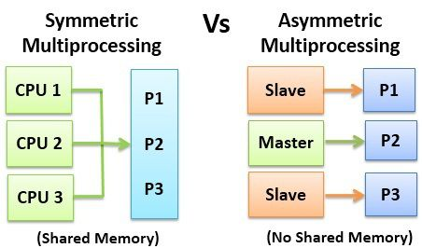
Computer-System Architecture
  Two types
    Asymmetric Multiprocessing
    Symmetric Multiprocessing

Slide 26

Symmetric Multiprocessing Architecture

Slide 27

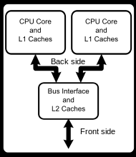
A Dual-Core Design

Slide 28
Distributed Systems
Computation is distributed among several processors. In contrast to tightly-coupled systems, the processors do not share a clock or memory. Each has its own local memory.
Communication is via a network. These systems are termed loosely-coupled or distributed systems. The processors vary in size and function and are called nodes.

Slide 29
Distributed Systems (contd.)
Advantages of distributed systems:
Reliability: If one node fails, the remaining nodes can continue operating. So by building enough redundancy, the system will not fail if one or more nodes fail (e.g. redundant web servers).
Computation speedup: Computation can be distributed among various nodes to run concurrently (e.g. load balanced web servers).
Resource Sharing: Software, data, and hardware resources can be shared. E.g. data files in node A can be accessed by a user at node B. Files can be printed at a shared laser printer.
Communication: Processes at various nodes can exchange information.

Slide 30
Clustered Systems
Are a form of distributed systems. Composed of 2 or more independent machines coupled together.
  Usually sharing storage via a storage-area network (SAN)
  Provides a high-availability service which survives failures
    Asymmetric clustering has one machine in hot-standby mode while other machine/server run applications. The hot-standby machine only monitors the active server. If it fails, the hot-standby machine becomes the active server.
    Symmetric clustering has multiple nodes running applications, monitoring each other
  Some clusters are for high-performance computing (HPC)
    Applications must be written to use parallelization

Slide 31
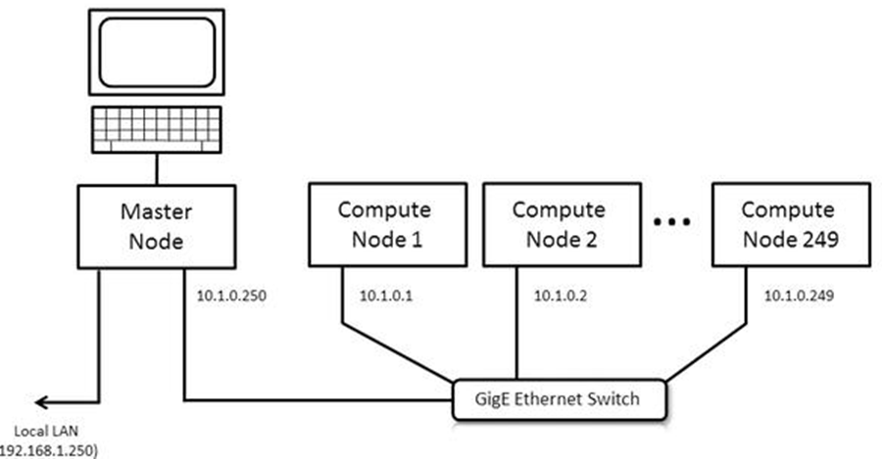
Clustered Systems (contd.)
An example is the Beowulf cluster where the cluster master node does the management and provisioning and a set of compute nodes that do computations.
Beowulf Clusters are scalable performance clusters based on commodity hardware, on a private network, with open source software (Linux) infrastructure. Each consists of a cluster of PCs or workstations dedicated to running high-performance computing tasks.

Slide 32
Operating System Structure
Multiprogramming needed for efficiency
  Single user cannot keep CPU and I/O devices busy at all times
  Multiprogramming organizes jobs (code and data) so CPU always has one to execute
  A subset of total jobs in system is kept in memory
  One job selected and run via job scheduling
  When it has to wait (for I/O for example), OS switches to another job

Slide 33
Operating System Structure (Cont.)
Timesharing (multitasking) is logical extension in which CPU switches jobs so frequently that users can interact with each job while it is running, creating interactive computing
  Response time should be < 1 second
  Each user has at least one program executing in memory process
  If several jobs ready to run at the same time  CPU scheduling
  If processes don’t fit in memory, swapping moves them in and out to run
  Virtual memory allows execution of processes not completely in memory

Slide 34

Memory Layout for Multiprogrammed System

Slide 35
Operating-System Operations
Interrupt driven by hardware
Software error or request creates exception or trap
  Division by zero, request for operating system service
Other process problems include infinite loop, processes modifying each other or the operating system
Dual-mode operation allows OS to protect itself and other system components
  User mode and kernel mode
  Mode bit provided by hardware
    Provides ability to distinguish when system is running user code or kernel code
    Some instructions designated as privileged, only executable in kernel mode
    System call changes mode to kernel, return from call resets it to user

Slide 36

Transition from User to Kernel Mode
Timer to prevent infinite loop / process hogging resources
  Set interrupt after specific period
  Operating system decrements counter
  When counter zero generate an interrupt
  Set up before scheduling process to regain control or terminate program that exceeds allotted time

Slide 37
Process Management
A process is a program in execution. It is a unit of work within the system. Program is a passive entity, process is an active entity.
Process needs resources to accomplish its task
  CPU, memory, I/O, files
  Initialization data
Process termination requires reclaim of any reusable resources
Single-threaded process has one program counter specifying location of next instruction to execute
  Process executes instructions sequentially, one at a time, until completion
Multi-threaded process has one program counter per thread
Typically system has many processes, some user, some operating system running concurrently on one or more CPUs
  Concurrency by multiplexing the CPUs among the processes / threads

Slide 38
Process Management Activities
The operating system is responsible for the following activities in connection with process management:
Creating and deleting both user and system processes
Suspending and resuming processes
Providing mechanisms for process synchronization
Providing mechanisms for process communication
Providing mechanisms for deadlock handling

Slide 39
Memory Management
All data in memory before and after processing
All instructions required in memory in order to execute
Memory management activities
  Keeping track of which parts of memory are currently being used and by whom
  Deciding which processes (or parts thereof) and data to move into and out of memory
  Allocating and deallocating memory space as needed

Slide 40
Storage Management
OS provides uniform, logical view of information storage
  Abstracts physical properties to logical storage unit - file
  Each medium is controlled by device (i.e., disk drive, tape drive)
    Varying properties include access speed, capacity, data-transfer rate, access method (sequential or random)
File-System management
  Files usually organized into directories
  Access control on most systems to determine who can access what
  OS activities include
    Creating and deleting files and directories
    Primitives to manipulate files and directories
    Mapping files onto secondary storage
    Backup files onto stable (non-volatile) storage media

Slide 41
Mass-Storage Management
Usually disks used to store data that does not fit in main memory or data that must be kept for a “long” period of time
Entire speed of computer operation hinges on disk subsystem and its algorithms
OS activities
  Free-space management
  Storage allocation
  Disk scheduling
Some storage need not be fast
  Tertiary storage includes optical storage, magnetic tape
  Varies between WORM (write-once, read-many-times) and RW (read-write)

Slide 42

Performance of Various Levels of Storage
Movement between levels of storage hierarchy can be explicit or implicit

Slide 43

Migration of Integer A from Disk to Register
Multitasking environments must be careful to use most recent value, no matter where it is stored in the storage hierarchy
Multiprocessor environment must provide cache coherency in hardware such that all CPUs have the most recent value in their cache
Distributed environment situation even more complex
  Several copies of a datum can exist
  Various solutions covered in Chapter 17

Slide 44
I/O Subsystem
One purpose of OS is to hide peculiarities of hardware devices from the user
I/O subsystem responsible for
  Memory management of I/O including buffering (storing data temporarily while it is being transferred), and spooling (the overlapping of output of one job with input of other jobs)
  General device-driver interface
  Drivers for specific hardware devices

Slide 45
Protection and Security
Protection – any mechanism for controlling access of processes or users to resources defined by the OS.
It means being able to distinguish between authorized and unauthorized access. E.g. userid/password, smart cards with biometrics data etc.
A system can have adequate protection (authorization) and still be prone to failure and inappropriate access (e.g. if a user’s userid/password is stolen). Then data can be copied or deleted.

Slide 46
Protection and Security
Security – It is the job of security to defend a system against internal and external attacks.
  Huge range, including denial-of-service, worms, viruses, identity theft, theft of service
While defending against some of these attacks may be considered to be an O/S function on some systems, it is left to specialized software on other systems (viruses, malware etc.) such as Norton’s Security Suite.

Slide 47
Protection and Security
Most O/S’ maintain UIDs and GIDs to generally first distinguish among users, to determine who can do what:
  User identities (user IDs, security IDs) include name and associated number, one per user
  User ID then associated with all files, processes of that user to determine access control
  Group identifier (group ID) allows set of users to be defined and controls managed, then also associated with each process, file. E.g. in UNIX a file owner may perform all operations on a file while the group members may only be allowed to read a file.
  Privilege escalation allows user to change to effective ID with more rights

Slide 48
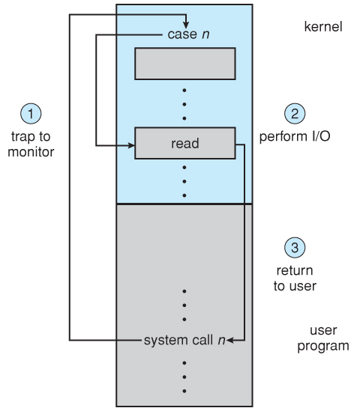
I/O Protection
The I/O system must protect against either accidental or deliberate erroneous I/O.
All I/O instructions are privileged instructions.
User applications are not allowed to perform I/O in user mode - All I/O requests are handled through system calls that must be performed in kernel mode.

Slide 49
Memory Protection
Need to:
Protect the interrupt vector from modification by a user program.
Protect the Interrupt Service Routines (ISRs) from modification.
Protect user programs from one another.

Slide 50
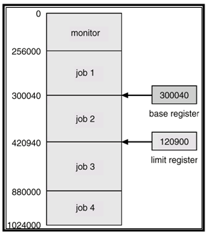
Memory Protection
There are two registers: base and limit.
Base register is the smallest legal physical memory.
Limit register is the size of the range.

Slide 51
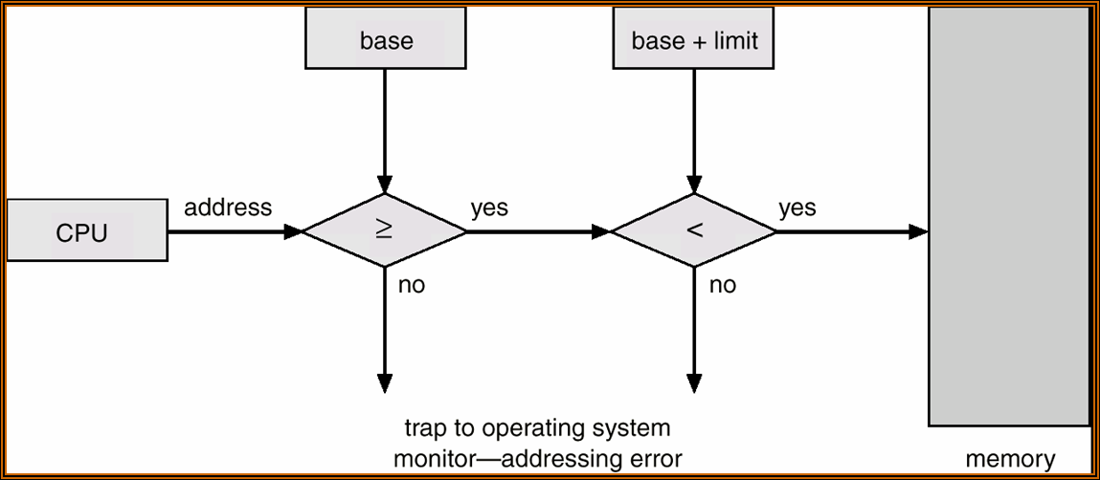
Memory Protection
Every CPU address generated in user mode is compared with the base and limit registers.
Note: Base and limit registers can only be loaded by O/S which uses a privileged instruction to do so.

Slide 52
CPU Protection
CPU protection is needed to prevent a user program from getting stuck in an infinite loop and never returning control to the O/S.
A timer is used to prevent this.
The timer is set to interrupt, say every N msecs.
The O/S then switches the CPU to another process in a multitasking O/S.
Loading/setting a timer is a privileged instruction.

Slide 53
Special Purpose Systems
Real-time Embedded Systems
  Found in car engines, microwave ovens etc. They have specific tasks and the systems they run on are usually primitive and so the O/S provides limited features. They have little or no GUI.
  Embedded systems almost always run RTOS. This is used when rigid time requirements have been placed on the operation of the CPU or flow of data.
  Sensors bring data to the computer which then analyzes this data. E.gs of real-time system include medical imaging systems, weapon systems, automobile engine fuel injection systems.

Slide 54
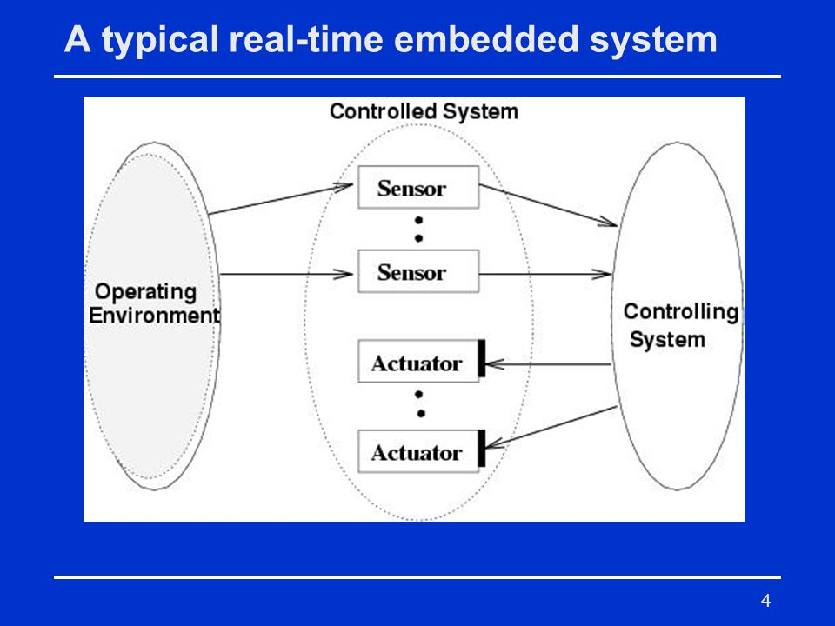
Special Purpose Systems

Slide 55
Special Purpose Systems
Handheld Systems
Include smart phones such as iPhones (iOS) and Androids.
Challenges are due to limited size of such devices. Their small size leads to a small amount of memory, slower CPUs, and small display screens.
Memory is between 2-4 GB and so OS and apps need to manage memory efficiently.
CPUs in handhelds run at a fraction of the speed of a CPU in a PC. Faster CPUs require more power which means a larger battery, which requires more space and would need to be recharged frequently. So OS and apps must be designed not to tax the CPU.
Lack of physical space limits I/P methods to small screen-based keyboards and touch screens.
Small screens mean that only a subset of a web page is delivered and displayed on the handheld device.

Slide 56
Computing Environments
Traditional computing
  Web technologies are stretching the boundaries of traditional computing.
  Company portals provide web accessibility to their internal servers. Smart phones can connect wirelessly to their company portals.
  High-speed home networks connect multiple machines, including mobile devices wirelessly networked through Wifi Router/Cable Modem etc.

Slide 57

Computing Environments (Cont)
Client-Server Computing
  Evolved from the move away from centralized computing with terminals.
  We have two types: compute servers and file servers.
    Compute-server provides an interface to client to request services such as read data (i.e. database)
    File-server provides file-system interface for clients to create, update, read, and delete files (e.g. web server).

Slide 58
Peer-to-Peer Computing
Another model of distributed system
P2P does not distinguish clients and servers
  Instead all nodes are considered peers
  May each act as client, server or both
  Advantage over traditional client-server system is that the server is a bottleneck. But in a P2P system, services can be provided by several nodes.
  Node must first join a P2P network
    Registers its service with central lookup service. Any node needing service first contacts the lookup service to determine which node provides the service and then then client node directly communicates with the service provider. This is a hybrid approach.
    E.g. file-sharing service Napster where the central lookup server maintains an index of all files stored on peer nodes, with the exchange of files taking place between peer nodes.

Slide 59
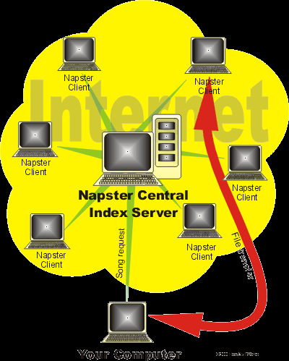
Peer-to-Peer Computing

Slide 60
Peer-to-Peer Computing
Another approach is to have a client first discover the node that provides the desired service by broadcasting a request for service to all other nodes in the network.
The node (or nodes) providing that service responds to the peer making the request.
To support this approach a discover protocol must be provided that allows peers to discover services offered by peers. This is totally distributed approach.
E.g. Gnutella
Notes:
Your machine knows of at least one other Gnutella machine somewhere on the network. It knows this because you've told it the location of the machine by typing in the IP address, or because the software has an IP address for a Gnutella host pre-programmed in. Your machine sends the song name you typed in to the Gnutella machine(s) it knows about.
These machines search to see if the requested file is on the local hard disk. If so, they send back the file name (and machine IP address) to the requester.
At the same time, all of these machines send out the same request to the machines they are connected to, and the process repeats.
A request has a TTL (time to live) limit placed on it. A request might go out six or seven levels deep before it stops propagating. If each machine on the Gnutella network knows of just four others, that means that your request might reach 8,000 or so other machines on the Gnutella network if it propagates seven levels deep.

Slide 61
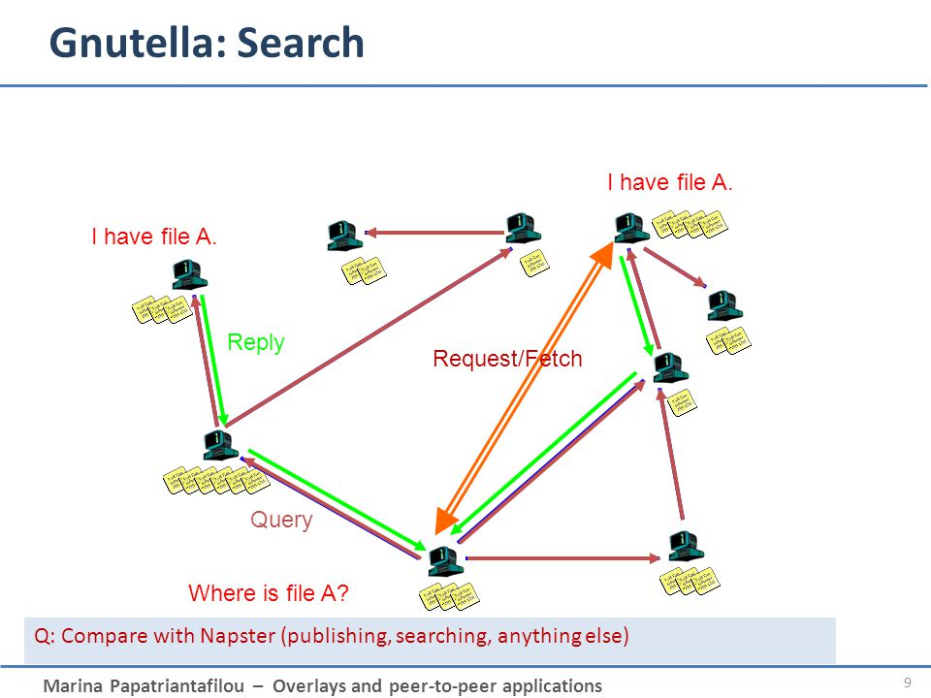
Peer-to-Peer Computing

Slide 62
Web-Based Computing
Web has become ubiquitous
PCs used to be more prevalent devices but now mobile devices (e.g. smart phones and tablets) are more prevalent modes of access
Now load balancers are used to manage web traffic among similar servers
Use of operating systems like Windows 95, client-side, have evolved into Linux and Windows XP, which can be clients and servers

Slide 63
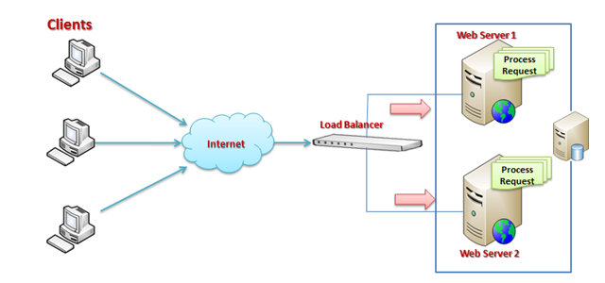
Web-Based Computing

Slide 64
Open-Source Operating Systems
Operating systems made available in source-code format rather than just binary closed-source
Counter to the copy protection and Digital Rights Management (DRM) movement
Started by Free Software Foundation (FSF), which has “copyleft” GNU Public License (GPL)
Examples include GNU/Linux, BSD UNIX (including core of Mac OS X), and Sun Solaris

Slide 65
End of Chapter 1

