Slide 1

Chapter 6: CPU Scheduling
Operating System Concepts – 9th Edition
Silberschatz, Galvin and Gagne ©2013

Slide 2

Chapter 6: CPU Scheduling
Basic Concepts
Scheduling Criteria
Scheduling Algorithms
Thread Scheduling
Multiple-Processor Scheduling
Real-Time CPU Scheduling
Operating Systems Examples
Algorithm Evaluation
6.2

Slide 3
Objectives
CPU scheduling is the basis for multi-programmed operating systems
Process Scheduling
 By switching among processes (see Chap-3)
– Increases productivity of computer
Thread Scheduling
 By switching among kernel threads (see Chap-4)
To describe various CPU-scheduling algorithms
To discuss evaluation criteria for selecting a CPU-scheduling algorithm for a particular system
To examine the scheduling algorithms of several operating systems
6.3

Slide 4
Basic Concepts
Objective of multiprogramming: Achieve maximum CPU utilization as possible
CPU always running a process
No idle CPU
CPU–I/O Burst Cycle:
Process execution consists of a cycle of
CPU execution and I/O wait
When a process is waiting, then assign the CPU to another process
See Process Scheduler on Chap-3
CPU burst followed by I/O burst
CPU burst distribution is of main concern
6.4

Slide 5
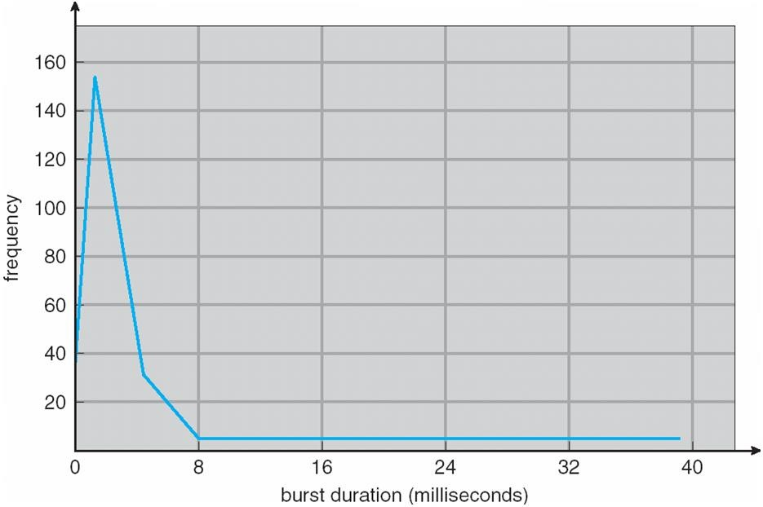
Histogram of CPU-burst Times
6.5

Slide 6
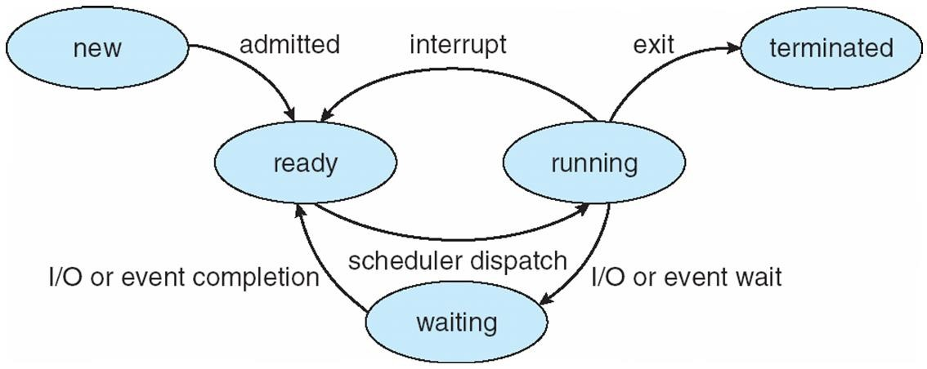
Diagram of Process State
3.6

Slide 7
CPU Scheduler
Short-term scheduler selects from among the processes in ready queue and allocates the CPU to one of them
Queue may be ordered in various ways: FIFO, LIFO, Random, Priority, … etc
CPU scheduling decisions may take place when a process:
Switches from running to waiting state; ex: as result of I/O request or wait()
Switches from running to ready state; ex: when an interrupt occurs
Switches from waiting to ready; ex: at completion of I/O
Terminates
Scheduling taking place only under circumstances 1 and 4 is nonpreemptive
No choice in terms of scheduling; new process must be selected for CPU
Process keeps the CPU until it either terminates or switches to waiting state
All other scheduling is preemptive; can result in race conditions (see Chap-5)
Consider access to shared data
Consider preemption while in kernel mode
Consider interrupts occurring during crucial OS activities
6.7

Slide 8
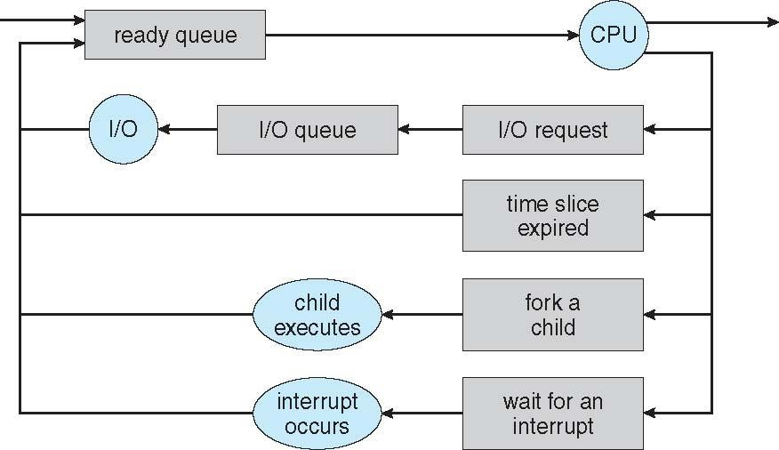
Representation of Process Scheduling
Queueing diagram represents queues, resources, flows
Jobs
3.8

Slide 9
Dispatcher
Dispatcher module gives control of the CPU to the process selected by the short- term scheduler; this involves:
Switching context
Switching to user mode
Jumping to the proper location in the user program to restart that program
Dispatch latency – time it takes for the dispatcher to stop one process and start another running
Dispatcher is invoked during every process switch; hence it should be as fast
as possible

Slide 10
Multiple-Processor Scheduling
CPU scheduling more complex when multiple CPUs are available
Homogeneous processors within a multiprocessor
Asymmetric multiprocessing – only one processor accesses the system data structures, alleviating the need for data sharing
Symmetric multiprocessing (SMP) – each processor is self- scheduling, all processes in common ready queue, or each has its own private queue of ready processes
Currently, most common
Processor affinity – process has affinity for processor on which it is currently running
soft affinity
hard affinity
Variations including processor sets

Slide 11



NUMA and CPU Scheduling
Note that memory-placement algorithms can also consider affinity

Slide 12
Multiple-Processor Scheduling – Load Balancing
If SMP, need to keep all CPUs loaded for efficiency
Load balancing attempts to keep workload evenly distributed
Push migration – periodic task checks load on each processor,
and if found pushes task from overloaded CPU to other CPUs
Pull migration – idle processors pulls waiting task from busy processor

Slide 13
Multicore Processors
Recent trend to place multiple processor cores on same physical chip
Faster and consumes less power
Multiple threads per core also growing
Takes advantage of memory stall to make progress on another thread while memory retrieve happens

Slide 14
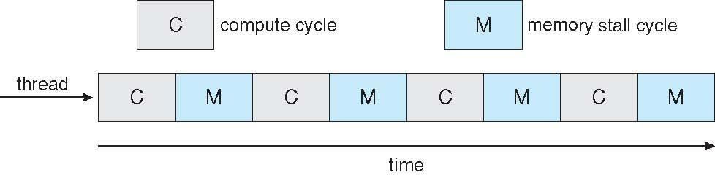

Multithreaded Multicore System

Slide 15
Virtualization and Scheduling
Virtualization software schedules multiple guests onto CPU(s)
Each guest doing its own scheduling
Not knowing it doesn’t own the CPUs
Can result in poor response time
Can effect time-of-day clocks in guests
Can undo good scheduling algorithm efforts of guests

Slide 16
Scheduling Criteria
CPU utilization – keep the CPU as busy as possible
Ranges from 40% to 90% in a real system; i.e., from light to heavy loaded
Scheduling algorithm optimization criteria: Max CPU utilization
Throughput – # of processes that complete their execution per time unit
Ranges from 10 processes/second to 1 process/hour
Scheduling algorithm optimization criteria: Max throughput
Turnaround time – amount of time to execute a particular process
Sum of times spent in job pool + ready queue + CPU execution + doing I/O
Scheduling algorithm optimization criteria: Min turnaround time
Waiting time – amount of time a process has been waiting in the ready queue
Sum of times spent waiting in the ready queue
Scheduling algorithm optimization criteria: Min waiting time
Response time – amount of time it takes from when a request was submitted
until the first response is produced, not output (for time-sharing environment)
The time it takes to start responding to the user; in an interactive system
Scheduling algorithm optimization criteria: Min response time

Slide 17
First-Come First-Served (FCFS) Scheduling Algorithm
Process | Burst Time
P₁ | 24
P₂ | 3
P₃ | 3
Suppose that the processes arrive in the order: P₁ , P₂ , P₃
The Gantt Chart for the schedule is: [includes start and finish time of each process]
P₁ | P₂ | P₃
0
24
27
30
Waiting time for P₁ = 0; P₂ = 24; P₃ = 27
Average waiting time: (0 + 24 + 27)/3 = 17
The simplest scheduling algorithm but usually very bad average waiting time

Slide 18
FCFS Scheduling
Suppose that the processes arrive in the order:
P₂ , P₃ , P₁
The Gantt chart for the schedule is:
P₂ | P₃ | P₁
3 6
Waiting time for P₁ = 6; P₂ = 0; P₃ = 3
Average waiting time: (6 + 0 + 3)/3 = 3; substantial reduction in waiting time
Much better than previous case
Convoy effect - short process behind long process;
CPU-bound holds CPU while I/O-bounds wait in ready queue for the CPU
 I/O devices are idle until CPU released… then CPU is idle.. Then … this repeats
Consider one CPU-bound and many I/O-bound processes
 I/O-bounds spend most of the time waiting for CPU-bound to release CPU
 Result in lower CPU and device utilization
FCFS is nonpreemptive: process holds CPU until termination or I/O request
0
30

Slide 19
Shortest-Job-First (SJF) Scheduling Algorithm
Associate with each process the length of its next CPU burst
Use these lengths to schedule the process with the shortest time
Always assign the CPU to the process that has the smallest next CPU burst
FCFS breaks the tie if two process have the same next CPU burst length
Better term: Shortest-Next-CPU-Burst-Scheduling (SNCB) algorithm
But most books use SJF
SJF is optimal – gives minimum average waiting time for a given set of processes
The difficulty is knowing the length of the next CPU request
Could ask users to estimate their processes’ time limits; for job scheduling
 CPU scheduling can use these time limits as estimates of CPU burst lengths

Slide 20
Example of SJF
Process | Burst Time
P₁ | 6
P₂ | 8
P₃ | 7
P₄ | 3
SJF scheduling chart
P₄
P₁
P₃
P₂
0
3
9
16
24
Average waiting time = (3 + 16 + 9 + 0) / 4 = 7
With FCFS it would be 10.25 time units with this order P₁ P₂ P₃ P₄
Moving a short process before a long one decreases its waiting time more than it increases the long process’s waiting time. Thus, decrease of average waiting time

Slide 21
Determining Length of Next CPU Burst
SJF algo cannot be implemented at the level of the short-term CPU scheduling
No way to know exact length of process’s next CPU burst
 Estimate it using lengths of past bursts: next = average of all past bursts
Then pick process with shortest predicted next CPU burst
Exponential averaging: next = average of (past estimate + past actual)
t_{n} = actual length of n^{th} CPU burst
τ _{n+1} = predicted value for the next CPU burst 3. α, 0 ≤ α ≤ 1
4. Define :
τ _{n=1} = α t_{n} + (1− α )τ _{n} .
Relative weight of recent history (t_{n}) and past history (τ_{n}): α = ½ usual but in [0, 1]
Preemptive version called shortest-remaining-time-first (SRTF algorithm)
The next burst of new process may be shorter than that left of current process
 Currently running process will be preempted

Slide 22



Prediction of the Length of the Next CPU Burst

Slide 23
Examples of Exponential Averaging
α =0
τ_{n+1} = τ_{n}
Recent history does not count
α =1
τ_{n+1} = t_{n}
Only the actual last CPU burst counts
If we expand the formula, we get:
τ_{n+1} = αt_{n} + (1 - α)αt_{n-1} +
… + (1 - α)^{j}αt_{n-j}
+ … + (1 - α)^{n+1}τ₀
Since both α and (1 - α) are less than or equal to 1, each successive term has less weight than its predecessor

Slide 24
Example of Shortest-Remaining-Time-First
Now we add the concepts of varying arrival times and preemption to the analysis
Process | Arrival Time | Burst Time
P₁ | 0 | 8
P₂ | 1 | 4
P₃ | 2 | 9
P₄ | 3 | 5
Preemptive SJF Gantt Chart
P₁ | P₂ | P₄ | P₁ | P₃
0
1
5
10
17
26
Average waiting time = [(10-1) + (1-1) + (17-2) + (5-3)]/4 = 26/4 = 6.5 time units
Nonpreemptive SJF will result in 7.75 time units

Slide 25
Priority Scheduling
A priority number (integer) is associated with each process
The CPU is allocated to the process with the highest priority
We assume that smallest integer ≡ highest priority
 Internally defined priority: based on criteria within OS. Ex: memory needs
 Externally defined priority: based on criteria outside OS. Ex: paid process
Preemptive: a running process is preempted by a new higher priority process
Nonpreemptive: running process holds CPU until termination or I/O request
SJF is priority scheduling: priority is the inverse of predicted next CPU burst time
Problem ≡ Starvation – some low priority process may never get the CPU
Process wait indefinitely in the ready queue due to stream of high priority processes
Solution ≡ Aging – as time progresses increase the priority of the process
Example: do priority = priority – 1 every 15 minutes

Slide 26
Example of Priority Scheduling
Process | Burst Time | Priority
P₁ | 10 | 3
P₂ | 1 | 1
P₃ | 2 | 4
P₄ | 1 | 5
P₅ | 5 | 2
Priority scheduling Gantt Chart
P₁ | P₂ | P₁ | P₃ | P₄
0 1 6
Average waiting time = 8.2 msec
16
18 19

Slide 27
Round Robin (RR)
Each process gets a small unit of CPU time (time quantum or time slice q), usually 10-100 milliseconds. After this time has elapsed, the process is preempted and added to the end of the ready queue.
Ready queue is treated as a circular queue
If there are n processes in the ready queue and the time quantum is q, then each process gets 1/n of the CPU time in chunks of at most q time units at once. No process waits more than (n-1)×q time units.
Timer interrupts at every quantum to schedule next process
Performance depends on heavily on the size of the time quantum
If q very large ⇒ RR scheduling = FCFS scheduling
If q very small ⇒ q must be large with respect to context switch
 Otherwise overhead of number of context switches will be is too high

Slide 28
Example of RR with Time Quantum = 4
Process | Burst Time
P₁ | 24
P₂ | 3
P₃ | 3
The Gantt chart is:
P₁ | P₂ | P₃ | P₁ | P₁ | P₁ | P₁ | P₁
0 4 7 10 14 18
Average waiting time under RR scheduling is often long
22
26
30
Typically, higher average turnaround than SJF, but better response
q should be large compared to context switch time
q usually between 10ms to 100ms, context switch < 10 μsec

Slide 29
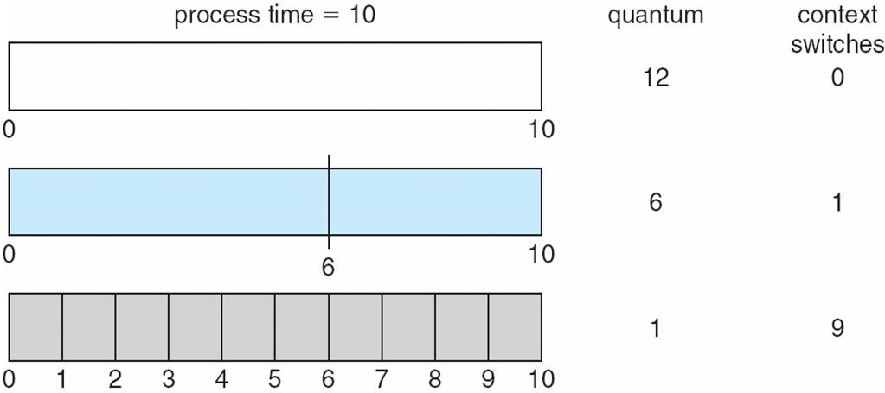
Time Quantum and Context Switch Time

Slide 30
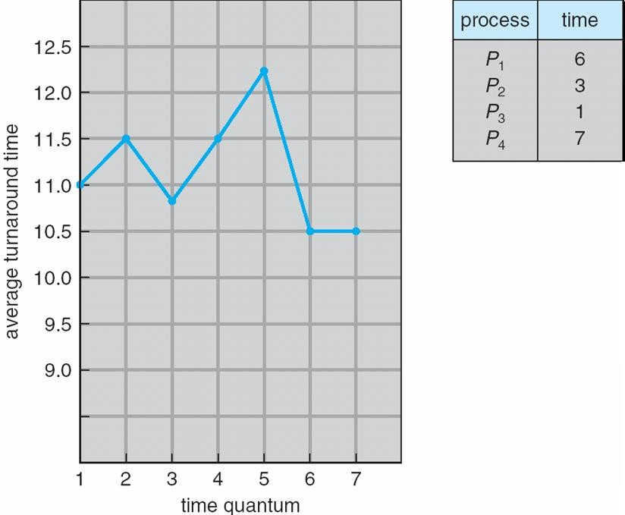
Turnaround Time Varies With The Time Quantum
80% of CPU bursts should be shorter than q

Slide 31
Multilevel Queue
Ready queue is partitioned into separate queues; e.g., two queues containing
foreground (interactive) processes
 May have externally defined priority over background processes
background (batch) processes
Process permanently associated to a given queue; no move to a different queue
Each queue has its own scheduling need, and hence, different algorithm:
foreground – RR or …
background – FCFS or …
Must schedule among the queues too (not just processes):
Fixed priority scheduling; (i.e., serve all from foreground then from
background). Possibility of starvation.
Time slice – each queue gets a certain amount of CPU time which it can schedule amongst its processes;
 80% to foreground in RR, and, 20% to background in FCFS

Slide 32
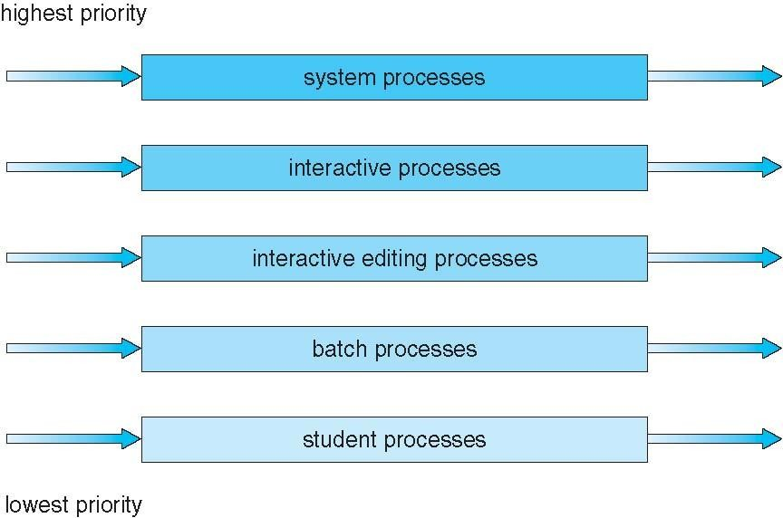
Multilevel Queue Scheduling

Slide 33
Multilevel Feedback Queue
A process can move between the queues; aging can be implemented this way
Move heavy foreground CPU-bound process to the background queue
Move starving background process to the foreground queue
Multilevel-feedback-queue scheduler defined by the following parameters:
number of queues
scheduling algorithms for each queue
method used to determine when to upgrade a process
method used to determine when to demote a process
method used to determine which queue a process will enter when that
process needs service
… etc

Slide 34
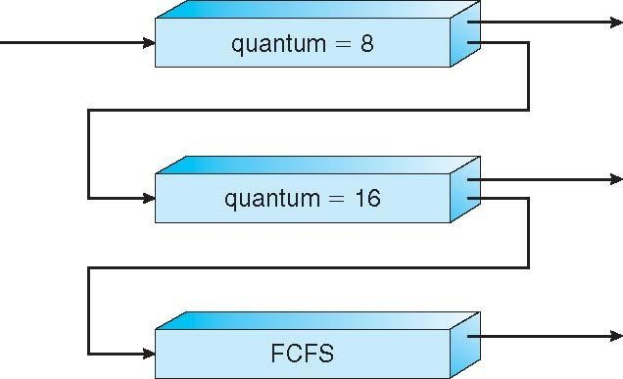
Example of Multilevel Feedback Queue
Three queues:
Q₀ – RR with time quantum 8 milliseconds
 Highest priority. Preempts Q₁ and Q₂ proc’s
Q₁ – RR time quantum 16 milliseconds
 Medium priority. Preempts processes in Q₂
Q₂ – FCFS
 Lowest priority
Scheduling
A new job enters queue Q₀ which uses RR-8
 When it gains CPU, job receives 8 milliseconds
 If it does not finish in 8 milliseconds, job is moved to queue Q₁
At Q₁ job is receives 16 additional milliseconds
 If it still does not complete, it is preempted and moved to queue Q₂

Slide 35
Thread Scheduling
Distinction between user-level and kernel-level threads
When OS support threading, then kernel threads are scheduled; not processes
On OS using many-to-one or many-to-many mapping models, the thread library
schedules user threads to run on an available lightweight process (LWP)
Known as process-contention scope (PCS) since scheduling competition is within the process; i.e., among user threads belonging to the same process
 Which user thread goes to the kernel…?
Typically done via user thread priorities set by the programmer
Kernel thread scheduled onto available CPU is system-contention scope (SCS)
Competition is among all kernel threads in the system
Also on OS using one-to-one mapping model

Slide 36
Pthread Scheduling
API allows specifying either PCS or SCS during thread creation
PTHREAD_SCOPE_PROCESS schedules threads using PCS scheduling
PTHREAD_SCOPE_SYSTEM schedules threads using SCS scheduling
Can be limited by OS – Linux and Mac OS X only allow PTHREAD_SCOPE_SYSTEM

Slide 37
Pthread Scheduling API
#include <pthread.h> #include <stdio.h> #define NUM_THREADS 5
int main(int argc, char *argv[]) { int i, scope;
pthread_t tid[NUM THREADS];
pthread_attr_t attr;
/* get the default attributes */ pthread_attr_init(&attr);
/* first inquire on the current scope */
if (pthread_attr_getscope(&attr, &scope) != 0)
fprintf(stderr, "Unable to get scheduling scope\n");
else {
if (scope == PTHREAD_SCOPE_PROCESS) printf("PTHREAD_SCOPE_PROCESS");
else if (scope == PTHREAD_SCOPE_SYSTEM) printf("PTHREAD_SCOPE_SYSTEM");
else
fprintf(stderr, "Illegal scope value.\n");
}

Slide 38
Pthread Scheduling API
/* set the scheduling algorithm to PCS or SCS */ pthread_attr_setscope(&attr, PTHREAD_SCOPE_SYSTEM);
/* create the threads */
for (i = 0; i < NUM_THREADS; i++)
pthread_create(&tid[i],&attr,runner,NULL);
/* now join on each thread */
for (i = 0; i < NUM_THREADS; i++)
pthread_join(tid[i], NULL);
}
/* Each thread will begin control in this function */
void *runner(void *param)
{
/* do some work ... */
pthread_exit(0);
}

Slide 39
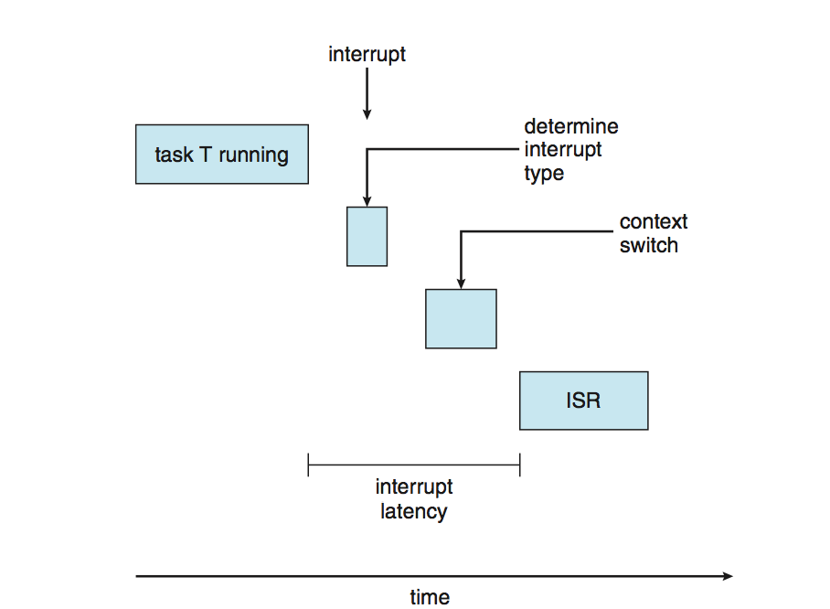
Real-Time CPU Scheduling
Can present obvious challenges
Soft real-time systems – no guarantee as to when critical real- time process will be scheduled
Hard real-time systems – task must be serviced by its deadline
Event latency: [occurred to serviced]
Two types of event latencies affect performance
Interrupt latency – time from arrival of interrupt to start of routine that services interrupt
Dispatch latency – time for dispatcher to take current process off CPU and switch to another
Want to minimize both latencies

Slide 40











Real-Time CPU Scheduling [Dispatch Latency]
Conflict phase of dispatch latency:
Preemption of any process
running in kernel mode
Release by low-priority processes of resources needed by a high-priority process

Slide 41
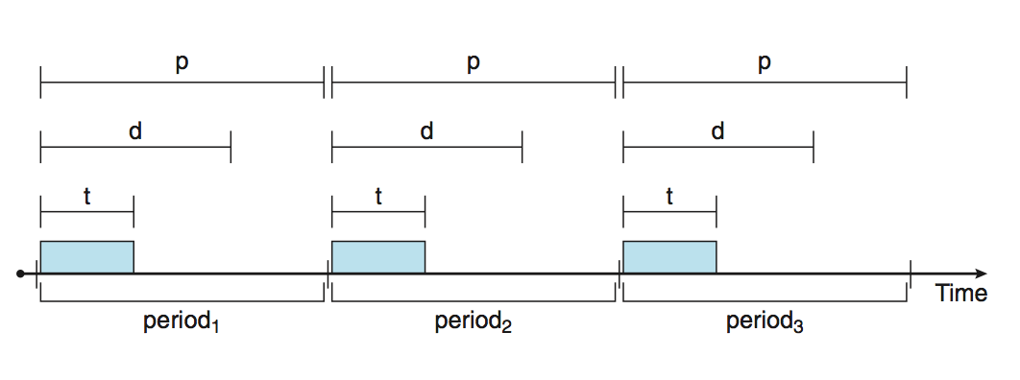
Priority-Based Scheduling
Real-time OS responds immediately to a real-time process when it request CPU
Real-time scheduler must support preemptive priority-based algorithm
 But only guarantees soft real-time functionality
Hard real-time systems must also provide ability to meet task deadlines
 Periodic processes require CPU at constant intervals
Each process has a processing time t, a deadline d, and a period p
– 0 ≤ t ≤ d ≤ p
Rate of periodic task is 1/p
 Admission-control: process announces it requirements, then scheduler admits the process if it can complete it on time, or, reject it if it cannot serviced it by deadline
Operating System Concepts – 9th Edition 6.35 Silberschatz, Galvin and Gagne ©2013

Slide 42
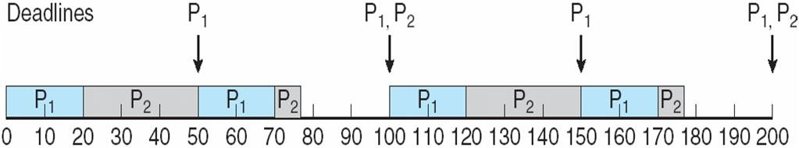
Rate-Monotonic Scheduling
Static priority policy with preemption
A priority is assigned to a process based on the inverse of its period p
 Shorter periods = higher priority; Longer periods = lower priority
 Assumes processing time t is the same for each CPU burst
 Rationale: higher priority to tasks that require the CPU more often
Example:
Process P₁ : t₁ = 20, d₁ = complete CPU burst by start of next period, p₁ = 50.
Process P₂ : t₂ = 35, d₂ = complete CPU burst by start of next period, p₂ = 100.
P₁ is assigned a higher priority than P₂.
CPU utilization = t_{i} / p_{i}. Thus total CPU utilization = 20/50 + 35/100 = 75%

Slide 43
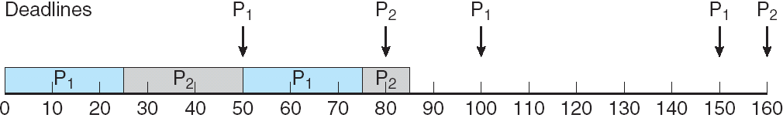
Missed Deadlines with Rate-Monotonic Scheduling
Process P₁ : t₁ = 25, d₁ = complete CPU burst by start of next period, p₁ = 50.
Process P₂ : t₂ = 35, d₂ = complete CPU burst by start of next period, p₂ = 80.
Total CPU utilization = 25/50 + 35/80 = 94%
P₁ is assigned a higher priority than P₂.
P₂ has missed the deadline for completion of its CPU burst at time 80
Reason - bounded CPU utilization; worst case for N processes: B = N(2^{1/N} - 1)
Bounded at B = 83% for N = 2 processes
Theory: cannot guarantee that processes can be scheduled to meet their deadlines if actual CPU utilization > Bound B
 94% > 83% in the example above

Slide 44
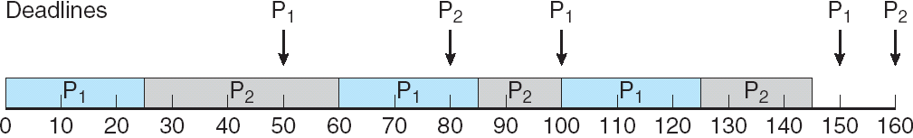
Earliest Deadline First Scheduling (EDF)
Dynamic priority policy with preemption
Priorities are dynamically assigned according to deadlines:
 Earlier deadline = higher priority; later deadline = lower priority
New runnable process must announce its deadline requirements to scheduler
 Scheduler will adjust current priorities accordingly
Process need not be periodic
CPU burst time need not be constant
Process P₁ : t₁ = 25, d₁ = complete CPU burst by start of next period, p₁ = 50.
Process P₂ : t₂ = 35, d₂ = complete CPU burst by start of next period, p₂ = 80.
P₁ is initially assigned a higher priority than P₂ since d₁ = 50 ≤ d₂ = 80

Slide 45
Proportional Share Scheduling
T shares of time are allocated among all processes in the system
An application receives N shares of time where N < T
This ensures each application will receive N / T of the total processor time
Example: three processes A, B and C, with T = 100 shares
A, B and C assigned each 50, 15 and 20 shares, respectively
Thus A will have 50% of total processor times, and so on with B and C
Scheduler must use admission-control policy:
Admit a request only if sufficient shares are available
Example: If new process D needs 30 share then scheduler will deny him CPU
 Current total share is 50 + 15 + 20 = 85
 Only a new process with share < 15 can be scheduled

Slide 46
POSIX Real-Time Scheduling
The POSIX.1b standard
API provides functions for managing real-time threads
Defines two scheduling classes for real-time threads:
SCHED_FIFO - threads are scheduled using a FCFS strategy with a FIFO queue. There is no time-slicing for threads of equal priority
SCHED_RR - similar to SCHED_FIFO except time-slicing occurs for threads of
equal priority
Defines two functions for getting and setting scheduling policy:
pthread_attr_getsched_policy(pthread_attr_t *attr, int
*policy)
pthread_attr_setsched_policy(pthread_attr_t *attr, int policy)

Slide 47
POSIX Real-Time Scheduling API
#include <pthread.h> #include <stdio.h> #define NUM_THREADS 5
int main(int argc, char *argv[])
{
int i, policy; pthread_t_tid[NUM_THREADS];
pthread_attr_t attr;
/* get the default attributes */
pthread_attr_init(&attr);
/* get the current scheduling policy */
if (pthread_attr_getschedpolicy(&attr, &policy) != 0)
fprintf(stderr, "Unable to get policy.\n");
else {
if (policy == SCHED_OTHER) printf("SCHED_OTHER\n"); else if (policy == SCHED_RR) printf("SCHED_RR\n"); else if (policy == SCHED_FIFO) printf("SCHED_FIFO\n");
}

Slide 48
POSIX Real-Time Scheduling API (Cont.)
/* set the scheduling policy - FIFO, RR, or OTHER */
if (pthread_attr_setschedpolicy(&attr, SCHED_FIFO) != 0)
fprintf(stderr, "Unable to set policy.\n");
/* create the threads */
for (i = 0; i < NUM_THREADS; i++)
pthread_create(&tid[i],&attr,runner,NULL);
/* now join on each thread */
for (i = 0; i < NUM_THREADS; i++)
pthread_join(tid[i], NULL);
}
/* Each thread will begin control in this function */ void *runner(void *param)
{
/* do some work ... */ pthread_exit(0);
}

Slide 49
Operating System Examples
Linux scheduling
Windows scheduling
Solaris scheduling

Slide 50
Linux Scheduling Through Version 2.5
Prior to kernel version 2.5, ran variation of standard UNIX scheduling algorithm
Version 2.5 moved to constant order O(1) scheduling time
Preemptive, priority based
Two priority ranges: time-sharing and real-time
Real-time range from 0 to 99 and nice value from 100 to 140
Map into global priority with numerically lower values indicating higher priority
Higher priority gets larger q
Task run-able as long as time left in time slice (active)
If no time left (expired), not run-able until all other tasks use their slices
All run-able tasks tracked in per-CPU runqueue data structure
 Two priority arrays (active, expired)
 Tasks indexed by priority
 When no more active, arrays are exchanged
Worked well, but poor response times for interactive processes

Slide 51
Linux Scheduling in Version 2.6.23 +
Completely Fair Scheduler (CFS)
Scheduling classes
Each has specific priority
Scheduler picks highest priority task in highest scheduling class
Rather than quantum based on fixed time allotments, based on proportion of CPU time
2 scheduling classes included, others can be added
default
real-time
Quantum calculated based on nice value from -20 to +19
Lower value is higher priority
Calculates target latency – interval of time during which task should run at least once
Target latency can increase if say number of active tasks increases
CFS scheduler maintains per task virtual run time in variable vruntime
Associated with decay factor based on priority of task – lower priority is higher decay
rate
Normal default priority yields virtual run time = actual run time
To decide next task to run, scheduler picks task with lowest virtual run time

Slide 52
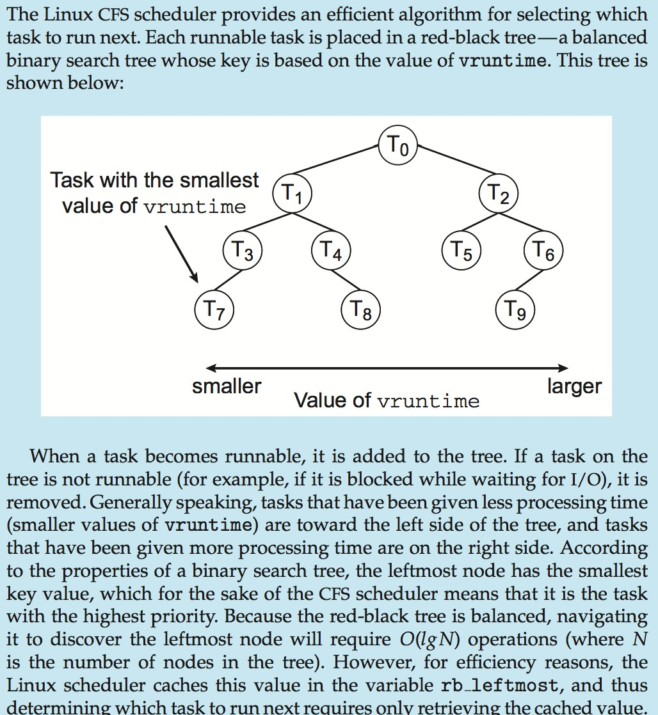
CFS Performance

Slide 53
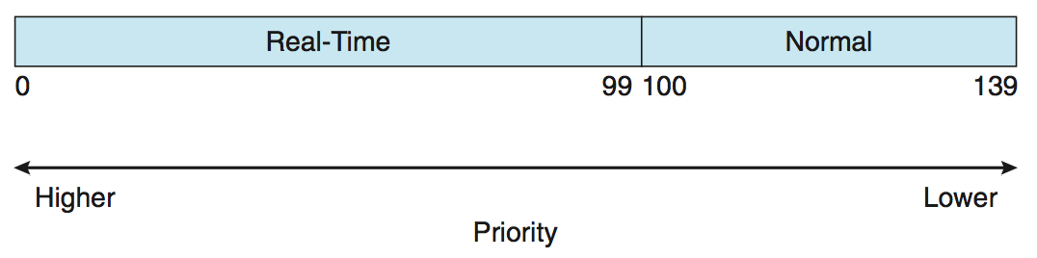
Linux Scheduling
Real-time scheduling according to POSIX.1b
Real-time tasks have static priorities
Real-time plus normal map into global priority scheme
Nice value of -20 maps to global priority 100
Nice value of +19 maps to priority 139

Slide 54
Windows Scheduling
Windows uses priority-based preemptive scheduling
Highest-priority thread runs next
Dispatcher is scheduler
Thread runs until (1) blocks, (2) uses time slice, (3) preempted by higher-priority thread
Real-time threads can preempt non-real-time
32-level priority scheme
Variable class is 1-15, real-time class is 16-31
Priority 0 is memory-management thread
Queue for each priority
If no run-able thread, runs idle thread

Slide 55
Windows Priority Classes
Win32 API identifies several priority classes to which a process can belong
REALTIME_PRIORITY_CLASS, HIGH_PRIORITY_CLASS, ABOVE_NORMAL_PRIORITY_CLASS,NORMAL_PRIORITY_CLASS, BELOW_NORMAL_PRIORITY_CLASS, IDLE_PRIORITY_CLASS
All are variable except REALTIME
A thread within a given priority class has a relative priority
TIME_CRITICAL, HIGHEST, ABOVE_NORMAL, NORMAL, BELOW_NORMAL, LOWEST, IDLE
Priority class and relative priority combine to give numeric priority
Base priority is NORMAL within the class
If quantum expires, priority lowered, but never below base

Slide 56
Windows Priority Classes
If wait occurs, priority boosted depending on what was waited for
Foreground window given 3x priority boost
Windows 7 added user-mode scheduling (UMS)
Applications create and manage threads independent of kernel
For large number of threads, much more efficient
UMS schedulers come from programming language libraries like C++
Concurrent Runtime (ConcRT) framework

Slide 57

















Windows Priorities

Slide 58
Solaris
Priority-based scheduling
Six classes available
Time sharing (default) (TS)
Interactive (IA)
Real time (RT)
System (SYS)
Fair Share (FSS)
Fixed priority (FP)
Given thread can be in one class at a time
Each class has its own scheduling algorithm
Time sharing is multi-level feedback queue
Loadable table configurable by sysadmin

Slide 59

Solaris Dispatch Table

Slide 60

Solaris Scheduling

Slide 61
Solaris Scheduling
Scheduler converts class-specific priorities into a per-thread global priority
Thread with highest priority runs next
Runs until (1) blocks, (2) uses time slice, (3) preempted by higher- priority thread
Multiple threads at same priority selected via RR

Slide 62
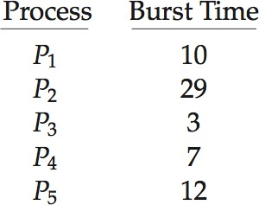
Algorithm Evaluation
How to select CPU-scheduling algorithm for an OS?
Determine criteria, then evaluate algorithms
Deterministic modeling
Type of analytic evaluation
Takes a particular predetermined workload and defines the
performance of each algorithm for that workload
Consider 5 processes arriving at time 0:

Slide 63
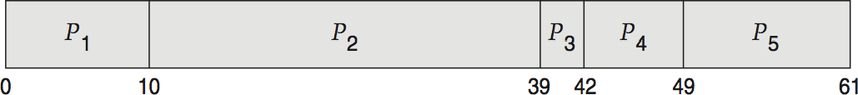
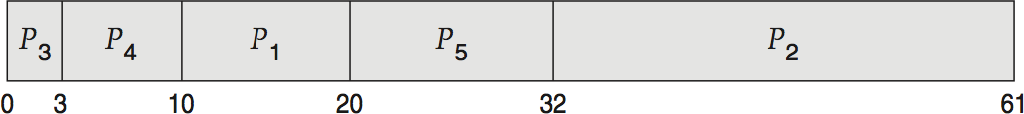
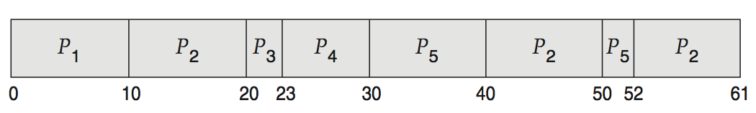
Deterministic Evaluation
For each algorithm, calculate minimum average waiting time
Simple and fast, but requires exact numbers for input, applies only to those inputs
FCS is 28ms:
Non-preemptive SFJ is 13ms:
RR is 23ms:

Slide 64
Queueing Models
Describes the arrival of processes, and CPU and I/O bursts probabilistically
Commonly exponential, and described by mean
Computes average throughput, utilization, waiting time, etc
Computer system described as network of servers, each with queue of waiting processes
Knowing arrival rates and service rates
Computes utilization, average queue length, average wait time, etc

Slide 65
Little’s Formula
n = average queue length
W = average waiting time in queue
λ = average arrival rate into queue
Little’s law – in steady state, processes leaving queue must equal processes arriving, thus:
n = λ x W
Valid for any scheduling algorithm and arrival distribution
For example, if on average 7 processes arrive per second, and normally 14 processes in queue, then average wait time per process = 2 seconds

Slide 66
Simulations
Queueing models limited
Simulations more accurate
Programmed model of computer system
Clock is a variable
Gather statistics indicating algorithm performance
Data to drive simulation gathered via
 Random number generator according to probabilities
 Distributions defined mathematically or empirically
 Trace tapes record sequences of real events in real systems

Slide 67




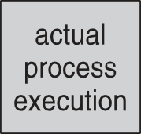
Evaluation of CPU Schedulers by Simulation

Slide 68
Implementation
Even simulations have limited accuracy
Just implement new scheduler and test in real systems
High cost, high risk
Environments vary
Most flexible schedulers can be modified per-site or per-system
Or APIs to modify priorities
But again environments vary

Slide 69
End of Chapter 6
Operating System Concepts – 9th Edition

