Slide 1
Pthreads
May be provided either as user-level or kernel-level
A POSIX standard (IEEE 1003.1c) API for thread creation and synchronization
Specification, not implementation
API specifies behavior of the thread library, implementation is up to development of the library
Common in UNIX operating systems (Solaris, Linux, Mac OS X)
The following code is to find summation of non-negative numbers with a separate thread.

Slide 2
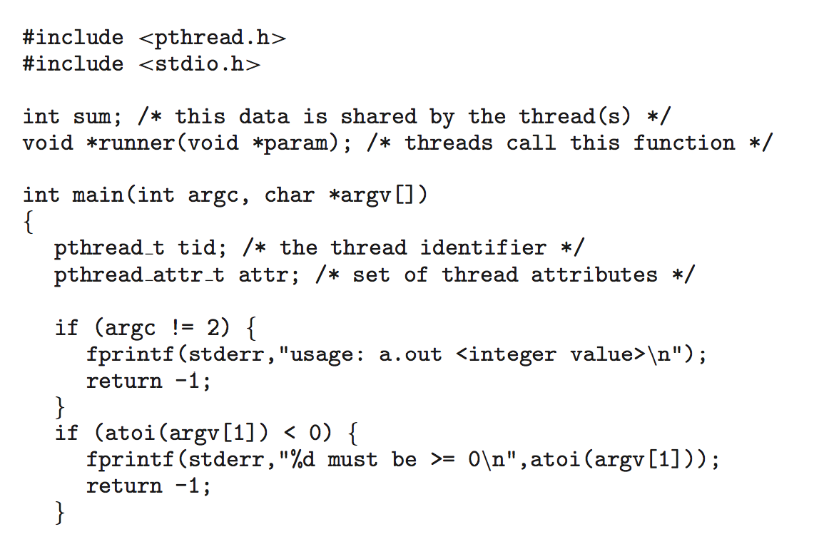
Pthreads Example

Slide 3
Pthreads Example (Cont.)

