Slide 1
DATA HAZARDS

Slide 2
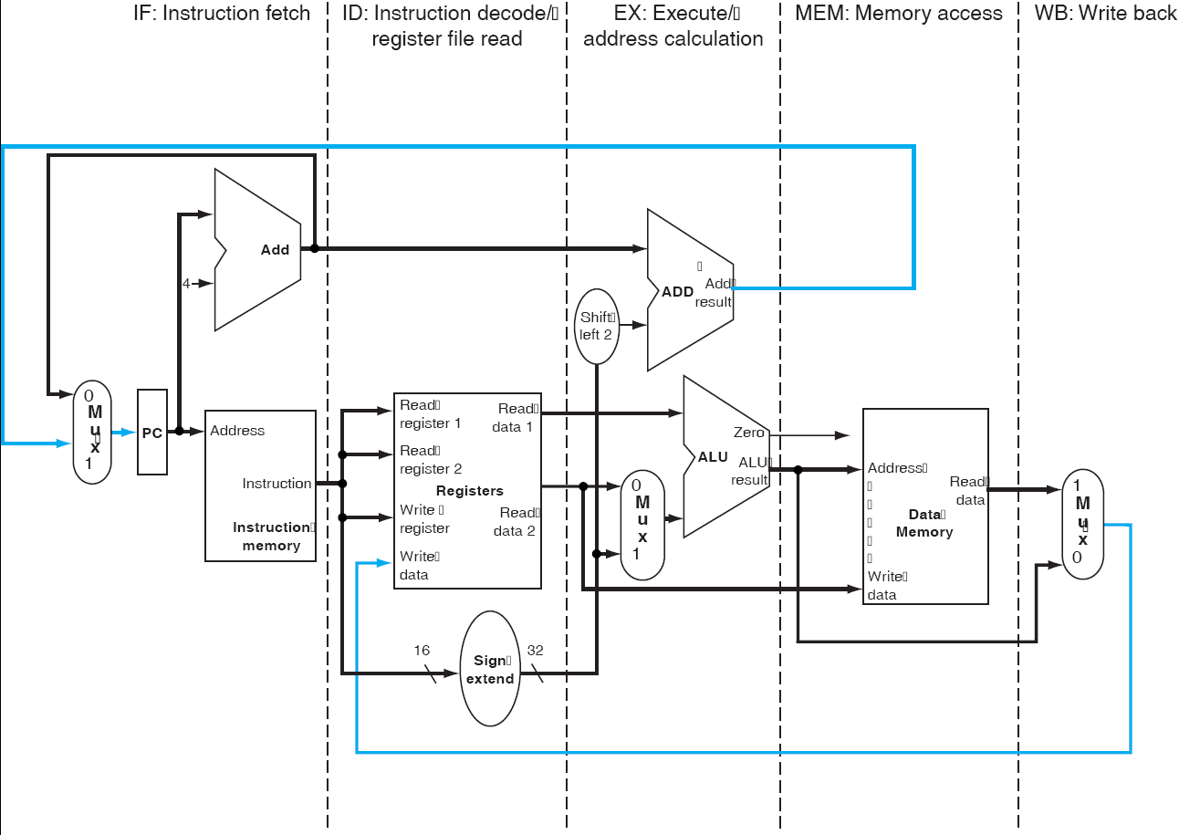
Review - Single-Cycle Processor

Slide 3
The Basic Pipeline For MIPS
Cycle 1
Cycle 2
Cycle 3
Cycle 4
Cycle 5
Cycle 6
Cycle 7
I
n
s
t
r.
O
r
d
e
r
Ifetch
Reg
ALU
DMem
Reg
Ifetch
Reg
ALU
DMem
Reg
Ifetch
Reg
ALU
DMem
Reg
Ifetch
Reg
ALU
DMem
Reg

Slide 4
Data Hazards in ALU Instructions
Consider this sequence:
  sub $2, $1,$3
  and $12,$2,$5
  or $13,$6,$2
  add $14,$2,$2
  sw $15,100($2)
We can resolve hazards with forwarding
  How do we detect when to forward?
Notes:
Morgan Kaufmann Publishers
Chapter 4 — The Processor

Slide 5
The Basic Pipeline For MIPS
Cycle 1
Cycle 2
Cycle 3
Cycle 4
Cycle 5
Cycle 6
Cycle 7
I
n
s
t
r.
O
r
d
e
r
Ifetch
Reg
ALU
DMem
Reg
Ifetch
Reg
ALU
DMem
Reg
Ifetch
Reg
ALU
DMem
Reg
Ifetch
Reg
ALU
DMem
Reg

Slide 6
Detecting the Need to Forward
Pass register numbers along pipeline
  e.g., ID/EX.RegisterRs = register number for Rs sitting in ID/EX pipeline register
ALU operand register numbers in EX stage are given by
  ID/EX.RegisterRs, ID/EX.RegisterRt
Data hazards when
  1a. EX/MEM.RegisterRd = ID/EX.RegisterRs
  1b. EX/MEM.RegisterRd = ID/EX.RegisterRt
  2a. MEM/WB.RegisterRd = ID/EX.RegisterRs
  2b. MEM/WB.RegisterRd = ID/EX.RegisterRt
Fwd from
EX/MEM
pipeline reg
Fwd from
MEM/WB
pipeline reg
Notes:
Morgan Kaufmann Publishers
Chapter 4 — The Processor

Slide 7
Detecting the Need to Forward
But only if forwarding instruction will write to a register!
  EX/MEM.RegWrite, MEM/WB.RegWrite
And only if Rd for that instruction is not $zero
  EX/MEM.RegisterRd ≠ 0,
  MEM/WB.RegisterRd ≠ 0
Notes:
Morgan Kaufmann Publishers
Chapter 4 — The Processor

Slide 8
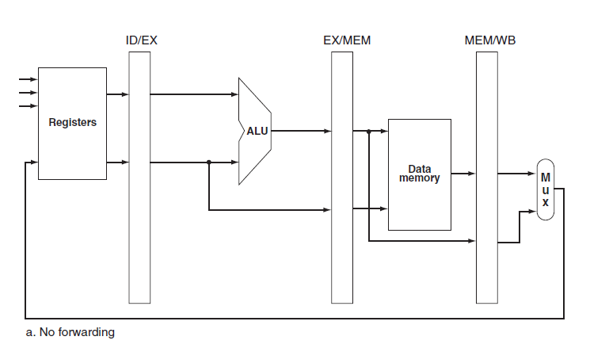
ALU and pipeline registers without forwarding

Slide 9
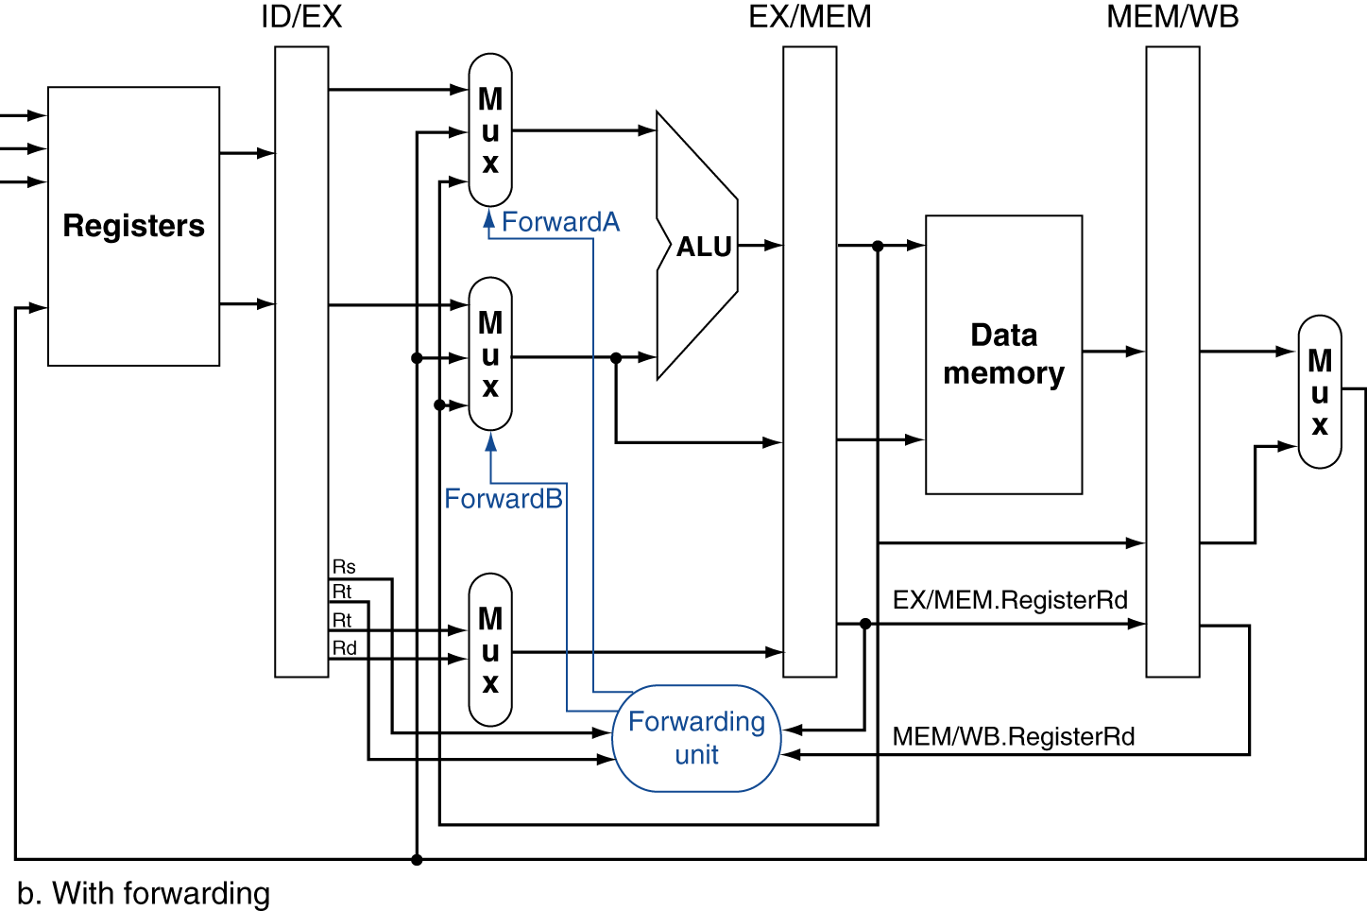
Forwarding Paths
Notes:
Morgan Kaufmann Publishers
Chapter 4 — The Processor

Slide 10
Forwarding Conditions
EX hazard
  if (EX/MEM.RegWrite and (EX/MEM.RegisterRd ≠ 0)
  and (EX/MEM.RegisterRd = ID/EX.RegisterRs))
  ForwardA = 10
  if (EX/MEM.RegWrite and (EX/MEM.RegisterRd ≠ 0)
  and (EX/MEM.RegisterRd = ID/EX.RegisterRt))
  ForwardB = 10
MEM hazard
  if (MEM/WB.RegWrite and (MEM/WB.RegisterRd ≠ 0)
  and (MEM/WB.RegisterRd = ID/EX.RegisterRs))
  ForwardA = 01
  if (MEM/WB.RegWrite and (MEM/WB.RegisterRd ≠ 0)
  and (MEM/WB.RegisterRd = ID/EX.RegisterRt))
  ForwardB = 01
Notes:
Morgan Kaufmann Publishers
Chapter 4 — The Processor

Slide 11
Double Data Hazard
Consider the sequence:
  add $1,$1,$2
  add $1,$1,$3
  add $1,$1,$4
Notes:
Morgan Kaufmann Publishers
Chapter 4 — The Processor

Slide 12
Yet Another Complication!
Another potential data hazard can occur when there is a conflict between the result of the WB stage instruction and the MEM stage instruction – which should be forwarded?
I
n
s
t
r.
O
r
d
e
r
add $1,$1,$2
IM
Reg
ALU
DM
Reg
add $1,$1,$3
IM
Reg
ALU
DM
Reg
add $1,$1,$4
IM
Reg
ALU
DM
Reg
2ND add gives the more recent result. So this data is to be forwarded to instruction3
Notes:
For lecture

Slide 13
Revised Forwarding Condition
  Forward only if EX hazard condition isn’t true
MEM hazard
  if (MEM/WB.RegWrite and (MEM/WB.RegisterRd ≠ 0)
  and not (EX/MEM.RegWrite and (EX/MEM.RegisterRd ≠ 0)
  and (EX/MEM.RegisterRd = ID/EX.RegisterRs))
  and (MEM/WB.RegisterRd = ID/EX.RegisterRs))
  ForwardA = 01
  if (MEM/WB.RegWrite and (MEM/WB.RegisterRd ≠ 0)
  and not (EX/MEM.RegWrite and (EX/MEM.RegisterRd ≠ 0)
  and (EX/MEM.RegisterRd = ID/EX.RegisterRt))
  and (MEM/WB.RegisterRd = ID/EX.RegisterRt))
  ForwardB = 01
Notes:
Morgan Kaufmann Publishers
Chapter 4 — The Processor

Slide 14
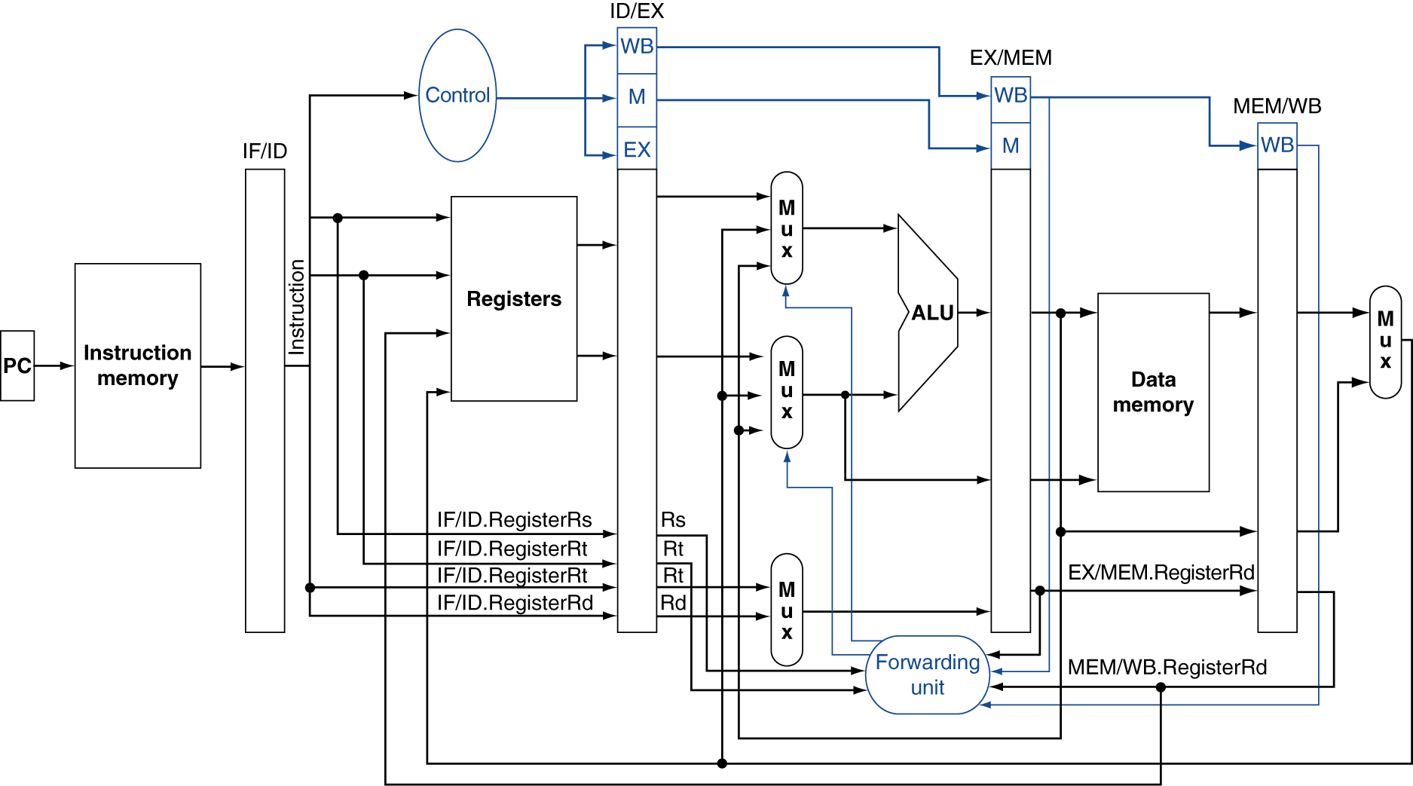
Datapath with Forwarding
Notes:
Morgan Kaufmann Publishers
Chapter 4 — The Processor

Slide 15
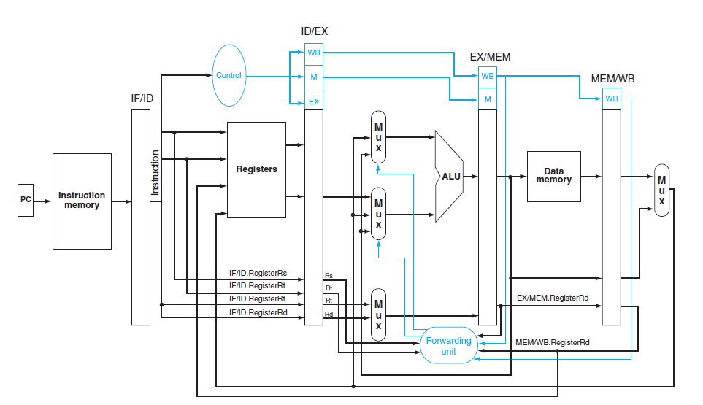

Slide 16
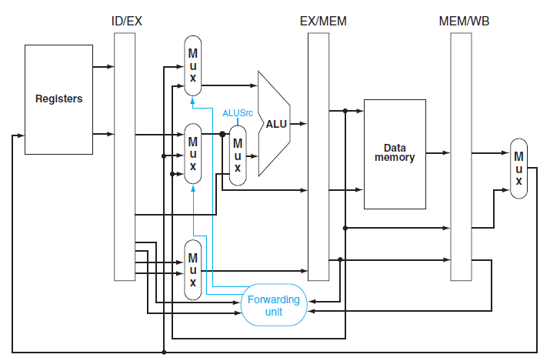
Including provision to select the immediate constant as ALU input

Slide 17
DATA HAZARDS AND STALLS

Slide 18
lw $2, 20($1)
and $4,$2,$5
Can forwarding save the situation??

Slide 19
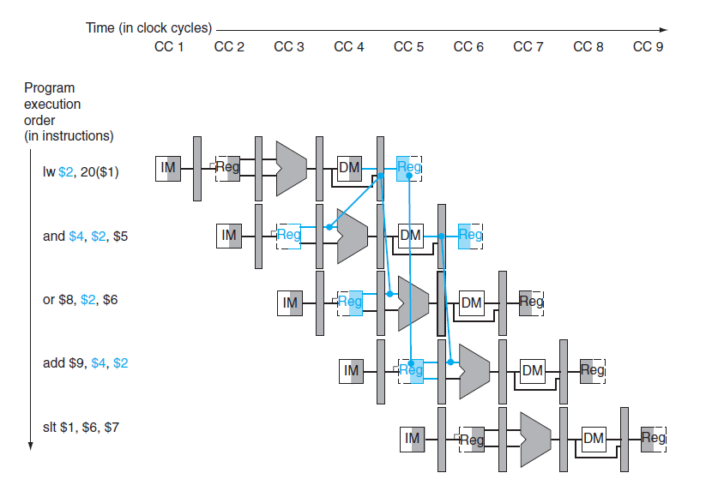
Dependency between load, and
cannot be solved by forwarding

Slide 20
Check when using instruction is decoded in ID stage
ALU operand reg numbers given by
  IF/ID.RegisterRs, IF/ID.RegisterRt
  Load-use hazard when
ID/EX.MemRead and
((ID/EX.RegisterRt = IF/ID.RegisterRs) or
(ID/EX.RegisterRt = IF/ID.RegisterRt))
If detected stall and insert a bubble

Slide 21
How to stall pipeline
Force control values in ID/EX register to 0
EX, MEM and WB do nop (no-operation)
Prevent update of PC and IF/ID register
  Using instruction is decoded again
  Following instruction is fetched again
1-cycle stall allows MEM to read data for lw
Can subsequently forward to EX stage (detected and handled by forwarding unit)

Slide 22
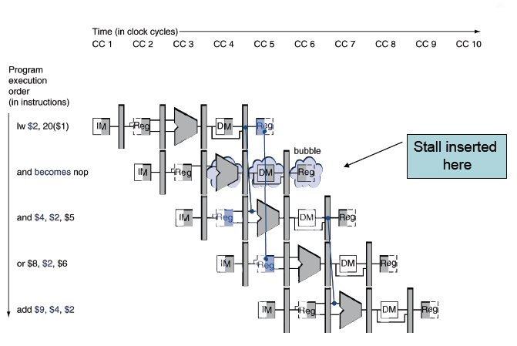

Slide 23
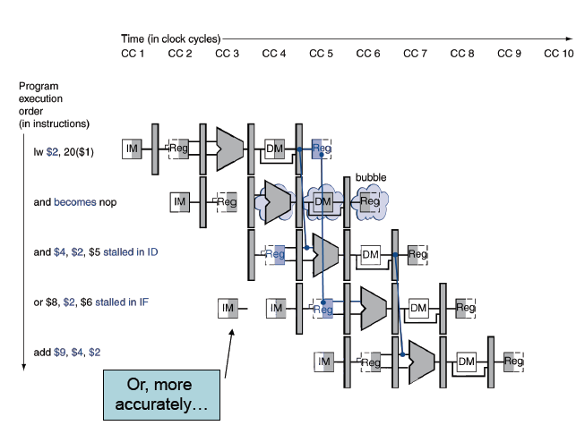
In CC4 and performs RF ,
or performs IF again

Slide 24
Pipeline should be stalled for the combination of load followed by an instruction that reads the data written by load (when the 2nd instruction needs that data in execution phase)
Eg
lw $2, 20($1)
and $4,$2,$5
or $8, $2, $6
add $9 $4 $2
A Hazard Detection Unit is added in ID stage
Hazard forces and, or instruction to repeat in CC4 what they did in CC3
and – reads registers and decodes
or – refetched from IM

Slide 25
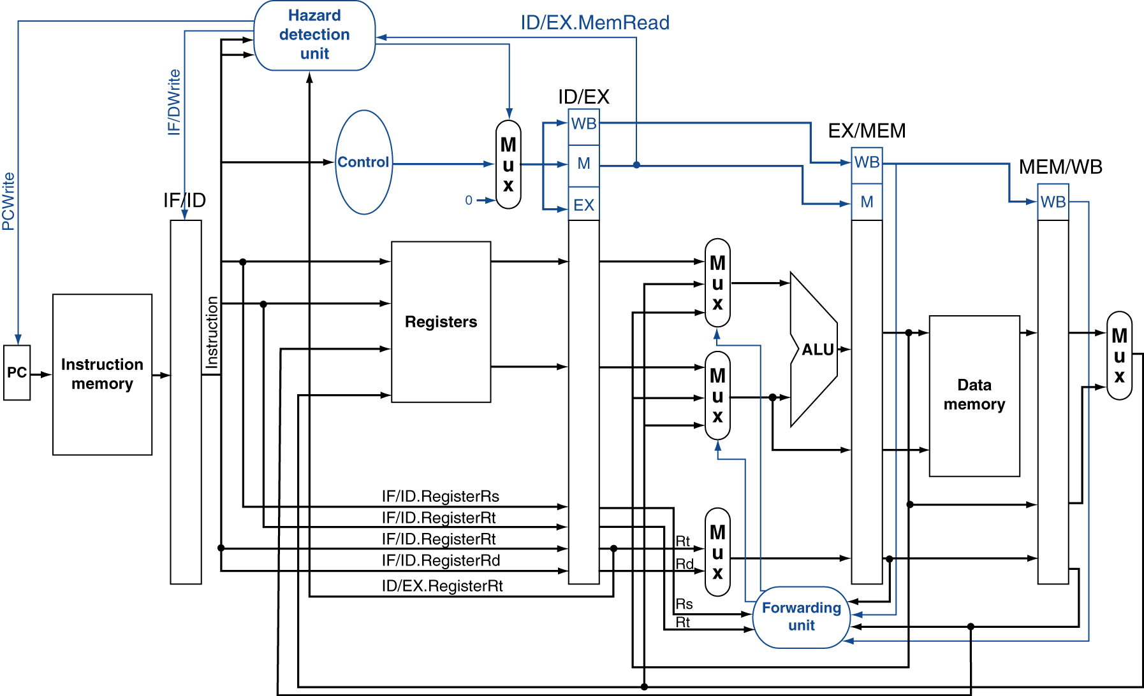
Datapath with Hazard Detection
Notes:
Morgan Kaufmann Publishers
Chapter 4 — The Processor

Slide 26
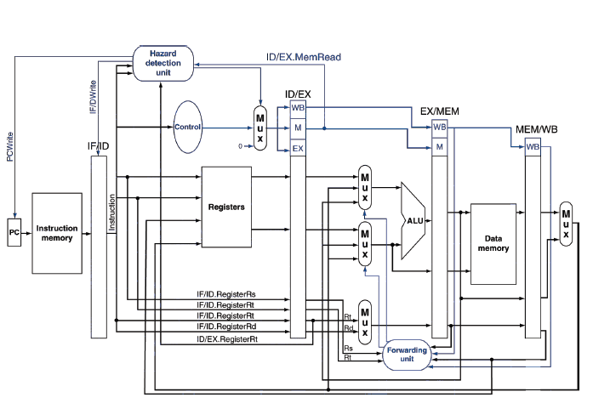

Slide 27
Stalls and Performance
The BIG Picture
Stalls reduce performance
  But are required to get correct results
Compiler can arrange code to avoid hazards and stalls
  Requires knowledge of the pipeline structure
Notes:
Morgan Kaufmann Publishers
Chapter 4 — The Processor

