Slide 1
Combinational Logic Circuits with Verilog
Reference Book:
A Text Book of Digital Electronics
Scientific International Publishers Ltd (SIPL), INDIA. Shriram K Vasudevan, Jai Vighneshwar, Subashri and Sumana R
Edition-1, 2013.
ISBN: 978-93-81714-53-9
(Second Edition Scheduled for December 2016.)
Shriram K Vasudevan

Slide 2
Agenda
To introduce combinational circuits to the reader.
You will get a clear clarity on arithmetic circuits like half adder, full adder and subtractors.
Complete discussion on decoders, encoders are presented with design and explanation for a clear understanding.
Finally, multiplexers are also discussed in depth which will complete the discussion.

Slide 3
What is combinational logic?
Combinational logic is one where the output is a pure function of the present input only.
This is 100% opposite to sequential logic, where the output depends not only on the present input but also on the history of the input.
To put it in simple words, sequential logic has memory while combinational logic does not.
We focus on adders, subtractors, encoders, decoders, multiplexers and de-multiplexers.

Slide 4
A Half Adder
What is an adder?
Simple, it is used to add something. Well, to bring to digital electronics, it adds bits.
Half adder is used to add two bits.
Half adder can accept two binary inputs.
With that inputs, it will compute the added result and will give two outputs. One is sum and the next is carry.
Normally sum is represented as S and carry is represented as C.

Slide 5
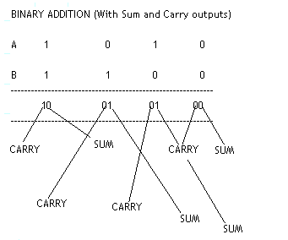
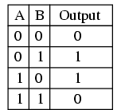

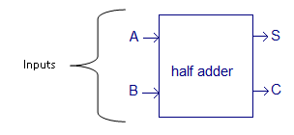
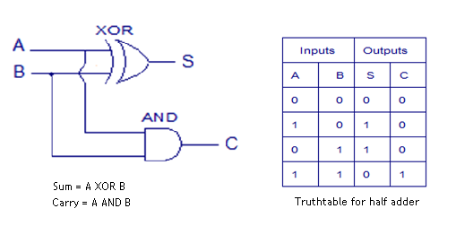
Contd.,
input B | input A | CARRY digit | SUM digit
0 | 0 | 0 | 0
0 | 1 | 0 | 1
1 | 0 | 0 | 1
1 | 1 | 1 | 0

Slide 6
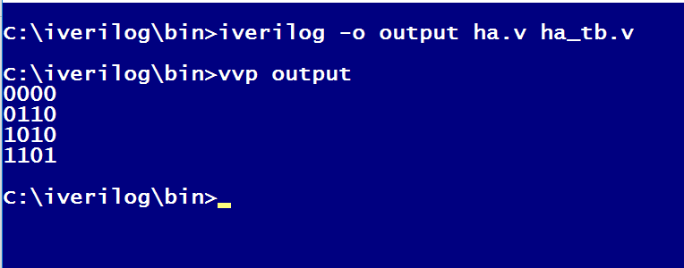
Code for half adder…

Slide 7
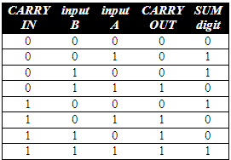
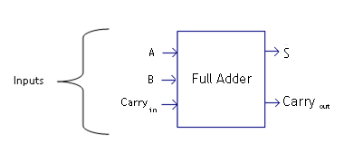
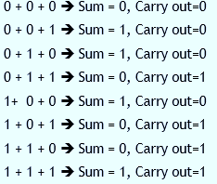
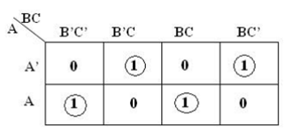

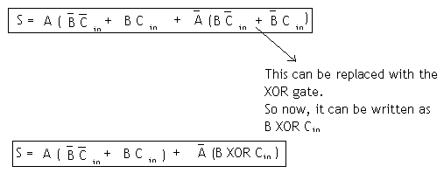


A Full Adder…

Slide 8
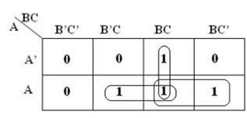

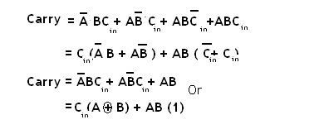
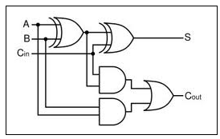
Contd.,

Slide 9
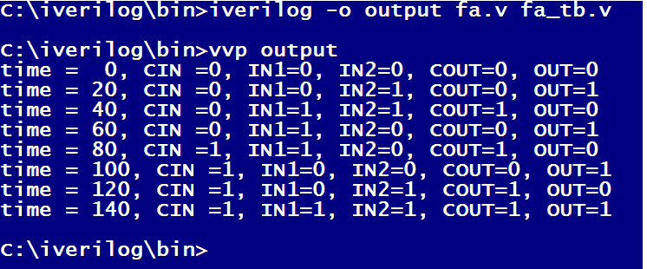
Code for full adder…

Slide 10
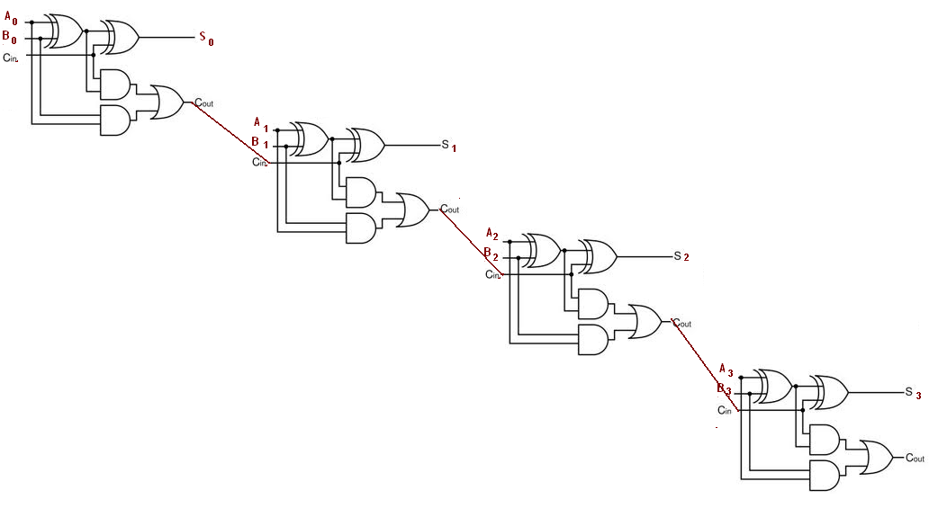
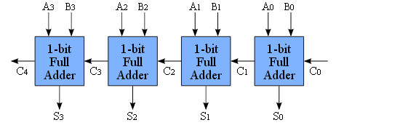
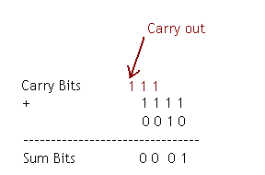
4 Bit ripple carry adder
Why it is referred to be as a ripple adder?
The result of addition of two bits will be depending on the carry being generated by addition of past bits.
Final sum is obtainable as a result of the carry being rippled through. So the adder is referred to be as ripple carry adder.
It can be built by having 4 full adders as shown in figure
Case: 1 (where there is no carry being generated)
Two 4 bit words: 0 0 0 1 + 0 0 1 0
Sum = 0 0 1 1
Output carry will be = 0 0 0 0
Case:2 (With carry being generated)

Slide 11

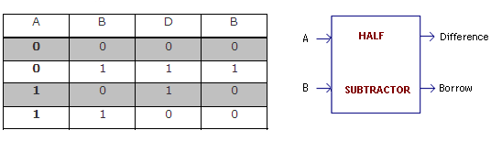
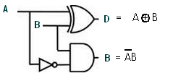

Half subtractor
As half adder half subtractor is again a combinational logic circuit that can be used to perform the arithmetic subtraction operation.
It will have two inputs and two outputs.
Assignment = Full Subtractor

Slide 12
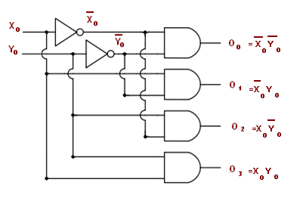
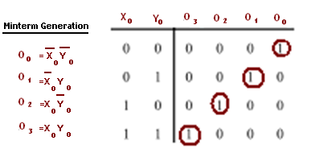

Decoders
It is again a combinational circuit which will be helping to convert the n bit binary information to 2^{n} unique outputs.
2 to 4 decoder
it decodes 2 inputs to 4 outputs

Slide 13
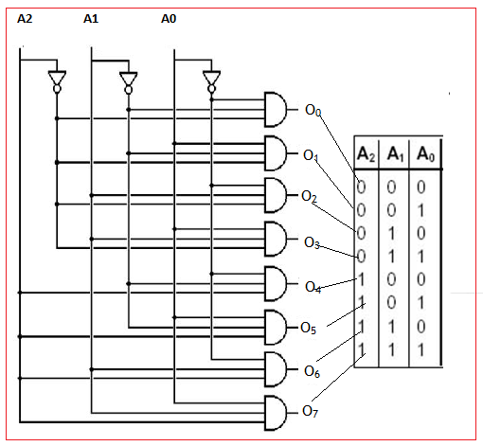
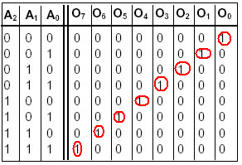
3 to 8 decoder

Slide 14
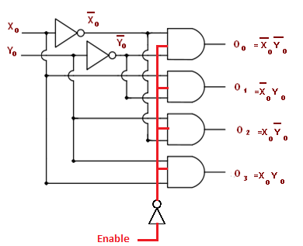
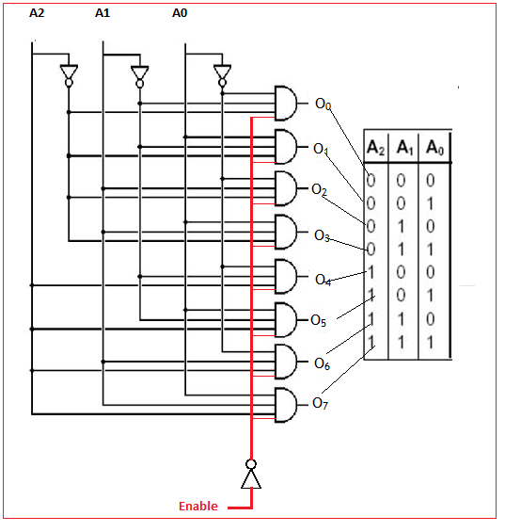
Decoders with Enable line
What will that Enable line do? Simple. The decoder will be active / inactive based on the status of the enable line.
3 to 8 decoder
2 to 4 decoder

Slide 15
Encoder
Encoders are precisely opposite to decoders.
It will accept 2^n inputs and it will get n outputs.
For an instance when there are 8 inputs, 3 outputs will be obtained. This is reverse to the decoder.
So obviously, truth table will also be opposite to decoder.

Slide 16
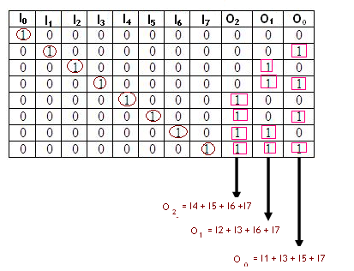
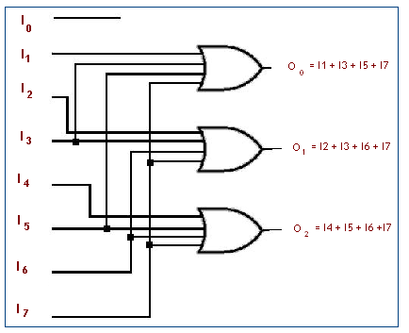
Octal to Binary Encoder
As shown in the table, at any point in time, only one input line is 1.
Others remain zero and it is highlighted in the table.
To get the expression derived out of the table one should see the occurrences of 1 for outputs O_{0,} O₁ and O₂.

Slide 17
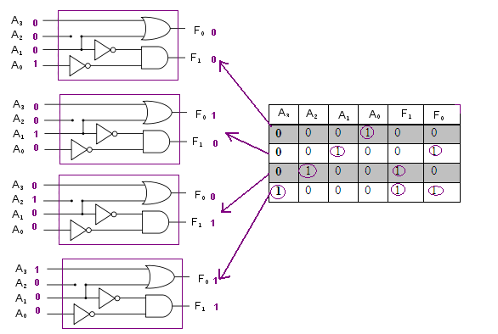
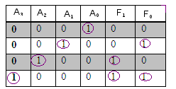
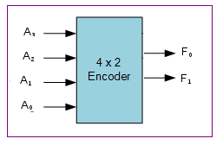

4 to 2 Encoder
4x2 Encoder implementation

Slide 18
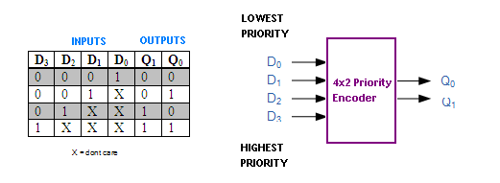
Priority Encoder
This encoder will prioritize the bits in the input stream and whenever it encounters a high priority input bit, it will ignore all other lower priority inputs.
once the high signal is found, rest will be ignored. D₀ is of lowest priority and D₃ is of highest priority.
So if D₃ is high, rest of all bits will be ignored or it will be considered as don’t care.

Slide 19
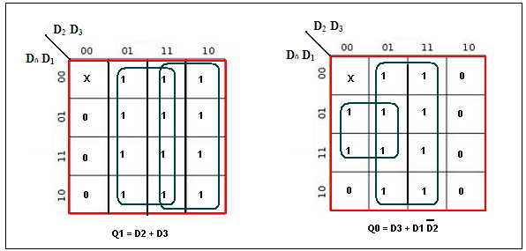
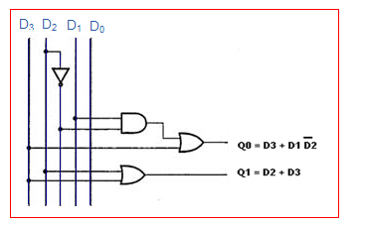
Contd.,

Slide 20
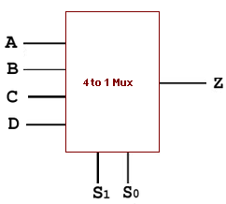
Multiplexers
It is yet another combinational circuit that has multiple binary inputs and one output.
One of those input will be sent to the output based on the selection line. There is a proposition.
When there are 2^{n} inputs, there will be n selection lines.

Slide 21
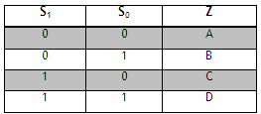
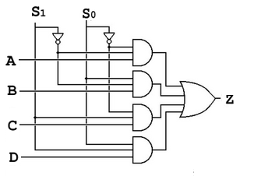
Contd.,
The next step is to understand the way the Multiplexer works.
Based on the select inputs, one of the inputs will be prompted as output.
Here from the table shown above one can find that, when A has to be received as the output out of A, B, C and D, select lines S₀and S₁should be 0.
Like wise the rest of inputs can be prompted as outputs based on the select lines.

Slide 22
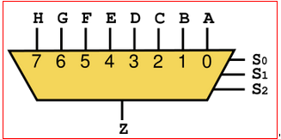
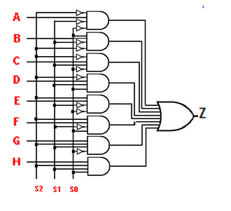
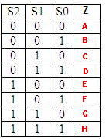
8:1 Multiplexer
8 inputs will be available in this multiplexer and it can prompt one of those inputs as output.
Since based on the scheme that for 2^n inputs, there will be n selection lines, here it should be 3 selection lines

Slide 23
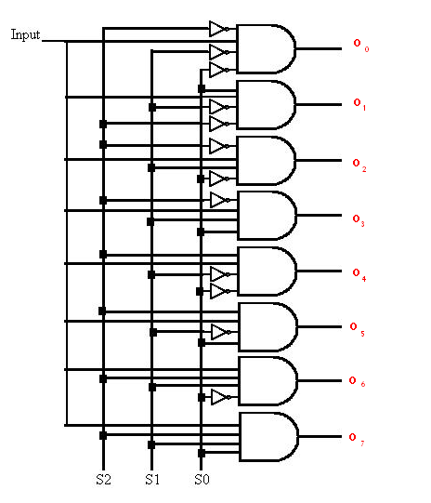
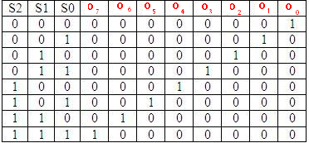
De - Multiplexers
De-multiplexer will have a single input and multiple output lines.
Selection of one of many data-output-lines is carried out, which is connected to the single input.

Slide 24
Points to remember
A combinational circuit can be built with logic gates.
Adder, subtractor, encoders, decoders, multiplexers, demultiplexers are some of the strong examples of combinational circuits.
Half adder is used to add two input bits and will generate the output with sum and carry.
Full adder is different from half adder in a way that it accepts the carry input as well which is not supported in half adder.
Ripple carry adder can be framed with 4 full adders.
Decoder converts the n bit binary information to 2^{n} unique outputs. In short it can be used to convert a binary code to a decimal or octal or hexa decimal output.
Encoders are precisely opposite to decoders. It will accept 2n inputs and it will get n outputs. For an instance when there are 8 inputs, 3 outputs will be obtained.
Priority encoder will prioritize the bits in the input stream and whenever it encounters a high priority input bit, it will ignore all other lower priority inputs.
A multiplexer will have multiple binary inputs and one output. One of those input will be sent to the output based on the selection line.
De-multiplexer will have a single input and multiple output lines. Selection of one of many data-output-lines is carried out, which is connected to the single input.

Slide 25
Thanks.
Shriram K V

