Slide 1
Memory Hierarchy
Shriram K Vasudevan

Slide 2
Introduction
From the earliest days of computing, programmers have wanted unlimited amounts of fast memory. (Luxury Matters! )
We can’t afford to have more memory as it would be very expensive. So, we will look at the aid programmers are offered by creating the illusion of unlimited fast memory. (Virtual)
An analogy is always helpful!

Slide 3
Contd.,
Suppose you were a student writing a term paper on important historical developments in computer hardware.
You are sitting at a desk in a library with a collection of books that you have pulled from the shelves and are examining.
You find that several of the important computers that you need to write about are described in the books you have, but there is nothing about the EDSAC.
Therefore, you go back to the shelves and look for an additional book. You find a book on early British computers that covers EDSAC.
Once you have a good selection of books on the desk in front of you, there is a good probability that many of the topics you need can be found in them, and you may spend most of your time just using the books on the desk without going back to the shelves.
Having several books on the desk in front of you saves time compared to having only one book there and constantly having to go back to the shelves to return it and take out another.

Slide 4
Contd.,
The same principle allows us to create the illusion of a large memory that we can access as fast as a very small memory.
Just as you did not need to access all the books in the library at once with equal probability, a program does not access all of its code or data at once with equal probability.
Otherwise, it would be impossible to make most memory accesses fast and still have large memory in computers, just as it would be impossible for you to fit all the library books on your desk and still find what you wanted quickly

Slide 5
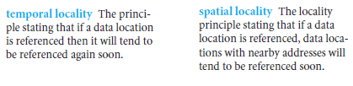
Contd.,
This principle of locality underlies both the way in which you did your work in the library and the way that programs operate.
The principle of locality states that programs access a relatively small portion of their address space at any instant of time, just as you accessed a very small portion of the library’s collection.
There are two different types of locality:
You brought out the book on early English computers to find out about EDSAC, you also noticed that there was another book shelved next to it about early mechanical computers, so you also brought back that book too and, later on, found something useful in that book.
Books on the same topic are shelved together in the library to increase spatial locality
If you recently brought a book to your desk to look at, you will probably need to look at it again soon

Slide 6
Contd.,
Just as accesses to books on the desk naturally exhibit locality, locality in programs arises from simple and natural program structures.
For example, most programs contain loops, so instructions and data are likely to be accessed repeatedly, showing high amounts of temporal locality.
Since instructions are normally accessed sequentially, programs show high spatial locality.
Accesses to data also exhibit a natural spatial locality. For example, accesses to elements of an array or a record will naturally have high degrees of spatial locality.

Slide 7
Contd.,
We take advantage of the principle of locality by implementing the memory of a computer as a memory hierarchy.
A memory hierarchy consists of multiple levels of memory with different speeds and sizes.
The faster memories are more expensive per bit than the slower memories and thus smaller.

Slide 8
Contd.,
Today, there are three primary technologies used in building memory hierarchies.
Main memory is implemented from DRAM (dynamic random access memory), while levels closer to the processor (caches) use SRAM (static random access memory).
The third technology, used to implement the largest and slowest level in the hierarchy, is magnetic disk.

Slide 9
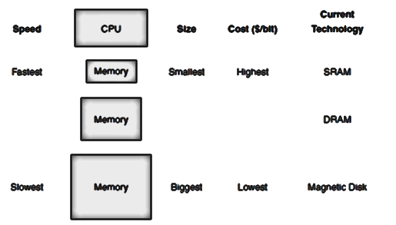
Contd.,
Figure below shows the faster memory is close to the processor and the slower, less expensive memory is below it.
The goal is to present the user with as much memory as is available in the cheapest technology, while providing access at the speed offered by the fastest memory.

Slide 10
Contd.,
The memory system is organized as a hierarchy: a level closer to the processor is generally a subset of any level further away, and all the data is stored at the lowest level.
By analogy, the books on your desk form a subset of the library you are working in, which is in turn a subset of all the libraries on campus.
Furthermore, as we move away from the processor, the levels take progressively longer to access, just as we might encounter in a hierarchy of campus libraries.

Slide 11
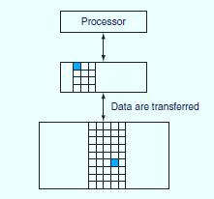
Contd.,
A memory hierarchy can consist of multiple levels, but data is copied between only two adjacent levels at a time, so we can focus our attention on just two levels.
The upper level—the one closer to the processor—is smaller and faster (since it uses more expensive technology) than the lower level.
Figure below shows that the minimum unit of information that can be either present or not present in the two-level hierarchy is called a block or a line; in our library analogy, a block of information is one book.
Within each level, the unit of information that is present or not is called a block.
Usually we transfer an entire block when we copy something between levels.

Slide 12



Contd.,
If the data requested by the processor appears in some block in the upper level, this is called a hit (analogous to your finding the information in one of the books on your desk).
If the data is not found in the upper level, the request is called a miss.
The lower level in the hierarchy is then accessed to retrieve the block containing the requested data.
(Continuing our analogy, you go from your desk to the shelves to find the desired book.)

Slide 13
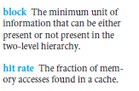
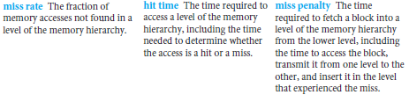
Cond.,
The hit rate, or hit ratio, is the fraction of memory accesses found in the upper level; it is often used as a measure of the performance of the memory hierarchy.
The miss rate (1 – hit rate) is the fraction of memory accesses not found in the upper level.

Slide 14
Contd.,
Since performance is the major reason for having a memory hierarchy, the time to service hits and misses is important.
Hit time is the time to access the upper level of the memory hierarchy, which includes the time needed to determine whether the access is a hit or a miss (that is, the time needed to look through the books on the desk).
The miss penalty is the time to replace a block in the upper level with the corresponding block from the lower level, plus the time to deliver this block to the processor (or, the time to get another book from the shelves and place it on the desk).
Because the upper level is smaller and built using faster memory parts, the hit time will be much smaller than the time to access the next level in the hierarchy, which is the major component of the miss penalty. (The time to examine the books on the desk is much smaller than the time to get up and get a new book from the shelves.)

Slide 15
Contd.,
Concepts used to build memory systems affect many other aspects of a computer, including how the operating system manages memory and I/O, how compilers generate code, and even how applications use the computer.
Of course, because all programs spend much of their time accessing memory, the memory system is necessarily a major factor in determining performance.
The reliance on memory hierarchies to achieve performance has meant that programmers, who used to be able to think of memory as a flat, random access storage device, now need to understand memory hierarchies to get good performance

Slide 16
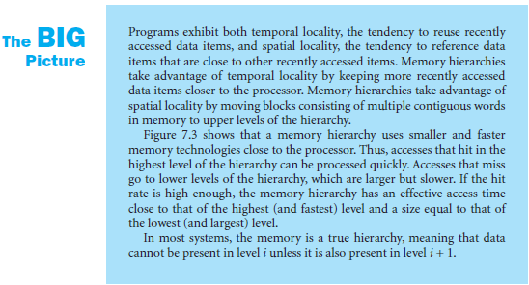
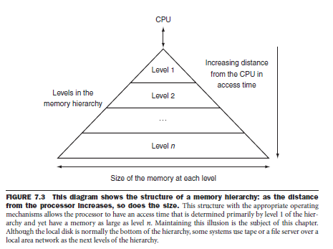

Slide 17
The basics of cache!
Cache: a safe place for hiding or storing things – Says some dictionary.
In our library example, the desk acted as a cache—a safe place to store things (books) that we needed to examine.
We begin by looking at a very simple cache in which the processor requests are each one word and the blocks also consist of a single word.

Slide 18
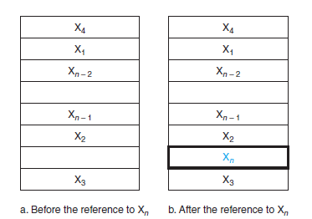
Contd.,
Figure RHS shows such a simple cache, before and after requesting a data item that is not initially in the cache.
Before the request, the cache contains a collection of recent references X1, X2, . . . , Xn – 1, and the processor requests a word Xn that is not in the cache.
This request results in a miss, and the word Xn is brought from memory into cache.
This reference causes a miss that forces the cache to fetch Xn from memory and insert it into the cache.

Slide 19
Contd.,
There are two questions to answer:
How do we know if a data item is in the cache?
Moreover, if it is, how do we find it?
The answers to these two questions are related. If each word can go in exactly one place in the cache, then it is straightforward to find the word if it is in the cache.
The simplest way to assign a location in the cache for each word in memory is to assign the cache location based on the address of the word in memory.
This cache structure is called direct mapped, since each memory location is mapped directly to exactly one location in the cache. The typical mapping between addresses and cache locations for a direct-mapped cache is usually simple.

Slide 20
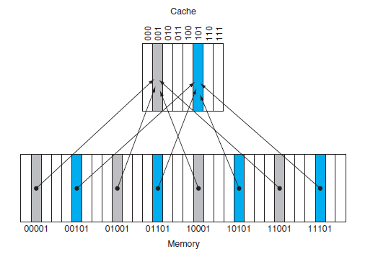
Contd.,
For example, Figure LHS shows how the memory addresses between 1ten (00001two) and 29ten (11101two) map to locations 1ten (001two) and 5ten (101two) in a direct-mapped cache of eight words.
This is called Direct Mapping!
Because each cache location can contain the contents of a number of different memory locations, how do we know whether the data in the cache corresponds to a requested word?
That is, how do we know whether a requested word is in the cache or not?
We answer this question by adding a set of tags to the cache. The tags contain the address information required to identify whether a word in the cache corresponds to the requested word.

Slide 21
Contd.,
The tag needs only to contain the upper portion of the address, corresponding to the bits that are not use as an index into the cache.
For example, (See RHS) we need only to have the upper 2 of the 5 address bits in the tag, since the lower 3-bit index field of the address selects the block.

Slide 22
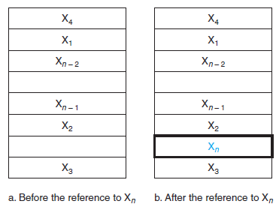
Contd.,
We also need a way to recognize that a cache block does not have valid information.
For instance, when a processor starts up, the cache does not have good data, and the tag fields will be meaningless.
Even after executing many instructions, some of the cache entries may still be empty, as in Figure RHS.
Thus, we need to know that the tag should be ignored for such entries.
The most common method is to add a valid bit to indicate whether an entry contains a valid address.
If the bit is not set, there cannot be a match for this block.

Slide 23
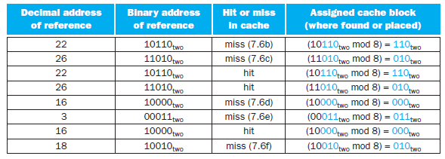
Accessing a Cache
Figure (next page) shows the contents of an eight-word direct-mapped cache as it responds to a series of requests from the processor.
Since there are eight blocks in the cache, the low-order 3 bits of an address give the block number.
When the word at address 18 (10010two) is brought into cache block 2 (010two), the word at address 26 (11010two), which was in cache block 2 (010two), must be replaced by the newly requested data.
This behavior allows a cache to take advantage of temporal locality: recently accessed words replace less recently referenced words.
This situation is directly analogous to needing a book from the shelves and having no more space on your desk—some book already on your desk must be returned to the shelves.
In a direct-mapped cache, there is only one place to put the newly requested item and hence only one choice of what to replace.

Slide 24
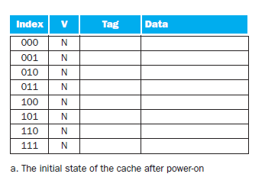
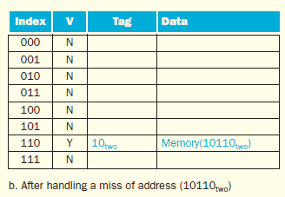
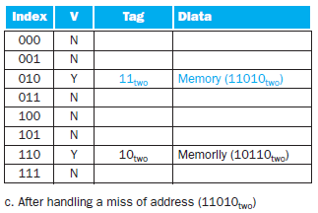
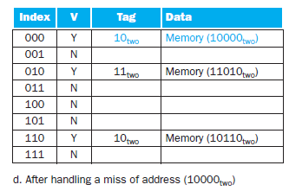
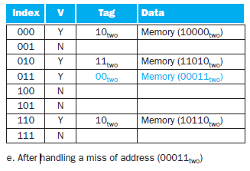
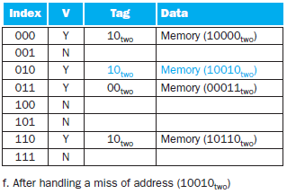
The cache is initially empty, with all valid bits (V entry in cache) turned off (N). The processor requests the following addresses: 10110two
(miss), 11010two (miss), 10110two (hit), 11010two (hit), 10000two (miss), 00011two (miss), 10000two (hit), and 10010two (miss). The figures show the
cache contents after each miss in the sequence has been handled. When address 10010two (18) is referenced, the entry for address 11010two (26) must
be replaced, and a reference to 11010two will cause a subsequent miss. The tag field will contain only the upper portion of the address. The full address
of a word contained in cache block i with tag field j for this cache is j ∞ 8 + i, or equivalently the concatenation of the tag field j and the index i. For
example, in cache f above, index 010 has tag 10 and corresponds to address 10010.

Slide 25
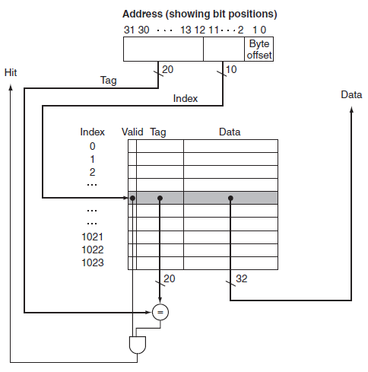
Contd.,
We know where to look in the cache for each possible address: the low-order bits of an address can be used to find the unique cache entry to which the address could map.
how a referenced address is divided into
■ a cache index, which is used to select the block
■ a tag field, which is used to compare with the value of
the tag field of the cache
The tag from the cache is compared against the upper portion of the address to determine whether the entry in the cache corresponds to the requested address.
Because the cache has 210 (or 1024) words and a block size of 1 word, 10 bits are used to index the cache, leaving 32 – 10 – 2 = 20 bits to be compared against the tag. If the tag and upper 20 bits of the address are equal and the valid bit is on, then the request hits in the cache, and the word is supplied to the processor.
Otherwise, a miss occurs.

Slide 26

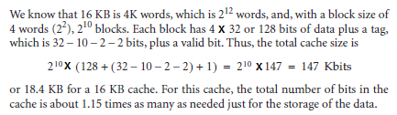
Contd.,
4 words = 2 ^ 2
Byte Offset
3
4
Word 1 | Word 2 | Word 3 | Word 4
32 bits
1
2
3
4
.
.
.
2^10
1
2
2 ^ 10 Blocks

Slide 27
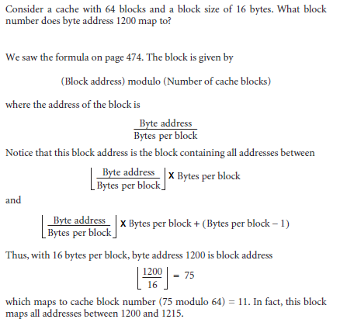

Contd.,
Hint:
64 Benches
One bench = 16 Members
1200 th person will sit at?

Slide 28
Handling Cache Misses
cache miss: A request for data from the cache that cannot be filled because the data is not present in the cache.
The control unit must detect a miss and process the miss by fetching the requested data from memory (or, as we shall see, a lower-level cache).
If the cache reports a hit, the computer continues using the data as if nothing had happened.
Modifying the control of a processor to handle a hit is trivial;
Misses, however, require some extra work.
The cache miss handling is done with the processor control unit and with a separate controller that initiates the memory access and refills the cache.
The processing of a cache miss creates a stall, similar to the pipeline stalls discussed in pipelining, which would require saving the state of all registers.
For a cache miss, we can stall the entire processor, essentially freezing the contents of the temporary and programmer-visible registers, while we wait for memory. In contrast, pipeline stalls, are more complex because we must continue executing some instructions while we stall others.

Slide 29
Contd.,
Let’s look a little more closely at how instruction misses are handled for either the multicycle or pipelined datapath; the same approach can be easily extended to handle data misses.
If an instruction access results in a miss, then the content of the Instruction register is invalid.
To get the proper instruction into the cache, we must be able to instruct the lower level in the memory hierarchy to perform a read.
Since the program counter is incremented in the first clock cycle of execution in both the pipelined and multicycle processors, the address of the instruction that generates an instruction cache miss is equal to the value of the program counter minus 4.

Slide 30
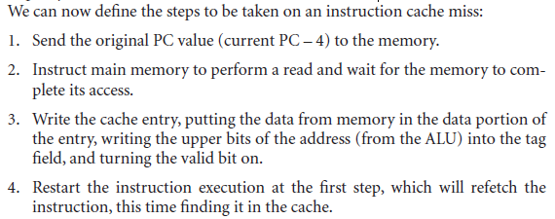
Contd.,
Once we have the address, we need to instruct the main memory to perform a read.
We wait for the memory to respond (since the access will take multiple cycles), and then write the words into the cache.

Slide 31
Self Study
Handling Cache Writes – Page 483 of the text book.

Slide 32
Measuring and Improving Cache Performance
We explore two different techniques for improving cache performance.
One focuses on reducing the miss rate by reducing the probability that two different memory blocks will contend for the same cache location.
The second technique reduces the miss penalty by adding an additional level to the hierarchy.
This technique, called multilevel caching, first appeared in high-end computers and now available even in “Dabba” computers!

Slide 33
Contd.,
CPU time can be divided into the clock cycles that the CPU spends executing the program and the clock cycles that the CPU spends waiting for the memory system.
Normally, we assume that the costs of cache accesses that are hits are part of the normal CPU execution cycles.
Thus,
CPU time = (CPU execution clock cycles + Memory-stall clock cycles) * Clock cycle time
The memory-stall clock cycles come primarily from cache misses, and we make that assumption here.

Slide 34

Contd.,
Memory-stall clock cycles can be defined as the sum of the stall cycles coming from reads plus those coming from writes:
The read-stall cycles can be defined in terms of the number of read accesses per program, the miss penalty in clock cycles for a read, and the read miss rate:
Memory-stall clock cycles = Read-stall cycles + Write-stall cycles
The read-stall cycles can be defined in terms of the number of read accesses per program, the miss penalty in clock cycles for a read, and the read miss rate:

Slide 35

Contd.,
Writes are more complicated. For a write-through scheme, we have two sources of stalls:
write misses, which usually require that we fetch the block before continuing the write.
write buffer stalls, which occur when the write buffer is full when a write occurs.
Thus, the cycles stalled for writes equals the sum of these two:

Slide 36
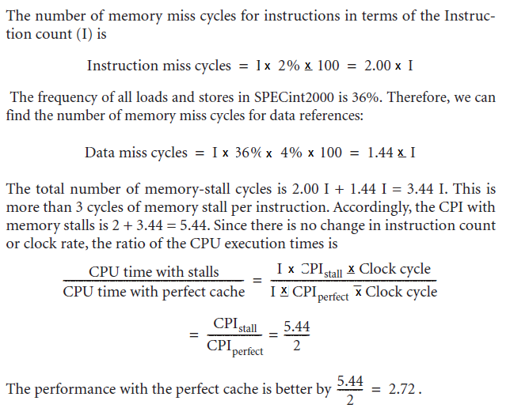
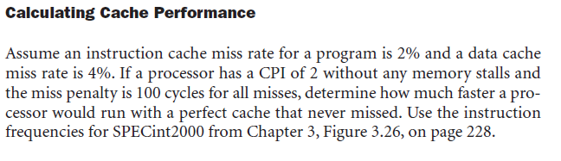
Contd.,

Slide 37
Reducing Cache Misses by More Flexible Placement of Blocks
So far, when we place a block in the cache, we have used a simple placement scheme: A block can go in exactly one place in the cache.
It is direct mapping! We have seen it already!
There is actually a whole range of schemes for placing blocks. At one extreme is direct mapped, where a block can be placed in exactly one location.

Slide 38
Contd.,
At the other extreme is a scheme where a block can be placed in any location in the cache.
Such a scheme is called fully associative because a block in memory may be associated with any entry in the cache.
To find a given block in a fully associative cache, all the entries in the cache must be searched because a block can be placed in any one.
To make the search practical, it is done in parallel with a comparator associated with each cache entry. These comparators significantly increase the hardware cost, effectively making fully associative placement practical only for caches with small numbers of blocks.

Slide 39
Contd.,
The middle range of designs between direct mapped and fully associative is called set associative.
In a set-associative cache, there are a fixed number of locations (at least two) where each block can be placed;
A set-associative cache with n locations for a block is called an n-way set-associative cache.
An n-way set-associative cache consists of a number of sets, each of which consists of n blocks. Each block in the memory maps to a unique set in the cache given by the index field, and a block can be placed in any element of that set.
Thus, a set associative placement combines direct-mapped placement and fully associative placement: a block is directly mapped into a set, and then all the blocks in the set are searched for a match.

Slide 40
Contd.,
Remember that in a direct-mapped cache, the position of a memory block is given by
(Block number) modulo (Number of cache blocks)
In a set-associative cache, the set containing a memory block is given by
(Block number) modulo (Number of sets in the cache)

Slide 41
Contd.,
Since the block may be placed in any element of the set, all the tags of all the elements of the set must be searched.
In a fully associative cache, the block can go anywhere and all tags of all the blocks in the cache must be searched.

Slide 42
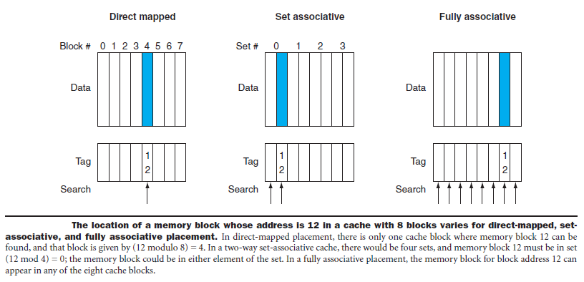
Contd.,
For example, Figure below shows where block 12 may be placed in a cache with eight blocks total, according to the block placement policy for direct-mapped, two-way set-associative, and fully associative caches.

Slide 43
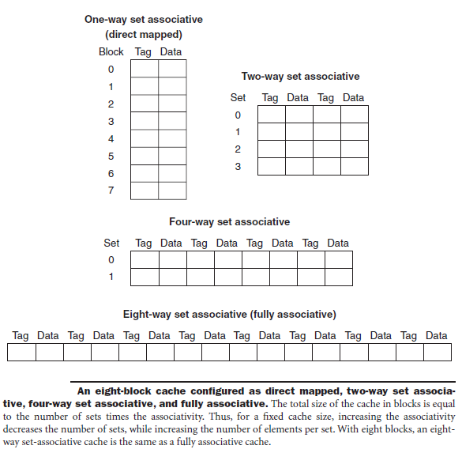
Contd.,
We can think of every block placement strategy as a variation on set associativity.
Figure below shows the possible associativity structures for an eight-block cache.
A direct-mapped cache is simply a one-way set-associative cache: each cache entry holds one block and each set has one element.
A fully associative cache with m entries is simply an m-way set-associative cache; it has one set with m blocks, and an entry can reside in any block within that set.
The advantage of increasing the degree of associativity is that it usually decreases the miss rate, as the next example shows. The main disadvantage, is an increase in the hit time.

Slide 44
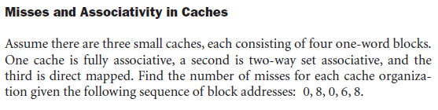
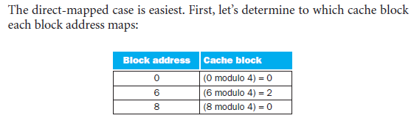
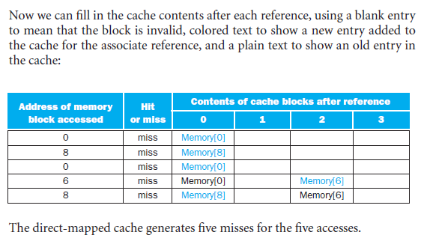
Contd.,

Slide 45
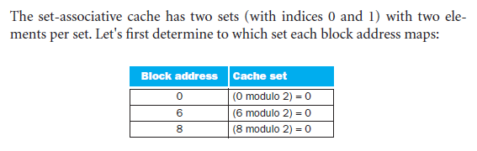
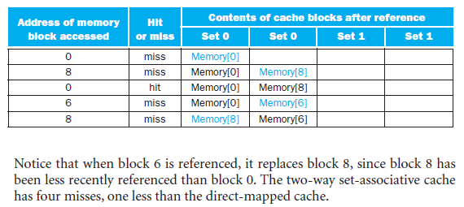
Contd.,
Because we have a choice of which entry in a set to replace on a miss, we need a replacement rule.
Set-associative caches usually replace the least recently used block within a set; that is, the block that was used furthest in the past is replaced.

Slide 46
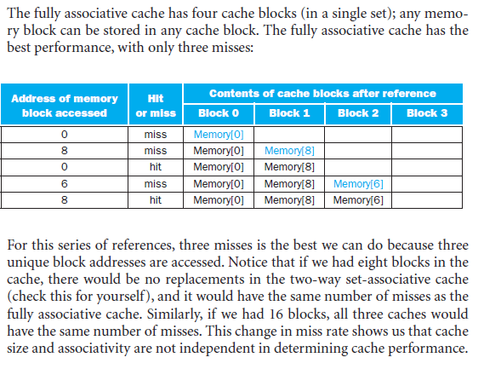
Contd.,

Slide 47
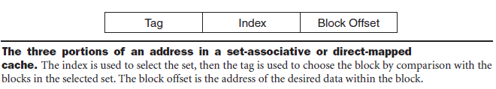
Locating a Block in the Cache
Now, let’s consider the task of finding a block in a cache that is set associative.
Just as in a direct-mapped cache, each block in a set-associative cache includes an address tag that gives the block address.
The tag of every cache block within the appropriate set is checked to see if it matches the block address from the processor.
Figure below shows how the address is decomposed. The index value is used to select the set containing the address of interest, and the tags of all the blocks in the set must be searched.
Because speed is of the essence, all the tags in the selected set are searched in parallel. As in a fully associative cache, a sequential search would make the hit time of a set-associative cache too slow.

Slide 48
Contd.,
If the total cache size is kept the same, increasing the associativity increases the number of blocks per set, which is the number of simultaneous compares needed to perform the search in parallel: each increase by a factor of two in associativity doubles the number of blocks per set and halves the number of sets.
Accordingly, each factor-of-two increase in associativity decreases the size of the index by 1 bit and increases the size of the tag by 1 bit.
In a fully associative cache, there is effectively only one set, and all the blocks must be checked in parallel.
Thus, there is no index, and the entire address, excluding the block offset, is compared against the tag of every block. In other words, we search the entire cache without any indexing.

Slide 49
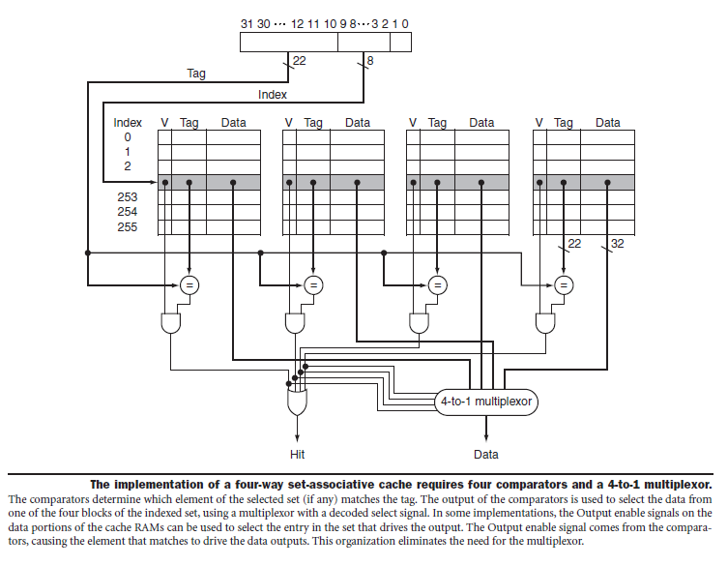
Contd.,

Slide 50

Virtual Memory
Very important topic of discussion! Our Last Topic!
In the previous section, we saw how caches provided fast access to recently used portions of a program’s code and data.
Similarly, the main memory can act as a “cache” for the secondary storage, usually implemented with magnetic disks.
This technique is called virtual memory.

Slide 51
Contd.,
Historically, there were two major motivations for virtual memory:
To allow efficient and safe sharing of memory among multiple programs
To remove the programming burdens of a small, limited amount of main memory.
Four decades after its invention, it’s the former reason that reigns today.

Slide 52
Contd.,
Consider a collection of programs running at once on a computer.
The total memory required by all the programs may be much larger than the amount of main memory available on the computer, but only a fraction of this memory is actively being used at any point in time.
Main memory need contain only the active portions of the many programs, just as a cache contains only the active portion of one program.
Thus, the principle of locality enables virtual memory as well as caches, and virtual memory allows us to efficiently share the processor as well as the main memory.
Of course, to allow multiple programs to share the same memory, we must be able to protect the programs from each other, ensuring that a program can only read and write the portions of main memory that have been assigned to it.

Slide 53
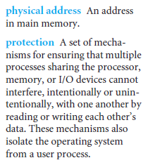
Contd.,
We cannot know which programs will share the memory with other programs when we compile them.
In fact, the programs sharing the memory change dynamically while the programs are running.
Because of this dynamic interaction, we would like to compile each program into its own address space— separate range of memory locations accessible only to this program.
Virtual memory implements the translation of a program’s address space to physical addresses.
This translation process enforces protection of a program’s address space from other programs.

Slide 54
Contd.,
The second motivation for virtual memory is to allow a single user program to exceed the size of primary memory.
Formerly, if a program became too large for memory, it was up to the programmer to make it fit.
Programmers divided programs into pieces and then identified the pieces that were mutually exclusive.
These overlays were loaded or unloaded under user program control during execution, with the programmer ensuring that the program never tried to access an overlay that was not loaded and that the overlays loaded never exceeded the total size of the memory. Overlays were traditionally organized as modules, each containing both code and data.
Calls between procedures in different modules would lead to overlaying of one module with another. As you can well imagine, this responsibility was a substantial burden on programmers.

Slide 55
Contd.,
Virtual memory, which was invented to relieve programmers of this difficulty, automatically manages the two levels of the memory hierarchy represented by main memory (sometimes called physical memory to distinguish it from virtual memory) and secondary storage.

Slide 56
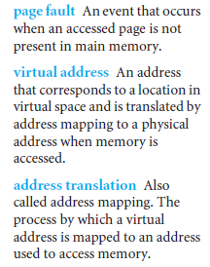
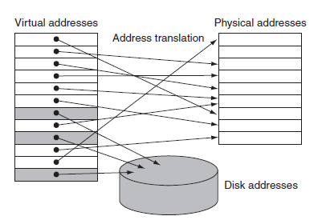
Contd.,
A virtual memory block is called a page, and a virtual memory miss is called a page fault.
With virtual memory, the processor produces a virtual address, which is translated by a combination of hardware and software to a physical address, which in turn can be used to access main memory.
Figure RHS shows the virtually addressed memory with pages mapped to main memory. This process is called address mapping or address translation
The processor generates virtual addresses while the memory is accessed using physical addresses. Both the virtual memory and the physical memory are broken into pages, so that a virtual page is really mapped to a
physical page.

Slide 57
Contd.,
If we return to our library analogy, we can think of a virtual address as the title of a book and a physical address as the location of that book in the library
Virtual memory also simplifies loading the program for execution by providing relocation.
Relocation maps the virtual addresses used by a program to different physical addresses before the addresses are used to access memory.
This relocation allows us to load the program anywhere in main memory.
Furthermore, all virtual memory systems in use today relocate the program as a set of fixed-size blocks (pages), thereby eliminating the need to find a contiguous block of memory to allocate to a program; instead, the operating system need only find a sufficient number of pages in main memory.
Formerly, relocation problems required special hardware and special support in the operating system; today, virtual memory also provides this function.

Slide 58
Basic Paging – Basic Method.
The basic method for implementing paging involves
Breaking physical memory into fixed-sized blocks called FRAMES.
Breaking logical memory into blocks of the same size called PAGES.
When a process is to be executed, its pages are loaded into any available memory frames from their source (a file system or the backing store). Can you understand this? If not, recollect what is physical and logical memory!!
The backing store is divided into fixed-sized blocks that are of the same size as the memory frames. (Just to hold!)

Slide 59
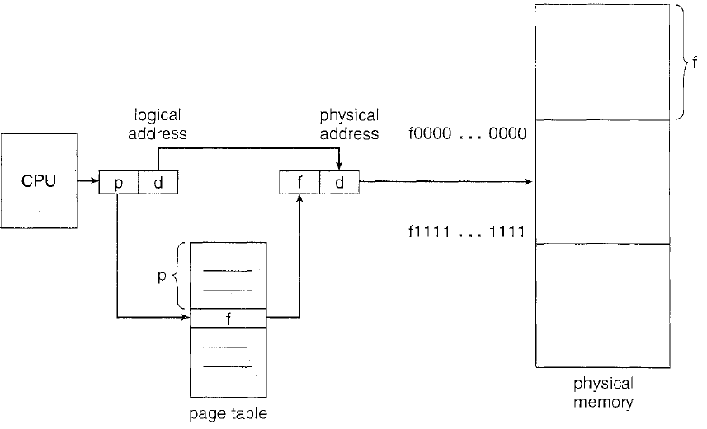
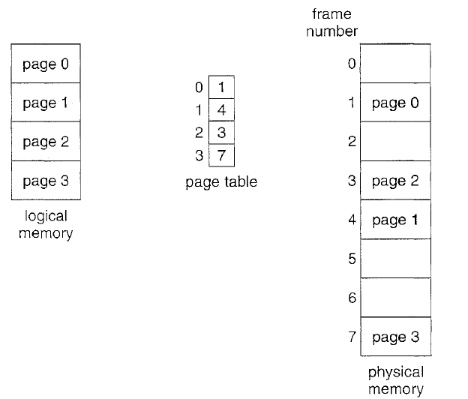
Every address generated by the CPU is divided into two parts
Page number (p)
Page offset (d)
The page number is used as an index into a page table.
The page table contains the base address of each page in physical memory.
This base address is combined with the page offset to define the physical memory address that is sent to the memory unit.

Slide 60
Contd.,
The page size (like the frame size) is defined by the hardware.
The size of a page is typically a power of 2, varying between 512 bytes and 16 MB per page, depending on the computer architecture.
The selection of a power of 2 as a page size makes the translation of a logical address into a page number and page offset particularly easy.
If the size of the logical address space is 2^m, and a page size is 2^n addressing units (bytes or words) then the high-order m- n bits of a logical address designate the page number, and the n low-order bits designate the page offset.

Slide 61
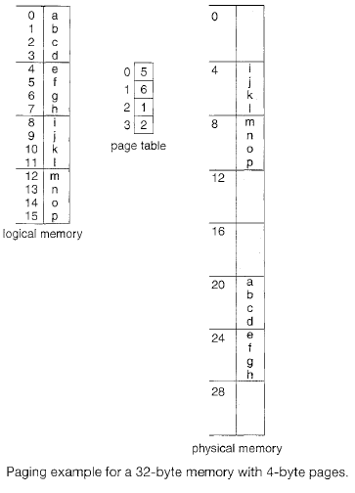
Example
Assume n= 2 and m = 4.
Using a page size of 4 bytes and a physical memory of 32 bytes (8 pages), we show how the user's view of memory can be mapped into physical memory.
Steps:
Logical address 0 is page 0, offset 0
Indexing into the page table, we find that page 0 is in frame
5.
Thus, logical address 0 maps to physical address 20 [= (5 x 4) + 0].
Logical address 3 (page 0, offset 3) maps to physical address 23 [ = (5 x 4) + 3].
Logical address 4 is page 1, offset 0; according to the page table, page 1 is mapped to
frame 6. Thus, logical address 4 maps to physical address 24 [ = ( 6 x 4) + O].
Logical address 13 is page 3, offset 1. according to the page table, page 3 is mapped to
frame 2. Thus, logical address 13 maps to physical address 9 = [=(2*4) + 1)

