Slide 1
Arithmetic Operations.
Lets work on little math… It is fun!
Shriram K Vasudevan

Slide 2
Few Questions.
Computer words are composed of bits; thus words can be represented as binary numbers.
■ How are negative numbers represented?
■ What is the largest number that can be represented in a computer word?
■ What happens if an operation creates a number bigger than can be represented?
■ What about fractions and real numbers?
These are the mystical questions to be answered!

Slide 3
More Questions…
How does hardware really multiply or divide numbers?
The goal of this discussion is to unravel this mystery, including representation of numbers, arithmetic algorithms, hardware that follows these algorithms, and the implications of all this for instruction sets. (I mean, u have to study a lot! ☺)

Slide 4

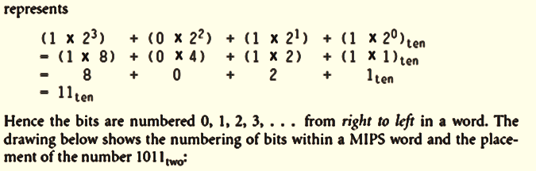
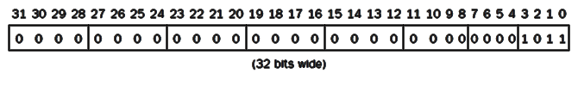
Contd.,

Slide 5
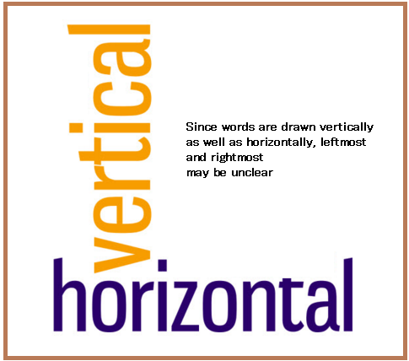
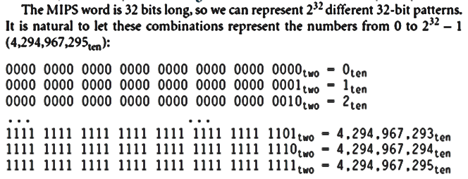
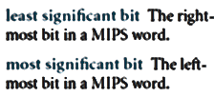
Contd.,
Why the concept of LSB and MSB came? Any idea?

Slide 6
Contd.,
Why Base 2 is not easy for us?
Base 2 is not natural to human beings; we have 10 fingers and so find base 10 natural.
Why didn’t computers use decimal?
In fact, the first commercial computer did offer decimal arithmetic. (Surprising!!)
The problem was that the computer still used on and off signals, so a decimal digit was simply represented by several binary digits.
Decimal proved so inefficient that subsequent computers reverted to all binary, converting to base 10 only for the relatively infrequent input/output events.

Slide 7

Contd.,
Note: Numbers really have an infinite number of digits, with almost all being 0 except for a few of the rightmost digits. We just don’t normally show leading 0s.
Hardware can be designed to add, subtract, multiply, and divide these binary bit patterns.
If the number that is the proper result of such operations cannot be represented by these rightmost hardware bits, overflow is said to have occurred. (An example please, idly helps ☺)
It’s up to the operating system and program to determine what to do if overflow occurs.

Slide 8

Contd.,
Computer programs calculate both positive and negative numbers, so we need a representation that distinguishes the positive from the negative.
The most obvious solution is to add a separate sign, which conveniently can be represented in a single bit; the name for this representation is sign and magnitude.
There are problems here in this approach!! ☹ Let’s get to know them too!

Slide 9
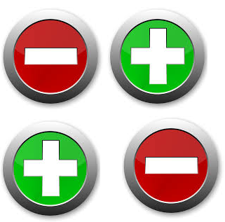
Contd.,
First, it’s not obvious where to put the sign bit. To the right? To the left? Early computers tried both.
Second, adders for sign and magnitude may need an extra step to set the sign because we can’t know in advance what the proper sign will be.
As a result of these shortcomings, sign and magnitude was soon abandoned.

Slide 10
Contd.,
Given that there was no obvious better alternative, the final solution was to pick the representation that made the hardware simple: leading 0s mean positive, and leading 1s mean negative.

Slide 11
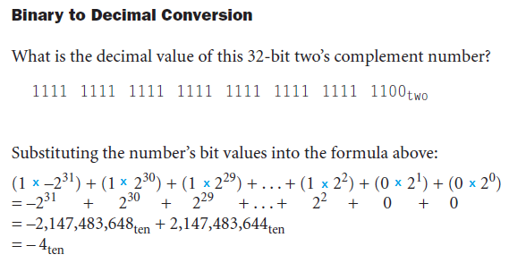
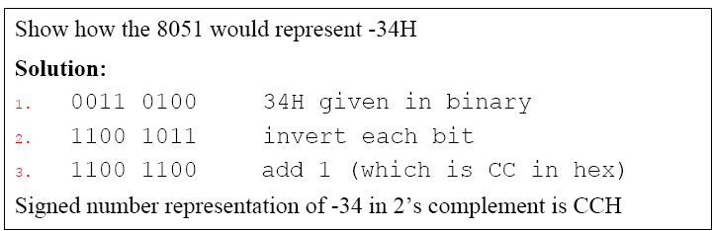
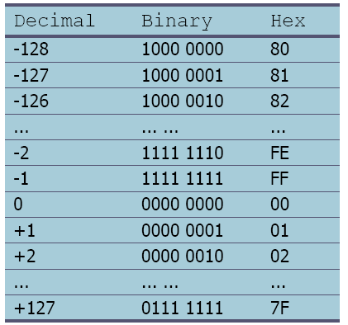
Refer this.. Signed arithmetic ☺ I took 8051 as sample.
D7 (MSB) is the sign and D0 to D6 are the magnitude of the number
If D7=0, the operand is positive, and if D7=1, it is negative
Positive numbers are 0 to +127
Negative number representation(2’s complement)
1. Write the magnitude of the number in 8-bit binary (no sign)
2. Invert each bit
3. Add 1 to it

Slide 12
New introduction.
MIPS offers two versions of the set on less than comparison to handle these alternatives.
Set on less than (slt) and set on less than immediate (slti) work with signed integers.
Unsigned integers are compared using set on less than unsigned (sltu) and set on less than immediate unsigned (sltiu).

Slide 13
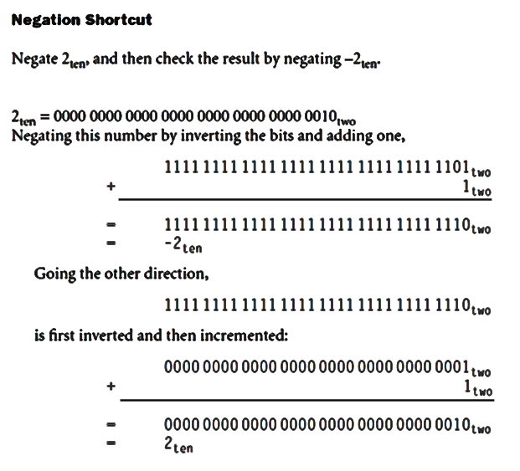
Negation

Slide 14
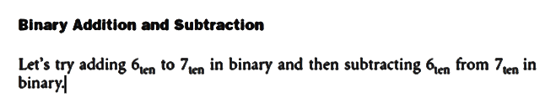
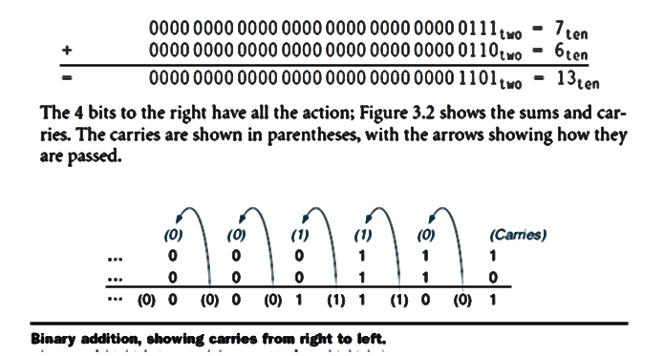
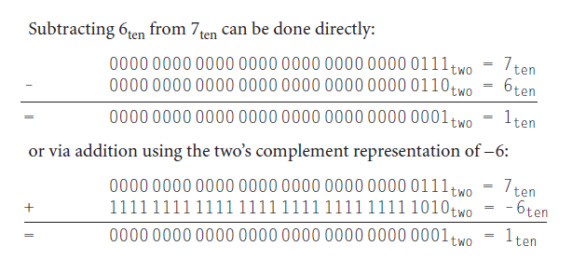
Addition and Subtraction
Addition is just what you would expect in computers.
Digits are added bit by bit from right to left, with carries passed to the next digit to the left, just as you would do by hand.
Subtraction uses addition: The appropriate operand is simply negated before being added. (This is tricky, right) ☺

Slide 15
Overflow..
Overflow occurs when the result from an operation cannot be represented with the available hardware, in this case a 32-bit word. (Example of keeping many laddus in hand)
When can overflow occur in addition?
When adding operands with different signs, overflow cannot occur.
The reason is the sum must be no larger than one of the operands.
For example, –10 + 4 = –6.
Since the operands fit in 32 bits and the sum is no larger than an operand, the sum must fit in 32 bits as well.
So Let’s understand:
Therefore no overflow can occur when adding positive and negative operands.
There are similar restrictions to the occurrence of overflow during subtract, but it’s just the opposite principle:
When the signs of the operands are the same, overflow cannot occur.

Slide 16
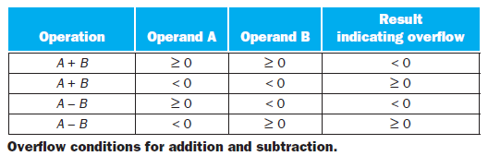
When does overflow occur?
ADDITION:
Overflow occurs when adding two positive numbers and the sum is negative, or vice versa.
Clearly, adding or subtracting two 32-bit numbers can yield a result that needs 33 bits to be fully expressed.
The lack of a 33rd bit means that when overflow occurs the sign bit is being set with the value of the result instead of the proper sign of the result.
Since we need just one extra bit, only the sign bit can be wrong.
This means a carry out occurred into the sign bit.
SUBTRACTION
Overflow occurs in subtraction when we subtract a negative number from a positive number and get a negative result, or when we subtract a positive number from a negative number and get a positive result.
This means a borrow occurred from the sign bit.

Slide 17
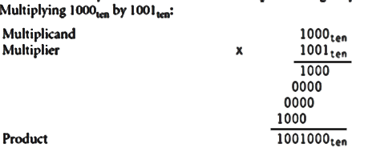
Multiplication
First let’s review the multiplication of decimal numbers in longhand to remind ourselves of the steps and the names of the operands. ( I mean basic multiplication!)
The first operand is called the multiplicand and the second the multiplier.
The final result is called the product.
As you may recall, the algorithm learned in grammar school is to take the digits of the multiplier one at a time from right to left, multiplying the multiplicand by the single digit of the multiplier and shifting the intermediate product one digit to the left of the earlier intermediate products.
God’s sake! I won’t explain this!

Slide 18
Contd.,
The first observation is that the number of digits in the product is considerably larger than the number in either the multiplicand or the multiplier.
Hence, like add, multiply must cope with overflow because we frequently want a 32-bit product as the result of multiplying two 32-bit numbers.
Let’s get better.. Move out of legacy!

Slide 19
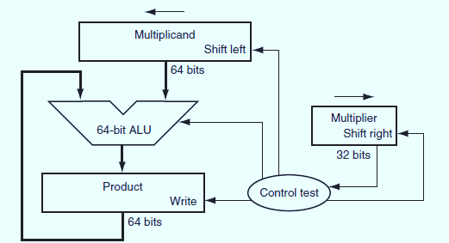
Sequential Version of the Multiplication Algorithm and Hardware
This design mimics the algorithm we learned in grammar school; the hardware is shown in Figure. LHS.
data flows from top to bottom to more closely resemble the paper-and-pencil method.
The Multiplicand register, ALU, and Product register are all 64 bits wide, with only the Multiplier register containing 32 bits.
The 32-bit multiplicand starts in the right half of the Multiplicand register and is shifted left 1 bit on each step. The multiplier is shifted in the opposite direction at each step. The algorithm starts with the product initialized to 0.
Control decides when to shift the Multiplicand and Multiplier registers and when to write new values into the Product register.

Slide 20
Contd.,
Let’s assume that the multiplier is in the 32-bit Multiplier register and that the 64-bit Product register is initialized to 0.
From the paper-and-pencil example below, it’s clear that we will need to move the multiplicand left one digit each step as it may be added to the intermediate products. Over 32 steps a 32-bit multiplicand would move 32 bits to the left.
Hence we need a 64-bit Multiplicand register, initialized with the 32-bit multiplicand in the right half and 0 in the left half. This register is then shifted left 1 bit each step to align the multiplicand with the sum being accumulated in the 64-bit Product register.

Slide 21
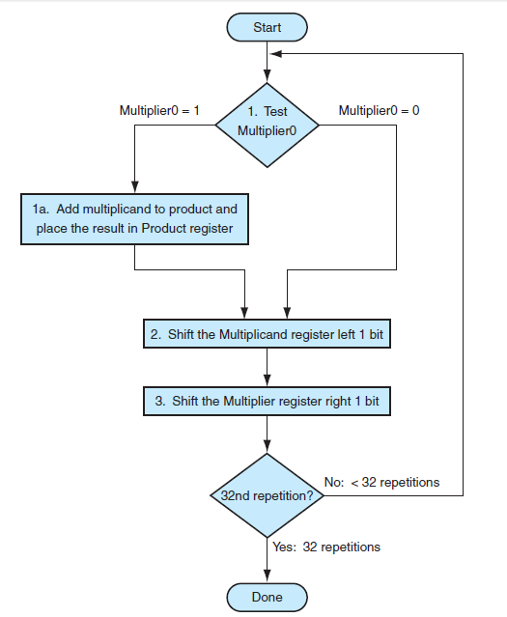
Contd.,
Three basic steps are needed for each bit.
The least significant bit of the multiplier (Multiplier0) determines whether the multiplicand is added to the Product register.
The left shift in step 2 has the effect of moving the intermediate operands to the left, just as when multiplying by hand.
The shift right in step 3 gives us the next bit of the multiplier to examine in the following iteration. These three steps are repeated 32 times to obtain the product.

Slide 22
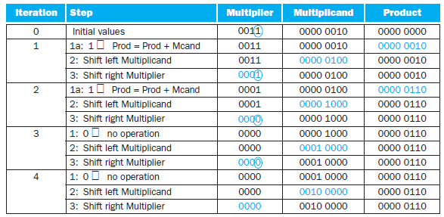
One simple example..
Using 4-bit numbers to save space, multiply 2ten * 3ten, or 0010two * 0011two
Figure RHS shows the value of each register for each of the steps labeled according to Figure RHS_top, with the final value of 0000 0110two or 6ten.
Color is used to indicate the register values that change on that step, and the bit circled is the one examined to determine the operation of the next step

Slide 23
Signed Multiplication
So far we have dealt with positive numbers. The easiest way to understand how to deal with signed numbers is to first convert the multiplier and multiplicand to positive numbers and then remember the original signs.
The algorithms should then be run for 31 iterations, leaving the signs out of the calculation. As we learned in grammar school, we need negate the product only if the original signs disagree.
It turns out that the last algorithm will work for signed numbers provided that we remember that the numbers we are dealing with have infinite digits, and that we are only representing them with 32 bits. Hence, the shifting steps would need to extend the sign of the product for signed numbers.
When the algorithm completes, the lower word would have the 32-bit product

Slide 24
Multiplication in MIPS.
MIPS provides a separate pair of 32-bit registers to contain the 64-bit product, called Hi and Lo.
To produce a properly signed or unsigned product, MIPS has two instructions: multiply (mult) and multiply unsigned (multu).
To fetch the integer 32-bit product, the programmer uses move from lo (mflo).
The MIPS assembler generates a pseudo instruction for multiply that specifies three general purpose registers, generating mflo and mfhi instructions to place the product into registers.

Slide 25
Division
The reciprocal operation of multiply is divide, an operation that is even less frequent and even more peculiar.
It even offers the opportunity to perform a mathematically invalid operation: dividing by 0.
Let’s start with an example of long division using decimal numbers to recall the names of the operands and the grammar school division algorithm.
For reasons similar to those in the previous section, we limit the decimal digits to just 0 or 1.

Slide 26
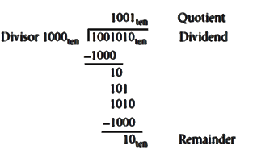
Contd.,
The example is dividing 1,001,010ten by 1000ten:
The two operands (dividend and divisor) and the result (quotient) of divide are accompanied by a second result called the remainder
The basic grammar school division algorithm tries to see how big a number can be subtracted, creating a digit of the quotient on each attempt.
Our carefully selected decimal example uses only the numbers 0 and 1, so it’s easy to figure out how many times the divisor goes into the portion of the dividend: it’s either 0 times or 1 time.
Binary numbers contain only 0 or 1, so binary division is restricted to these two choices, thereby simplifying binary division.

Slide 27
A Division Algorithm and Hardware
Figure below shows hardware to mimic our grammar school algorithm.
We start with the 32-bit Quotient register set to 0.
Each iteration of the algorithm needs to move the divisor to the right one digit, so we start with the divisor placed in the left half of the 64-bit Divisor register and shift it right 1 bit each step to align it with the dividend.
The Remainder register is initialized with the dividend.

Slide 28
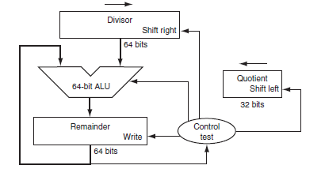
Contd.,
The Divisor register, ALU, and Remainder register are all 64 bits wide, with only the Quotient register being 32 bits.
The 32-bit divisor starts in the left half of the Divisor register and is shifted right 1 bit on each iteration.
The remainder is initialized with the dividend.
Control decides when to shift the Divisor and Quotient registers and when to write the new value into the Remainder register.

Slide 29
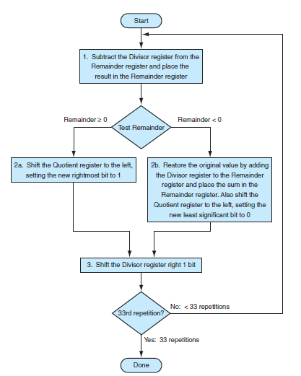
Contd.,
Figure shows three steps of the first division algorithm.
Unlike a human, the computer isn’t smart enough to know in advance whether the divisor is smaller than the dividend.
It must first subtract the divisor in step 1; remember that this is how we performed the comparison in the set on less than instruction.
If the result is positive, the divisor was smaller or equal to the dividend, so we generate a 1 in the quotient (step 2a).
If the result is negative, the next step is to restore the original value by adding the divisor back to the remainder and generate a 0 in the quotient (step 2b).
The divisor is shifted right and then we iterate again. The remainder and quotient will be found in their namesake registers after the iterations are complete.

Slide 30
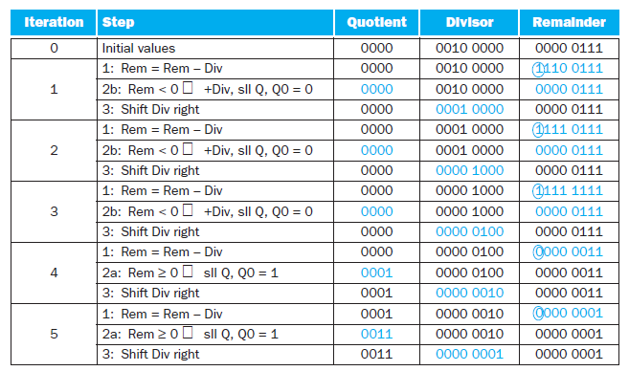
A Divide Algorithm – An Example.
Using a 4-bit version of the algorithm to save pages, let’s try dividing 7ten by 2ten, or 0000 0111two by 0010two.
The surprising requirement of this algorithm is that it takes n + 1 steps to get the proper quotient and
remainder.

Slide 31
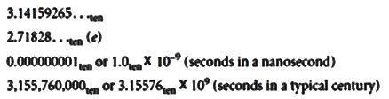
Floating Point.
Going beyond signed and unsigned integers, programming languages support numbers with fractions, which are called reals in mathematics.
Here are some examples of reals:

