Slide 1
FUNCTION DEPENDENCY AND
TYPES & EXAMPLE

Slide 2

Need of Normalization
inst_dept

Slide 3
Functional Dependency
Functional dependency is a relationship that exists when one attribute uniquely determines another attribute.
X->Y
The attributes of a table is said to be dependent on each other when an attribute of a table uniquely identifies another attribute of the same table.

Slide 4
example:
Suppose we have a student table with attributes:
Stu_Id, Stu_Name, Stu_Age.
Stu_Id→Stu_Name

Slide 5
Formally:
If column A of a table uniquely identifies the column B of same table
then it can represented as A->B (Attribute B is functionally dependent on attribute A)

Slide 6
Types of Functional Dependencies
Trivial functional dependency
Non-trivial functional dependency
Multivalued dependency
Transitive dependency

Slide 7
Trivial functional dependency
The dependency of an attribute on a set of attributes is known as trivial functional dependency if the set of attributes includes that attribute.
Symbolically:
A →B is trivial functional dependency if B is a subset of A.
A→A & B →B

Slide 8
For example:
Consider a table with two columns Student_id and Student_Name.
{Student_Id, Student_Name} → Student_Id
Student_Id -> Student_Id
Student_Name → Student_Name.

Slide 9
Non-trivial functional dependency
If a functional dependency X->Y holds true where Y is not a subset of X then this dependency is called non trivial Functional dependency.

Slide 10
Example :
An employee table with three attributes: emp_id, emp_name, emp_address.
The following functional dependencies are non-trivial: emp_id -> emp_name (emp_name is not a subset of emp_id)
emp_id -> emp_address (emp_address is not a subset of emp_id)
On the other hand, the following dependencies are trivial:
{emp_id, emp_name} -> emp_name [emp_name is a subset of {emp_id, emp_name}]

Slide 11
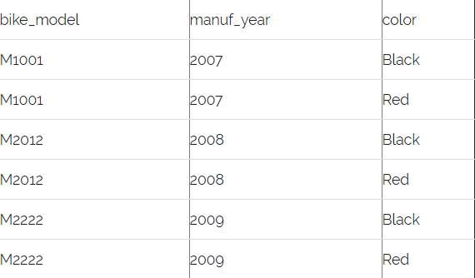
Multivalued dependency
Multivalued dependency occurs when there are more than one independent multivalued attributes in a table.
Consider a bike manufacture company, which produces two colors (Black and white) in each
model every year.

Slide 12
Here columns manuf_year and color are independent of each other and dependent on bike_model. In this case these two columns are said to be multivalued dependent on bike_model.
These dependencies can be represented like this:
bike_model ->> manuf_year
bike_model ->> color

Slide 13
Transitive dependency
A functional dependency is said to be transitive if it is indirectly formed by two functional dependencies.
X -> Z is a transitive dependency if the following three functional dependencies hold true:
X->Y
Y does not ->X Y->Z

Slide 14

Example :-

Slide 15
{Book} ->{Author} (if we know the book, we knows the author name)
{Author} does not ->{Book}
{Author} -> {Author_age}
Therefore as per the rule of transitive dependency:
{Book} -> {Author_age} should hold, that makes sense because if we know the book name we can know the author’s age.

