Slide 1
4 NF , 5 NF

Slide 2
Multivalued Dependency
StudentName | CourseDiscipline | Activities
Amit | Mathematics | Singing
Amit | Mathematics | Dancing
Yuvraj | Computers | Cricket
Akash | Literature | Dancing
Akash | Literature | Cricket
Akash | Literature | Singing

Slide 3
StudentName | CourseDiscipline
Amit | Mathematics
Amit | Mathematics
Yuvraj | Computers
Akash | Literature
Akash | Literature
Akash | Literature
StudentName | Activities
Amit | Singing
Amit | Dancing
Yuvraj | Cricket
Akash | Dancing
Akash | Cricket
Akash | Singing

Slide 4
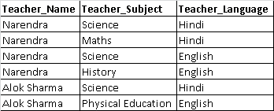
Table: Teacher
Teacher

Slide 5
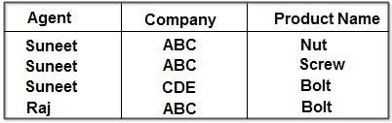
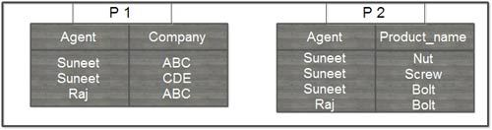
Join Dependency

Slide 6
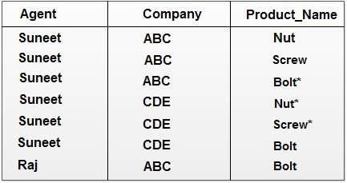

Slide 7
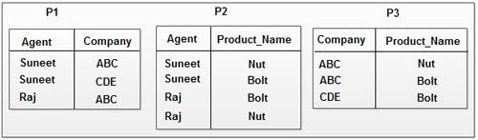

Slide 8
EmpName | EmpSkills | EmpJob (Assigned Work)
Tom | Networking | EJ001
Harry | Web Development | EJ002
Katie | Programming | EJ002

Slide 9
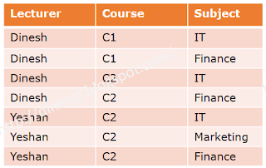
What is the highest possible normal form of the following table. Normalize to 5NF
Course, Subject -> Lecturer
Course, Lecturer -> Subject
Lecturer -> Subject

Slide 10
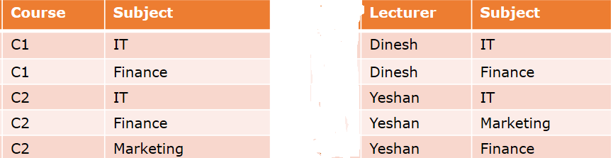
BCNF

Slide 11
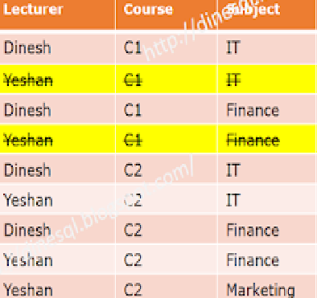
Not in 5NF

Slide 12
