Slide 1
PLSQL

Slide 2
Declarations
This section starts with the keyword DECLARE. It is an optional section and defines all variables, cursors, subprograms, and other elements to be used in the program.
Executable Commands
This section is enclosed between the keywords BEGIN and END and it is a mandatory section. It should have at least one executable line of code, which may be just a NULL command to indicate that nothing should be executed.
Exception Handling
This section starts with the keyword EXCEPTION. This optional section contains exception(s) that handle errors in the program.

Slide 3
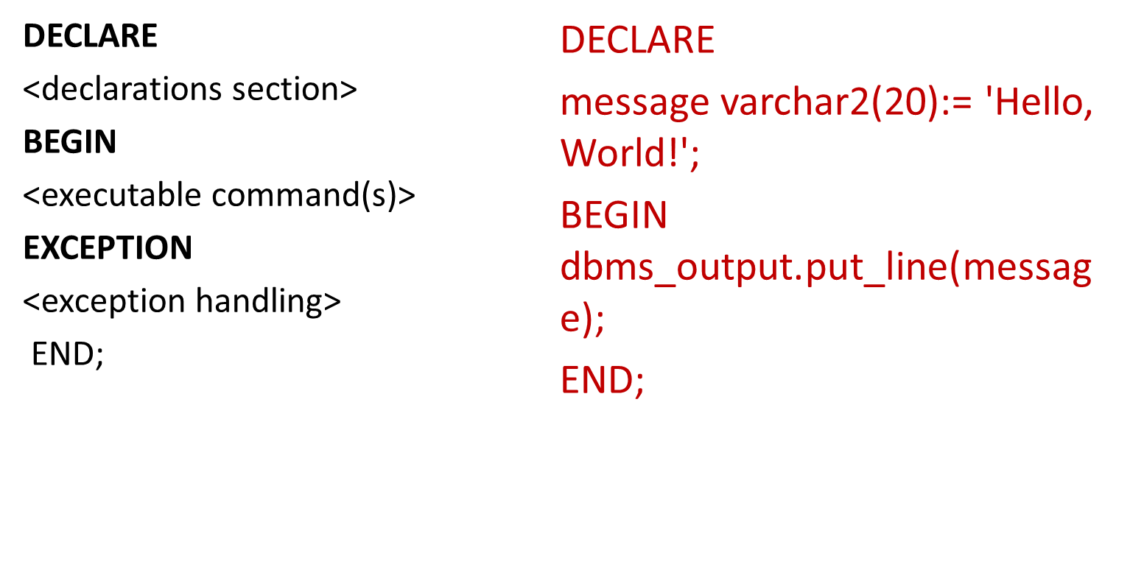

Slide 4
Data Type & Description
PLS_INTEGER Signed integer in range -2,147,483,648 through 2,147,483,647, represented in 32 bits
BINARY_INTEGER Signed integer in range -2,147,483,648 through 2,147,483,647, represented in 32 bits
BINARY_FLOAT Single-precision IEEE 754-format floating-point number
BINARY_DOUBLE Double-precision IEEE 754-format floating-point number
NUMBER(prec, scale) Fixed-point or floating-point number with absolute value in range 1E-130 to (but not including) 1.0E126. A NUMBER variable can also represent 0
DEC(prec, scale) ANSI specific fixed-point type with maximum precision of 38 decimal digits
DECIMAL(prec, scale) IBM specific fixed-point type with maximum precision of 38 decimal digits
NUMERIC(pre, secale) Floating type with maximum precision of 38 decimal digits
DOUBLE PRECISION ANSI specific floating-point type with maximum precision of 126 binary digits (approximately 38 decimal digits)
FLOAT ANSI and IBM specific floating-point type with maximum precision of 126 binary digits (approximately 38 decimal digits)
INT ANSI specific integer type with maximum precision of 38 decimal digits
INTEGER ANSI and IBM specific integer type with maximum precision of 38 decimal digits
SMALLINT ANSI and IBM specific integer type with maximum precision of 38 decimal digits
REAL Floating-point type with maximum precision of 63 binary digits (approximately 18 decimal digits)

Slide 5
Example:
DECLARE
num1 INTEGER;
num2 REAL;
num3 DOUBLE PRECISION;
BEGIN
null;
END;

Slide 6
Sample Program:
DECLARE
a integer := 10;
b integer := 20;
c integer;
f real;
BEGIN
c:= a + b;
dbms_output.put_line('Value of c: ' || c);
f:= 70.0/3.0;
dbms_output.put_line('Value of f: ' || f);
END;

Slide 7
Local and Global Variables
Local variables − Variables declared in an inner block and not accessible to outer blocks.
Global variables − Variables declared in the outermost block or a package.
DECLARE
-- Global variables
num1 number := 95;
num2 number := 85;
BEGIN
dbms_output.put_line('Outer Variable num1: ' || num1);
dbms_output.put_line('Outer Variable num2: ' || num2);
DECLARE
-- Local variables
num1 number := 195;
num2 number := 185;
BEGIN
dbms_output.put_line('Inner Variable num1: ' || num1);
dbms_output.put_line('Inner Variable num2: ' || num2);
END;
END;

Slide 8
Loops
DECLARE
i number(1);
j number(1);
BEGIN
<< outer_loop >>
FOR i IN 1..3 LOOP
<< inner_loop >>
FOR j IN 1..3 LOOP
dbms_output.put_line('i is: '|| i || ' and j is: ' || j);
END loop inner_loop;
END loop outer_loop;
END;

Slide 9
Creating a procedure
CREATE [OR REPLACE] PROCEDURE procedure_name [(parameter_name [IN | OUT | IN OUT] type [, ...])]
{IS | AS}
BEGIN < procedure_body >
END procedure_name;
/

Slide 10
Example
CREATE OR REPLACE PROCEDURE greetings
AS
BEGIN dbms_output.put_line('Hello World!');
END;
/

Slide 11
Executing a Procedure
EXECUTE greetings;
(OR)
BEGIN
  greetings;
END;
/

Slide 12
Dropping a Procedure
DROP PROCEDURE procedure-name;
(OR)
BEGIN
  DROP PROCEDURE greetings;
  END;
  /

Slide 13
Example
DECLARE
a number;
b number;
c number;
PROCEDURE findMin(x IN number, y IN number, z OUT number)
IS
BEGIN
IF x < y
  THEN z:= x;
ELSE z:= y;
END IF;
END;

Slide 14
BEGIN
a:= 23;
b:= 45;
findMin(a, b, c);
dbms_output.put_line(' Minimum of (23, 45) : ' || c);
END;
/

Slide 15
Example
DECLARE
a number;
PROCEDURE squareNum(x IN OUT number)
IS
BEGIN
x := x * x;
END;
BEGIN
a:= 23;
squareNum(a);
dbms_output.put_line(' Square of (23): ' || a);
END;
/

Slide 16
Creating a Function
CREATE [OR REPLACE] FUNCTION function_name
[(parameter_name [IN | OUT | IN OUT] type [, ...])]
RETURN return_datatype
{IS | AS}
BEGIN
< function_body >
END [function_name];
/

Slide 17
Example
create or replace function sum1(n1 in number, n2 in number)
return number
is
n3 number(8);
begin
n3 :=n1+n2;
return n3;
end;
--Function call
DECLARE
n3 number(2);
BEGIN
n3 := sum1(11,22);
dbms_output.put_line('Sum is: ' || n3);
END;
/

Slide 18
BEGIN
a:= 23;
b:= 45;
c := findMax(a, b);
dbms_output.put_line(' Maximum of (23,45): ' || c);
END;
/

Slide 19
Example 2
CREATE OR REPLACE FUNCTION totalCustomers
RETURN number IS
total number(2) := 0;
BEGIN
SELECT count(*) into total
FROM customers;
RETURN total;
END;

Slide 20
Calling a function
DECLARE
c number(2);
BEGIN
c := totalCustomers();
dbms_output.put_line('Total no. of Customers: ' || c);
END;
/

Slide 21
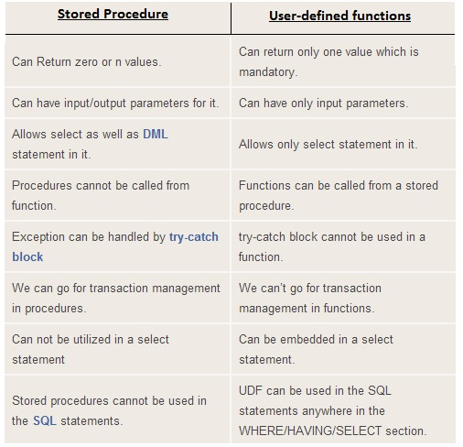
Procedure Vs Functions

Slide 22
Assigning SQL Query Results to PL/SQL Variables
DECLARE c_id customers.id%type := 1;
c_name customers.name%type;
c_addr customers.address%type;
c_sal customers.salary%type;
BEGIN
SELECT name, address, salary INTO c_name, c_addr, c_sal FROM customers
WHERE id = c_id;
dbms_output.put_line ('Customer ' ||c_name || ' from ' || c_addr || ' earns ' || c_sal);
END;

Slide 23
CURSOR
context area : contains all information needed for processing the statement[ eg: Number of rows processed, etc. ]
A cursor is a pointer to this context area .
The set of rows the cursor holds is referred to as the active set
Implicit cursors
Explicit cursors

Slide 24
Implicit Cursors
Implicit cursors are automatically created by Oracle whenever an SQL statement is executed.
INSERT : Holds the data that needs to be inserted
UPDATE and DELETE operations: the cursor identifies the rows that would be affected.
ATTRIBUTES:

Slide 25
ATTRIBUTE | DESCRIPTION
%FOUND | Returns TRUE if an INSERT, UPDATE, or DELETE statement affected one or more rows or a SELECT INTO statement returned one or more rows. Otherwise, it returns FALSE
%NOTFOUND | The logical opposite of %FOUND. It returns TRUE if an INSERT, UPDATE, or DELETE statement affected no rows, or a SELECT INTO statement returned no rows. Otherwise, it returns FALSE.
%ISOPEN | Always returns FALSE for implicit cursors, because Oracle closes the SQL cursor automatically after executing its associated SQL statement.
%ROWCOUNT | Returns the number of rows affected by an INSERT, UPDATE, or DELETE statement, or returned by a SELECT INTO statement

Slide 26
Example:
Select * from customers;
+----+----------+-----+-----------+----------+
| ID | NAME | AGE | ADDRESS | SALARY |
+----+----------+-----+-----------+----------+
| 1 | Ramesh | 32 | Ahmedabad | 2000.00 |
| 2 | Khilan | 25 | Delhi | 1500.00 |
| 3 | kaushik | 23 | Kota | 2000.00 |
| 4 | Chaitali | 25 | Mumbai | 6500.00 |
| 5 | Hardik | 27 | Bhopal | 8500.00 |
| 6 | Komal | 22 | MP | 4500.00 |
+----+----------+-----+-----------+----------+

Slide 27
DECLARE
total_rows number(2);
BEGIN
UPDATE customers
SET salary = salary + 500;
IF sql%notfound THEN
dbms_output.put_line('no customers selected');
ELSIF sql%found THEN
total_rows := sql%rowcount;
dbms_output.put_line( total_rows || ' customers selected ');
END IF;
END;

Slide 28
Explicit Cursors
Explicit cursors are programmer defined cursors for gaining more control over the context area.
An explicit cursor should be defined in the declaration section of the PL/SQL Block
CURSOR cursor_name IS select_statement;

Slide 29
4 steps
Declaring the cursor for initializing in the memory
Opening the cursor for allocating memory
Fetching the cursor for retrieving data
Closing the cursor to release allocated memory

Slide 30
Declaring the Cursor
CURSOR c_customers IS
SELECT id, name, address FROM customers;
Opening the Cursor
OPEN c_customers;
Fetching the Cursor
FETCH c_customers INTO c_id, c_name, c_addr;
Closing the Cursor
CLOSE c_customers;

Slide 31
DECLARE
c_id customers.id%type;
c_name customers.name%type;
c_addr customers.address%type;
CURSOR c_customers is
SELECT id, name, address FROM customers;
BEGIN
OPEN c_customers;
LOOP
FETCH c_customers into c_id, c_name, c_addr;
dbms_output.put_line(c_id || ' ' || c_name || ' ' || c_addr);
EXIT WHEN c_customers%notfound;
END LOOP;
CLOSE c_customers;
END;

