Slide 2
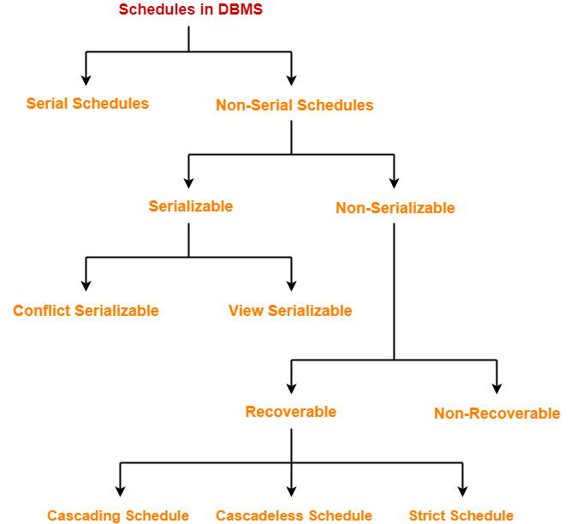

Slide 3
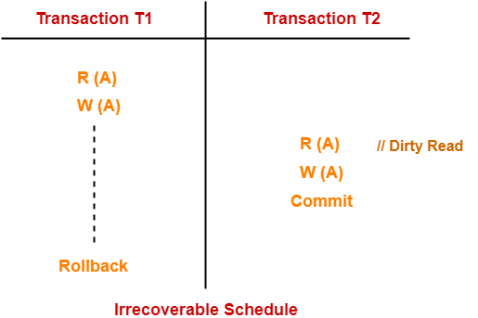
Irrecoverable Schedules
If in a schedule,
A transaction performs a dirty read operation from an uncommitted transaction
And commits before the transaction from which it has read the value
then such a schedule is known as an Irrecoverable Schedule.

Slide 4
Irrecoverable Schedules
T2 performs a dirty read operation.
T2 commits before T1.
T1 fails later and roll backs.
The value that T2 read now stands to be incorrect.
T2 can not recover since it has already committed.

Slide 5
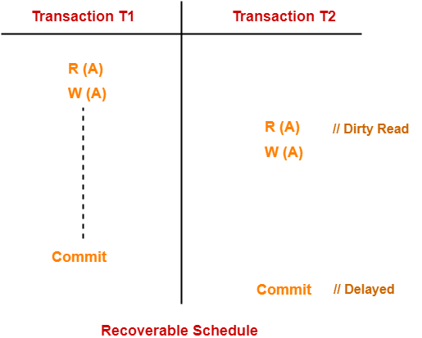
Recoverable Schedules
If in a schedule,
A transaction performs a dirty read operation from an uncommitted transaction
And its commit operation is delayed till the uncommitted transaction either commits or roll backs
then such a schedule is known as a Recoverable Schedule.

Slide 6
Recoverable Schedules
T2 performs a dirty read operation.
The commit operation of T2 is delayed till T1 commits or roll backs.
T1 commits later.
T2 is now allowed to commit.
In case, T1 would have failed, T2 has a chance to recover by rolling back.

Slide 7
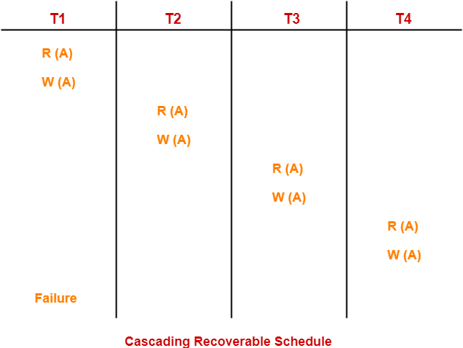
Cascading Schedule
If in a schedule, failure of one transaction causes several other dependent transactions to rollback or abort, then such a schedule is called as a Cascading Schedule or Cascading rollback or Cascading Abort.

Slide 8
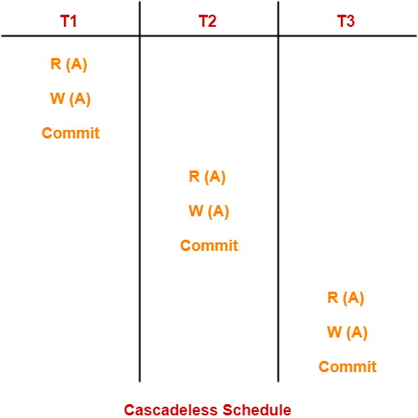
Cascadeless Schedule
If in a schedule, a transaction is not allowed to read a data item until the last transaction that has written it is committed or aborted: Cascadeless Schedule.
Cascadeless schedule allows only committed read operations.
Therefore, it avoids cascading roll back

Slide 9
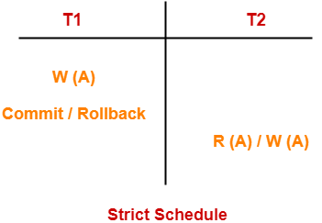
Strict Schedule
If in a schedule, a transaction is neither allowed to read nor write a data item until the last transaction that has written it is committed or aborted
Strict schedule allows only committed read and write operations.

Slide 10
Concurrency Control

Slide 11
Lock-Based Protocols
A lock is a mechanism to control concurrent access to a data item
Data items can be locked in two modes :
1. exclusive (X) mode. Data item can be both read as well as
written. X-lock is requested using lock-X(A) instruction.
2. shared (S) mode. Data item can only be read. S-lock is
requested using lock-S(A) instruction.
Lock requests are made to concurrency-control manager. Transaction can proceed only after request is granted.

Slide 12
Lock-compatibility matrix
A transaction may be granted a lock on an item if the requested lock is compatible with locks already held on the item by other transactions
Any number of transactions can hold shared locks on an item,
but if any transaction holds an exclusive on the item no other transaction may hold any lock on the item.
If a lock cannot be granted, the requesting transaction is made to wait till all incompatible locks held by other transactions have been released. The lock is then granted.

Slide 13
The Two-Phase Locking Protocol
This is a protocol which ensures conflict-serializable schedules.
Phase 1: Growing Phase
transaction may obtain locks
transaction may not release locks
Phase 2: Shrinking Phase
transaction may release locks
transaction may not obtain locks

Slide 14
Example
T1 follows 2PL protocol
All of its locks are acquired before it releases any of them
T2 does not
It releases its lock on X and then goes on to later acquire a lock on Y
T1 T2
Lock-s(X) lock-s(X)
Read(X) Read(X)
Lock-x(Y) unlock-s(X)
Unlock-s(X) lock-x(Y)
Read(Y) Read(Y)
Y = Y + X Y = Y + X
Write(Y) Write(Y)
Unlock-x(Y) unlock-x(Y)

Slide 15
Lost Update can’t happen with 2PL
T1 T2
Read(X)
X = X - 5
Read(X)
X = X + 5
Write(X)
Write(X)
COMMIT
COMMIT
read-lock(X)
read-lock(X)
cannot acquire
write-lock(X):
T2 has read-lock(X)
cannot acquire
write-lock(X):
T1 has
read-lock(X)

Slide 16
Uncommitted Update cannot happen with 2PL
T1 T2
Read(X)
X = X - 5
Write(X)
Read(X)
X = X + 5
Write(X)
ROLLBACK
COMMIT
read-lock(X)
write-lock(X)
Waits till T1
releases
write-lock(X)
Locks released

Slide 17
Inconsistent analysis cannot happen with 2PL
T1 T2
Read(X)
X = X - 5
Write(X)
Read(X)
Read(Y)
Sum = X+Y
Read(Y)
Y = Y + 5
Write(Y)
read-lock(X)
write-lock(X)
Waits till T1
releases
write-locks on
X and Y
read-lock(Y)
write-lock(Y)

Slide 18
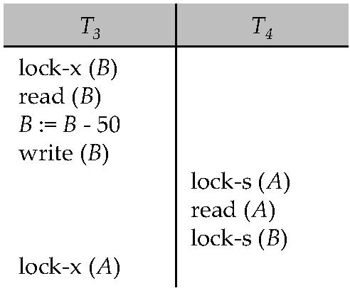
Pitfalls of Lock-Based Protocols
Consider the partial schedule
Neither T₃ nor T₄ can make progress — executing lock-S(B) causes T₄ to wait for T₃ to release its lock on B, while executing lock-X(A) causes T₃ to wait for T₄ to release its lock on A.
Such a situation is called a deadlock.
To handle a deadlock one of T₃ or T₄ must be rolled back and its locks released.

Slide 19
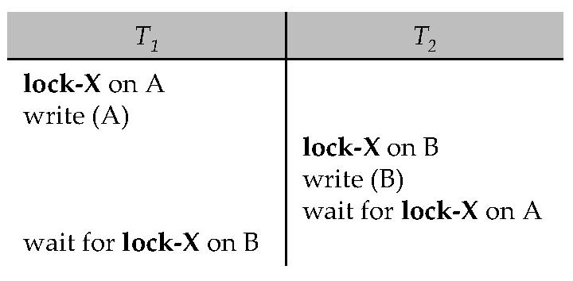
Deadlock Handling
Consider the following two transactions:
T₁: write (A) T₂: write(B)
write(B) write(A)
Schedule with deadlock

Slide 20
Deadlock Detection
Wait for Graph
V is a set of vertices (all the transactions in the system)
E is a set of edges; each element is an ordered pair T_{i} →T_{j}.
If T_{i} → T_{j} is in E, then there is a directed edge from T_{i} to T_{j}, implying that T_{i} is waiting for T_{j} to release a data item.
The system is in a deadlock state if and only if the wait-for graph has a cycle

Slide 21
Deadlock Detection (Cont.)
Wait-for graph without a cycle
Wait-for graph with a cycle

Slide 22
Deadlock Prevention
wait-die scheme — non-preemptive
older transaction may wait for younger one to release data item. Younger transactions never wait for older ones; they are rolled back instead.
a transaction may die several times before acquiring needed data item
wound-wait scheme — preemptive
older transaction wounds (forces rollback) of younger transaction instead of waiting for it. Younger transactions may wait for older ones.
may be fewer rollbacks than wait-die scheme.

