Slide 1
EXCEPTION,INDEXING,SEQUENCE

Slide 2
An exception is an error condition during a program execution. PL/SQL supports programmers to catch such conditions using EXCEPTION block in the program and an appropriate action is taken against the error condition. There are two types of exceptions
System-defined exceptions
User-defined exceptions

Slide 3
DECLARE
<declarations section>
BEGIN
<executable command(s)>
EXCEPTION
<exception handling goes here >
WHEN exception1 THEN exception1-handling-statements
WHEN exception2 THEN exception2-handling-statements
WHEN exception3 THEN exception3-handling-statements ........ WHEN others THEN exception3-handling-statements
END;

Slide 4
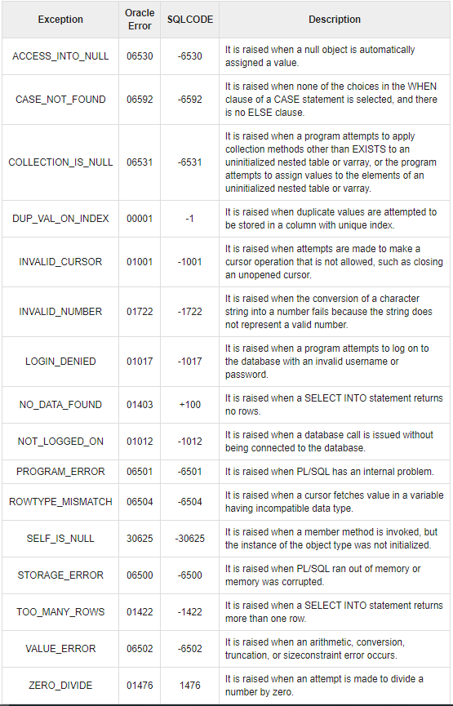

Slide 5
System Defined Exceptions
DECLARE
c_id customers.id%type := 8;
c_name customerS.Name%type;
c_addr customers.address%type;
BEGIN
SELECT name, address INTO c_name, c_addr
FROM customers
WHERE id = c_id;
DBMS_OUTPUT.PUT_LINE ('Name: '|| c_name);
DBMS_OUTPUT.PUT_LINE ('Address: ' || c_addr);
EXCEPTION
WHEN no_data_found THEN
dbms_output.put_line('No such customer!');
WHEN others THEN
dbms_output.put_line('Error!');
END;
/

Slide 6
User-defined Exceptions
A user-defined exception must be declared and then raised explicitly.
The syntax for declaring an exception is −
DECLARE
my-exception EXCEPTION;

Slide 7
Get a customer id from the user. When ever the user enters an invalid customer id raise an invalid_id exception
DECLARE
c_id customers.id%type := &cc_id;
c_name customerS.Name%type;
c_addr customers.address%type;
-- user defined exception
ex_invalid_id EXCEPTION;
BEGIN
IF c_id <= 0 THEN
RAISE ex_invalid_id;
ELSE
SELECT name, address INTO c_name, c_addr
FROM customers
WHERE id = c_id;
DBMS_OUTPUT.PUT_LINE ('Name: '|| c_name);
DBMS_OUTPUT.PUT_LINE ('Address: ' || c_addr);
END IF;
EXCEPTION
WHEN ex_invalid_id THEN
dbms_output.put_line('ID must be greater than zero!');
WHEN no_data_found THEN
dbms_output.put_line('No such customer!');
WHEN others THEN
dbms_output.put_line('Error!');
END;

Slide 8
EXERCISE 1
Create the following tables
student_info(rollno varchar(10),name varchar(10),no_of_arrears numeric(2,0));
Scholarshp(rollno.name.no_of_arrears)
Create an exception when a student has more than ten arrears, else add his name for scholarship

Slide 9
EXERCISE 2
Create the following tables
inst_commission(id varchar(10), commission numeric(12,2));
To add commission to the instructors based on the number of subjects they have offered till now. If the number of courses offered by the instructor is zero raise an exception, else insert the data into inst_commision table

Slide 10
INDEXING
Indexing An indexing is an ordered list of contents of a column or group of columns in a table.
Creating
Simple Index
SQL>create index indexfile_name on table_name(column_name)
Composite index
SQL>create index indexfile_name on table_name(column_name1, column_name2)

Slide 11
Unique index
SQL> create unique index indexfile_name on table_name(column_name)
SQL>create unique index indexfile_name on table_name(column_name1, column_name
Dropping
SQL>drop index indexfile_name

Slide 12
Sequence
Most applications require the automatic generation of a numeric value. Oracle provides an automatic sequence generator of numeric values.
Creating
To create a sequence order_seq which will start generating numbers from 1 to 9999 in ascending order with an interval of 1.
SQL>create sequence order_seq
increment by 1
start with 1
maxvalue 9999
cycle;

Slide 13
Referencing a sequence
This can be done by using select statement.
To refer to the next value
SQL>select order_seq.nextval from dual
To refer to the current value
SQL>select order_seq.currval from dual
Using a sequence
Insert values in the sales_order table, the s_order_no must be generated by using the order_seq sequence
SQL>insert into sales_order(s_order_no,s_order_date,client_no)
values(order_seq.nextval,sysdate,’c0001’);

Slide 14
Altering a sequence
SQL>alter sequence order_seq increment by 2
Dropping
SQL>drop sequence order_seq

