Slide 1
LECTURE-1
INTRODUCTION
Sikha O K
Assistant Professor
Computer Science and Engineering
ASE-Coimbatore

Slide 2

What is a database?
Database: a very large, integrated collection of data managed by a DBMS.
  Some examples:
  University database
  Airline database
  Banking database

Slide 3
What is a DBMS?
A Database Management System (DBMS) is a software system designed to store, manage, and facilitate access to databases.
DBMS contains information about a particular enterprise
Defn: DBMS is a collection of interrelated data and a set of programs to access those data.
Well-known DBMSs:
  MySQL
  PostgreSQL
  Microsoft SQL Server
  Oracle
  Sybase and
  IBM DB2.

Slide 4



Slide 5

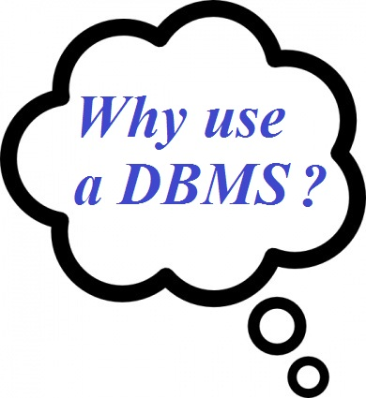

What’s wrong with file system?

Slide 6
Drawbacks of File system
Drawbacks of using file systems to store data:
  Data redundancy and inconsistency
    Multiple file formats, duplication of information in different files
  Difficulty in accessing data
    Need to write a new program to carry out each new task
  Data isolation — multiple files and formats
  Integrity problems
    Integrity constraints (e.g. “dept_name of student must be a valid department name”) become “buried” in program code rather than being stated explicitly
    Hard to add new constraints or change existing ones

Slide 7
Drawbacks of file system(Cont.)
  Atomicity of updates
    Failures may leave database in an inconsistent state with partial updates carried out
    Example: Transfer of funds from one account to another should either complete or not happen at all
  Concurrent access by multiple users
    Concurrent accessed needed for performance
    Uncontrolled concurrent accesses can lead to inconsistencies
      Example: Two people reading a balance (say 100) and updating it by withdrawing money (say 50 each) at the same time
  Security problems
    Hard to provide user access to some, but not all, data
Database systems offer solutions to all the above problems

Slide 8
Application areas of DBMS
Banking: For customer information, accounts, and loans, and banking transactions.
Airlines: Reservations and schedule information.
Universities: For student information, course registrations, and grades.
Credit card transactions: For purchases on credit cards and generation of monthly statements.
Note:
Airlines were among the first to use databases in a geographically distributed manner - terminals situated around the world accessed the central database system through phone lines and other data networks.

Slide 9
Cont ..
Finance: For storing information about holdings, sales, and purchases of financial instruments such as stocks and bonds.
Sales: For customer, product, and purchase information.
Manufacturing: Management of supply chain, tracking production of items in factories, inventories of items in warehouses / stores, and orders for items.
Human resources: Information about employees, salaries, payroll taxes and benefits, generation of paychecks
Telecommunication: For keeping records of calls made, generating monthly bills, maintaining balances on prepaid calling cards, and storing information about the communication networks.

Slide 10


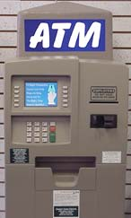
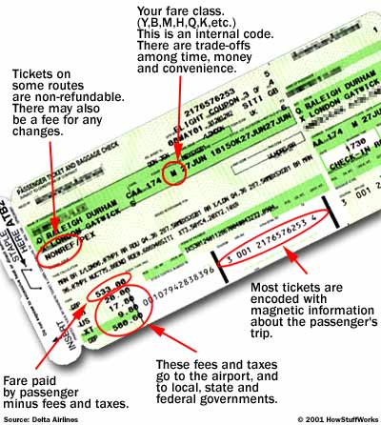


Some Popular databases

Slide 11

View of Data
An architecture for a database system

Slide 12
Levels of Abstraction
Physical level: describes how a record (e.g., customer) is stored.
Logical level: describes data stored in database, and the relationships among the data.
  type instructor = record
  ID : string;
  name : string;
  dept_name : string;
  salary : integer;
        end;
View level: application programs hide details of data types. Views can also hide information (such as an employee’s salary) for security purposes.

Slide 13
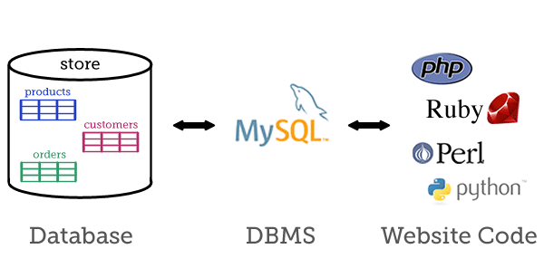
How a DBMS looks like?
The diagram shows how a database, the DBMS, and your website's code interact with each other
A database (left) is a collection of related data, managed by a DBMS such as MySQL (centre). Web scripts (right) communicate with the DBMS in order to insert, update, delete and retrieve data in the database.

Slide 14
Instances and Schemas
Similar to types and variables in programming languages
Schema – the logical structure of the database
  Example: The database consists of information about a set of customers and accounts and the relationship between them
  Analogous to type information of a variable in a program
  Physical schema: database design at the physical level
  Logical schema: database design at the logical level
Instance – the actual content of the database at a particular point in time
  Analogous to the value of a variable
Physical Data Independence – the ability to modify the physical schema without changing the logical schema
  Applications depend on the logical schema
  In general, the interfaces between the various levels and components should be well defined so that changes in some parts do not seriously influence others.

Slide 15
Database Design
The process of designing the general structure of the database:
Conceptual Design
Logical Design
Deciding on the database schema. Database design requires that we find a “good” collection of relation schemas.
Physical Design – Deciding on the physical layout of the database

Slide 16
Data Models
A set of concepts to describe the structure of a database, and certain constraints that the database should obey.
A collection of tools for describing
  Data
  Data relationships
  Data semantics
  Data constraints
Relational model
Entity-Relationship data model (mainly for database design)
Object-based data models (Object-oriented and Object-relational)
Semistructured data model (XML)
Other older models:
  Network model
  Hierarchical model

Slide 17

Relational Model
Relational model (Chapter 2)
Example of tabular data in the relational model
Columns
Rows

Slide 18
A Sample Relational Database

Slide 19

Database Design?
Is there any problem with this design?

Slide 20

The Entity-Relationship Model
Models an enterprise as a collection of entities and relationships
  Entity: a “thing” or “object” in the enterprise that is distinguishable from other objects
    Described by a set of attributes
  Relationship: an association among several entities
Represented diagrammatically by an entity-relationship diagram:
What happened to dept_name of instructor and student?

Slide 21
Database Languages
DDL-Data Definition Language
DML-Data Manipulation Language
DCL-Data Control Language
TCL-Transaction Control Language

Slide 22
Data Definition Language (DDL)
Specification notation for defining the database schema
  Example: create table instructor (
  ID char(5),
  name varchar(20),
  dept_name varchar(20),
  salary numeric(8,2))
To add integrity Constraints
  Domain Constraint
  Primary key (ID uniquely identifies instructors)
  Referential Integrity
    Referential integrity (references constraint in SQL)
      e.g. dept_name value in any instructor tuple must appear in department relation
  Authorization

Slide 23
Data Manipulation Language (DML)
Language for accessing and manipulating the data organized by the appropriate data model
  DML also known as query language
Two classes of languages
  Procedural – user specifies what data is required and how to get those data
  Declarative (nonprocedural) – user specifies what data is required without specifying how to get those data
SQL is the most widely used query language

Slide 24
Data Control Language (DCL)
Deals with permission and other control of the database
Examples: GRANT,REVOK
Deals with transaction and synchronization
Examples: COMMIT,ROLLBACK
Transaction Control Language(TCL)

Slide 25

Database System Internals

Slide 26
Storage Management
Storage manager is a program module that provides the interface between the low-level data stored in the database and the application programs and queries submitted to the system.
The storage manager is responsible to the following tasks:
  Interaction with the file manager
  Efficient storing, retrieving and updating of data
Issues:
  Storage access
  File organization
  Indexing and hashing

Slide 27

Query Processing
1. Parsing and translation
2. Optimization
3. Evaluation

Slide 28
Query Processing (Cont.)
Alternative ways of evaluating a given query
  Equivalent expressions
  Different algorithms for each operation
Cost difference between a good and a bad way of evaluating a query can be enormous
Need to estimate the cost of operations
  Depends critically on statistical information about relations which the database must maintain
  Need to estimate statistics for intermediate results to compute cost of complex expressions

Slide 29
Transaction Management
What if the system fails?
What if more than one user is concurrently updating the same data?
A transaction is a collection of operations that performs a single logical function in a database application
Transaction-management component ensures that the database remains in a consistent (correct) state despite system failures (e.g., power failures and operating system crashes) and transaction failures.
Concurrency-control manager controls the interaction among the concurrent transactions, to ensure the consistency of the database.

Slide 30
Database Architecture
The architecture of a database systems is greatly influenced by
the underlying computer system on which the database is running:
Centralized
Client-server
Parallel (multi-processor)
Distributed

Slide 31

Database Architecture

Slide 32
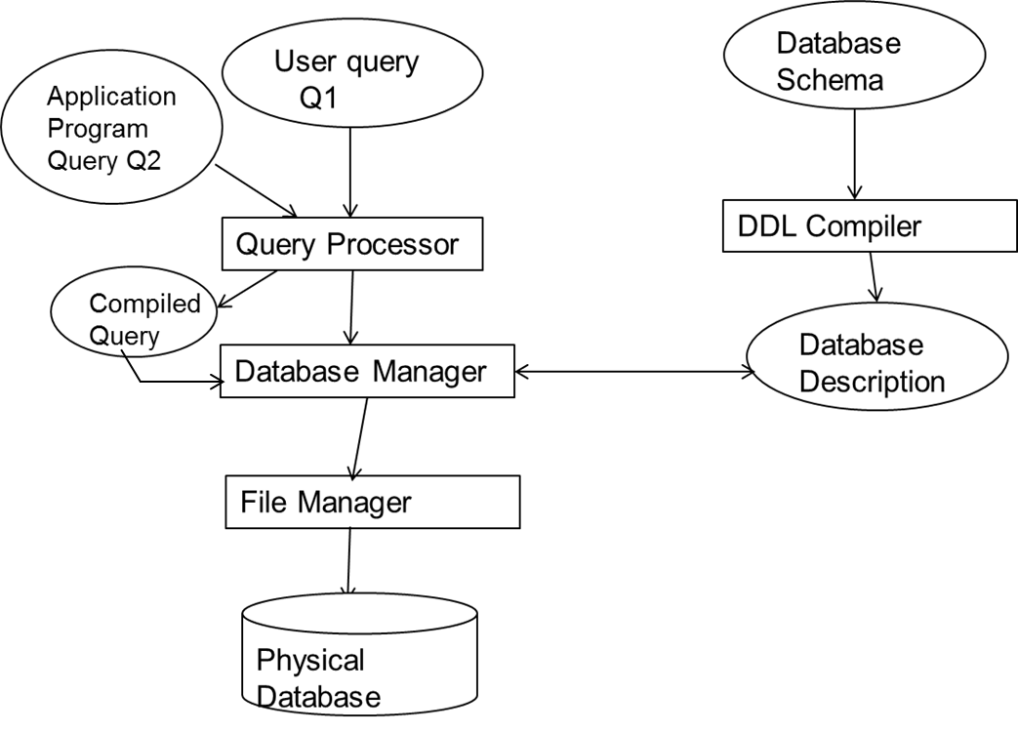
Database Architecture

Slide 33

Database Users and Administrators
Database

