Slide 1
Chapter 2: Intro to Relational Model

Slide 2

Example of a Relation
INSTRUCTOR
attributes
(or columns)
tuples
(or rows)

Slide 3
Attribute Types
The set of allowed values for each attribute is called the domain of the attribute
Atomic
Composite
Single Valued
Multivalued
ID | NAME | DEPT_NAME | SALARY | PHONE NO
1 | X | CSE | 10000 | 9191819191 7877878778
2 | Y | MECH | 15000 | 2347879980
3 | Z | CSE | 20000 | 1234567890

Slide 4
student
marks
s_name | S_roll
ram | 123
sanjay | 124
manju | 125
meenu | 126
ram | 127
Sub1 | Sub2 | sub3
100 | 60 | 70
45 | 50 | 60
80 | 67 | 89
65 | 27 | 56
29 | 78 | 90
HOW DO YOU MAKE THE ABOVE RELATION MEANINGFUL?
Sub1 | Sub2 | sub3 | S_roll
100 | 60 | 70 | 123
45 | 50 | 60 | 124
80 | 67 | 89 | 125
65 | 27 | 56 | 126
29 | 78 | 90 | 127

Slide 5
KEYS
A data item [attribute] which can uniquely identify a tuple in a relation.
->SUPER KEY
-> CANDIDATE KEY
-> PRIMARY KEY
SUPER KEY
Any combination of attributes which can uniquely identify a tuple
SK={S_roll} , {s_name,S_roll}
s_name | S_roll
ram | 123
sanjay | 124
manju | 125
meenu | 126
ram | 127

Slide 6
Identify super keys for the following table
SK={ book_id} , {book_id,name}, {name,author}, {book_id,name,author}
Super key will be redundant
book_id | name | author
B1 | XYZ | A1
B2 | ABC | A1
B3 | XYZ | A2
B4 | PQR | A3
B5 | LSP | A1

Slide 7
Candidate key
A super key without redundancy
Not reducable
Minimal super key
{ book_id}
{book_id,name}
{name,author}
{book_id,name,author}
book_id | name | author
B1 | XYZ | A1
B2 | ABC | A1
B3 | XYZ | A2
B4 | PQR | A3
B5 | LSP | A1

Slide 8


Slide 9
Consider the following relation
citizen{VotersID, Aadhar_Number, Name, Age, Gender, Address}
Identify the candidate keys, Super Keys
Voters ID | Aadhar_ Number | Name | Age | Gender | Address

Slide 10
Identify the keys
{Suit,Value} together make a unique value.
card
Suit | Value | Num_times_played
Hearts | Ace | 5
Diamonds | Three | 2
Hearts | Jack | 5
Clubs | Spades | 1

Slide 11
Composite candidate key : candidate key containing 2 or more attributes
Eg: {Suit,Value} is a composite key of
cards(Suit,Value,Num_times_played)
Simple candidate key : A candidate key with only one attribute
eg: instructor (ID,name,dept_name,salary)
{ID} is a simple candidate key

Slide 12
Primary key
One of the candidate key
How will you select a primary key ?
book_id | name | author
B1 | XYZ | A1
B2 | ABC | A1
B3 | XYZ | A2
B4 | PQR | A3
B5 | LSP | A1
{ book_id}
{name,author}

Slide 13
Foreign key:
r1,r2 ← relations
a relation r1 can have an attribute which will be the primary key of another relation r2
This attribute is known as foreign key from r1 referencing r2
r1 – referencing relation
r2- referenced relation

Slide 15
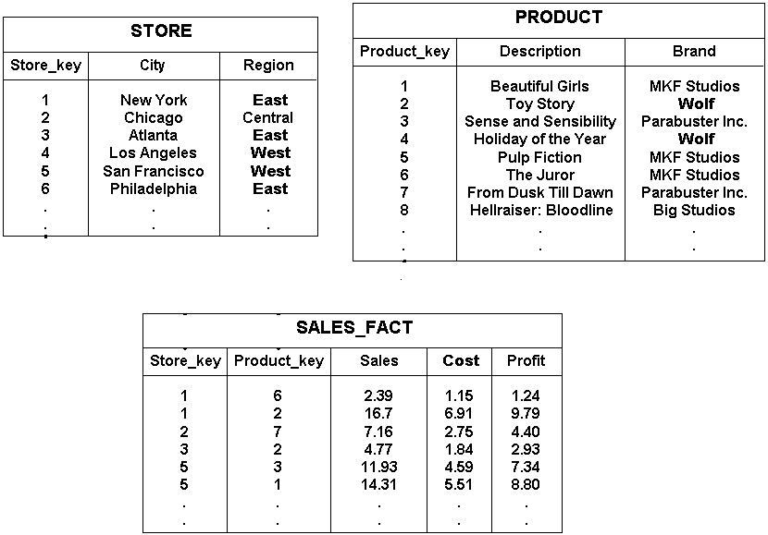


Slide 16
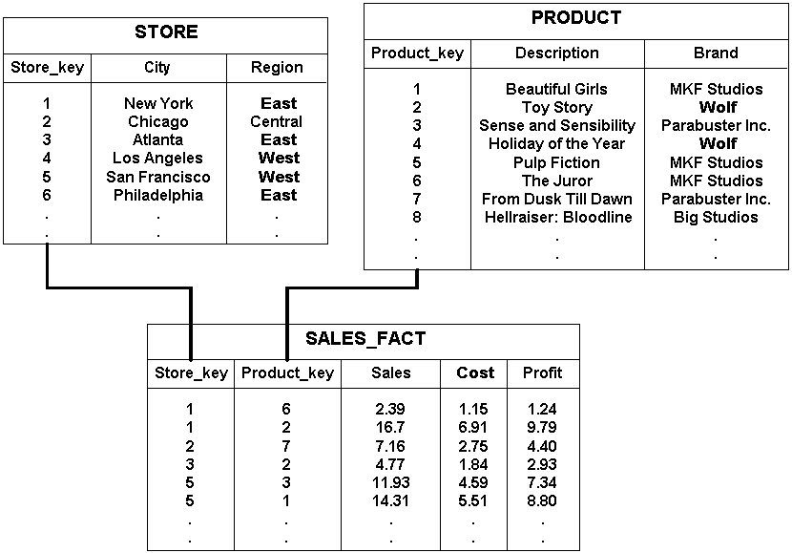

Slide 17
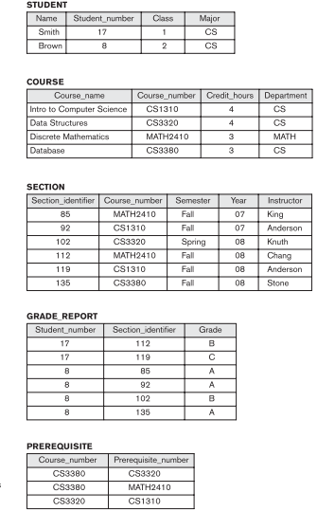

Slide 18
Constraints & need of constraints
Database constraints are restrictions on the contents of the database or on database operations
PURPOSE
To avoid invalid data entry.
To avoid data inconsistency.
To ensure data integrity.
PK={book_id}
book_id | name | author
B1 | XYZ | A1
NULL | ABC | A1
B3 | XYZ | A2
B4 | PQR | A3
NULL | LSP | A1

Slide 19
Constraints & need of constraints
department employee
dept_ID | D_name | building
1 | CSE | x
2 | MEC | y
3 | CHE | z
4 | CEN | v
EMP_id | E_name | dept_id
123 | XYZ | 1
124 | ABC | 2
456 | XYZ | 3
467 | PQR | 4
345 | yuy | 5

Slide 20
foreign key constraint
constraint prevents any actions that would destroy link between tables with the corresponding data values
  A new row cannot be added to referencing relation unless it has a matching record in referenced relation
dept_ID | D_name | building
1 | CSE | x
2 | MEC | y
3 | CHE | z
4 | CEN | v
EMP_id | E_name | Dept_id
123 | XYZ | 1
124 | ABC | 2
456 | XYZ | 3
467 | PQR | 4
345 | yuy | 5

Slide 21
foreign key constraint
The foreign key constraints are used to enforce referential integrity.
dept_ID | D_name | building
1 | CSE | x
2 | MEC | y
3 | CHE | z
4 | CEN | v
EMP_id | E_name | Dept_id
123 | XYZ | 1
124 | ABC | 2
456 | XYZ | 3
467 | PQR | 4

Slide 22
Database constraints provide a way to guarantee that:
  rows in a table have valid primary or unique key values
  rows in a dependent table have valid foreign key values that reference rows in a parent table
  individual column values are valid

Slide 23
TYPES
  primary key constraint
  unique constraint (to enforce candidate key integrity)
  foreign key constraint (to enforce foreign key, or referential integrity)
  check constraint (to restrict a column's values; a partial enforcement of domain integrity)

Slide 24
Primary key constraint
A primary key serves as the unique identifier for rows in the table.
The syntax of the primary key constraint (following the Constraint keyword and the constraint name, if they're specified) is
To satisfy a PRIMARY KEY constraint, both of the following conditions must be true:
• No column that is part of the primary key can contain a null.
• A table can have only one primary key

Slide 25
Primary key constraint in SQL
PRIMARY KEY constraints can be defined at the column or the table level.
However, if a composite PRIMARY KEY is created, it must be defined at the table level.

Slide 26
Unique & check constraint
Unique : Ensures that each row for a column must have a unique value
CHECK - Ensures that the value in a column meets a specific condition
NOT NULL

Slide 27
TABLE LEVEL CHECK CONSTRAINT
CREATE TABLE employees(employee_id INT NOT NULL,
last_name VARCHAR(50) NOT NULL, first_name VARCHAR(50),
salary INT, CONSTRAINTcheck_employee_id CHECK (employee_id BETWEEN 1 and 10000) );

Slide 28
CREATE TABLE Persons
(
P_Id int NOT NULL,
LastName varchar(255) NOT NULL,
FirstName varchar(255),
Address varchar(255),
City varchar(255),
CONSTRAINT chk_Person CHECK (P_Id>0 AND City='Sandnes')
)

Slide 29
NOT NULL CONSTRAINT
CREATE TABLE employees(employee_id INT NOT NULL,
last_name VARCHAR(50) NOT NULL,
first_name VARCHAR(50),
salary INT,
CONSTRAINT check_employee_id CHECK (employee_id BETWEEN 1 and 10000) );

Slide 30

Schema Diagram for University Database

