Slide 1
SQL Rename,Having,Like

Slide 2
SQL Aliases
SQL aliases are used to give a table, or a column in a table, a temporary name.
Aliases are often used to make column names more readable.
An alias only exists for the duration of the query.

Slide 3
Alias Column Syntax:
SELECT column_name AS alias_name FROM table_name;
Alias Table Syntax:
SELECT column_name(s) FROM table_name AS alias_name;

Slide 4
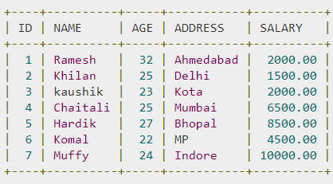
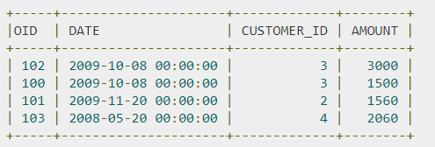
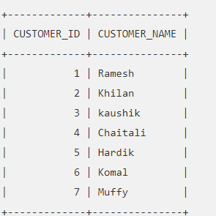
customer
order
a)

Slide 5
Having Clause
HAVING Clause : To specify conditions that filter which group results appear in the results.
The WHERE clause places conditions on the selected columns
HAVING clause places conditions on groups created by the GROUP BY clause
SELECT column1, column2
FROM table1, table2
WHERE [ conditions ]
GROUP BY column1, column2
HAVING [ conditions ]
ORDER BY column1, column2

Slide 6
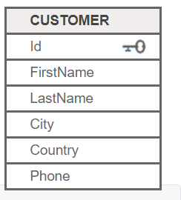
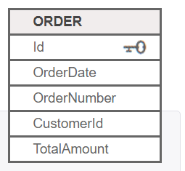
List the number of customers in each country. Only include countries with more than
10 customers.
2. List the number of customers in each country, except the USA, sorted high to low.
Only include countries with 9 or more customers.
3. List all customer with average order amount between 10000 and 12000

Slide 7
SQL LIKE Operator
LIKE operator is used in a WHERE clause to search for a specified pattern in a column.
% - The percent sign represents zero, one, or multiple characters
_ - The underscore represents a single character
SELECT column1, column2, ... FROM table_name WHERE columnN LIKE pattern;

Slide 8
LIKE Operator | Description
WHERE CustomerName LIKE 'a%' | Finds any values that start with "a"
WHERE CustomerName LIKE '%a' | Finds any values that end with "a"
WHERE CustomerName LIKE '%or%' | Finds any values that have "or" in any position
WHERE CustomerName LIKE '_r%' | Finds any values that have "r" in the second position
WHERE CustomerName LIKE 'a_%_%' | Finds any values that start with "a" and are at least 3 characters in length
WHERE ContactName LIKE 'a%o' | Finds any values that start with "a" and ends with "o"

