Slide 1
JOINS

Slide 2
SQL JOINS
A SQL Join statement is used to combine data or rows from two or more tables based on a common field between them. Different types of Joins are:
INNER JOIN
LEFT JOIN
RIGHT JOIN
FULL JOIN

Slide 3
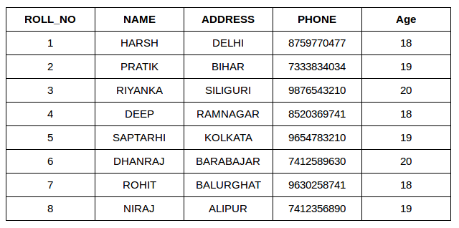
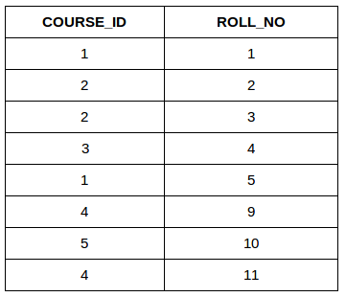
STUDENT
COURSE

Slide 4
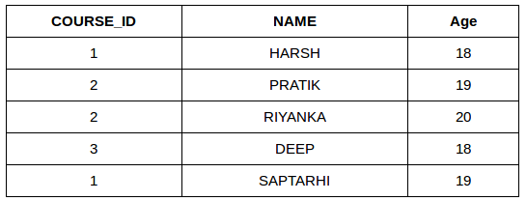
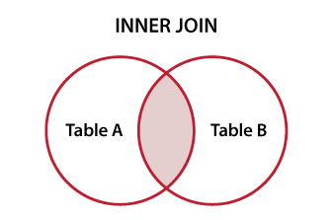
INNER JOIN:
SELECT Course.COURSE_ID, Student.NAME, Student.AGE
FROM Student INNER JOIN Course
ON Student.ROLL_NO = Course.ROLL_NO

Slide 5
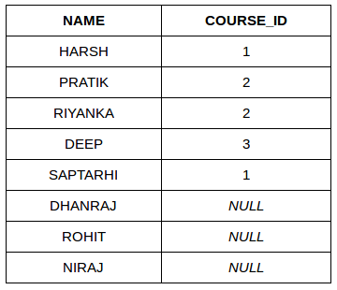
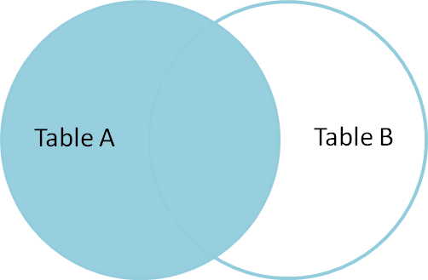
LEFT JOIN:
SELECT Student.NAME,Course.COURSE_ID
FROM Student LEFT JOIN Course
ON Course.ROLL_NO = Student.ROLL_NO;

Slide 6
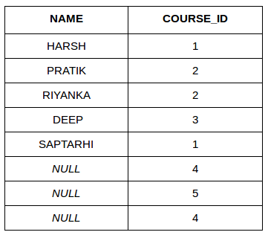
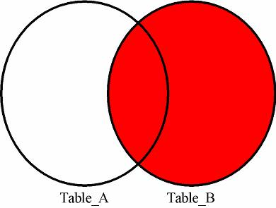
RIGHT JOIN:
SELECT Student.NAME,Course.COURSE_ID
FROM Student RIGHT JOIN
Course ON Course.ROLL_NO = Student.ROLL_NO;;

Slide 7
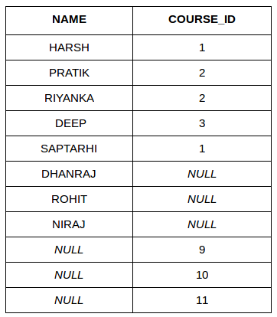
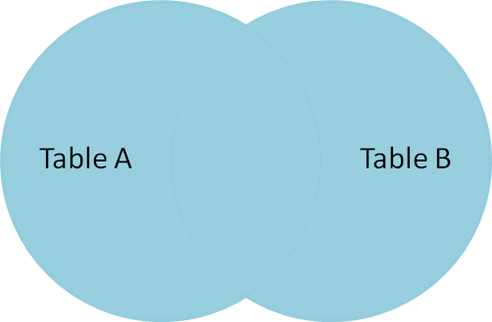
FULL JOIN:
SELECT Student.NAME,Course.COURSE_ID
FROM Student FULL JOIN Course
ON Course.ROLL_NO = Student.ROLL_NO;

Slide 8
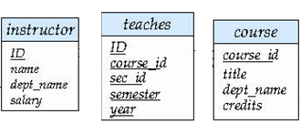
NATURAL JOIN for more than 2 tables
SELECT A1,A2……..An
FROM (T1 NATURAL JOIN T2) JOIN T3 USING(attribute)
List the names of instructors along with the titles of courses that they teach

Slide 9
List the names of instructors along with the titles of courses that they teach
SELECT name,title
FROM (instructor NATURAL JOIN teaches) JOIN courseUSING(course_id)

