Slide 1
Transform ER Diagram into Tables
Lecture-8
Sikha O K

Slide 2
RULES….
Convert all the Entities in the diagram to tables.
All single valued attributes of an entity is converted to a column of the table
Key attribute in the ER diagram becomes the Primary key of the table.
Declare the foreign key column, if applicable.
Any multi-valued attributes are converted into new table.
Any composite attributes are merged into same table as different columns.
One can ignore derived attribute, since it can be calculated at any time.

Slide 3
Converting Weak Entity
Weak entity is also represented as table.
Add a foreign key column, which would be the primary key column of its strong entity.
This foreign key column along with its key attribute column forms the primary key of the table.

Slide 4
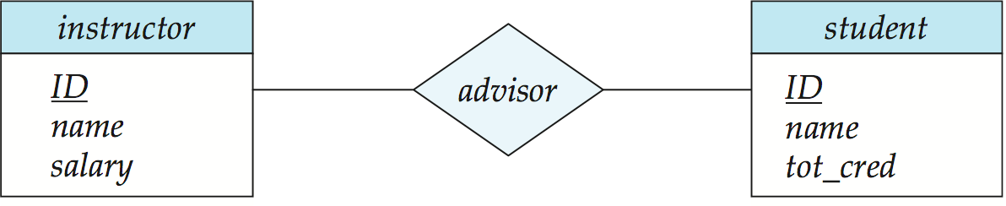
Conversion of relationship sets:
1-1
Primary key of either the side can be added as the foreign key of one of the table
1-M or M-1
The primary key at 1 cardinality entity is added as foreign key to N cardinality entity
M-N
A many-to-many relationship set is represented as a schema with attributes for the primary keys of the two participating entity sets, and any descriptive attributes of the relationship set.
advisor = (s_id, i_id)

Slide 5
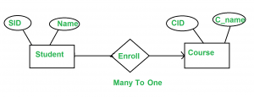


Slide 6
