Slide 1









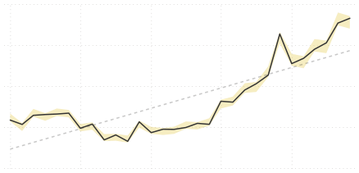





Power BI Desktop
$24.9M
REVENUE
$10.5M
PROFIT
25.2K
ORDERS
2.2%
RETURN RATE
Revenue Trending
Orders by Category
$2.0M
Accessories
17.0K
$1.5M
Bikes
13.9K
Clothing
7.0K
$1.0M
Top 10 Products
Water Bottle - 30 oz.
Patch Kit/8 Patches
Mountain Tire Tube
Road Tire Tube
Sport-100 Helmet, Red
AWC Logo Cap
Sport-100 Helmet, Blue
Fender Set - Mountain
Sport-100 Helmet, Black
Mountain Bottle Cage
OrdersRevenueReturn %

3,983 $39,755 1.95%
2,952 $13,506 1.61%
2,846 $28,333 1.64%
2,173 $17,265 1.55%
2,099 $73,444 3.33%
2,062 $35,882 1.11%
1,995 $67,120 3.31%
1,975 $87,041 1.36%
1,940 $65,270 2.68%
1,896 $38,062 2.02%
$0.5M
$0.0M
Jan 2020
Jul 2020
Jan 2021
Jul 2021
Jan 2022
Monthly Revenue
Monthly Orders
Monthly Returns
166
$1.83M
Prev Month: $1.77M(+3.31%)
2,146
Prev Month: 2165(-0.88%)
Most Ordered Product Type:
Most Returned Product Type:
Prev Month: 169(+1.78%)
Tires and Tubes
Shorts

Slide 2

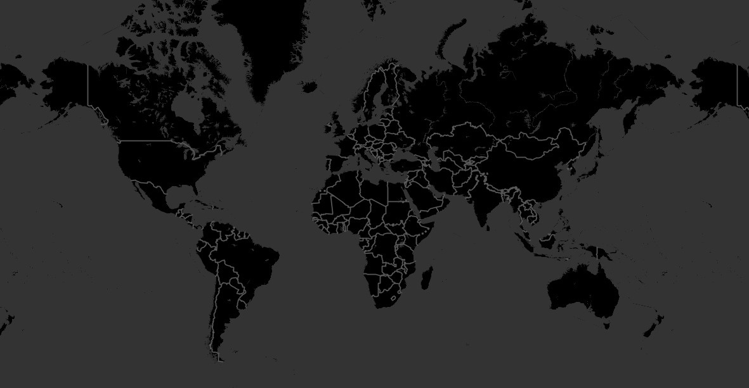
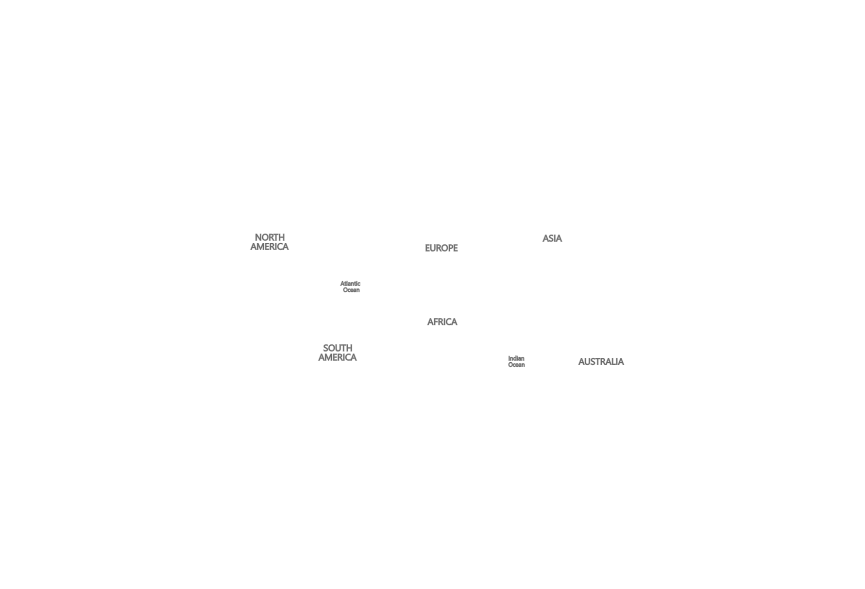




Power BI Desktop
Select all
Europe
North America
Pacific
Canada
United Kingdom
France
Germany
United States
Australia
© 2023 Miicrrosofftt Corrporrattiion

Slide 3



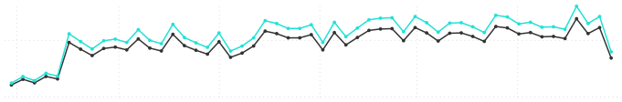



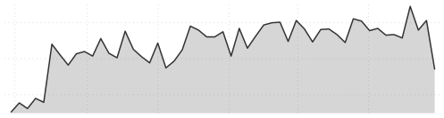
Power BI Desktop
Selected Product:
Monthly Orders vs. Target
Monthly Revenue vs. Target
Monthly Profit vs. Target
Water Bottle - 30 oz.
404
$4,067
$2,546
0
438
$0
$4,292
$0
$2,687
Price Adjustment (%)
0.10

Total Profit
Adjusted Profit
$500
$0
Jul 2021
Sep 2021
Nov 2021
Jan 2022
Mar 2022
May 2022
Product Metric Selecti…

Orders

Revenue

Profit

Returns

Return %
Report Summary
Total orders for Water Bottle - 30 oz.
were 404
Adjusted Profit (230.30% increase) and
Total Profit (230.30% increase) both
trended up between
Monday, June 28, 2021 and
Monday, June 27, 2022.
Profit experienced the longest period
$600
$400
$200
Jul 2021
Sep 2021
Nov 2021
Jan 2022
Mar 2022
May 2022

Slide 4


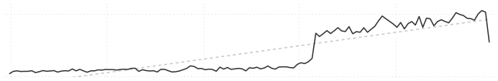
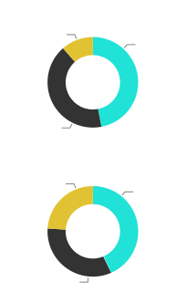
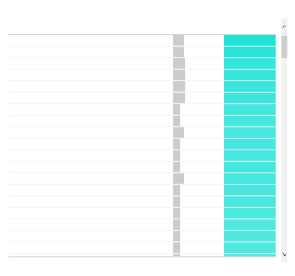





Power BI Desktop
Total Customers
Revenue per Customer
17.4K
UNIQUE CUSTOMERS
$1,431
REVENUE PER CUSTOMER
500
0
Jan 2020
Jul 2020
Jan 2021
Jul 2021
Jan 2022
Orders by Income Level
Top 100 Customers
Customer KeyFull NameOrdersRevenue

11433Mr. Maurice Shan6$12,408
11439Mrs. Janet Munoz6$12,015
11241Mrs. Lisa Cai7$11,330
11417Mrs. Lacey Zheng7$11,086
11420Mr. Jordan Turner7$11,022
11242Mr. Larry Munoz7$10,852
13263Mrs. Kate Anand4$10,437
12655Mr. Larry Vazquez4$10,395
11425Mrs. Ariana Gray6$10,391
12631Mr. Clarence Gao4$10,332
12650Mr. Aaron Wright4$10,329
13405Mr. Ethan Bryant4$10,309
11429Mr. Marco Lopez6$10,290
12632Mrs. Bonnie Nath4$10,283
11245Mr. Ricky Vazquez4$10,166
11237Mr. Clarence Anand4$10,065
11428Mrs. Deanna Perez4$9,762
11427Mrs. Desiree Dominguez4$9,718
11423Mrs. Jasmine Stewart4$9,717
Total 1,272$615,329
2020
2022
High 2.8K
Average 11.6K
Top Customer (by Revenue):
Mr. Maurice Shan
Low 10.3K
Orders:
Revenue:
Orders by Occupation
6
$12.4K
Management 4.4K
Professional 7.9K
Among customers in skilled manual roles in 2022, Ruben Suarez drove the most revenue at $4,683
Skilled Manual 6.0K

Slide 5
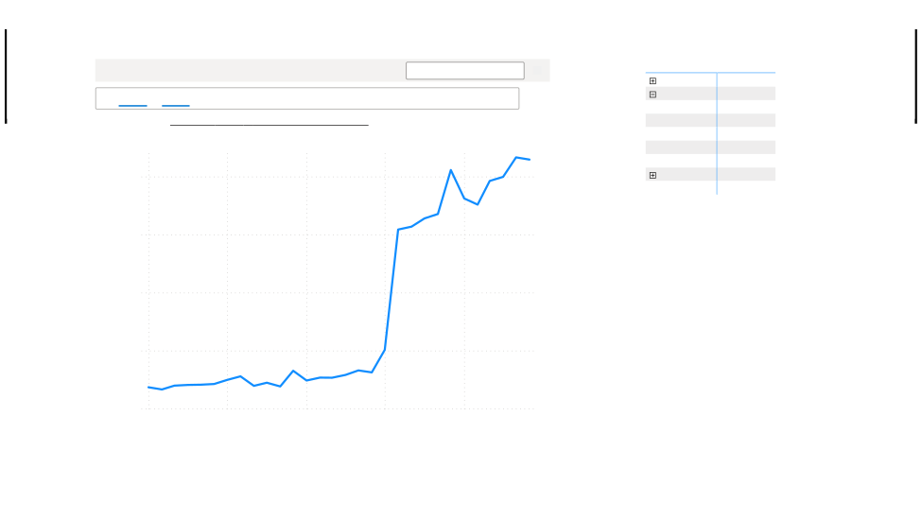
Power BI Desktop
CategoryName

Accessories

Bikes
Black
Blue
Red
Silver
Yellow

Clothing
Total
Total Orders 16,983
13,929
5,062
1,263
1,912
2,562
3,130
6,976
25,164

Help Q&A understand people better by adding synonyms.
Add synonyms now


Orders by month

Showing results forTotal orders sorted by calendar lookup start of month

2,000
1,500
Total Orders
1,000
500
0
Jan 2020
Jul 2020
Jan 2021
Jul 2021
Jan 2022
Start of Month

Slide 6

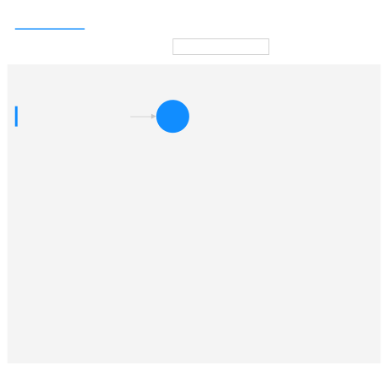
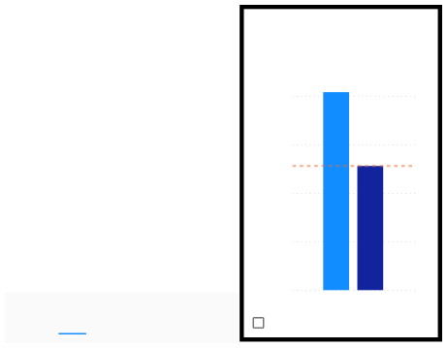
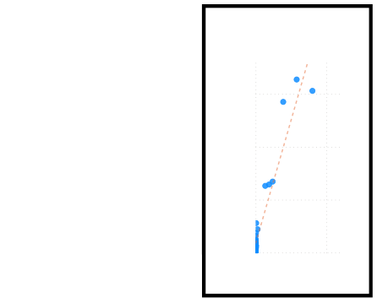


Power BI Desktop
Key influencers
Top segments

Key influencers
Top segments

What influences HomeOwner to be
Y

?
What influences Average Retail Price to
Increase

?
When...
....the likelihood of HomeOwner being Y increases by

HomeOwner is more likely to be Y when MaritalStatus is M than otherwise (on average).
When...
....the average of Average Retail Price increases by

On average when Sum of ProductCost increases, Average Retail Price also increases.
Sum of ProductCost goes up 8570.61
$478.6
MaritalStatus is M
1.62x
80%
Is Parent? is Yes
1.59x
$1,500
60%
AnnualIncome is 30000 - 120000
1.23x
$1,000
%HomeOwner is Y
Average Retail Price
40%
EducationLevel is Graduate Degree
1.19x
$500
20%
Occupation is Management
1.10x
Occupation is Skilled Manual
Sort by:ImpactCount
0%
$0
$0K
$50K
1.09x
MS
MaritalStatus
Only show values that are influencers
Sum of ProductCost

