Slide 1






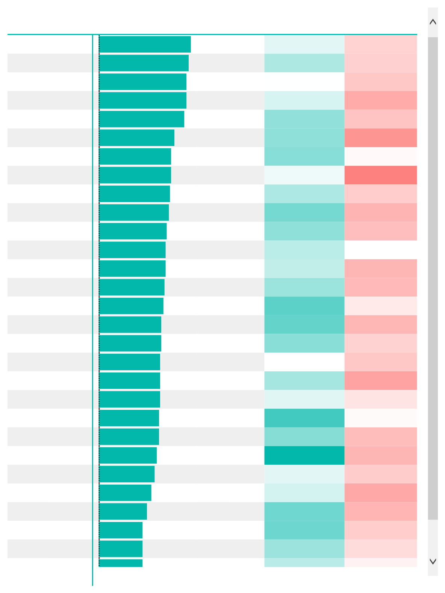



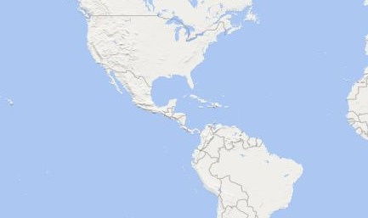






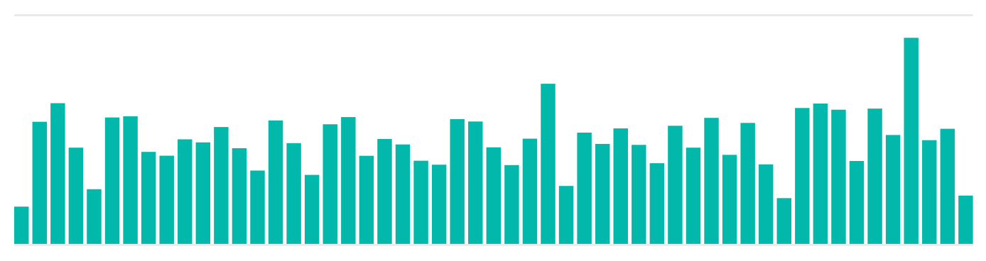

Power BI Desktop
Current Month Transactions
18,325
Goal: 17,339(+5.69%)
Current Month Profit
$71,682
Goal: 67.87K(+5.61%)
Current Month Returns
496
Goal: 482(-2.9%)
Product Brand Hermanos
Ebony
Tell Tale
Tri-State
High Top
Nationeel
Best Choice
Horatio
Fort West
Fast
Sunset
Carrington
Red Wing
Big Time
Cormorant
Imagine
Super
Denny
High Quality
Golden
BBB Best
PigTail
Plato
Landslide
CDR
Better
Carlson
Pleasant
Total
Total Transactions

5,342
5,238
5,112
5,099
4,940
4,408
4,218
4,195
4,108
4,097
3,953
3,891
3,870
3,816
3,744
3,634
3,618
3,584
3,577
3,550
3,514
3,467
3,352
3,270
3,078
2,823
2,564
2,564
113,668
Total Profit $21,753
$20,354
$19,982
$19,980
$19,810
$18,617
$18,355
$17,737
$15,834
$16,469
$14,018
$14,883
$15,870
$15,560
$15,749
$15,102
$13,868
$16,015
$16,139
$13,256
$12,991
$11,617
$12,748
$10,647
$12,062
$9,179
$10,534
$10,187
$449,627
Profit MarginReturn Rate 58.64% 0.95%
59.81% 0.96%
58.05% 0.99%
58.91% 1.10%
60.42% 1.01%
60.44% 1.18%
60.64% 0.81%
58.42% 1.26%
59.80% 0.97%
61.03% 1.07%
60.45% 1.03%
59.52% 0.78%
59.36% 1.06%
60.20% 1.05%
61.60% 0.87%
61.40% 1.06%
60.59% 0.96%
58.02% 0.99%
59.98% 1.13%
58.72% 0.88%
62.12% 0.80%
60.68% 1.04%
63.55% 1.06%
58.65% 0.98%
58.98% 1.11%
61.15% 1.07%
61.20% 0.97%
60.18% 0.92%
59.94% 1.00%
USA
Mexico
Select all
Canada
Mexico
USA
© 2023 TomTom,, © 2023 Miicrrosofftt Corrporrattiion,, © OpenSttrreettMap
Canada
Weekly Revenue Trending
Revenue vs. Target
$119.48K
$50K
$120K
$0K
Jan 1998
Apr 1998
Jul 1998
Oct 1998

Slide 2
Power BI Desktop
Performance Notes
Portland reached 1,000 sales in December to close out the year
High Top product returns doubled in Mexico (4 to 8), at a return rate of 1.2%
Plato products drove the strongest overall profit margin (63.55%) in 1998

Slide 3


Power BI Desktop
store_country Canada
Mexico
USA
Total
Total Revenue $9,629
$48,622
$61,910
$120,161
Total Transactions 1,459
7,350
9,516
18,325
Total Returns 42
198
256
496
Total Profit $5,798
$28,976
$36,909
$71,682

