Slide 1

Online Automotive Dealership System
CIS 693 – Master’s project

Slide 2

Contents
Project objective
Features
Development model
Artifacts of application system
Technologies
Data and Database
Infrastructure support(AWS)

Slide 3

Project objective
Abstract
The online car dealership system aims to provide a user-friendly platform for customers to buy, sell, and test drive cars. It helps manage car inventory and orders efficiently for both customers and the dealership. The system features car, order, and test drive management, along with an admin login and dashboard. It was developed using HTML, CSS, JavaScript, Python (Django Framework), and a NoSQL database. Development is complete, and the app is ready for deployment.

Slide 4
Features
Efficiently manage and organize vehicle inventory.
Streamline the ordering process for customers.
Enable administrators to track and manage orders, including payment and delivery status.
Facilitate scheduling and tracking of test drives.
Provide a user-friendly interface for both customers and administrators.

Slide 5

Development model
Used the scrum development model , which is one of the agile framework to build the application project.
What it is exactly ?
Scrum is a framework for agile software development which works on the principles of transparency and adaption.
It works in a way like iterative and incremental development, teamwork , collaboration.
Work is organized into time-boxed iterations called sprints, typically lasting 1-4 weeks.

Slide 6
Artifacts of application system
Artifacts of a software project are the things like documents, diagrams, and code that are made or used while building software. They show different parts of how the software is made, tested, and kept working. These artifacts help teams work together, keep track of what they're doing, and make sure the software works well.
Artifacts that I used are 1) Activity diagram
2) Use case diagram

Slide 7
Technologies
Technologies used to build the application
HTML: The page layout has been designed in HTML
CSS: CSS has been used for all the designing part
JavaScript: All the validation task and animations has been developed by JavaScript
Python: All the business logic has been implemented in Python
RDBMS: MySQL database has been used as a database for the project
Django: Project has been developed over the Django Framework

Slide 8

Data and Database
Use of database
The purpose of the database in this automotive dealer management system is to store and manage essential data related to vehicles, customers, orders, and test drives. It serves as the backbone of the system, facilitating data retrieval, storage, and manipulation
Input data available to database
Vehicle details: Category, name, cost, description.
Customer information: Cust-Id, Name, Delivery Address, Phone number, Email.
Order details: Order date and time, bill amount, payment status, delivery status.
Test drive details: Date, time, and related information for test drive scheduling.

Slide 9

Infrastructure support(AWS)
AWS offers a wide range of services that can be used for deployment, including computing power (Amazon EC2), storage (Amazon S3), databases (Amazon RDS), and networking (Amazon VPC).
I took AWS cloud services as the infrastructure support which means leveraging the various services offered by Amazon Web Services (AWS) to build and host my application and services.

Slide 10
AWS Deployment
Amazon EC2 (Elastic Compute Cloud):
EC2 instances will host our Django application.
Amazon RDS (Relational Database Service):
RDS is used to host our database.
Amazon VPC (Virtual Private Cloud):
Set up a Virtual Private Cloud to isolate our resources and provide network-level security.
Amazon Route 53:
Use Route 53 for domain registration and DNS management. It can route incoming traffic to your EC2 instances.
AWS Identity and Access Management (IAM):
Create IAM roles and policies to control access and permissions for AWS resources.
Elastic IP address
Amazon EC2 instance will have a public IP address

Slide 11
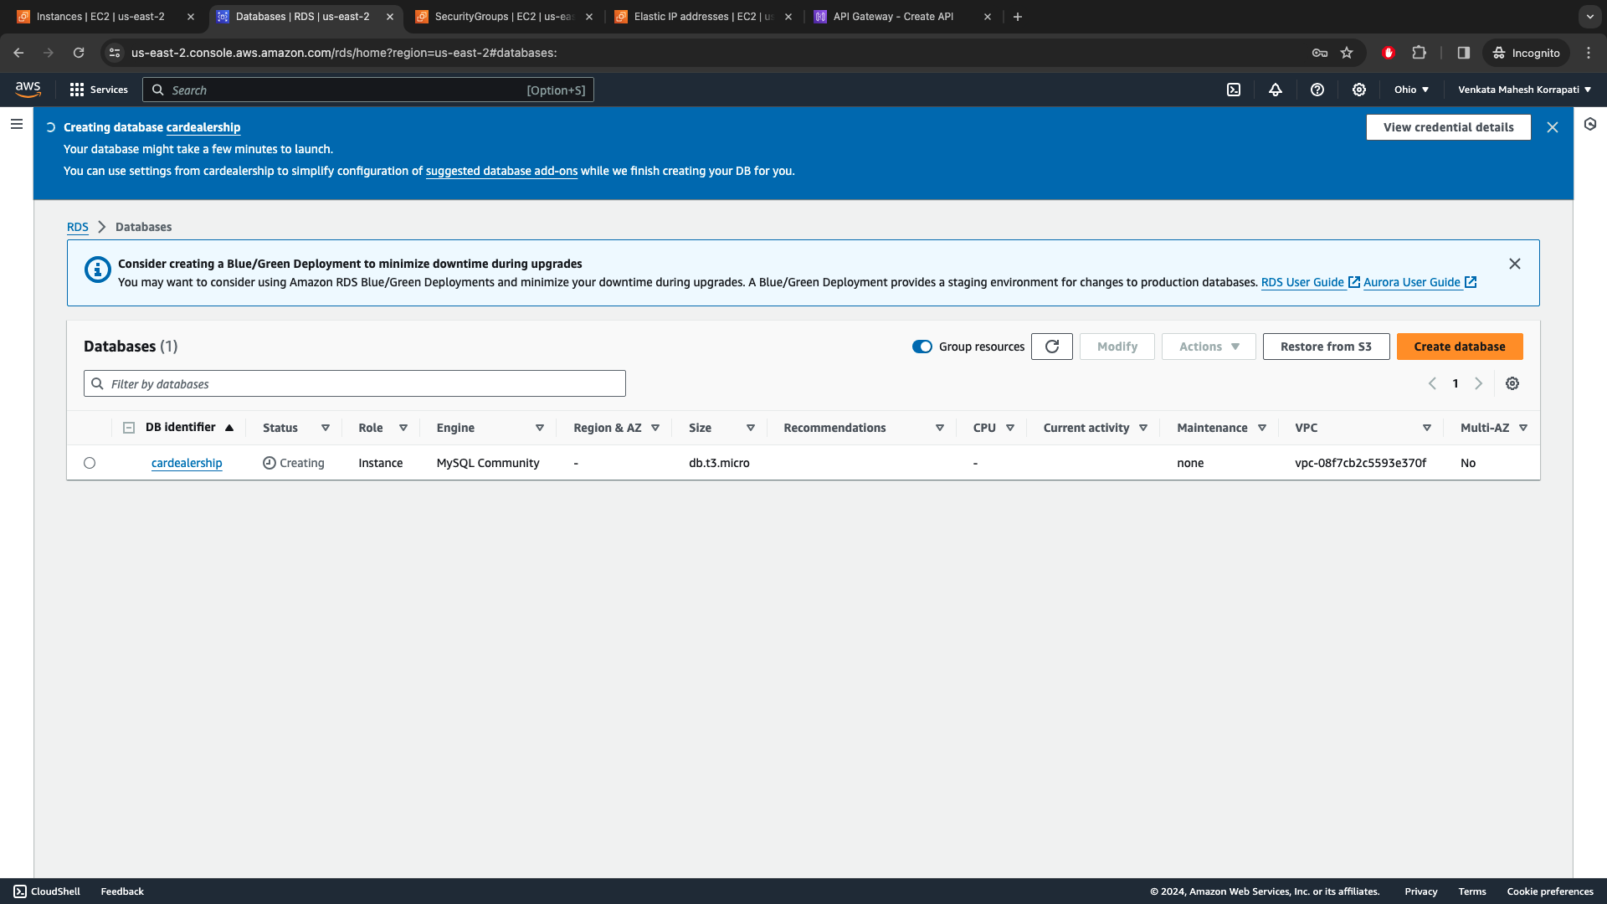

Slide 12
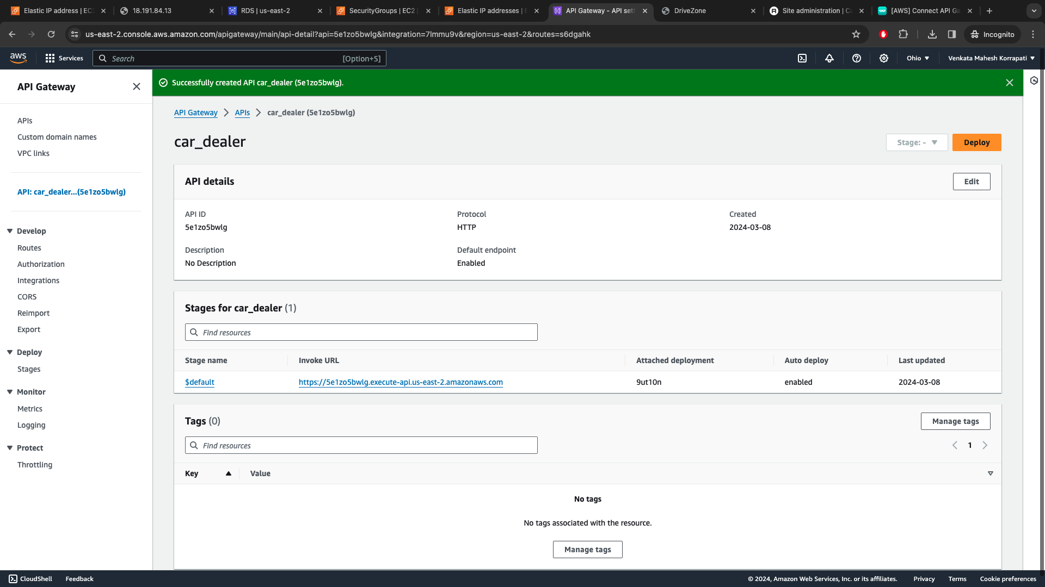

Slide 13

Conclusion
This online car dealership system offers benefits to customers and the dealership, with a user-friendly interface for buying, selling, and test-driving cars, potentially increasing sales and customer satisfaction. Features like car management and order fulfillment can improve dealership operations. Future improvements could include adding features like a recommendation engine and integrating with other applications to enhance functionality, making it a valuable tool for the automotive industry with further development.

