Slide 1
Automated Essay Scoring
Using Incremental
Latent Semantic Analysis
Mingqing Zhanga, Shudong Haoa, Yanyan Xua
School of Information Science and Technology,
Beijing Forestry University
Hengli Peng
Institute of Educational Measurement, Beijing Language and Culture University
Dengfeng Ke
Institute of Automation, Chinese Academy of Sciences
JOURNAL OF SOFTWARE, VOL. 9, NO. 2, FEBRUARY 2014

Slide 2
Overview
Abstract
Introduction
Proposed Method
Experimental Results
Conclusion

Slide 3


What is AES?
AES is the art of giving students , and scores and feedback on their essays and constructed responses.
automatic
iterative
correct
AES models are able to make predictions that closely match those made by human graders.

Slide 4
How does it work?
Students write essays
Teacher grade some sample of essays
AES Model is trained
Model Automatically scores essays

Slide 5
Why AES?
Scoring students writing
  Often lead to an inaccuracy in grading
    Very much time consuming and expensive
    Labor intensive task
    Require recruiting, training, calibration and monitoring
    Subject to perception difference error, drift error, inconsistency error
  Some rater consistently give high scores(leniency)
  Some rate consistently give low scores (severity)
more accurate and fastest Automated Essay Scoring System is essential

Slide 6


Introduction
Sarcasm?
10⁸+
285 M
“the use of irony to make or convey contempt”
Why Twitter?
Huge Data [Political, Popular Product, Movies]
Every tweet has a limitation of 140 characters.

Slide 7
Overview

Slide 8
Motivation & Related Work
Motivation
Sentiment analysis and openion mining rely on emotional words in text to detect it’s polarity (positively or negatively).
“All your products are incredibly amazing!!!”
“Did I say incredibly?? Well, it’s true, nobody would believe that. They break the second day you buy them -_-”
Indispensable to detect sarcastic message autometically?
Related Works
Filtering satirical news articles from true newswire documents [Features - profanity, slangs, semantic validity. Approach: SVM]
Sarcasm in amazon and Twitter [Approach: semi-supervised]
Sarcasm in Twitter by hashtags
Positive sentiment contrasts with a negative situation by boot-strapping algoritham using the seed word “love”.
Sarcasm on psychologycal effect and historical information.

Slide 9
Overview
Abstract
Introduction
Motivation & Related Work
Proposed Approach
Experimental Results
Conclusion

Slide 10
Introduction
Data Collection
Twitter
Twitter API
Twitter API
Sarcastic
Non-sarcastic
#sarcasm
Exclude #sarcasm
Data Set
Notes:
Test notes

Slide 11







Preliminaries
Singular Value Decomposition (SVD)
An Matrix Decomposition approach used for dimensionality reduction;
M
(m x n)
U
(m x r)
$$∑$$
(r x r)
$$V^{T}$$
(r x n)
$∑$ _{k x k}
${ V}^{T}$_{k x n}
=
X
X
U _{m x k}
M’ _{m x n} = U _{m x k} x $∑$ _{k x k} x${ V}^{T}$_{k x n}
To get better approximation of the original matrix M in lower dimension
remove
1. (r – k) columns in U
2. (r – k) elements in $∑$
3. (r - k) rows in $V^{T}$

Slide 12
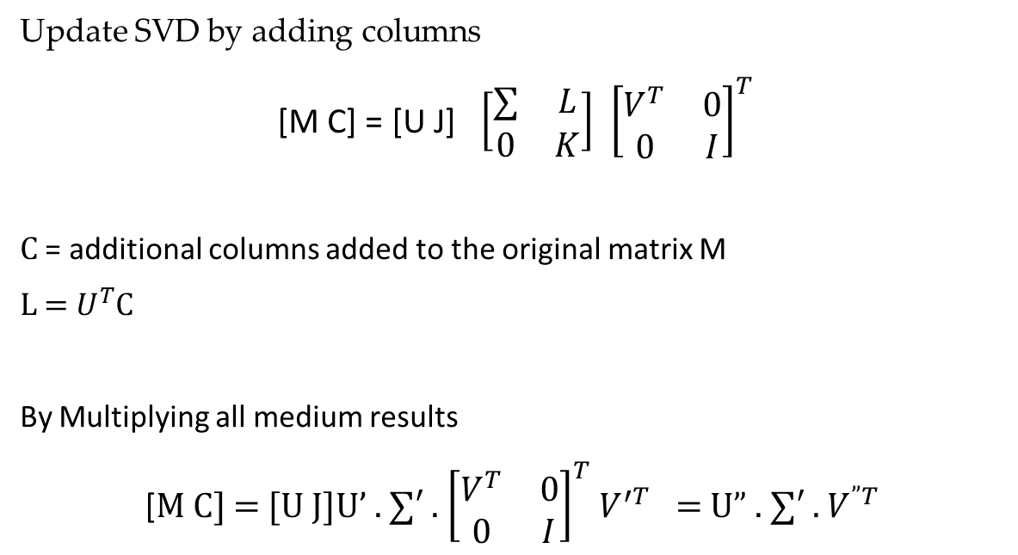
Preliminaries
Incremental Singular Value Decomposition (ISVD)
Update SVD by adding columns
[M C] = [U J] $\left[\begin{matrix}∑ & L \\ 0 & K\end{matrix}\right]$ ${\left[\begin{matrix}V^{T} & 0 \\ 0 & I\end{matrix}\right]}^{T}$
C = additional columns added to the original matrix M
L = $U^{T}$C
By Multiplying all medium results
[M C] = [U J]U’ . $∑′$ . ${\left[\begin{matrix}V^{T} & 0 \\ 0 & I\end{matrix}\right]}^{T}$ $V^{′T}$ = U” . $∑′$ . $V^{”T}$

Slide 13
Preliminaries
Latent Semantic Analysis (LSA)
Analysis Essays vectors in a reduced dimensionality semantic space.
Use Singular value decomposition (SVD)
Produce low rank approximation of the original dataset matrix
Can’t be used effectively when faced a massive dataset
Incremental Latent Semantic Analysis (ILSA)
Use Incremental Singular value decomposition (SVD)
Can process huge dataset of test essays
Effective to reduce the usage of memory and time consuming with a better automatic scoring performance accuracy

Slide 14
The Proposed Method
Traditional LSA can be performed in 5 steps
1
2
3
4
5
Text Preprocessing
weighting
Calculating SVD
Correlation Measurement
Correlation
Method
But the problem in Traditional LSA is
For massive dataset calculating SVD becomes an impossible task
This paper propose an Incremental LSA technique to solve this problem.

Slide 15
Flow Chart of the Proposed Method
Text preprocessing
Segmenting
Producing t-d matrix
weighting
Calculating TF-IDF matrix
Incremental LSA
Incremental SVD
re-projecting
Scoring performance
measurement
Support Vector Machine

Slide 16
Proposed Method
Text Preprocessing
All the essays are segmented into words
Stopwords are eliminated.
Essay vector form the original dataset matrix
words
M
… …
essay vector
4. t-d (term document) matrix is generated.

Slide 17
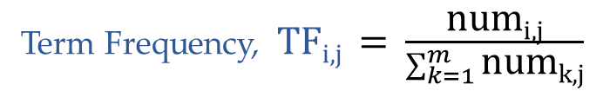
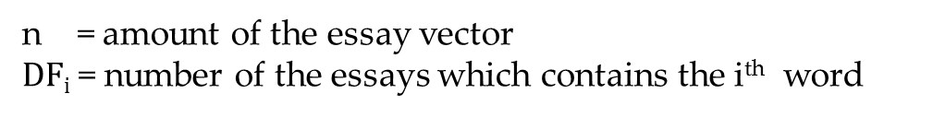
Proposed Method
Weighting
Every element in the t-d matrix are weighted as
W_{i,j} = TF_{i,j} x IDF_{i,j}
Term Frequency, TF_{i,j} = $\frac{\text{num}\text{i}\text{,}\text{j}}{\sum_{k=1}^{m}{\text{num}\text{k}\text{,}\text{j}}}$
$\text{num}\text{i}\text{,}\text{j}$ = number of the i^{th} word appeared in j^{th} essay
Inverse Document Frequency, IDF_{i,j} = $\log{\frac{\text{n}}{ 1 + \text{DF}\text{i} }}$
n = amount of the essay vector
$\text{DF}\text{i}$ = number of the essays which contains the i^{th} word

Slide 18
Proposed Method
Incremental LSA
Consists of two parts
    Incremental SVD
    Re-projecting
Incremental SVD
    Fastest Algorithm
    Very much useful for massive Dataset
Algorithm
Apply conventional SVD to first n’ essay vector to
Obtain mediate result of matrix decomposition.
Update the mediate result by adding N columns (batch size).
The process is repeated until all essay vectors are added.

Slide 19


Proposed Method
Incremental LSA
Re-projecting
M’ _{m x n} = U _{m x k} x $∑$ _{k x k} x${ V}^{T}$_{k x n}
k = number of the semantics remaining
constructs semantic space for the dataset.
Any essay vector can be re-projected to the semantic space based on t-f and word corpus d_{j} .
Re-projecting Incremental SVD
$\hat{dj}= ∑$⁻¹ x U^{T} x d_{j}
d_{j} = is the essay vector based on the same word corpus

Slide 20
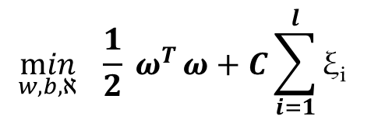
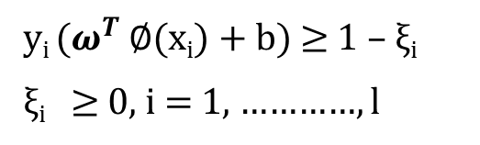
Proposed Approach
Scoring Performance Measurement
Support Vector Machine is used to score the essays.
Word corpus generated from the training set can be used to produce t-d matrix for the test set.
$$\min_{w,b,ℵ}{\frac{1}{2} ω^{T}}ω+C\sum_{i=1}^{l}{\text{ξ}\text{i} }$$
Optimum solution for SVM
y_{i} ($ω^{T}$ $∅$(x_{i}) + b) ≥ 1 – ξ_{i}
ξ_{i} ≥ 0, i = 1, …………, l
Constrains:
y_{i} = Human scoring
C = Regularization parameter

Slide 21
Experimental Results
Environment & Dataset
Linux Machine
2.0 GHz Intel Xeno E5-2620
96G memory
Dataset
15,776 test essays as training set
1000 test essays as test set
Teacher score (form 0 to 6 at intervals of 0.5) is added to the essay vector
SVM algorithm for classifying test set
Tools
WFST tool for segmenting essays
MATLAB and C language to compute performance metrics
LIBSVM for training

Slide 22
Experimental Results
Computing Time
Impossible task
for conventional SVD to handle very large data set.
Incremental SVD
Less time consuming
Performs better
3. Far more efficient
when comparing with traditional SVD
Training set size | Time(s)
 | Incremental | Conventional
31552 | 141.661 | 1111.324
47328 | 231.759 | 1692.691
63104 | 339.327 | 2617.137
78880 | 460.742 | 3858.184
94656 | 592.244 | 5466.019
110432 | 680.372 | 7929.217
126208 | 824.693 | N/A
141984 | 978.254 | N/A
157760 | 1145.381 | N/A

Slide 23
Experimental Results
Computing Time
Comparison of conventional SVD and Incremental SVD

Slide 24
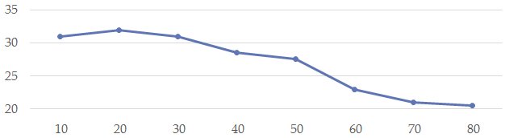

Experimental Results
Relative Update Time
Calculating ability of the Incremental SVD for different sizes of dataset
Relative update times = $\frac{(N−n′)}{optimum batch size} X \frac{base}{N}$
Relative update times -->
Essay vectors (thousands) ---->
As the dataset grows relative update times declines.
Incremental method performs more efficiently when dataset grows larger.

Slide 25
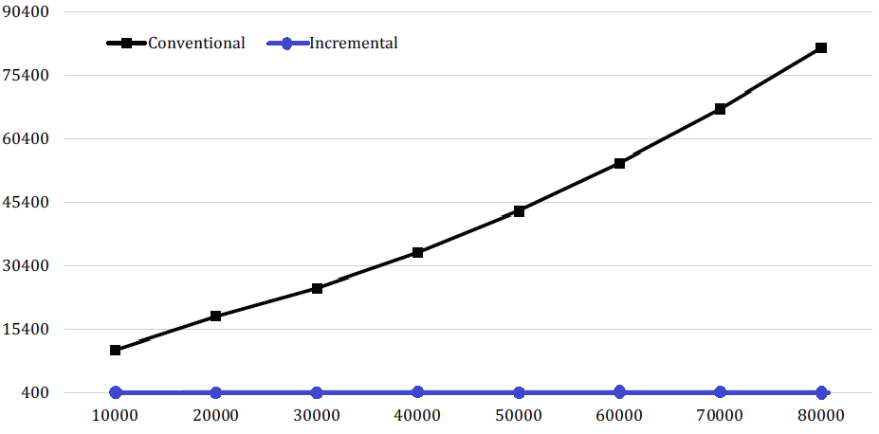
Experimental Results
Memory Usage
Economic memory usage in Incremental SVD
Memory usage (MB) ---->
Size of the training set ---->
Comparison between conventional and Incremental SVD in memory usage

Slide 26
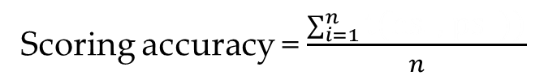

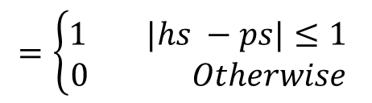
Experimental Results
Scoring Performance
Scoring accuracy = $\frac{\sum_{i=1}^{n}{\text{t}\text{(}\text{hsi} \text{, }\text{psi} \text{))}}}{n}$
$$\text{t}\text{(}\text{hsi}\text{ , }\text{psi}\text{ )}$$
$$\text{t}\text{(}\text{hsi}\text{ , }\text{psi}\text{ )}$$
$$=\left\{\begin{aligned}1 |hs −ps|≤1 \\ 0 Otherwise \end{aligned}\right.$$
In experiment Using Incremental LSA
Test Set Size | Tolerable Scoring | Scoring Accuracy
1000 | 888 | 88.8%
Incremental LSA has also scoring accuracy 88.8%. This is acceptable.

Slide 27
Conclusion
Handle Large Dataset
Can handle large dataset effectively.
Economic Memory Usage
Effective to reduce the usage of memory.
Less Time Consuming
Consume less time to build the model.
Better Scoring Performance
Have acceptable scoring accuracy.
Incremental LSA method performs better and more efficiently for larger dataset

Slide 28
Thanks

