Slide 1

LAB V
Introduction to Fading Channel
and Computer Simulation
ECE 4202 COMM ENG LAB IV

Slide 2

Agenda
Introduction to fading channel
Types of fading
Generation and statistics of fading samples
Channel Estimation
Link level simulation in fading channel
LAB Assignment+Quiz
ECE 4202 COMM ENG LAB IV

Slide 3
Radio Propagation
Radio propagation is classified into
  Large-scale propagation (path loss)
  Small-scale propagation (fading)
Large-scale propagation
  Behavior of radio waves over ‘long’ distance (several tens to hundreds of meters)
Small-scale propagation
  Behavior of radio waves over ‘short’ distance (5 to 40 wavelengths)
THIS LAB IS ABOUT SMALL-SCALE FADING
ECE 4202 COMM ENG LAB IV

Slide 4
Introduction to Fading Channel
Fading is the time variation of received signal as observed by a receiver antenna
  Multiple paths exist between the transmitter and receiver. Relative delay differences between paths can’t be resolved
  Movement of mobile terminal. Received signals have random phases.
  Random superposition creates largely fluctuating resultant vector
ECE 4202 COMM ENG LAB IV

Slide 5



Radio wave propagation scenario
LARGE SCALE
reflection
refraction
Mobile/static
LoS
LoS
scattering
ECE 4202 COMM ENG LAB IV

Slide 6
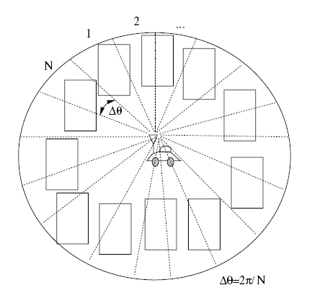
Cont’d
SMALL SCALE
Non-resolvable;
Seen as a single path by receiver
Angle of arrival
Each of the wave has random phase and amplitude.
All are randomly superpositioned.
scatterers
ECE 4202 COMM ENG LAB IV

Slide 7
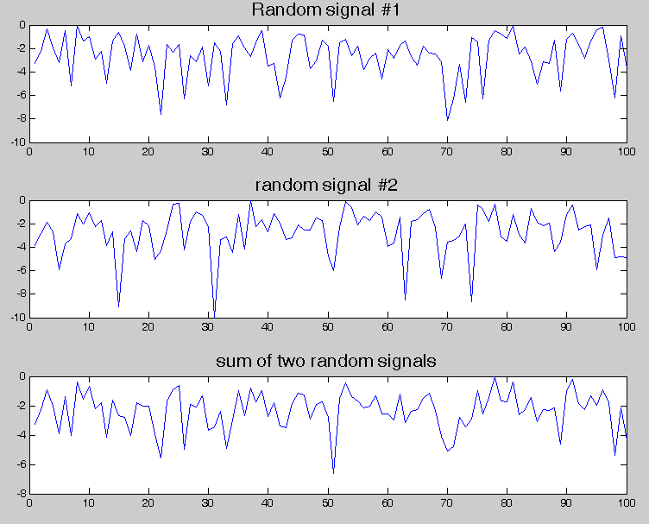
Random superposition
ECE 4202 COMM ENG LAB IV

Slide 8
Fading statistics
Rayleigh fading
  No Line of Sight (LoS) component presents
Rician fading
  Line of Sight (LoS) component presents
  Deterministic component, contributes significantly to the total received power
ECE 4202 COMM ENG LAB IV

Slide 9
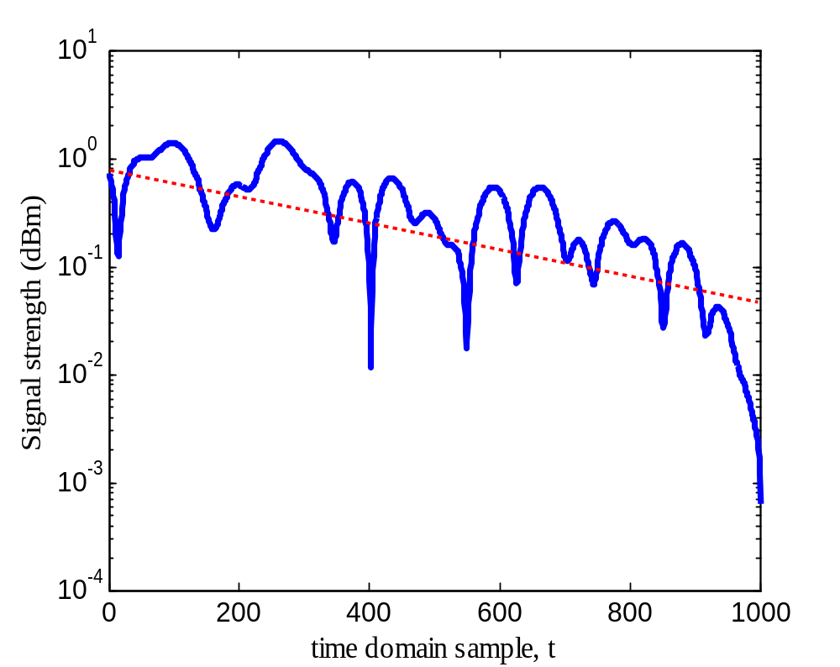
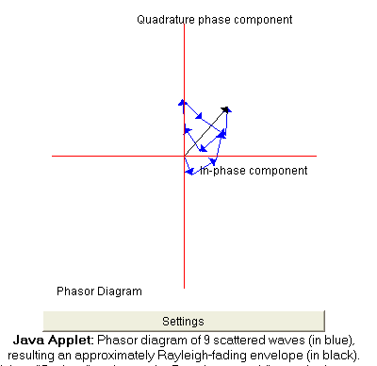
Cont’d
Deep fade (very weak signal)
*generates burst error
ECE 4202 COMM ENG LAB IV

Slide 10
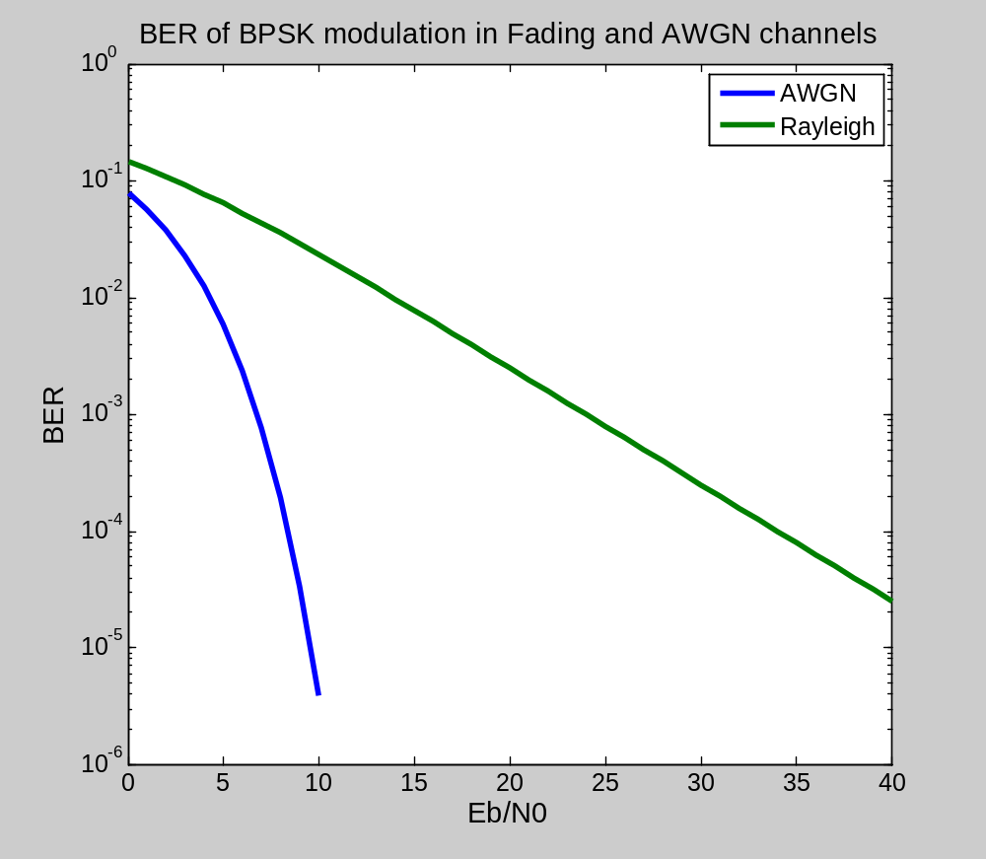
Fading Effect to BER
Fading makes BER decreases only linearly with SNR/ Eb/N0
ECE 4202 COMM ENG LAB IV

Slide 11
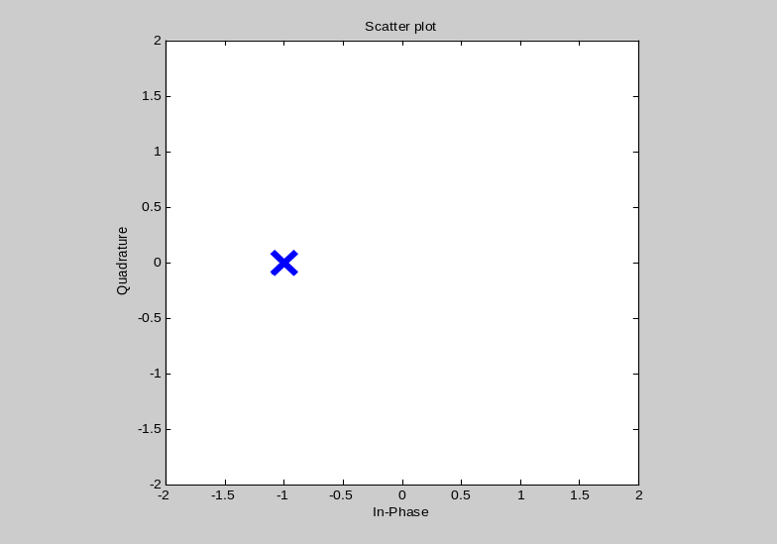
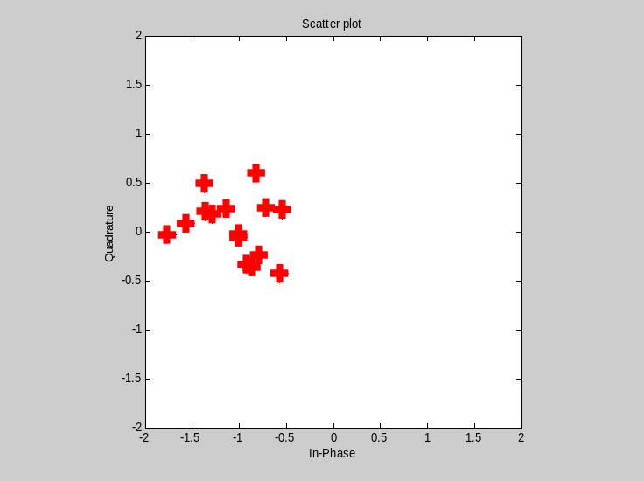
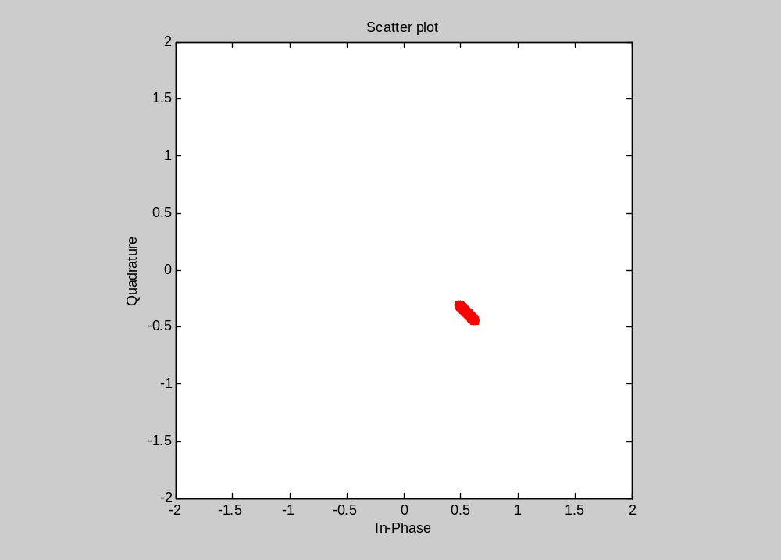
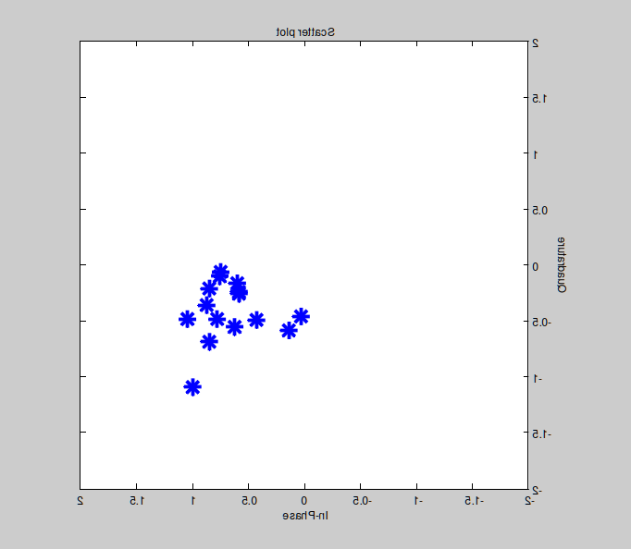
What happen to the tx signal?
AWGN n(t)
TXSIG
AWGN
FADING h(t)
AWGN n(t)
FADING
FADING+AWGN
ECE 4202 COMM ENG LAB IV

Slide 12
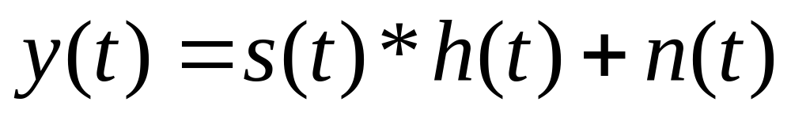
Cont’d
Fading effect is multiplicative to the transmit signal
It causes rotation to the transmit signal
If we do not “undo” the rotation caused by fading, the whole information will be detected erroneously
ECE 4202 COMM ENG LAB IV

Slide 13
Generating fading samples
Create a fading object
Generate a transmit signal
use filter() which does not require generation of fading sample
Create a fading object
Generate fading samples by filtering all one sequence with the fading object as above
Generate a transmit signal
Convolve the fading sample with the transmit signal
  In case of no multipath, it reduces to multiplication
ECE 4202 COMM ENG LAB IV

Slide 14
%create fading object with sampling period of 0.1ms, f_{D}=50Hz
channel= rayleighchan(1e-4,50);
%generate transmit signal (BPSK)
data=randint(1,50);
txsig=pskmod(data,2);
scatterplot(txsig);
%generate faded signal (before adding noise)
fadesig=filter(channel, txsig);
scatterplot(fadesig);
%add noise
rxsig=awgn(fadesig,15);
%demodulate
recsig=pskdemod(rxsig,2);
%calculate the number of errors
sum(recsig~=data)
ECE 4202 COMM ENG LAB IV

Slide 15
“undo” the fading
How can we undo the fading effect???
Fading is caused by the (radio) channel. Fading is not known by transmitter and receiver
What observed by a receiver is y(t)
ECE 4202 COMM ENG LAB IV

Slide 16
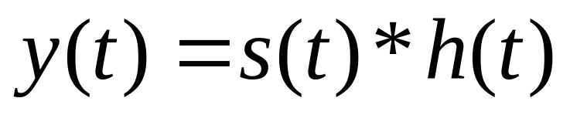
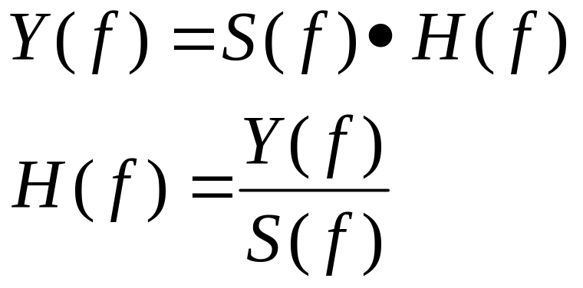
Cont’d
Assume noise free condition
  Note that, when h(t)=d(t), the convolution reduces to multiplication
Frequency domain representation (after Fourier transform)
ECE 4202 COMM ENG LAB IV

Slide 17
Channel Estimation
The process of estimating H(f) from Y(f)
  In case of delta function is equivalent to estimating h(t) from y(t)
How do we know H(f)?
  The receiver needs to know S(f)
  Transmitter must send sequence which is known to the receiver : pilot sequence
  How many pilot symbols are enough (provide good channel estimate)?
ECE 4202 COMM ENG LAB IV

Slide 18
Cont’d
Pilot sequence can be any sequence which is known to both transmitter and receiver
Pilot sequence
  p= 1 1 1 1
  p= 1 -1 1 -1
  p= 1 1 -1 -1
ECE 4202 COMM ENG LAB IV

Slide 19
Cont’d
In digital communication, user’s information/data is grouped into blocks/frames before transmission
  Add pilot sequence to each frame before modulation
  Pilot sequence is known to the receiver and hence does not carry information
ECE 4202 COMM ENG LAB IV

Slide 20
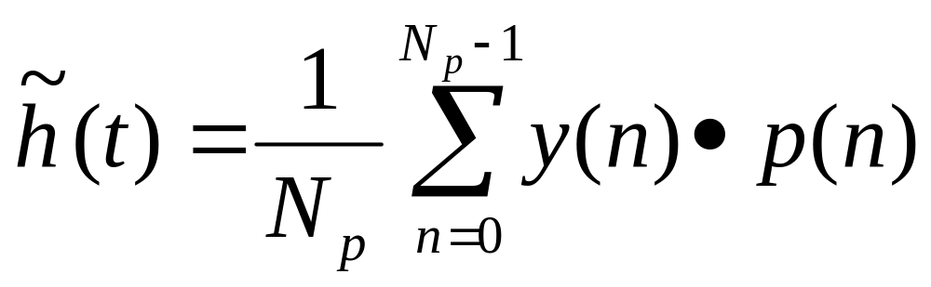
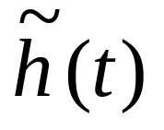
Cont’d
: Channel estimate
N_{p} : number of pilot symbols
y(n) : received signal samples
p(n) : n-th pilot symbol
ECE 4202 COMM ENG LAB IV

Slide 21
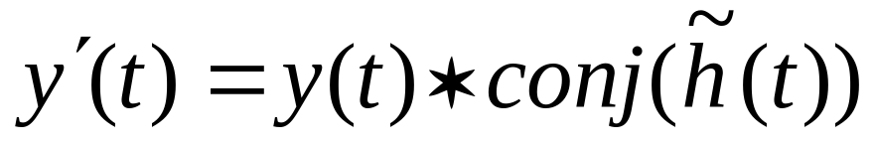
demodulation
Before we perform demodulation on the user information carrying signal we need to compensate for the fading effect
y’(t) is the input to the demodulator, not y(t)
ECE 4202 COMM ENG LAB IV

Slide 22
%create fading object with sampling period of 0.1ms, f_{D}=20Hz
channel= rayleighchan(1e-4,20);
%generate transmit signal (BPSK)
data=randint(1,50);
%BPSK modulation
modsig=pskmod(data,2);
%generate pilot signal
pilot= [1 1 -1 -1] ;
txsig =[pilot modsig];
scatterplot(txsig);
%generate faded signal (before adding noise)
fadesig=filter(channel, txsig);
scatterplot(fadesig);
%add noise
rxsig=awgn(fadesig,15);
%scatterplot(rxsig);
%channel estimation and compensation
h_tilde = channelestimate(pilot, rxsig(1:4))
modemin= rxsig(5:end)*conj(h_tilde);
%scatterplot(modemin);
%demodulate
recsig=pskdemod(modemin,2);
%calculate the number of errors
sum(recsig~=data)
ECE 4202 COMM ENG LAB IV

Slide 23
%function to perform channel estimation on
%bpsk modulated sequence
%[h_tilde]=channelestimate(pilot,rxsig)
function [h]=channelestimate(pilot, rxsig)
h = mean(rxsig.*pilot); %element wise multiplication followed by averaging
ECE 4202 COMM ENG LAB IV

Slide 24
Cautions
Simulating fading channel requires much more samples compared to AWGN channel
  Insufficient number of samples may lead to incorrect results
ECE 4202 COMM ENG LAB IV

