Slide 1
Digital Logic Design
Binary System

Slide 2
Overview
Digital Computer and Digital Systems
Binary Numbers
Number Systems [octal and hexadecimal]
Number Base Conversion
Complements
Binary Codes
Binary Logic
Integrated Circuit
Chapter 1 <number>

Slide 3
Digital System
Takes a set of discrete information inputs and discrete internal information (system state) and generates a set of discrete information outputs.
Discrete
Discrete
Inputs
Information
Discrete
Processing
Outputs
System
System State
Chapter 1 <number>

Slide 4
Types of Digital Systems
No state present
  Combinational Logic System
  Output = Function(Input)
State present
  State updated at discrete times
  => Synchronous Sequential System
  State updated at any time
  =>Asynchronous Sequential System
  State = Function (State, Input)
  Output = Function (State)
  or Function (State, Input)
Chapter 1 <number>

Slide 5
Signal
An information variable represented by physical quantity.
For digital systems, the variable takes on discrete values.
Two level, or binary values are the most prevalent values in digital systems.
Binary values are represented abstractly by:
  digits 0 and 1
  words (symbols) False (F) and True (T)
  words (symbols) Low (L) and High (H)
  and words On and Off.
Binary values are represented by values or ranges of values of physical quantities
Chapter 1 <number>

Slide 6
Signal Examples Over Time
Time
Continuous in value & time
Analog
Digital
Discrete in value & continuous in time
Asynchronous
Synchronous
Discrete in value & time
Chapter 1 <number>

Slide 7
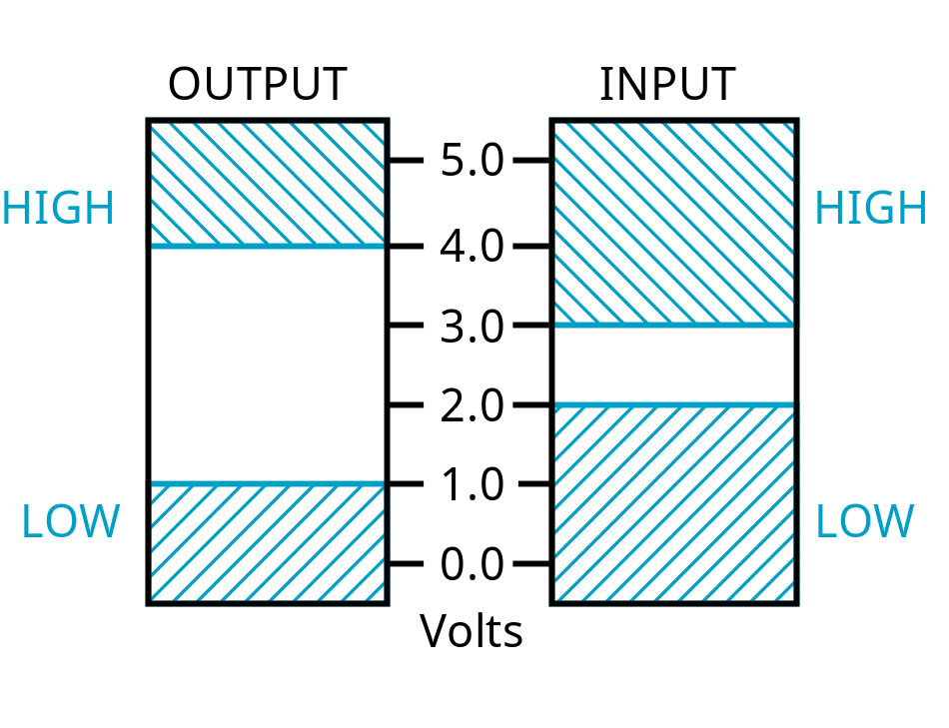
Signal Example – Physical Quantity: Voltage
Threshold Region
The HIGH range typically corresponds to binary 1 and LOW range to binary 0. The threshold region is a range of voltages
for which the input voltage value cannot be interpreted reliably as either a 0 or a 1.
Chapter 1 <number>

Slide 8
Number Systems
Positive radix, positional number systems
A number with radix r is represented by a string of digits:
A_{n - 1}A_{n - 2} … A₁A₀ . A₋ ₁ A₋ ₂ … A_{- m + 1} A_{- m}
in which 0 ≤ A_{i} < r and . is the radix point.
The string of digits represents the power series:
Chapter 1 <number>

Slide 9
Number Systems – Examples
 | General | Decimal | Binary
Radix (Base) | r | 10 | 2
Digits | 0 => r - 1 | 0 => 9 | 0 => 1
0 1 2 3 Powers of 4 Radix 5 -1 -2 -3 -4 -5 | r⁰ r¹ r² r³ r⁴ r⁵ r ⁻¹ r ⁻² r ⁻³ r ⁻⁴ r ⁻⁵ | 1 10 100 1000 10,000 100,000 0.1 0.01 0.001 0.0001 0.00001 | 1 2 4 8 16 32 0.5 0.25 0.125 0.0625 0.03125
Chapter 1 <number>

Slide 10
Special Powers of 2
2¹⁰ (1024) is Kilo, denoted "K"
2²⁰ (1,048,576) is Mega, denoted "M"
2³⁰ (1,073, 741,824)is Giga, denoted "G"
Chapter 1 <number>

Slide 11
Positive Powers of 2
Useful for Base Conversion
Exponent
Value
Exponent
Value
0
1
11
2,048
1
2
12
4,096
2
4
13
8,192
3
8
14
16,384
4
16
15
32,768
5
32
16
65,536
6
64
17
131,072
7
128
18
262,144
8
256
19
524,288
9
512
20
1,048,576
10
1024
21
2,097,152
Chapter 1 <number>

Slide 12
Converting Binary to Decimal
To convert to decimal, use decimal arithmetic to form Σ (digit × respective power of 2).
Example: Convert 11010₂ to N₁₀:
Chapter 1 <number>
Notes:
Powers of 2: 43210
11010₂ =>
1 X 2⁴ = 16
+ 1 X 2³ = 8
+ 0 X 2² = 0
+ 1 X 2¹ = 2
+ 0 X 2⁰ = 0
26₁₀

Slide 13
Converting Decimal to Binary
Method
  Subtract the largest power of 2 that gives a positive remainder and record the power.
  Repeat, subtracting from the prior remainder and recording the power, until the remainder is zero.
  Place 1’s in the positions in the binary result corresponding to the powers recorded; in all other positions place 0’s.
Example: Convert 13.625₁₀ to N₂
Chapter 1 <number>

Slide 14
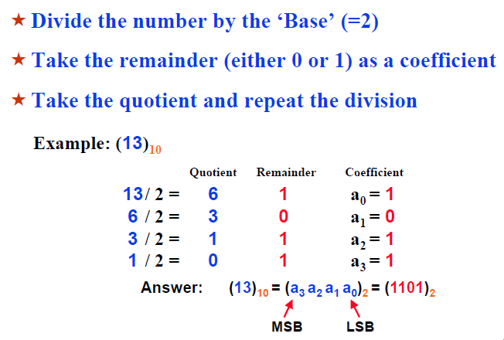
Converting Decimal to Binary
Chapter 1 <number>

Slide 15
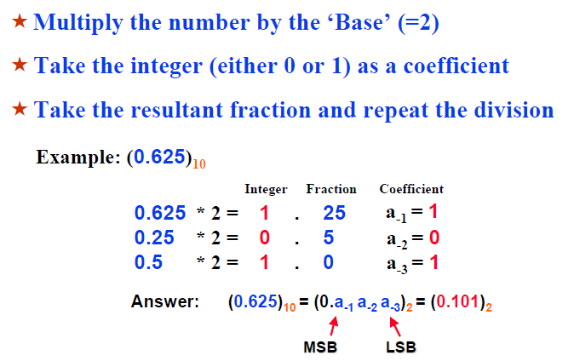
Converting Decimal to Binary
Chapter 1 <number>

Slide 16
Numbers in Different Bases
Good idea to memorize!
Decimal
Binary
Octal
Hexa
decimal
(Base 10)
(Base 2)
(Base 8)
(Base 16)
00
00000
00
00
01
00001
01
01
02
00010
02
02
03
00011
03
03
04
00100
04
04
05
00101
05
05
06
00110
06
06
07
00111
07
07
08
01000
10
08
09
01001
11
09
10
01010
12
0A
11
0101
1
13
0B
12
01100
14
0C
13
01101
15
0D
14
01110
16
0E
15
01111
17
0F
16
10000
20
10
Chapter 1 <number>

Slide 17
Number Base Conversion
To convert from one base to another:
1) Convert the Integer Part
2) Convert the Fraction Part
3) Join the two results with a radix point
Chapter 1 <number>

Slide 18
Conversion Details
To Convert the Integral Part:
  Repeatedly divide the number by the new radix and save the remainders. The digits for the new radix are the remainders in reverse order of their computation. If the new radix is > 10, then convert all remainders > 10 to digits A, B, …
To Convert the Fractional Part:
  Repeatedly multiply the fraction by the new radix and save the integer digits that result. The digits for the new radix are the integer digits in order of their computation. If the new radix is > 10, then convert all integers > 10 to digits A, B, …
Chapter 1 <number>

Slide 19
Example: Convert 46.6875₁₀ To Base 2
Convert 46 to Base 2
Convert 0.6875 to Base 2:
Join the results together with the radix point:
Chapter 1 <number>
Notes:
Answer 1: Converting 46 as integral part: Answer 2: Converting 0.6875 as fractional part:
46/2 = 23 rem = 0 0.6875 * 2 = 1.3750 int = 1
23/2 = 11 rem = 1 0.3750 * 2 = 0.7500 int = 0
11/2 = 5 remainder = 1 0.7500 * 2 = 1.5000 int = 1
5/2 = 2 remainder = 1 0.5000 * 2 = 1.0000 int = 1
2/2 = 1 remainder = 0 0.0000
1/2 = 0 remainder = 1 Reading off in the forward direction: 0.1011₂
Reading off in the reverse direction: 101110₂
Answer 3: Combining Integral and Fractional Parts:
101110. 1011₂

Slide 20
Checking the Conversion
To convert back, sum the digits times their respective powers of r.
From the prior conversion of 46.6875₁₀
101110₂ = 1·32 + 0·16 +1·8 +1·4 + 1·2 +0·1
= 32 + 8 + 4 + 2
= 46
0.1011₂ = 1/2 + 1/8 + 1/16
= 0.5000 + 0.1250 + 0.0625
= 0.6875
Chapter 1 <number>

Slide 21
Octal (Hexadecimal) to Binary and Back
Octal (Hexadecimal) to Binary:
  Restate the octal (hexadecimal) as three (four) binary digits starting at the radix point and going both ways.
Binary to Octal (Hexadecimal):
  Group the binary digits into three (four) bit groups starting at the radix point and going both ways, padding with zeros as needed in the fractional part.
  Convert each group of three bits to an octal (hexadecimal) digit.
Chapter 1 <number>

Slide 22
Octal to Hexadecimal via Binary
Convert octal to binary.
Use groups of four bits and convert as above to hexadecimal digits.
Example: Octal to Binary to Hexadecimal
6 3 5 . 1 7 7 ₈
Why do these conversions work?
Chapter 1 <number>
Notes:
Answer 1:
6 3 5 . 1 7 7 ₈
110|011|101 . 001|111|111 ₂
Regroup:
1|1001|1101 . 0011|1111|1(000)₂
Convert:
1 9 D . 3 F 8₁₆
Answer 2: Marking off in groups of three (four) bits corresponds to dividing or multiplying by 2³ = 8 (2⁴ = 16) in the binary system.

Slide 23
Non-numeric Binary Codes
Given n binary digits (called bits), a binary code is a mapping from a set of represented elements to a subset of the 2^{n} binary numbers.
Example: A
binary code
for the seven
colors of the
rainbow
Code 100 is
not used
Color
Binary Number
Red
000
Orange
001
Yellow
010
Green
011
Blue
101
Indigo
110
Violet
111
Chapter 1 <number>

Slide 24
Binary Codes for Decimal Digits
There are over 8,000 ways that you can chose 10 elements from the 16 binary numbers of 4 bits. A few are useful:
Decimal
8,4,2,1
Excess3
8,4,
-
2,
-
1
Gray
0
0000
0011
0000
0000
1
0001
0100
0111
0100
2
0010
0101
0110
0101
3
0011
0110
0101
0111
4
0100
0111
0100
0110
5
0101
1000
1011
0010
6
0110
1001
1010
0011
7
0111
1010
1001
0001
8
1000
1011
1000
1001
9
1001
1
100
1111
1000
Chapter 1 <number>

Slide 25
Binary Coded Decimal (BCD)
The BCD code is the 8,4,2,1 code.
This code is the simplest, most intuitive binary code for decimal digits and uses the same powers of 2 as a binary number, but only encodes the first ten values from 0 to 9.
Example: 1001 (9) = 1000 (8) + 0001 (1)
How many “invalid” code words are there?
What are the “invalid” code words?
Chapter 1 <number>
Notes:
Answer 1: 6
Answer 2: 1010, 1011, 1100, 1101, 1110, 1111

Slide 26
Excess 3 Code and 8, 4, –2, –1 Code
Decimal | Excess 3 | 8, 4, –2, –1
0 | 0011 | 0000
1 | 0100 | 0111
2 | 0101 | 0110
3 | 0110 | 0101
4 | 0111 | 0100
5 | 1000 | 1011
6 | 1001 | 1010
7 | 1010 | 1001
8 | 1011 | 1000
9 | 1100 | 1111
What interesting property is common to these two codes?
Chapter 1 <number>
Notes:
Answer: Both of these codes have the property that the codes for 0 and 9, 1 and 8, etc. can be obtained from each other by replacing the 0’s with the 1’s and vice-versa in the code words. Such a code is sometimes called a complement code.

Slide 27
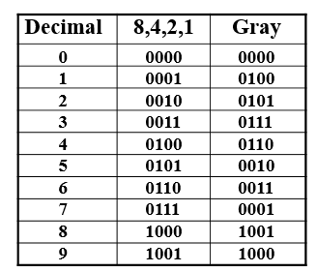
Gray Code
What special property does the Gray code have in relation to adjacent decimal digits?
Answer: As we “counts” up or down in decimal, the code word for the Gray code changes in only one bit position as we go from decimal digit to digit including from 9 to 0.
Chapter 1 <number>

Slide 28
Gray Code (Continued)
Does this special Gray code property have any value?
An Example: Optical Shaft Encoder
111
000
100
000
B
0
B
1
110
001
101
001
B
2
G
2
G
1
010
111
G
0
101
011
100
011
110
010
(a) Binary Code for Positions 0 through 7
(b) Gray Code for Positions 0 through 7
Chapter 1 <number>

Slide 29
Binary Arithmetic
Single Bit Addition with Carry
Multiple Bit Addition
Single Bit Subtraction with Borrow
Multiple Bit Subtraction
Multiplication
BCD Addition
Chapter 1 <number>

Slide 30
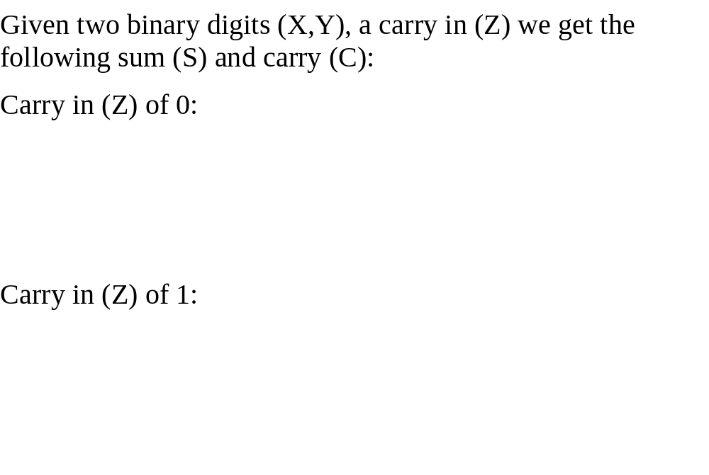
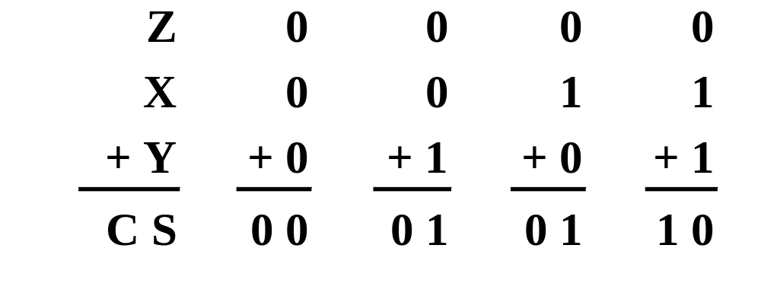
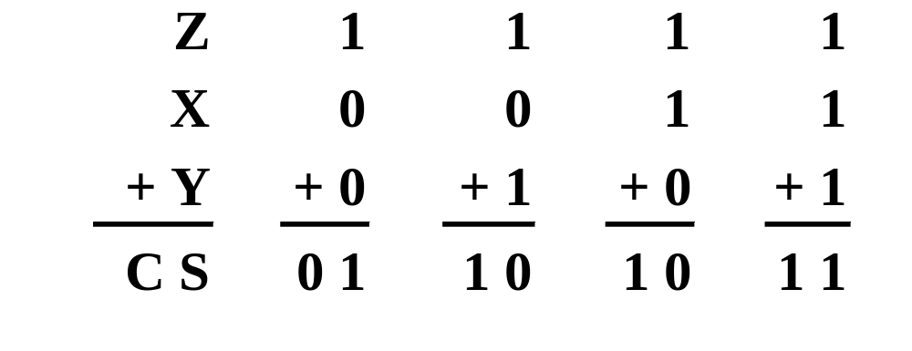
Single Bit Binary Addition with Carry
Chapter 1 <number>

Slide 31
Multiple Bit Binary Addition
Extending this to two multiple bit examples:
Carries 0 0
Augend 01100 10110
Addend +10001 +10111
Sum
Note: The 0 is the default Carry-In to the least significant bit.
Chapter 1 <number>
Notes:
Carries 00000 01100
Augend 01100 10110
Addend +10001 +10111
Sum 11101 101101

Slide 32
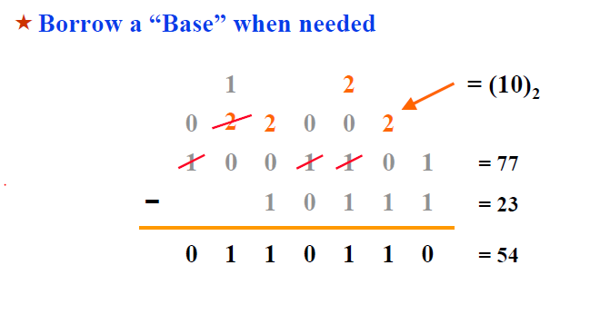
Binary Subtraction with Borrow
Chapter 1 <number>

Slide 33
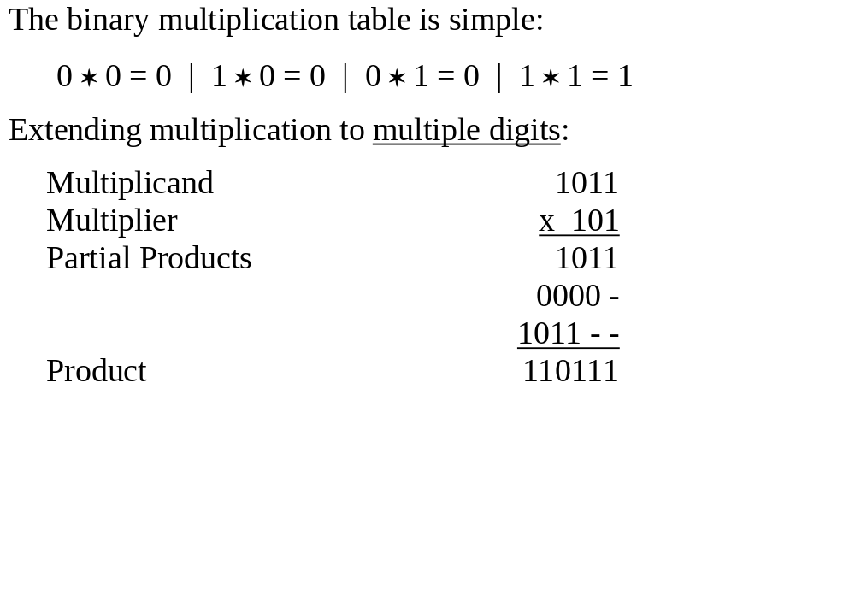
Binary Multiplication
Chapter 1 <number>

Slide 34
BCD Arithmetic
Given a BCD code, we use binary arithmetic to add the digits:
8
1000
Eight
+5
+0101
Plus 5
13
1101
is 13 (> 9)
Note that the result is MORE THAN 9, so must be
represented by two digits!
To correct the digit, subtract 10 by adding 6 modulo 16.
8
1000
Eight
+5
+0101
Plus 5
13
1101
is 13 (> 9)
+0110
so add 6
carry = 1
0011
leaving 3 + cy
0001 | 0011
Final answer (two digits)
If the digit sum is > 9, add one to the next significant digit
Chapter 1 <number>

Slide 35
BCD Addition Example
Add 2905_{BCD} to 1897_{BCD} showing carries and digit corrections.
0
0001 1000 1001 0111
+ 0010 1001 0000 0101
Chapter 1 <number>
Notes:
1 1 1 0
0001 1000 1001 0111
+ 0010 1001 0000 0101
0100 10010 1010 1100
+ 0000+ 0110+ 0110+ 0110
0100 1000 0000 0010

Slide 36
Error-Detection Codes
Redundancy (e.g. extra information), in the form of extra bits, can be incorporated into binary code words to detect and correct errors.
A simple form of redundancy is parity, an extra bit appended onto the code word to make the number of 1’s odd or even. Parity can detect all single-bit errors and some multiple-bit errors.
A code word has even parity if the number of 1’s in the code word is even.
A code word has odd parity if the number of 1’s in the code word is odd.
Chapter 1 <number>

Slide 37
4-Bit Parity Code Example
Fill in the even and odd parity bits:
The codeword "1111" has even parity and the codeword "1110" has odd parity. Both can be used to represent 3-bit data.
Even Parity
Odd Parity
Message
-
Parity
Message
-
Parity
000
-
000
-
001
-
001
-
010
-
010
-
011
-
011
-
100
-
100
-
101
-
101
-
110
-
110
-
111
-
111
-
Chapter 1 <number>
Notes:
Even Parity Bits: 0, 1, 1, 0, 1, 0, 0, 1
Odd Parity Bits: 1, 0, 0, 1, 0, 1, 1, 0

Slide 38
ASCII Character Codes
American Standard Code for Information Interchange
This code is a popular code used to represent information sent as character-based data. It uses 7-bits to represent:
  94 Graphic printing characters.
  34 Non-printing characters
Some non-printing characters are used for text format (e.g. BS = Backspace, CR = carriage return)
Other non-printing characters are used for record marking and flow control (e.g. STX and ETX start and end text areas).
Chapter 1 <number>

Slide 39
ASCII Properties
ASCII has some interesting properties:
Digits 0 to 9 span Hexadecimal values 30₁₆
to 39₁₆
.
Upper case A
-
Z span 41₁₆
to 5A₁₆
.
Lower case a
-
z span 61₁₆
to 7A₁₆
.
Lower to upper case translation (and vice versa)
occurs by
flipping bit 6.
Delete (DEL) is all bits set,
a carryover from when
punched paper tape was used to store messages.
Punching all holes in a row erased a mistake!
Chapter 1 <number>

Slide 40
UNICODE
UNICODE extends ASCII to 65,536 universal characters codes
  For encoding characters in world languages
  Available in many modern applications
  2 byte (16-bit) code words
  See Reading Supplement – Unicode on the Companion Website http://www.prenhall.com/mano
Chapter 1 <number>

