Slide 1
Digital Logic Design
Boolean Algebra And Logic Gates

Slide 2
Overview
Binary Logic and Gates
Logic Function Implementation
Boolean Algebra
Boolean Functions
Canonical Form
Standard Form
IC Digital Logic Families

Slide 3
Binary Logic and Gates
Binary variables take on one of two values.
Logical operators operate on binary values and binary variables.
Basic logical operators are the logic functions AND, OR and NOT.
Logic gates implement logic functions.
Boolean Algebra: a useful mathematical system for specifying and transforming logic functions.
We study Boolean algebra as foundation for designing and analyzing digital systems!

Slide 4
Logical Operations
The three basic logical operations are:
  AND
  OR
  NOT
AND is denoted by a dot (·).
OR is denoted by a plus (+).
NOT is denoted by an over bar ( ¯ ), a single quote mark (') after, or (~) before the variable.

Slide 5
Notation Examples
Examples:
  Y = A B is read “Y is equal to A AND B.”
  z = x + y is read “z is equal to x OR y.”
  X = A is read “X is equal to NOT A.”
⋅
Note: The statement:
  1 + 1 = 2 (read “one plus one equals two”)
is not the same as
  1 + 1 = 1 (read “1 or 1 equals 1”).

Slide 6
Truth Tables
Truth table - a tabular listing of the values of a function for all possible combinations of values on its arguments
Example: Truth tables for the basic logic operations:
AND
OR
X | Y | Z = X+Y
0 | 0 | 0
0 | 1 | 1
1 | 0 | 1
1 | 1 | 1
NOT
X
Y
Z = X·Y
X
Z
=
X
0
0
0
0
1
0
1
0
1
0
1
0
0
1
1
1

Slide 7
Logic Function Implementation
Using Switches
  For inputs:
    logic 1 is switch closed
    logic 0 is switch open
  For outputs:
    logic 1 is light on
    logic 0 is light off.
  NOT uses a switch:
    logic 1 is switch open
    logic 0 is switch closed
Switches in parallel => OR
Switches in series => AND
Normally-closed switch => NOT
C

Slide 8
Logic Function Implementation (Continued)
Example: Logic Using Switches
Light is on (L = 1) for
L(A, B, C, D) =
and off (L = 0), otherwise.
B
C
A
D
A ((B C') + D) = A B C' + A D

Slide 9
Logic Diagrams and Expressions
Truth Table
Equation
X Y Z
F
=
X
+
Y
⋅
Z
0 0 0
0
F
=
X
+
Y
Z
0 0 1
1
0 1 0
0
Logic Diagram
0 1 1
0
X
1 0 0
1
1 0 1
1
Y
F
1 1 0
1
Z
1 1 1
1
Boolean equations, truth tables and logic diagrams describe the same function!
Truth tables are unique; expressions and logic diagrams are not. This gives flexibility in implementing functions.

Slide 10
Boolean Algebra
An algebraic structure defined on a set of at least two elements, together with three binary operators (denoted +, · and ) that satisfies the following basic identities:
1.
X
+ 0
=
X
2.
X
. 1
=
X
3.
X
1
1
4.
X
. 0
0
+
=
=
5.
X + X
=
X
6.
X . X
=
X
7.
X + X
=
1
8.
X . X
=
0
9.
X = X
10.
X + Y
=
Y + X
11.
XY
=
YX
Commutative
12.
(X + Y)
+
Z
=
X + (Y
+
Z)
13.
(XY)
Z
=
X(Y
Z)
Associative
14.
X(Y +
Z)
=
XY
+
XZ
15.
X
+ YZ
=
(X + Y)
(X + Z)
Distributive
DeMorgan
16.
X + Y
=
X . Y
17.
X . Y
=
X + Y
’
s

Slide 11
Boolean Algebra
The identities above are organized into pairs. These pairs have names as follows:
01-04 Existence of 0 and 1 05-06 Idempotence
07-08 Existence of complement 09 Involution
10-11 Commutative Laws 12-13 Associative Laws
14-15 Distributive Laws 16-17 DeMorgan’s Laws
The dual of an algebraic expression is obtained by interchanging + and · and interchanging 0’s and 1’s.

Slide 12
Boolean Operator Precedence
The order of evaluation in a Boolean expression is:
    1. Parentheses
    2. NOT
    3. And
    4. OR
Consequence: Parentheses appear around OR expressions.
Example: F = A(B + C)(C + D)

Slide 13
Example 1: Boolean Algebraic Proof
A + A·B = A (Absorption Theorem)
Proof Steps Justification (identity or theorem)
A + A·B
= A · 1 + A · B X = X · 1
= A · ( 1 + B) X · Y + X · Z = X ·(Y + Z)(Distributive Law)
= A · 1 1 + X = 1
= A X · 1 = X
Our primary reason for doing proofs is to learn:
  Careful and efficient use of the identities and theorems of Boolean algebra, and
  How to choose the appropriate identity or theorem to apply to make forward progress.

Slide 14
Example 2: Boolean Algebraic Proofs
AB + AC + BC = AB + AC (Consensus Theorem)
Proof Steps Justification (identity or theorem)
AB + AC + BC
= AB + AC + 1 · BC ?
= AB +AC + (A + A) · BC ?
= ?
1 . X = X
X + X’ = 1
= AB + A’C + ABC + A’BC X(Y + Z) = XY + XZ (Distributive Law)
= AB + ABC + A’C + A’BC X + Y = Y + X (Commutative Law)
= AB . 1 + ABC + A’C . 1 + A’C . B X . 1 = X, X . Y = Y . X (Commutative Law)
= AB (1 + C) + A’C (1 + B) X(Y + Z) = XY +XZ (Distributive Law)
= AB . 1 + A’C . 1 = AB + A’C X . 1 = X

Slide 15
Example 3: Boolean Algebraic Proofs
Proof Steps Justification (identity or theorem)
= ??
(
X
+
Y
+
=
+
)
Z
X
Y
Y
(
X
Z
)
(
X
+
Y
)
Z
+
X
Y
= X’ Y’ Z + X Y’ (DeMorgan’s Law)
= Y’ X’ Z + Y’ X (Commutative Law)
= Y’ (X’ Z + X) (Distributive Law)
= Y’ (X’ + X)(Z + X) (Distributive Law)
= Y’ . 1 . (Z + X) A + A’ = 1
= Y’ (X + Z) (Commutative Law)

Slide 16
Proof of DeMorgan’s Laws
x
y
=
x
⋅
⋅
=
+
y
x
y
x
+
y
To show this we need to show that A + A’ = 1 and A.A’ = 0 with
A = x + y and A’ = x’. y’. This proves that x’. y’ = (x + y)’.
Part 1: Show x + y + x’. y’ = 1.
x + y + x’. y’
= (x + y + x’) (x + y + y’) X + YZ = (X + Y)(X + Z) (D. Law)
= (x + x’ + y) (x + y + y’) X + Y = Y + X (Commutative Law)
= (1 + y)(x + 1) X + X’ = 1
= 1 . 1 1 + X = 1
= 1 1 . X = 1

Slide 17
Proof of DeMorgan’s Laws
Part 2: Show (x + y) . x’. y’ = 0.
(x + y) . x’. y’
= (x . x’. y’ + y . x’. y’) X (Y + Z) = XY + XZ (D. Law)
= (x . x’. y’ + y . y’ . x’) XY = YX (Commutative Law)
= (0 . y’ + 0 . x’) X . X’ = 0
= (0 + 0) 0 . X = 0
= 0 X + 0 = X (With X = 0)
Based on the above two parts, x’y’ = (x + y)’
The second DeMorgan’s law is proved by duality. Note that DeMorgan’s
Law, given as an identity is not an axiom in the sense that it can be
proved using the other identities.

Slide 18
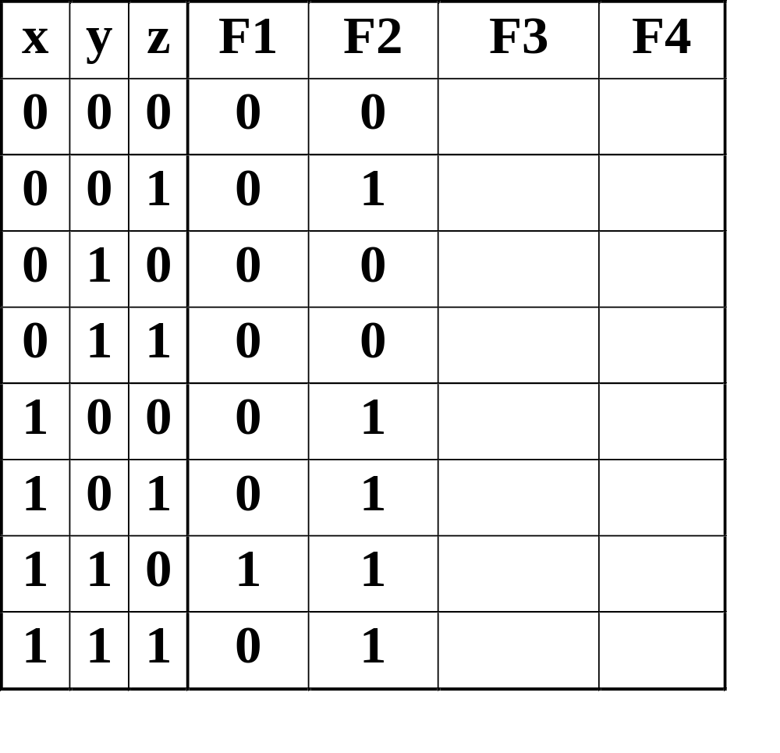
Boolean Function Evaluation
F1
=
xy
z
F2
=
x
+
y
z
1
0
0
1
1
1
0
0
0
1
0
1
1
1
0
0
F3
=
x
y
z
+
x
y
z
+
x
y
F4
=
x
y
+
x
z

Slide 19
Expression Simplification
An application of Boolean algebra
Simplify to contain the smallest number of literals (complemented and un-complemented variables):
A
B
+
A
C
D
+
A
B
D
+
A
C
D
+
A
B
C
D
= B (A + D) + A C 5 literals

Slide 20
Complementing Functions
Use DeMorgan's Theorem to complement a function:
  Interchange AND and OR operators
  Complement each constant value and literal
Example: Complement F =
F = (x + y + z)(x + y + z)
Example: Complement G = (a + bc)d + e
G =
x
y
z
+
x
y
z

Slide 21
Canonical Forms
It is useful to specify Boolean functions in a form that:
  Allows comparison for equality.
  Has a correspondence to the truth tables
Canonical Forms in common usage:
  Sum of Minterms (SOM)
  Product of Maxterms (POM)

Slide 22
Minterms
Minterms are AND terms with every variable present in either true or complemented form.
Given that each binary variable may appear normal (e.g., x) or complemented (e.g., ), there are 2^{n} minterms for n variables.
Example: Two variables (X and Y)produce 2 x 2 = 4 combinations:
  (both normal)
  (X normal, Y complemented)
  (X complemented, Y normal)
  (both complemented)
Thus there are four minterms of two variables.
x
XY
X
Y
X
Y
X
Y

Slide 23
Maxterms
Maxterms are OR terms with every variable in true or complemented form.
Given that each binary variable may appear normal (e.g., x) or complemented (e.g., x), there are 2^{n} maxterms for n variables.
Example: Two variables (X and Y) produce
2 x 2 = 4 combinations:
  (both normal)
  (x normal, y complemented)
  (x complemented, y normal)
  (both complemented)
X
+
Y
X
+
Y
X
+
Y
X
+
Y

Slide 24
Maxterms and Minterms
Examples: Two variable minterms and maxterms.
The index above is important for describing which variables in the terms are true and which are complemented.
Index | Minterm | Maxterm
0 | x y | x + y
1 | x y | x + y
2 | x y | x + y
3 | x y | x + y

Slide 25
Purpose of the Index
The index for the minterm or maxterm, expressed as a binary number, is used to determine whether the variable is shown in the true form or complemented form.
For Minterms:
  “1” means the variable is “Not Complemented” and
  “0” means the variable is “Complemented”.
For Maxterms:
  “0” means the variable is “Not Complemented” and
  “1” means the variable is “Complemented”.

Slide 26
Index Example in Three Variables
Example: (for three variables)
Assume the variables are called X, Y, and Z.
The standard order is X, then Y, then Z.
The Index 0 (base 10) = 000 (base 2) for three variables). All three variables are complemented for minterm 0 ( ) and no variables are complemented for Maxterm 0 (X,Y,Z).
  Minterm 0, called m₀ is .
  Maxterm 0, called M₀ is (X + Y + Z).
  Minterm 6 ?
  Maxterm 6 ?
X
,
Y
,
Z
X
Y
Z
m6 = X Y Z’
M6 = (X’ + Y’ + Z)

Slide 27
Minterm and Maxterm Relationship
Review: DeMorgan's Theorem
and
Two-variable example:
and
Thus M₂ is the complement of m₂ and vice-versa.
Since DeMorgan's Theorem holds for n variables, the above holds for terms of n variables
giving:
and
Thus M_{i} is the complement of m_{i}.
=
+
x
+
y
=
x
⋅
x
·
y
y
x
y
M
=
x
+
m
=
x·
y
y
2
2
M
=
m
m
=
M
i
i
i
i

Slide 28
Function Tables for Both
Minterms of Maxterms of
2 variables 2 variables
Each column in the maxterm function table is the complement of the column in the minterm function table since M_{i} is the complement of m_{i}.
x y
m
m
m
m
x y
M
M
M
M
0
1
2
3
0
1
2
3
0 0
1
0
0
0
0 0
0
1
1
1
0 1
0
1
0
0
0 1
1
0
1
1
1 0
0
0
1
0
1 0
1
1
0
1
1 1
0
0
0
1
1 1
1
1
1
0

Slide 29
Observations
In the function tables:
  Each minterm has one and only one 1 present in the 2^{n} terms (a minimum of 1s). All other entries are 0.
  Each maxterm has one and only one 0 present in the 2^{n} terms All other entries are 1 (a maximum of 1s).
We can implement any function by "ORing" the minterms corresponding to "1" entries in the function table. These are called the minterms of the function.
We can implement any function by "ANDing" the maxterms corresponding to "0" entries in the function table. These are called the maxterms of the function.
This gives us two canonical forms:
  Sum of Minterms (SOM)
  Product of Maxterms (POM) for stating any Boolean function.

Slide 30
Minterm Function Example
Example: Find F₁ = m₁ + m₄ + m₇
F1 = x y z + x y z + x y z
x y z
index
m₁
+
m₄
+
m₇
= F₁
0 0 0
0
0
+
0
+
0
= 0
0 0 1
1
1
+
0
+
0
= 1
0 1 0
2
0
+
0
+
0
= 0
0 1 1
3
0
+
0
+
0
= 0
1 0 0
4
0
+
1
+
0
= 1
1 0 1
5
0
+
0
+
0
= 0
1 1 0
6
0
+
0
+
0
= 0
1 1 1
7
0
+
0
+
1
= 1

Slide 31
Minterm Function Example
F(A, B, C, D, E) = m₂ + m₉ + m₁₇ + m₂₃
F(A, B, C, D, E) =
A’B’C’DE’ + A’BC’D’E + AB’C’D’E + AB’CDE

Slide 32
Maxterm Function Example
Example: Implement F1 in maxterms:
F₁ = M₀ · M₂ · M₃ · M₅ · M₆
F
=
(x
+
y
+
z)
·(x
+
y
+
z)·(x
+
y
+
z
)
1
·(
x
+
y
+
z
)·(
x
+
y
+
z)
x y z
i
M₀
⋅
M₂
⋅
M₃
⋅
M₅
⋅
M₆
= F1
0 0 0
0
0
⋅
1
⋅
1
⋅
1
⋅
1
= 0
0 0 1
1
1
⋅
1
⋅
1
⋅
1
⋅
1
= 1
0 1 0
2
1
⋅
0
⋅
1
⋅
1
⋅
1
= 0
0 1 1
3
1
⋅
1
⋅
0
⋅
1
⋅
1
= 0
1 0 0
4
1
⋅
1
⋅
1
⋅
1
⋅
1
= 1
1 0 1
5
1
⋅
1
⋅
1
⋅
0
⋅
1
= 0
1 1 0
6
1
⋅
1
⋅
1
⋅
1
⋅
0
= 0
1 1 1
7
1
⋅
1
⋅
1
⋅
1
⋅
1
= 1

Slide 33
Maxterm Function Example
F(A, B,C,D) =
F
=
⋅
⋅
⋅
(
A
,
B
,
C
,
D
)
M
M
M
M
3
8
11
14
(A + B + C’ + D’) (A’ + B + C + D) (A’ + B + C’ + D’) (A’ + B’ + C’ + D)

Slide 34
Canonical Sum of Minterms
Any Boolean function can be expressed as a Sum of Minterms.
  For the function table, the minterms used are the terms corresponding to the 1's
  For expressions, expand all terms first to explicitly list all minterms. Do this by “ANDing” any term missing a variable v with a term ( ).
Example: Implement as a sum of minterms.
  First expand terms:
  Then distribute terms:
  Express as sum of minterms: f = m₃ + m₂ + m₀
v
+
v
f
=
x
+
x
y
f
=
x
(
y
+
y
)
+
x
y
f
=
xy
+
x
y
+
x
y

Slide 35
Another SOM Example
F
=
A
+
B
C
Example:
There are three variables, A, B, and C which we take to be the standard order.
Expanding the terms with missing variables:
Collect terms (removing all but one of duplicate terms):
Express as SOM:
F = A(B + B’)(C + C’) + (A + A’) B’ C
= ABC + ABC’ + AB’C + AB’C’ + AB’C + A’B’C
= ABC + ABC’ + AB’C + AB’C’ + A’B’C
= m7 + m6 + m5 + m4 + m1 = m1 + m4 + m5 + m6 + m7

Slide 36
Shorthand SOM Form
From the previous example, we started with:
We ended up with:
F = m₁+m₄+m₅+m₆+m₇
This can be denoted in the formal shorthand:
Note that we explicitly show the standard variables in order and drop the “m” designators.
F
=
A
+
B
C

Slide 37
Canonical Product of Maxterms
Any Boolean Function can be expressed as a Product of Maxterms (POM).
  For the function table, the maxterms used are the terms corresponding to the 0's.
  For an expression, expand all terms first to explicitly list all maxterms. Do this by first applying the second distributive law , “ORing” terms missing variable v with a term equal to and then applying the distributive law again.
Example: Convert to product of maxterms:
  Apply the distributive law:
  Add missing variable z:
  Express as POM: f = M₂ · M₃
v
⋅
v
f
(
x
,
y
,
z
)
=
x
+
x
y
x
+
x
y
=
(x
+
x
)(x
+
y
)
=
1
⋅
(x
+
y
)
=
x
+
y
x
+
y
+
z
⋅
z
=
(
x
+
y
+
z
)
(
x
+
y
+
z
)

Slide 38
Another POM Example
Convert to Product of Maxterms:
Use x + y z = (x+y)·(x+z) with , and to get:
Then use to get:
and a second time to get:
Rearrange to standard order,
to give f = M₅ · M₂
f(A,
B,
C)
=
A
C
+
B
C
+
A
B
x
=
(A
C
+
B
C),
y
=
A
z
=
B
f
=
(A
C
+
B
C
+
A
)(A
C
+
B
C
+
B
)
x
+
x
y
=
x
+
y
f
=
(
C
+
BC
+
A
)(A
C
+
C
+
B
)
f
=
+
+
+
+
(
C
B
A
)(A
C
B
)
f
=
(
A
+
B
+
C
)(A
+
B
+
C)

Slide 39
Function Complements
The complement of a function expressed as a sum of minterms is constructed by selecting the minterms missing in the sum-of-minterms canonical forms.
Alternatively, the complement of a function expressed by a Sum of Minterms form is simply the Product of Maxterms with the same indices.
Example: Given
F
(
x
,
y
,
z
)
=
Σ
(
1
,
3
,
5
,
7
)
m
F
(
x
,
y
,
z
)
=
Σ
(
0
,
2
,
4
,
6
)
m
F
(
x
,
y
,
z
)
=
Π
(
1
,
3
,
5
,
7
)
M

Slide 40


Conversion Between Forms
To convert between sum-of-minterms and product-of-maxterms form (or vice-versa) we follow these steps:
  Find the function complement by swapping terms in the list with terms not in the list.
  Change from products to sums, or vice versa.
Example: Given F as before:
Form the Complement:
Then use the other form with the same indices – this
forms the complement again, giving the other form of the original function:
F
(
x
,
y
,
z
)
=
Σ
(
0
,
2
,
4
,
6
)
m

Slide 41
Standard Forms
Standard Sum-of-Products (SOP) form: equations are written as an OR of AND terms
Standard Product-of-Sums (POS) form: equations are written as an AND of OR terms
Examples:
  SOP:
  POS:
These “mixed” forms are neither SOP nor POS
A
B
C
+
A
B
C
+
B
(A
+
B)
·
(A
+
B
+
C
)
·
C
(A
B
+
C)
(A
+
C)
A
B
C
+
+
A
C
(A
B)

Slide 42
Standard Sum-of-Products (SOP)
A sum of minterms form for n variables can be written down directly from a truth table.
  Implementation of this form is a two-level network of gates such that:
  The first level consists of n-input AND gates, and
  The second level is a single OR gate (with fewer than 2^{n} inputs).
This form often can be simplified so that the corresponding circuit is simpler.

Slide 43
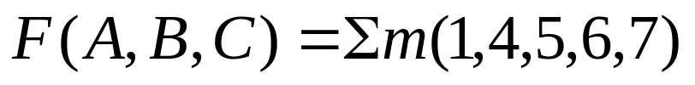
Standard Sum-of-Products (SOP)
A Simplification Example:
Writing the minterm expression:
F = A B C + A B C + A B C + ABC + ABC
Simplifying:
Simplified F contains 3 literals compared to 15 in minterm F
F = A’ B’ C + A (B’ C’ + B C’ + B’ C + B C)
= A’ B’ C + A (B’ + B) (C’ + C)
= A’ B’ C + A.1.1
= A’ B’ C + A
= B’C + A
??

Slide 44
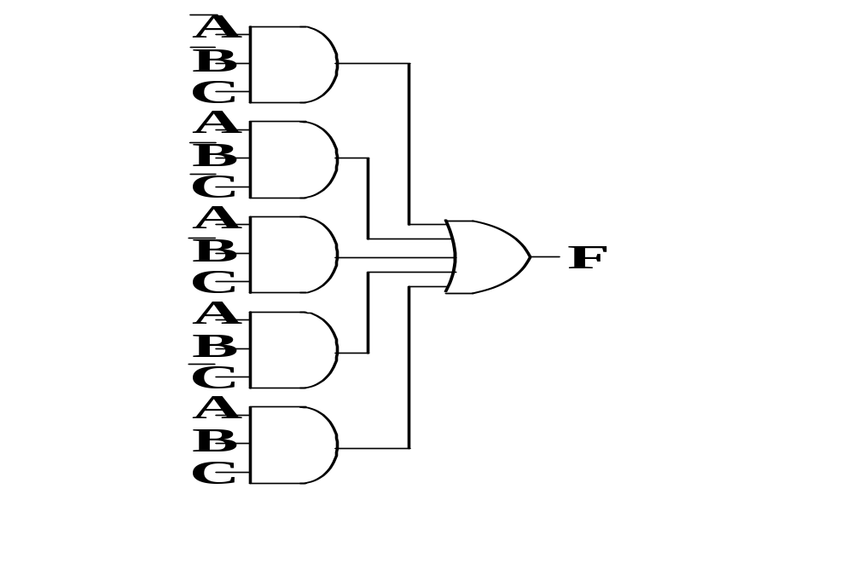
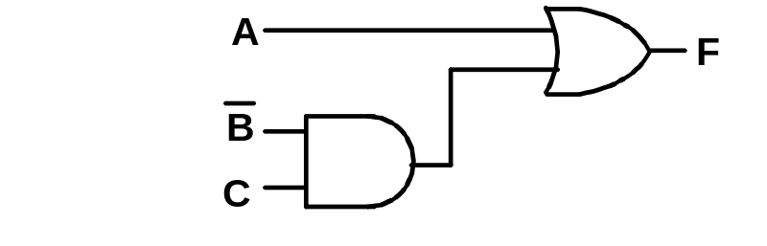
Two-level Implementation of SOP Expression
The two implementations for F are shown below – it is quite apparent which is simpler!

Slide 45
Conclusions
Canonical Forms (Sum-of-minterms, Product-of-Maxterms), or other standard forms (SOP, POS) differ in complexity
Boolean algebra can be used to manipulate equations into simpler forms.
Simpler equations lead to simpler two-level implementations
Questions:
  How can we attain a “simplest” expression?
  The next Lecture will deal with these issues.

