Slide 1

Digital Logic Design
CSE- 209
Simplification of Boolean Functions

Slide 2

Overview
Circuit Optimization
Two-Level Optimization
Map Manipulation
Multi-Level Circuit Optimization
NAND and NOR

Slide 3
Circuit Optimization
Goal: To obtain the simplest implementation for a given function
Optimization is a more formal approach to simplification that is performed using a specific procedure or algorithm
Optimization requires a cost criterion to measure the simplicity of a circuit
Two distinct cost criteria we will use:
Literal cost (L)
Gate input cost (G)
Gate input cost with NOTs (GN)

Slide 4
Literal Cost
Literal – a variable or it complement
Literal cost – the number of literal appearances in a Boolean expression corresponding to the logic circuit diagram
Examples:
F = BD + A C + A L = 8
F = BD + A C + A + AB L = 11
F = (A + B)(A + D)(B + C + )( + + D) L =10
Which solution is best?
B
D
C
B
D
C
B
D
B
C
The first !!

Slide 5
Gate Input Cost
Gate input costs - the number of inputs to the gates in the implementation corresponding exactly to the given equation or equations. (G - inverters not counted, GN - inverters counted)
Example:
F = BD + A C + A G = 8, GN = 11
F = BD + A C + A + AB G = 15, GN = 18
F = (A + )(A + D)(B + C + )( + + D) G = , GN =
Which solution is best?
B
C
D
B
D
C
B
B
D
B
C
14
17
The first !!

Slide 6
Cost Criteria
GN = G + 2 = 9
Example 1:
F = A + B C +
L = 5
C
B
G = L + 2 = 7
B
C
A
F
L (literal count) counts the AND inputs and the single literal OR input.
G (gate input count) adds the remaining OR gate inputs
GN(gate input count with NOTs) adds the inverter inputs

Slide 7
Cost Criteria
A
Example 2:
F = A B C +
L = 6 G = 8 GN = 11
F = (A + )( + C)( + B)
L = 6 G = 9 GN = 12
Same function and same literal cost
But first circuit has better gate input count and better gate input count with NOTs
B
C
B
A
C
F
C
B
A
Select it!
A
B
C
F

Slide 8
Boolean Function Optimization
Minimizing the gate input (or literal) cost of a (a set of) Boolean equation(s) reduces circuit cost.
We choose gate input cost.
Boolean Algebra and graphical techniques are tools to minimize cost criteria values.
Some important questions:
When do we stop trying to reduce the cost?
Do we know when we have a minimum cost?
Treat optimum or near-optimum cost functions for two-level (SOP and POS) circuits first.
Introduce a graphical technique using Karnaugh maps (K-maps, for short)

Slide 9
Karnaugh Maps (K-map)
A K-map is a collection of squares
Each square represents a minterm
The collection of squares is a graphical representation of a Boolean function
Adjacent squares differ in the value of one variable
Alternative algebraic expressions for the same function are derived by recognizing patterns of squares
The K-map can be viewed as
A reorganized version of the truth table
A topologically-warped Venn diagram as used to visualize sets in algebra of sets

Slide 10
Some Uses of K-Maps
Provide a means for:
Finding optimum or near optimum
SOP and POS standard forms, and
two-level AND/OR and OR/AND circuit implementations
for functions with small numbers of variables
Visualizing concepts related to manipulating Boolean expressions, and
Demonstrating concepts used by computer-aided design programs to simplify large circuits

Slide 11
Two Variable Maps
A 2-variable Karnaugh Map:
Note that minterm m0 and
minterm m1 are “adjacent”
and differ in the value of the
variable y
Similarly, minterm m0 and minterm m2 differ in the x variable.
Also, m1 and m3 differ in the x variable as well.
Finally, m2 and m3 differ in the value of the variable y
y = 0
y = 1
m
₀ =
m
₁ =
x = 0
x
y
x
y
x = 1
m
₂ =
m
₃ =
x
y
x
y

Slide 12
K-Map and Truth Tables
The K-Map is just a different form of the truth table.
Example – Two variable function:
We choose a,b,c and d from the set {0,1} to implement a particular function, F(x,y).
Function Table
K-Map
Input
Function
Values
Value
y = 0
y = 1
(x,y)
F(x,y)
x = 0
a
b
0 0
a
0 1
b
x = 1
c
d
1 0
c
1 1
d

Slide 13
K-Map Function Representation
Example: F(x,y) = x
For function F(x,y), the two adjacent cells containing 1’s can be combined using the Minimization Theorem:
F = x
y = 0
y = 1
x = 0
0
0
x = 1
1
1
F
(
x
,
y
)
=
x
y
+
x
y
=
x

Slide 14
K-Map Function Representation
Example: G(x, y) = x + y
For G(x,y), two pairs of adjacent cells containing 1’s can be combined using the Minimization Theorem:
G = x+y
y = 0
y = 1
x = 0
0
1
x = 1
1
1
(
)
(
)
G
(
x
,
y
)
=
x
y
+
x
y
+
xy
+
x
y
=
x
+
y
Duplicate x y

Slide 15
Three Variable Maps
A three-variable K-map:
Where each minterm corresponds to the product terms:
Note that if the binary value for an index differs in one bit position, the minterms are adjacent on the K-Map
yz=00
yz=01
yz=11
yz=10
x=0
m₀
m₁
m₃
m₂
x=1
m₄
m₅
m₇
m₆
yz=00
yz=01
yz=11
yz=10
x=0
x
y
z
x
y
z
x
y
z
x
y
z
x=1
x
y
z
x
y
z
x
y
z
x
y
z

Slide 16
Alternative Map Labeling
Map use largely involves:
Entering values into the map, and
Reading off product terms from the map.
Alternate labeling are useful:
y
y z
y
y
x
00
01
11
10
x
0
1
3
2
0
0
1
3
2
x
4
5
7
6
4
5
7
6
x
1
z
z
z
z

Slide 17
Example Functions
By convention, we represent the minterms of F by a "1" in the map and leave the minterms of blank
Example:
Example:
Learn the locations of the 8 indices based on the variable order shown (x, most significant and z, least significant) on the map boundaries
F
y
0
3
1
1
1
2
x
4
7
6
1
5
1
z
y
0
1
3
2
1
x
4
7
1
5
1
6
1
z

Slide 18
Combining Squares
By combining squares, we reduce number of literals in a product term, reducing the literal cost, thereby reducing the other two cost criteria
On a 3-variable K-Map:
One square represents a minterm with three variables
Two adjacent squares represent a product term with two variables
Four “adjacent” terms represent a product term with one variable
Eight “adjacent” terms is the function of all ones (no variables) = 1.

Slide 19
Example: Combining Squares
y
Example: Let
Applying the Minimization Theorem three times:
Thus the four terms that form a 2 × 2 square correspond to the term "y".
0
3
2
1
1
1
x
4
5
7
6
1
1
z
F
(
x
,
y
,
z
)
=
x
y
z
+
x
y
z
+
x
y
z
+
x
y
z
=
yz
+
y
z
=
y

Slide 20
Three-Variable Maps
Reduced literal product terms for SOP standard forms correspond to rectangles on K-maps containing cell counts that are powers of 2.
Rectangles of 2 cells represent 2 adjacent minterms; of 4 cells represent 4 minterms that form a “pairwise adjacent” ring.
Rectangles can contain non-adjacent cells as illustrated by the “pairwise adjacent” ring above.

Slide 21
Three-Variable Maps
Example Shapes of 2-cell Rectangles:
Read off the product terms for the rectangles shown
y
0
1
3
2
x
4
5
7
6
z

Slide 22
Three-Variable Maps
Example Shapes of 4-cell Rectangles:
Read off the product terms for the rectangles shown
y
0
1
3
2
x
4
5
7
6
z

Slide 23
Three Variable Maps
K-Maps can be used to simplify Boolean functions by systematic methods. Terms are selected to cover the “1s”in the map.
Example: Simplify
z
x
y
y
1
1
1
x
1
1
z
F(x,
y,
z)
=
z
+
x
y

Slide 24
Three-Variable Map Simplification
Use a K-map to find an optimum SOP equation for
Solution:
F = Z’ + X’ Y’ + X Y

Slide 25
Four Variable Maps
Map and location of minterms:
Y
0
1
3
2
4
5
7
6
12
15
14
X
13
W
8
9
11
10
Z

Slide 26
Four Variable Terms
Four variable maps can have rectangles corresponding to:
A single 1 = 4 variables, (i.e. Minterm)
Two 1s = 3 variables,
Four 1s = 2 variables
Eight 1s = 1 variable,
Sixteen 1s = zero variables (i.e. Constant "1")

Slide 27
Four-Variable Maps
Example Shapes of Rectangles:
Y
0
1
3
2
4
5
7
6
12
13
15
14
X
W
8
9
11
10
Z

Slide 28
Four-Variable Maps
Example Shapes of Rectangles:
Y
0
1
3
2
4
5
7
6
X
12
13
15
14
W
8
9
11
10
Z

Slide 29
Four-Variable Map Simplification
=
Σ
Solution:
F(W,
X,
Y,
Z)
(0,
2,4,5,6,7,
8,10,13,15
)
m
F = XZ + X'Z'

Slide 30
Four-Variable Map Simplification
=
Σ
Solution
F(W,
X,
Y,
Z)
(3,4,5,7,9,1
3,14,15
)
m
F = W' X Y' + W' Y Z + WXY + WY'Z

Slide 31
Five Variable or More K-Maps
For five variable problems, we use two adjacent K-maps. It becomes harder to visualize adjacent minterms for selecting PIs. You can extend the problem to six variables by using four K-Maps.
V = 0
V = 1
Y
Y
X
X
W
W
Z
Z

Slide 32
Don't Cares in K-Maps
Sometimes a function table or map contains entries for which it is known:
the input values for the minterm will never occur, or
The output value for the minterm is not used
In these cases, the output value need not be defined
Instead, the output value is defined as a “don't care”
By placing “don't cares” ( an “x” entry) in the function table or map, the cost of the logic circuit may be lowered.

Slide 33
Don't Cares in K-Maps
Ultimately, each “x” entry may take on either a 0 or 1 value in resulting solutions
For example, an “x” may take on value “0” in an SOP solution and value “1” in a POS solution, or vice-versa.
Any minterm with value “x” need not be covered by a prime implicant.

Slide 34
Example: BCD “5 or More”
The map below gives a function F1(w,x,y,z) which is defined as "5 or more" over BCD inputs. With the don't cares used for the 6 non-BCD combinations:
F1 (w,x,y,z) = w + x z + x y G = 7
This is much lower in cost than F2 where the “don't cares” were treated as "0s."
G = 12
For this particular function, cost G for the POS solution for F₁(w,x,y,z) is not changed by using the don't cares.
y
0
0
0
0
0
1
3
2
0
1
1
1
F₂(w,
x,
y,
z)
=
w
x
z
+
w
x
y
+
w
x
y
4
5
7
6
x
X
X
X
X
w
12
13
15
14
1
1
X
X
8
9
11
10
z

Slide 35
Product of Sums Example
Find the optimum POS solution:
Hint: Use and complement it to get the result.
F
F' = B' D' + A' B
F = (B + D)(A + B')

Slide 36
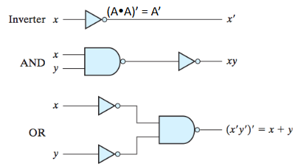
NAND and NOR
NAND: Universal gate (any digital circuit can be implemented using only NAND gates).
AND, OR and NOT can be implemented with NANDs

Slide 37

NAND
two ways to draw a NAND gate
Suggests a way to create all NAND gate implementation
move the bubbles around in a sum‐of‐products implementation...
you can also use algebra

Slide 38
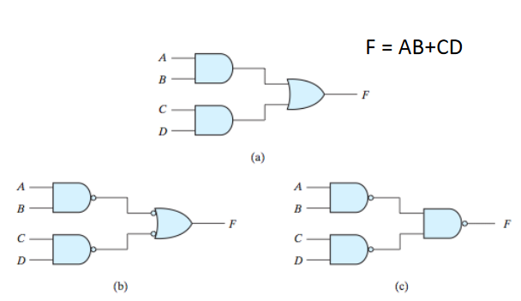
NAND

Slide 39
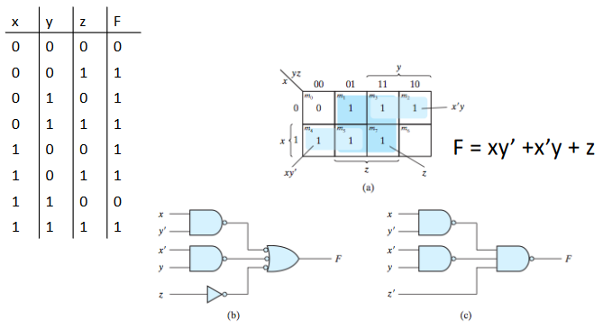
NAND only implementations

Slide 40
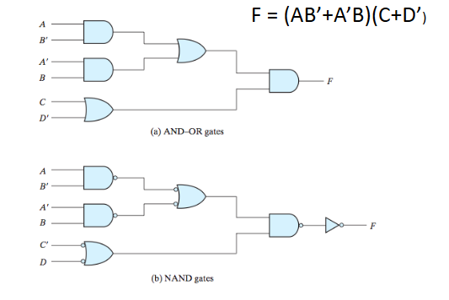
Multi-level all NAND

Slide 41
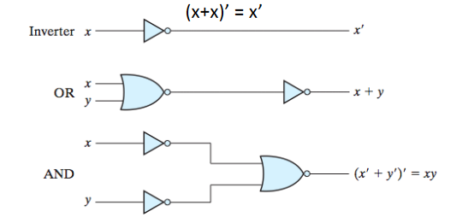
NOR implementation
Same idea, just start with product‐of‐sum

Slide 42
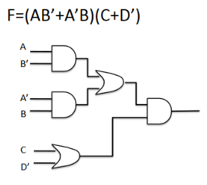
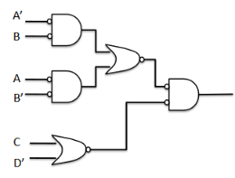
All NOR implementations

Slide 43
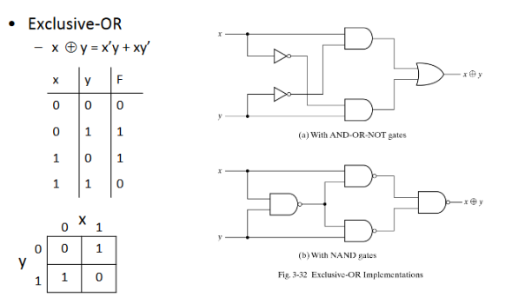
XOR

Slide 44
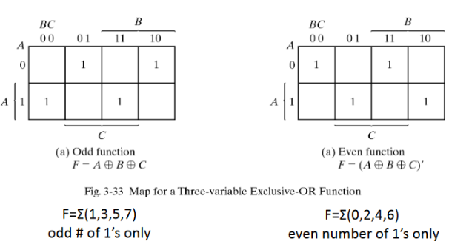
Example 1
3 input XOR – even/odd checker

Slide 45
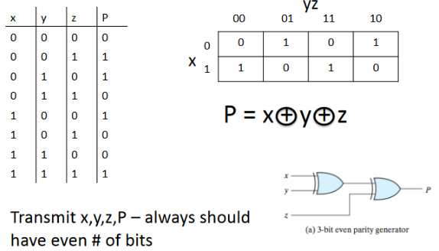
Example 2
Design a 3-bit even parity generator

