Slide 1

Digital Logic Design
CSE- 209
Combinational Logic

Slide 2

Overview
Combinational Circuits
Technology Parameter
Design Procedure
Functions and functional blocks
Decoding
Encoding
Selecting

Slide 3
Combinational Circuits
A combinational logic circuit has:
  A set of m Boolean inputs,
  A set of n Boolean outputs, and
  n switching functions, each mapping the 2^{m} input combinations to an output such that the current output depends only on the current input values
A block diagram:
Combinatorial
Logic
Circuit
m Boolean Inputs
n Boolean Outputs

Slide 4
Technology Parameters
Specific gate implementation technologies are characterized by the following parameters:
  Fan-in – the number of inputs available on a gate
  Fan-out – the number of standard loads driven by a gate output
  Logic Levels – the signal value ranges for 1 and 0 on the inputs and 1 and 0 on the outputs
  Noise Margin – the maximum external noise voltage superimposed on a normal input value that will not cause an undesirable change in the circuit output
  Cost for a gate - a measure of the contribution by the gate to the cost of the integrated circuit
  Propagation Delay – The time required for a change in the value of a signal to propagate from an input to an output
  Power Dissipation – the amount of power drawn from the power supply and consumed by the gate

Slide 5
Propagation Delay
Propagation delay is the time for a change on an input of a gate to propagate to the output.
Delay is usually measured at the 50% point with respect to the H and L output voltage levels.
High-to-low (t_{PHL}) and low-to-high (t_{PLH}) output signal changes may have different propagation delays.
High-to-low (HL) and low-to-high (LH) transitions are defined with respect to the output, not the input.
An HL input transition causes:
  an LH output transition if the gate inverts and
  an HL output transition if the gate does not invert.

Slide 6
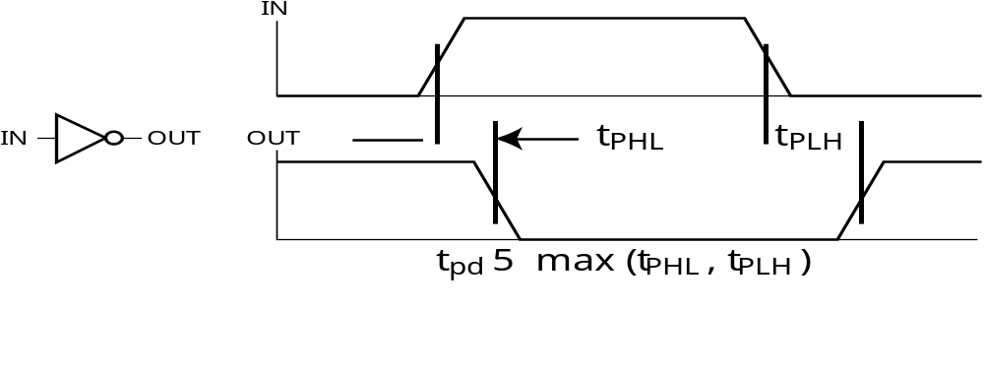
Propagation Delay
Propagation delays measured at the midpoint between the L and H values

Slide 7
Propagation Delay Example
Find t_{PHL}, t_{PLH} and t_{pd} for the signals given
tPHL = 1.4 ns, tPLH = 1.1 ns, tpd = 1.25 ns
IN (volts)
OUT (volts)
t (ns)
1.0 ns per division

Slide 8
Positive and Negative Logic
The same physical gate has different logical meanings depending on interpretation of the signal levels.
Positive Logic
  HIGH (more positive) signal levels represent Logic 1
  LOW (less positive) signal levels represent Logic 0
Negative Logic
  LOW (more negative) signal levels represent Logic 1
  HIGH (less negative) signal levels represent Logic 0
A gate that implements a Positive Logic AND function will implement a Negative Logic OR function, and vice-versa.

Slide 9
Positive and Negative Logic
Given this signal level table:
What logic function is implemented?
Input
Output
X Y
Positive Logic: OR
L
L
L
L H
H
H L
H
H
H
H
Positive
(H = 1)
Negative
(H = 0)
Logic
(L = 0)
Logic
(L = 1)
Negative Logic: AND
0 0
0
1 1
1
0 1
1
1 0
0
1 0
1
0 1
0
1 1
1
0 0
0
Notes:
Negative Logic: GO TO NEXT SLIDE

Slide 10
Design Procedure
Specification
  Write a specification for the circuit if one is not already available
Formulation
  Derive a truth table or initial Boolean equations that define the required relationships between the inputs and outputs.
Optimization
  Draw a logic diagram or provide a netlist for the resulting circuit using ANDs, ORs, and inverters
Technology Mapping
  Map the logic diagram or netlist to the implementation technology selected
Verification
  Verify the correctness of the final design

Slide 11
Top-Down versus Bottom-Up
A top-down design proceeds from an abstract, high-level specification to a more and more detailed design by decomposition and successive refinement
A bottom-up design starts with detailed primitive blocks and combines them into larger and more complex functional blocks
Designs usually proceed from both directions simultaneously
  Top-down design answers: What are we building?
  Bottom-up design answers: How do we build it?
Top-down controls complexity while bottom-up focuses on the details

Slide 12
CAD
Representative Computer-Aided Design Tools:
  Schematic Capture
  Logic Simulators
  Timing Verifiers
  Hardware Description Languages
    Verilog and VHDL
  Logic Synthesizers
  Integrated Circuit Layout

Slide 13
Functions and Functional Blocks
The functions considered are those found to be very useful in design
Corresponding to each of the functions is a combinational circuit implementation called a functional block.
In the past, many functional blocks were implemented as SSI, MSI, and LSI circuits.
Today, they are often simply parts within a VLSI circuits.

Slide 14
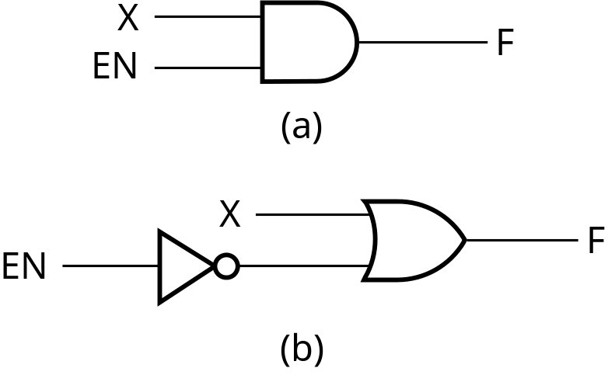
Enabling Function
Enabling permits an input signal to pass through to an output
Disabling blocks an input signal from passing through to an output, replacing it with a fixed value
The value on the output when it is disable can be Hi-Z (as for three-state buffers and transmission gates), 0 , or 1
When disabled, 0 output
When disabled, 1 output

Slide 15
Decoding
Decoding - the conversion of an n-bit input code to an m-bit output code with
n ≤ m ≤ 2^{n} such that each valid code word produces a unique output code
Circuits that perform decoding are called decoders
Here, functional blocks for decoding are
  called n-to-m line decoders, where m ≤ 2^{n}, and
  generate 2^{n} (or fewer) minterms for the n input variables

Slide 16
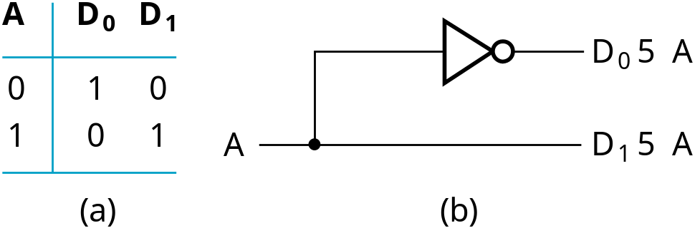
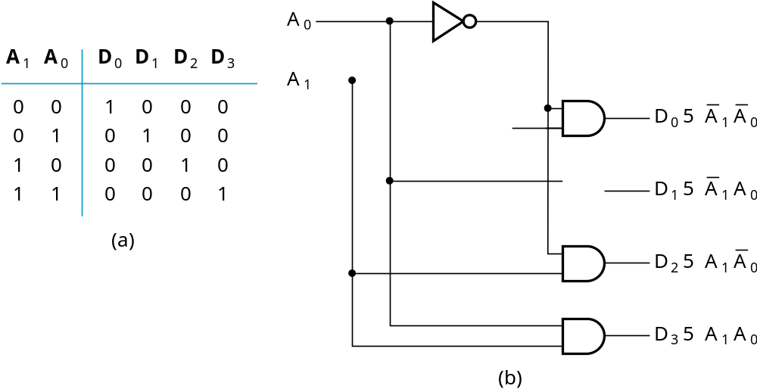
Decoder Examples
1-to-2-Line Decoder
2-to-4-Line Decoder
Note that the 2-4-line
made up of 2 1-to-2-
line decoders and 4 AND gates.

Slide 17
Decoder Expansion - Example 1
3-to-8-line decoder
  Number of output ANDs = 8
  Number of inputs to decoders driving output ANDs = 3
  Closest possible split to equal
    2-to-4-line decoder
    1-to-2-line decoder
  2-to-4-line decoder
    Number of output ANDs = 4
    Number of inputs to decoders driving output ANDs = 2
    Closest possible split to equal
      Two 1-to-2-line decoders

Slide 18
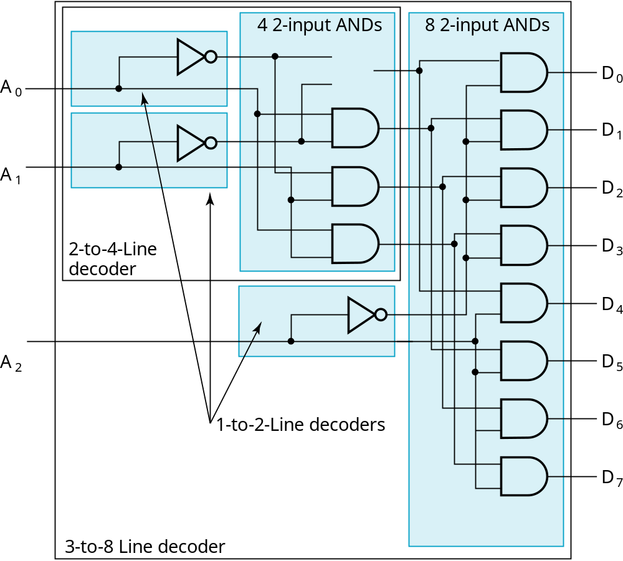
Decoder Expansion - Example 1
Result

Slide 19
Decoder Expansion - Example 2
7-to-128-line decoder
  Number of output ANDs = 128
  Number of inputs to decoders driving output ANDs = 7
  Closest possible split to equal
    4-to-16-line decoder
    3-to-8-line decoder
  4-to-16-line decoder
    Number of output ANDs = 16
    Number of inputs to decoders driving output ANDs = 2
    Closest possible split to equal
      2 2-to-4-line decoders

Slide 20
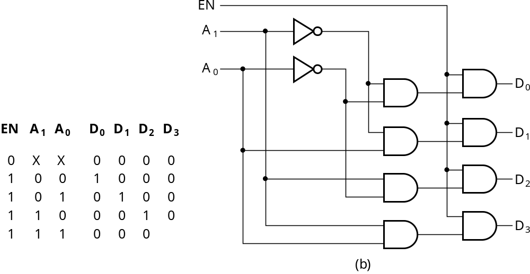
Decoder with Enable
In general, attach m-enabling circuits to the outputs
See truth table below for function
  Note use of X’s to denote both 0 and 1
  Combination containing two X’s represent four binary combinations
In this case, called a
demultiplexer

Slide 21
Encoding
Encoding - the opposite of decoding - the conversion of an m-bit input code to a n-bit output code with n ≤ m ≤ 2^{n} such that each valid code word produces a unique output code
Circuits that perform encoding are called encoders
An encoder has 2^{n} (or fewer) input lines and n output lines which generate the binary code corresponding to the input values
Typically, an encoder converts a code containing exactly one bit that is 1 to a binary code corres-ponding to the position in which the 1 appears.

Slide 22
Decimal to BCD Encoder
A decimal-to-BCD encoder
  Inputs: 10 bits corresponding to decimal digits 0 through 9, (D₀, …, D₉)
  Outputs: 4 bits with BCD codes
  Function: If input bit D_{i} is a 1, then the output (A₃, A₂, A₁, A₀) is the BCD code for i,
The truth table could be formed, but alternatively, the equations for each of the four outputs can be obtained directly.

Slide 23
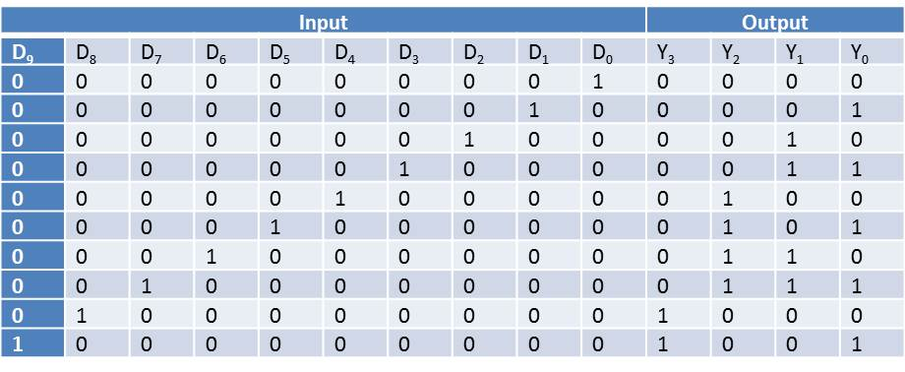
Decimal to BCD Encoder
Equations:
  A₃ = D₈ + D₉
  A₂ = D₄ + D₅ + D₆ + D₇
  A₁ = D₂ + D₃ + D₆ + D₇
  A₀ = D₁ + D₃ + D₅ + D₇ + D₉

Slide 24
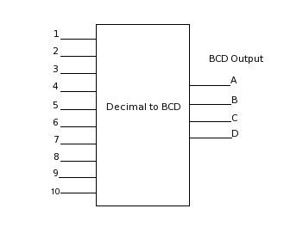
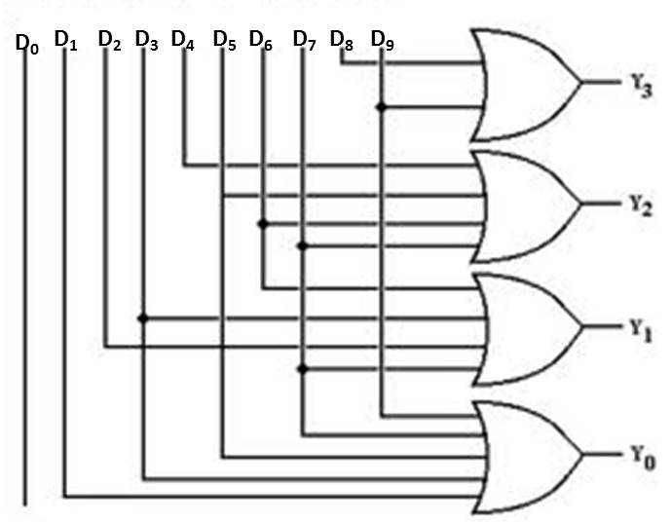
Decimal to BCD Encoder

Slide 25
Priority Encoder
If more than one input value is 1, then the encoder just designed does not work.
One encoder that can accept all possible combinations of input values and produce a meaningful result is a priority encoder.
Among the 1s that appear, it selects the most significant input position (or the least significant input position) containing a 1 and responds with the corresponding binary code for that position.

Slide 26
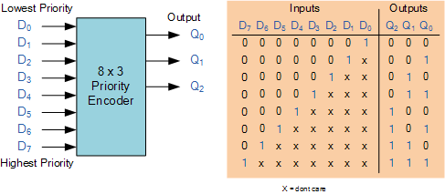
Priority Encoder Example
Priority encoder with 5 inputs (D_{7,} D_{6,} D_{5 ,} D₄, D₃, D₂, D₁, D₀) - highest priority to most significant 1 present - Code outputs Q₂, Q₁, Q₀ .

Slide 27
Priority Encoder Example
Could use a K-map to get equations, but can be read directly from table and manually optimized if careful:
  A₂ = D₄
  A₁ = D₃ + D₂ = F₁, F₁ = (D₃ + D₂)
  A₀ = D₃ + D₁ = (D₃ + D1)
  V = D₄ + F₁ + D₁ + D₀
D4
D4
D3
D4
D4
D4
D3
D2
D4
D2

Slide 28
Selecting
Selecting of data or information is a critical function in digital systems and computers
Circuits that perform selecting have:
  A set of information inputs from which the selection is made
  A single output
  A set of control lines for making the selection
Logic circuits that perform selecting are called multiplexers
Selecting can also be done by three-state logic or transmission gates

Slide 29
Multiplexers
A multiplexer selects information from an input line and directs the information to an output line
A typical multiplexer has n control inputs (S_{n − 1}, … S₀) called selection inputs, 2^{n} information inputs (I₂^{n} ₋ ₁, … I₀), and one output Y
A multiplexer can be designed to have m information inputs with m < 2^{n} as well as n selection inputs

Slide 30
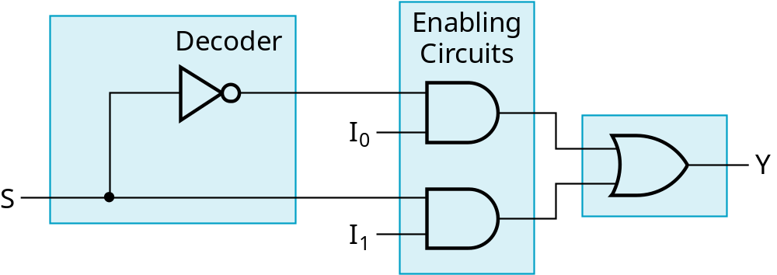
2-to-1-Line Multiplexer
Since 2 = 2¹, n = 1
The single selection variable S has two values:
  S = 0 selects input I₀
  S = 1 selects input I₁
The equation:
Y = I₀ + SI₁
The circuit:
S

Slide 31
2-to-1-Line Multiplexer
Note the regions of the multiplexer circuit shown:
  1-to-2-line Decoder
  2 Enabling circuits
  2-input OR gate
To obtain a basis for multiplexer expansion, we combine the Enabling circuits and OR gate into a 2 × 2 AND-OR circuit:
  1-to-2-line decoder
  2 × 2 AND-OR
In general, for an 2^{n}-to-1-line multiplexer:
  n-to-2^{n}-line decoder
  2^{n} × 2 AND-OR

Slide 32
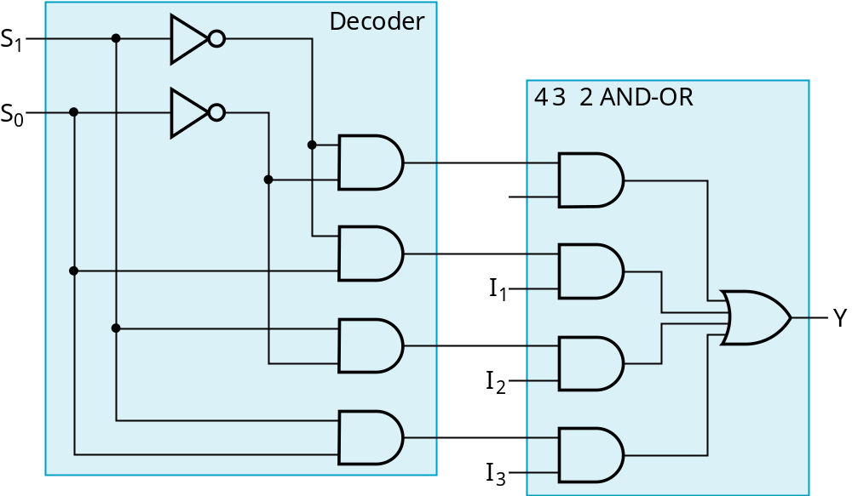
Example: 4-to-1-line Multiplexer
2-to-2²-line decoder
2² × 2 AND-OR

Slide 33
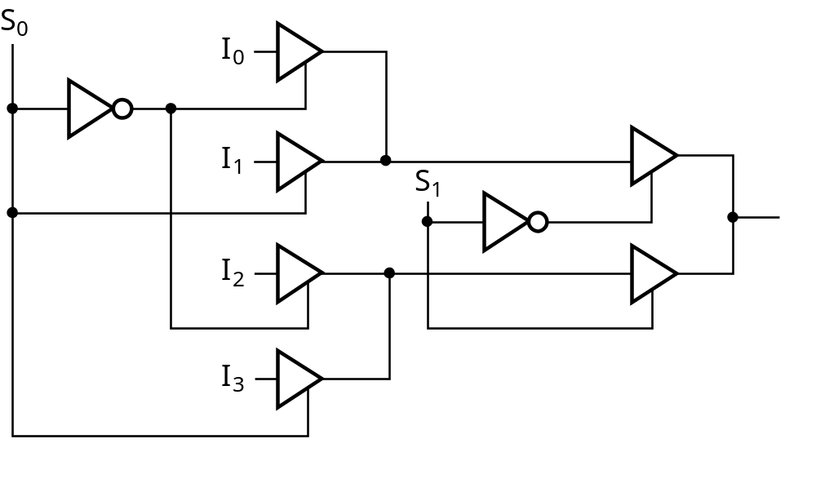
Other Selection Implementations
Three-state logic in place of AND-OR
Gate input cost = 14 compared to 22 (or 18) for gate implementation

Slide 34
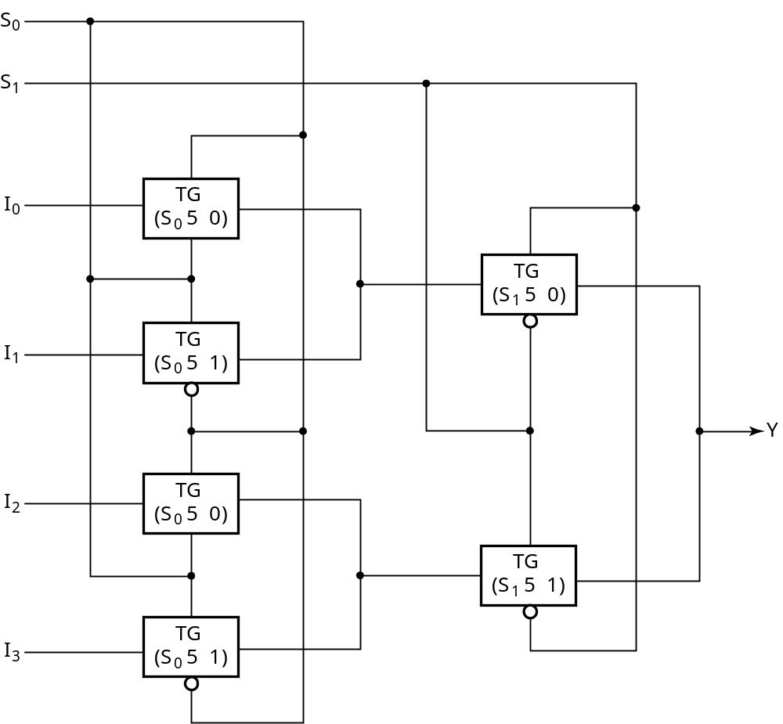
Other Selection Implementations
Transmission Gate Multiplexer
Gate input
cost = 8
compared
to 14 for
3-state logic
and 18 or 22
for gate logic

