Slide 2
Overview
Part 1 - Registers, Microoperations and Implementations
  Registers and load enable
  Register transfer operations
  Microoperations - arithmetic, logic, and shift
  Microoperations on a single register
    Multiplexer-based transfers
    Shift registers
Part 2 - Counters, register cells, buses, & serial operations
  Microoperations on single register (continued)
    Counters
  Register cell design
  Multiplexer and bus-based transfers for multiple registers
  Serial transfers and microoperations

Slide 3
Registers
Register – a collection of binary storage elements
In theory, a register is sequential logic which can be defined by a state table
More often think of a register as storing a vector of binary values
Frequently used to perform simple data storage and data movement and processing operations

Slide 4

Example: 2-bit Register
How many states are there?
How many input combinations?
Output combinations
What is the output function?
What is the next state function?
Moore or Mealy?
What are the the quantities above for an n-bit register?
A1
In1
D
Q
Y1
C
A0
In0
D
Q
Y0
CP
C
Current
Next State
Output
State
A1(t+
1
) A0(t+
1
)
(=A1 A0)
For I1 I0 =
A1 A0
00 01 10 11
Y1 Y0
0 0
00 01 10 11
0 0
0 1
00 01 10 11
0 1
1 0
00 01 10 11
1 0
1 1
00 01 10 11
1 1
Notes:
States: 2² = 4
Input Combinations: 2² = 4
Output Combinations: 2² = 4
Y = A
A(t+1) = IN
Moore
States = 2^{n}
Input Combinations = 2^{n}
Output Combinations = 2^{n}

Slide 5
Register Design Models
Due to the large numbers of states and input combinations as n becomes large, the state diagram/state table model is not feasible!
What are methods we can use to design registers?
  Add predefined combinational circuits to registers
    Example: To count up, connect the register flip-flops to an incrementer
  Design individual cells using the state diagram/state table model and combine them into a register
    A 1-bit cell has just two states
    Output is usually the state variable

Slide 6
Register Storage
Expectations:
  A register can store information for multiple clock cycles
  To “store” or “load” information should be controlled by a signal
Reality:
  A D flip-flop register loads information on every clock cycle
Realizing expectations:
  Use a signal to block the clock to the register,
  Use a signal to control feedback of the output of the register back to its inputs, or
  Use other SR or JK flip-flops which for (0,0) applied store their state
Load is a frequent name for the signal that controls register storage and loading
  Load = 1: Load the values on the data inputs
  Load = 0: Store the values in the register

Slide 7
Registers with Clock Gating
Load signal is used to enable the clock signal to pass through if 1 and prevent the clock signal from passing through if 0.
Example: For Positive Edge-Triggered or Negative Pulse Master-Slave Flip-flop:
What logic is needed for gating?
What is the problem?
Clock
Load
Gated Clock to FF
Gated Clock = Clock + Load
Clock Skew of gated clocks with respect to clock or each other

Slide 8
Registers with Load-Controlled Feedback
A more reliable way to selectively load a register:
  Run the clock continuously, and
  Selectively use a load control to change the register contents.
Example: 2-bit register
with Load Control:
For Load = 0,
loads register contents
(hold current values)
For Load = 1,
loads input values
(load new values)
Hardware more complex
than clock gating, but
free of timing problems
2-to-1 Multiplexers
A1
D
Q
Y1
Load
In1
C
A0
D
Q
Y0
C
In0
Clock

Slide 9
Register Transfer Operations
Register Transfer Operations – The movement and processing of data stored in registers
Three basic components:
  set of registers
  operations
  control of operations
Elementary Operations -- load, count, shift, add, bitwise "OR", etc.
  Elementary operations called microoperations

Slide 10
Register Notation
Letters and numbers – denotes a register (ex. R2, PC, IR)
Parentheses ( ) – denotes a range of register bits (ex. R1(1), PC(7:0), AR(L))
Arrow (←) – denotes data transfer (ex. R1 ← R2, PC(L) ← R0)
Comma – separates parallel operations
Brackets [ ] – Specifies a memory address (ex. R0 ← M[AR], R3 M[PC] )
R
7 6 5 4 3 2 1 0
15 8
7 0
15 0
PC(H)
PC(L)
R2

Slide 11
Conditional Transfer
If (K1 =1) then (R2 ← R1) is shortened to
K1: (R2 ← R1)
where K1 is a control variable specifying a conditional execution
of the microoperation.
K
1
n
Load
R1
R2
Clock
Clock
K₁
Transfer Occurs Here
No Transfers Occur Here

Slide 12
Microoperations
Logical Groupings:
  Transfer - move data from one set of registers to another
  Arithmetic - perform arithmetic on data in registers
  Logic - manipulate data or use bitwise logical operations
  Shift - shift data in registers
Arithmetic operations
+ Addition
– Subtraction
* Multiplication
/ Division
Logical operations
∨ Logical OR
∧ Logical AND
⊕ Logical Exclusive OR
‾ Not

Slide 13
Example Microoperations
Add the content of R1 to the content of R2 and place the result in R1.
R1← R1 + R2
Multiply the content of R1 by the content of R6 and place the result in PC.
PC ← R1 * R6
Exclusive OR the content of R1 with the content of R2 and place the result in R1.
R1 ← R1 ⊕ R2

Slide 14
Example Microoperations (Continued)
Take the 1's Complement of the contents of R2 and place it in the PC.
PC ← R2
On condition K1 OR K2, the content of R1 is Logic bitwise Ored with the content of R3 and the result placed in R1.
(K1 + K2): R1 ← R1 ∨ R3
NOTE: "+" (as in K₁ + K₂) and means “OR.” In R1 ← R1 + R3, + means “plus.”

Slide 15
Control Expressions
The control expression for an operation appears to the left of the operation and is separated from it by a colon
Control expressions specify the logical condition for the operation to occur
Control expression values of:
  Logic "1" -- the operation occurs.
  Logic "0" -- the operation is does not occur.
Example:
X K1 : R1 ← R1 + R2
X K1 : R1 ← R1 + R2 + 1
Variable K1 enables the add or subtract operation.
If X =0, then X =1 so X K1 = 1, activating the addition of R1 and R2.
If X = 1, then X K1 = 1, activating the addition of R1 and the two's complement of R2 (subtract).

Slide 16
Arithmetic Microoperations
From
Table
7-3:
Note that any register may be specified for source 1, source 2, or destination.
These simple microoperations operate on the whole word
Symbolic Designation
Description
R0
←
R1 + R2
Addition
R0
←
R1
Ones Complement
R0
←
R1 + 1
Two's Complement
R0
←
R2 +
R1 + 1
R2 minus R1 (2's Comp)
R1
←
R1 + 1
Increment (count up)
R1
←
R1
–
1
Decrement (count down)

Slide 17
Logical Microoperations
From Table 7-4:
Symbolic
Description
Designation
R0
←
R1
Bitwise NOT
R0
←
R1
∨
R2
Bitwise OR (sets bits)
R0
←
R1
∧
R2
Bitwise AND (clears bits)
R0
←
R1
⊕
R2
Bitwise EXOR (complements bits)

Slide 18
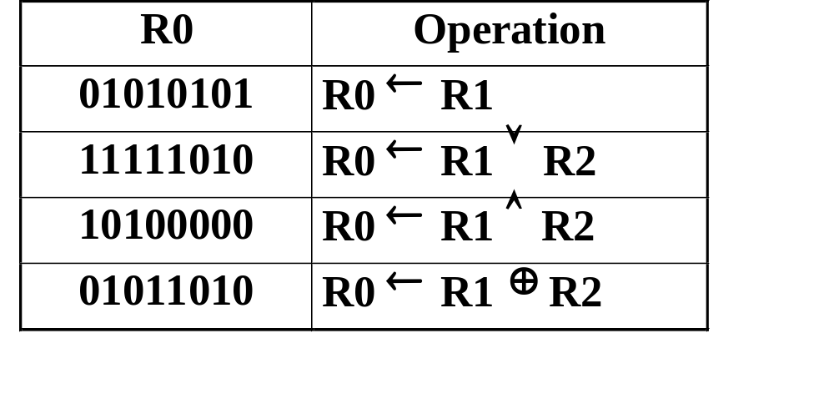
Logical Microoperations (continued)
Let R1 = 10101010,
and R2 = 11110000
Then after the operation, R0 becomes:

Slide 19
Shift Microoperations
From Table 7-5:
Let R2 = 11001001
Then after the operation, R1 becomes:
Symbolic
Description
Designation
R1
←
sl R2
Shift Left
R1
←
sr R2
Shift Right
R1
Operation
10010010
R1
←
sl R2
01100100
R1
←
sr R2
Note: These shifts "zero fill". Sometimes a separate flip-flop is used to provide the data shifted in, or to “catch” the data shifted out.
Other shifts are possible (rotates, arithmetic) (see Chapter 11).

Slide 20
Register Transfer Structures
Multiplexer-Based Transfers - Multiple inputs are selected by a multiplexer dedicated to the register
Bus-Based Transfers - Multiple inputs are selected by a shared multiplexer driving a bus that feeds inputs to multiple registers
Three-State Bus - Multiple inputs are selected by
3-state drivers with outputs connected to a bus that feeds multiple registers
Other Transfer Structures - Use multiple multiplexers, multiple buses, and combinations of all the above

Slide 21
Multiplexer-Based Transfers
Multiplexers connected to register inputs produce flexible transfer structures (Note: Clocks are omitted for clarity)
The transfers are: K1: R0 ← R1
K2 K1: R0 ← R2
Load
K
2
R2
K
1
S
Load
n
0
n
MUX
R0
Load
n
1
R1

Slide 22
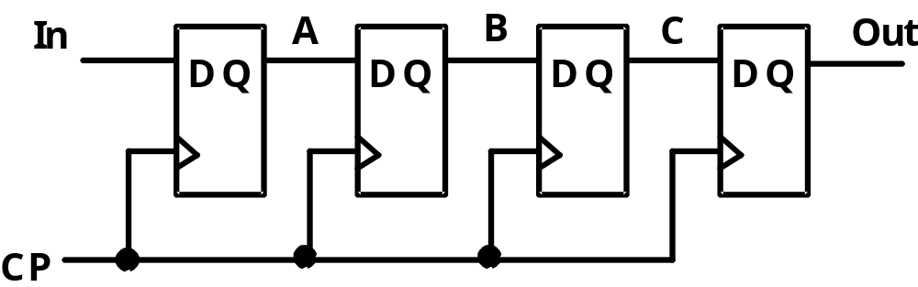
Shift Registers
Shift Registers move data laterally within the register toward its MSB or LSB position
In the simplest case, the shift register is simply a set of
D flip-flops connected in a row like this:
Data input, In, is called a serial input or the shift right input.
Data output, Out, is often called the serial output.
The vector (A, B, C, Out) is called the parallel output.

Slide 23
Shift Registers (continued)
The behavior of the
serial shift register
is given in the listing
on the lower right
T0 is the register
state just before
the first clock
pulse occurs
T1 is after the
first pulse and
before the second.
Initially unknown
states are denoted by “?”
Complete the last three
rows of the table
In
A
B
C
Out
D
Q
D
Q
D
Q
D
Q
Clock CP
CP
In
A
B
C
Out
T0
0
?
?
?
?
T1
1
0
?
?
?
T2
1
1
0
?
?
T3
0
1
1
0
?
T4
1
T5
1
T6
1
Notes:
ROW T4: 10110
Row T5: 11011
Row T6: 11101

Slide 24
Parallel Load Shift Registers
D_{A}
D_{B}
By adding a mux
between each shift register
stage, data can be
shifted or loaded
If SHIFT is low,
A and B are
replaced by the data on D_{A} and D_{B} lines, else data shifts right on each clock.
By adding more bits, we can make n-bit parallel load shift registers.
A parallel load shift register with an added “hold” operation that stores data unchanged is given in Figure 7-10 of the text.
A
B
IN
D
Q
D
Q
SHIFT
CP

Slide 25
Shift Registers with Additional Functions
By placing a 4-input multiplexer in front of each D flip-flop in a shift register, we can implement a circuit
with shifts right, shifts left, parallel load, hold.
Shift registers can also be designed to shift more than a single bit position right or left
Shift register can be designed to shift a variable number of bit positions specified by a variable called a shift amount.

Slide 26
Terms of Use
© 2004 by Pearson Education,Inc. All rights reserved.
The following terms of use apply in addition to the standard Pearson Education Legal Notice.
Permission is given to incorporate these materials into classroom presentations and handouts only to instructors adopting Logic and Computer Design Fundamentals as the course text.
Permission is granted to the instructors adopting the book to post these materials on a protected website or protected ftp site in original or modified form. All other website or ftp postings, including those offering the materials for a fee, are prohibited.
You may not remove or in any way alter this Terms of Use notice or any trademark, copyright, or other proprietary notice, including the copyright watermark on each slide.
Return to Title Page

