Slide 2
Overview
Datapath and Control
Algorithmic State Machines (ASM)
  ASM chart
  Timing considerations
ASM chart examples
  Binary multiplier
Hardwired Control
  Control design methods
  Sequence register and decoder
  One flip-flop per state
Microprogrammed control

Slide 3
Datapath and Control
Datapath - performs data transfer and processing operations
Control Unit - Determines the enabling and sequencing of the operations
The control unit receives:
  External control inputs
  Status signals
Control signals
Describe properties of
the state of the datapath
Control
Control
Status signals
Datapath
inputs
unit
Data
outputs
Control
Data
outputs
inputs
The control unit sends:
  Control signals
  Control outputs

Slide 4
Control Unit Types
Two distinct classes:
  Programmable
  Non-programmable.
A programmable control unit has:
  A program counter (PC) or other sequencing register with contents that points to the next instruction to be executed
  An external ROM or RAM array for storing instructions and control information
  Decision logic for determining the sequence of operations and logic to interpret the instructions
A non-programmable control units does not fetch instructions from a memory and is not responsible for sequencing instructions
  This type of control unit is our focus in this chapter

Slide 5
Algorithmic State Machines
The function of a state machine (or sequential circuit) can be represented by a state table or a state diagram.
A flowchart is a way of showing actions and control flow in an algorithm.
An Algorithmic State Machine (ASM) is simply a flowchart-like way to specify state diagrams for sequential logic and, optionally, actions performed in a datapath.
While flowcharts typically do not specify “time”, an ASM explicitly specifies a sequence of actions and their timing relationships.

Slide 6
ASM Primitives
State Box
(a rectangle)
Scalar Decision Box
(a diamond)
Vector Decision Box
(a hexagon)
Conditional Output Box
(oval).
The State Box is a rectangle, marked with the symbolic state name, containing register transfers and output signals activated when the control unit is in the state.
The Scalar Decision Box is a diamond that describes the effects of a specific input condition on the control. It has one input path and two exit paths, one for TRUE (1) and one for FALSE (0).
The Vector Decision Box is a hexagon that describes the effects of a specific n-bit (n > 2) vector of input conditions on the control. It has one input path and up to 2^{n} exit paths, each corresponding to a binary vector value.
The Conditional Output Box is an oval with entry from a decision block and outputs activated for the decision conditions being satisfied.

Slide 7
State Box
A rectangle with:
  The symbolic name for the state marked outside the upper left top
  Containing register transfer operations and outputs activated within or while leaving the state
  An optional state code, if assigned, outside the upper right top
(Symbolic Name)
(Optional state code)
IDLE
0000
(Register transfers
or outputs)
R ← 0
RUN

Slide 8
Scalar Decision Box
A diamond with:
  One input path
  (entry point).
  One input condition, placed in the center of the box, that is tested.
  A TRUE exit path taken if the condition is true
  (logic 1).
  A FALSE exit path taken if the condition is false
  (logic 0).
(False Condition)
(True Condition)
0
(Input)
1
START

Slide 9
Vector Decision Box
A hexagon with:
  One Input Path (entry point).
  A vector of input
  conditions, placed in the
  center of the box, that is
  tested.
  Up to 2^{n} output paths. The path taken has a binary vector value that matches the vector input condition
(Binary Vector Values)
(Binary Vector Values)
00
(Vector of Input
Conditions)
10
01
Z, Q0

Slide 10
Conditional Output Box
An oval with:
  One input path from a decision box or decision boxes.
  One output path
  Register transfers or outputs that occur only if the conditional path to the box is taken.
Transfers and outputs in a state box are Moore type - dependent only on state
Transfers and outputs in a conditional output box are Mealy type - dependent on both state and inputs
From Decision Box(es)
(Register transfers
or outputs)
R ← 0
RUN

Slide 11
Connecting Boxes Together
By connecting boxes together, we begin to see the power of expression.
What are the:
  Inputs?
  Outputs?
  Conditional Outputs?
  Transfers?
  Conditional Transfers?
IDLE
R← 0
AVAIL
0
1
START
PC ← 0
INIT

Slide 12
ASM Blocks
One state box along
with all decision and
conditional output
boxes connected
to it is called an ASM
Block.
The ASM Block
includes all items on the
path from the current
state to the same or other
states.
Entry
IDLE
ASM BLOCK
AVAIL
START
R← R + 1
R ← 0
Exit
0
1
Q0
Exit
Exit
MUL0
MUL1

Slide 13
ASM Timing
Outputs appear while in the state
Register transfers occur at the clock while exiting the state - New value occur in the next state!
Clock cycle 1
Clock cycle 2
Clock cycle 3
Clock
START
Q
1
Q
0
State
IDLE
MUL 1
AVAIL
A
0034
0000

Slide 14
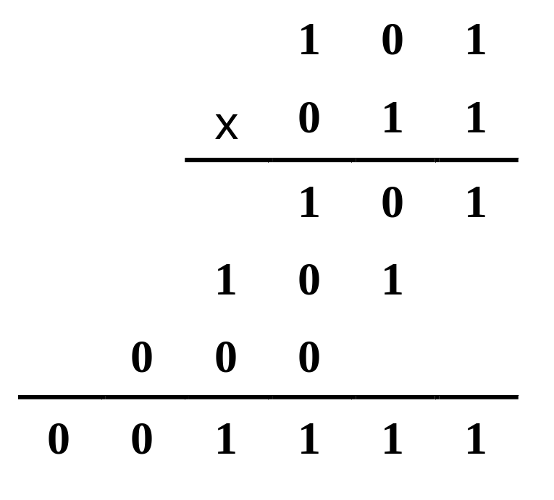
Multiplier Example
Partial products are:
101 x 0, 101 x 1, and 101 x 1
Example: (101 x 011) Base 2
Note that the partial product
summation for n digits, base 2 numbers requires adding up to n digits (with carries) in a column.
Note also n x m digit multiply
generates up to an m + n digit
result (same as decimal).

Slide 15
Example (1 0 1) x (0 1 1) Again
Reorganizing example to follow hardware algorithm:
 | 1 | 0 | 1
x | 0 | 1 | 1
0 | 0 | 0 | 0
+ | 1 | 0 | 1
0 | 1 | 0 | 1
0 | 0 | 1 | 0 | 1
+ | 1 | 0 | 1
0 | 1 | 1 | 1 | 1
0 | 0 | 1 | 1 | 1 | 1
0 | 0 | 0 | 1 | 1 | 1 | 1
Clear C || A
Multipler₀ = 1 => Add B
Addition
Shift Right (Zero-fill C)
Multipler₁ = 1 => Add B
Addition
Shift Right
Multipler₂ = 0 => No Add, Shift Right

Slide 16
Multiplier Example: Block Diagram
n
2
1
IN
n
Multiplicand
Counter P
Register B
log
n
n
2
Zero detect
G (Go)
C
out
Parallel adder
Z
n
n
Control
Q
o
Multiplier
unit
0
C
Shift register A
Shift register Q
4
n
Control signals
Product
OUT

Slide 17
Multiplexer Example: Operation
The multiplicand (top operand) is loaded into register B.
The multiplier (bottom operand) is loaded into register Q.
Register C|| Q is initialized to 0 when G becomes 1.
The partial products are formed in register C||A||Q.
Each multiplier bit, beginning with the LSB, is processed (if bit is 1, use adder to add B to partial product; if bit is 0, do nothing)
C||A||Q is shifted right using the shift register
  Partial product bits fill vacant locations in Q as multiplier is shifted out
  If overflow during addition, the outgoing carry is recovered from C during the right shift
Steps 5 and 6 are repeated until Counter P = 0 as detected by Zero detect.
  Counter P is initialized in step 4 to n – 1, n = number of bits in multiplier

Slide 18
Multiplier Example: ASM Chart
IDLE
MUL0
0
G
1
0
Q
1
C ←
0, A ←
0
0
P ←
n –
1
A ←
A +
B,
C ←
C
out
MUL1
C ← 0, C || A || Q ← sr C || A || Q,
P ←
P –
1
0
Z
1

Slide 19
Multiplier Example: ASM Chart (continued)
Three states are employ using a combined Mealy - Moore output model:
  IDLE - state in which:
    the outputs of the prior multiply is held until Q is loaded with the new multiplicand
    input G is used as the condition for starting the multiplication, and
    C, A, and P are initialized
  MUL0 - state in which conditional addition is performed based on the value of Q₀.
  MUL1 - state in which:
    right shift is performed to capture the partial product and position the next bit of the multiplier in Q₀
    the terminal count of 0 for down counter P is used to sense completion or continuation of the multiply.

Slide 20
Multiplier Example: Control Signal Table
Control Signals for Binary
Multiplier
Bloc
k Dia
g
ram
Contr
o
l
Contr
o
l
Mod
u
l
e
Mi
cr
oo
pe
ra
ti
on
Si
gn
al N
a
me
Exp
r
e
ssi
on
Register
A
:
A
←
0
I
nitia
liz
e
IDLE ·
G
A ←
A
+
B
Load MUL0 ·
Q
C
||
A
||
←
Q
sr
C
||
A
||
Q
Shift_dec
M
UL1
Register
B
:
B ←
IN
Load_B
LO
ADB
F
lip-F
lop
C
: C ←
0
C
lea
r
_C
IDLE ·
G +
MUL1
C ←
C
ou
t
Load
—
Register
Q
: Q ←
IN
Load_Q
LO
ADQ
C
||
A
||
Q
←
sr
C
||
A
||
Q
Shift_dec
—
Cou
n
ter
P
:
P ←
n
–
1
I
nitia
liz
e
—
P
←
P
–
1
Shift_dec
—

Slide 21
Multiplier Example: Control Table (continued)
Signals are defined on a register basis
LOADQ and LOADB are external signals controlled from the system using the multiplier and will not be considered a part of this design
Note that many of the control signals are “reused” for different registers.
These control signals are the “outputs” of the control unit
With the outputs represented by the table, they can be removed from the ASM giving an ASM that represents only the sequencing (next state) behavior

Slide 22
Multiplier Example - Sequencing Part of ASM
IDLE
00
0
G
1
MUL0
01
MUL1
10
0
Z
1

Slide 23
Hardwired Control
Control Design Methods
  The procedure from Chapter 6
  Procedure specializations that use a single signal to represent each state
    Sequence Register and Decoder
      Sequence register with encoded states, e.g., 00, 01, 10, 11.
      Decoder outputs produce “state” signals, e.g., 0001, 0010, 0100, 1000.
    One Flip-flop per State
      Flip-flop outputs as “state” signals, e. g., 0001, 0010, 0100, 1000.

Slide 24
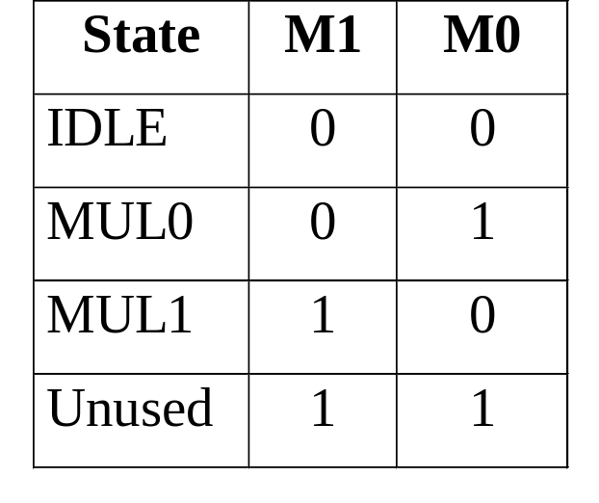
Multiplier Example: Sequencer and Decoder Design
Initially, use sequential circuit design techniques from
Chapter 4.
First, define:
  States: IDLE, MUL0, MUL1
  Input Signals: G, Z, Q₀ (Q₀ affects outputs, not next state)
  Output Signals: Initialize, LOAD, Shift_Dec, Clear_C
  State Transition Diagram (Use Sequencing ASM on Slide 22)
  Output Function: Use Table on Slide 20
Second, find
  State Assignments (two bits required)
  We will use two state bits to encode
  the three state IDLE, MUL0, and MUL1.

Slide 25
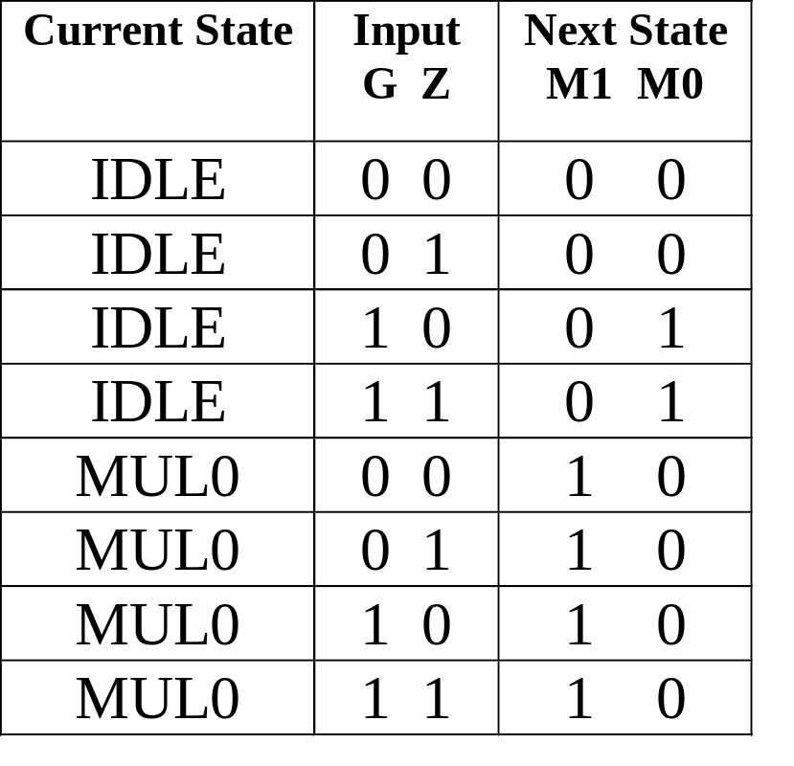
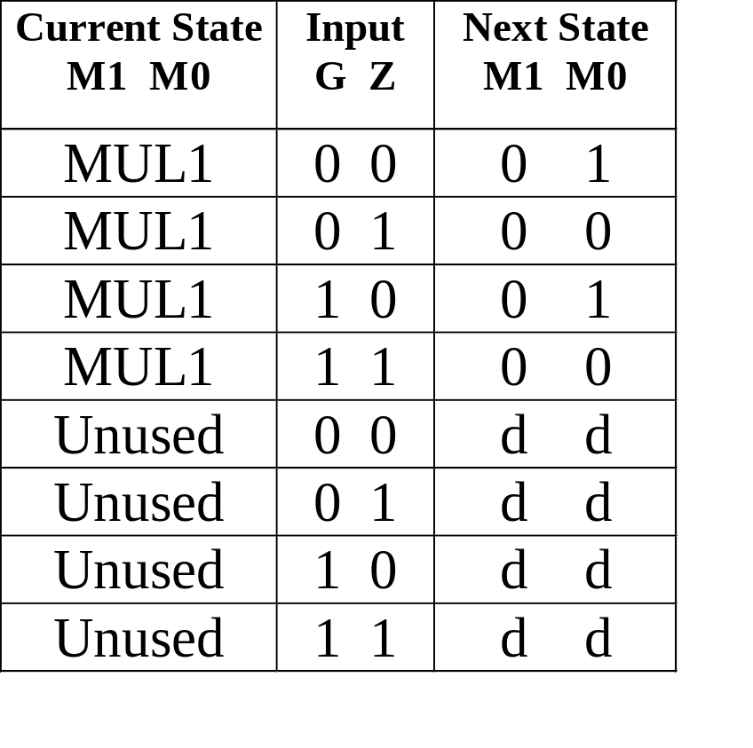
Multiplier Example: Sequencer and Decoder Design (continued)
Assuming that state variables M1 and M0 are decoded into states, the next state part of the state table is:

Slide 26
Multiplier Example: Sequencer and Decoder Design (continued)
Finding the equations for M1 and M0 is easier due to the decoded states:
M1 = MUL0
M0 = IDLE · G + MUL1 · Z
Note that since there are five variables, a K-map is harder to use, so we have directly written reduced equations.
The output equations using the decoded states:
Initialize = IDLE · G
Load = MUL0 · Q₀
Clear_C = IDLE · G + MUL1
Shift_dec = MUL1

Slide 27
Multiplier Example: Sequencer and Decoder Design (continued)
Doing multiple level optimization, extract IDLE · G:
START = IDLE · G
M1 = MUL0
M0 = START + MUL1 · Z
Initialize = START
Load = MUL0 · Q₀
Clear_C = START + MUL1
Shift_dec = MUL1
The resulting circuit using flip-flops, a decoder, and the above equations is given on the next slide.

Slide 28
Multiplier Example: Sequencer and Decoder Design (continued)
START
Initialize
G
M
0
D
Clear_C
Z
C
DECODER
A0
0
IDLE
1
MUL0
2
MUL1
Shift_dec
A1
3
M
1
D
C
Q
Load
0

Slide 29
One Flip-Flop per State
This method uses one flip-flop per state and a simple set of transformation rules to implement the circuit.
The design starts with the ASM chart, and replaces
  State Boxes with flip-flops,
  Scalar Decision Boxes with a demultiplexer with 2 outputs,
  Vector Decision Boxes with a (partial) demultiplexer
  Junctions with an OR gate, and
  Conditional Outputs with AND gates.
Each is discussed detail below.
  Figure 8-11 is the end result.

Slide 30
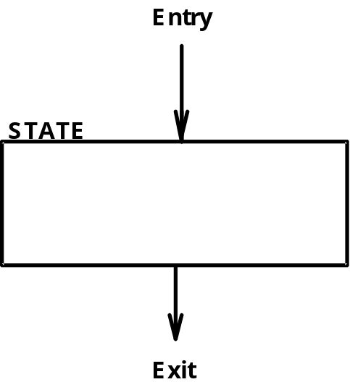
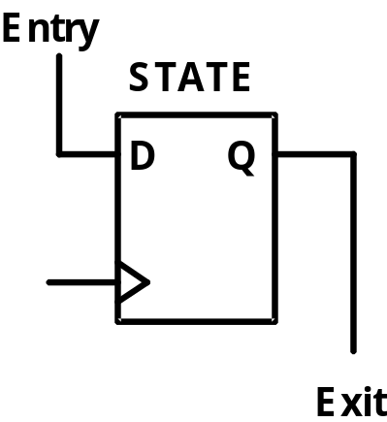
State Box Transformation Rules
Each state box transforms to a D Flip-Flop
Entry point is connected to the input.
Exit point is connected to the Q output.

Slide 31
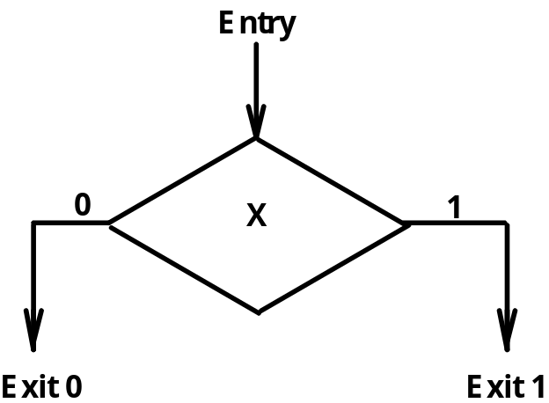
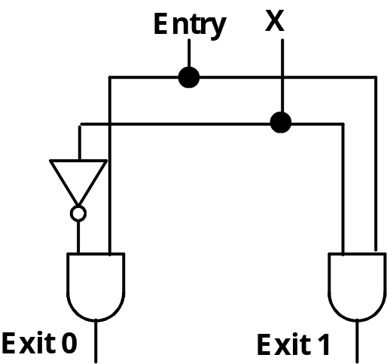
Scalar Decision Box Transformation Rules
Each Decision box transforms to a Demultiplexer
Entry points are "Enable" inputs.
The Condition is the "Select" input.
Decoded Outputs are the Exit points.

Slide 32
Vector Decision Box Transformation Rules
Each Decision box transforms to a Demultiplexer
Entry point is Enable inputs.
The Conditions are the Select inputs.
Demultiplexer Outputs are the Exit points.
(Binary Vector Values)
(Binary Vector Values)
DEMUX
(Vector of Input
Conditions)
Entry
EN
D₀
Exit 0
00
10
X₁
A₁
D₁
Exit 1
01
X₁, X₀
X₀
A₀
D₂
Exit2
D₃
Exit 3

Slide 33
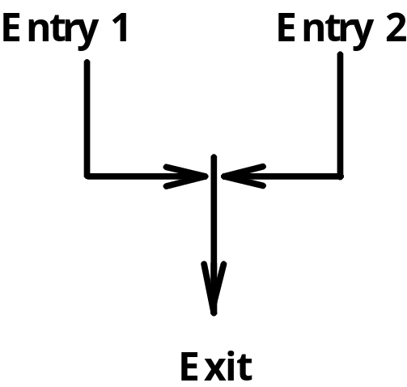
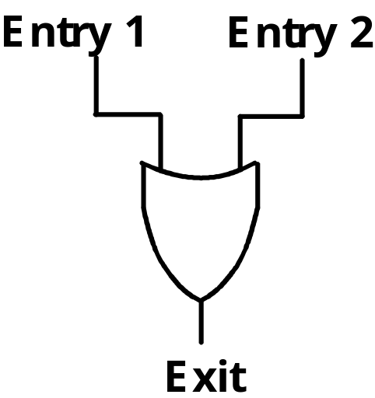
Junction Transformation Rules
Where two or more entry points join, connect the entry variables to an OR gate
The Exit is the output of the OR gate

Slide 34
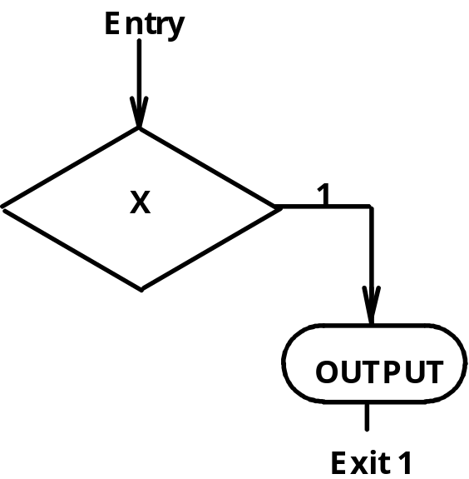
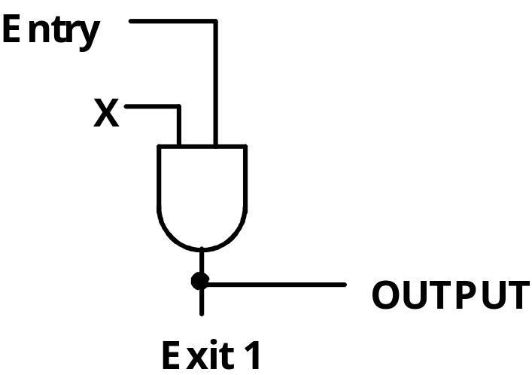
Conditional Output Box Rules
Entry point is Enable input.
The Condition is the "Select" input.
Demultiplexer Outputs are the Exit points.
The Control OUTPUT is the same signal as the exit value.

Slide 35
Multiplier Example: Flip-flop per State Design Logic Diagram
4
START
5
IDLE
1
Initialize
D
4
C
5
2
Clear _C
DEMUX
MUL0
1
Q
0
Load
EN
D
0
D
G
A
0
D
1
C
MUL1
1
5
D
Shift_dec
Clock
C
2
DEMUX
EN
D
0
Z
A
0
D
1

Slide 36
Speeding Up the Multiplier
In processing each bit of the multiplier, the circuit visits states MUL0 and MUL1 in sequence.
By redesigning the multiplier, is it possible to visit only a single state per bit processed?

Slide 37
Speeding Up Multiply (continued)
Examining the operations in MUL0 and MUL1:
  In MUL0, a conditional add of B is performed, and
  In MUL1, a right shift of C || A || Q in a shift register, the decrementing of P, and a test for P = 0 (on the old value of P) are all performed in MUL1
Any solution that uses one state must combine all of the operations listed into one state
The operations involving P are already done in a single state, so are not a problem.
The right shift, however, depends on the result of the conditional addition. So these two operations must be combined!

Slide 38
Speeding Up Multiply (continued)
By replacing the shift
register with a
combinational shifter
and combining the
adder and shifter,
the states can be merged.
The C-bit is no longer needed.
In this case, Z and Q₀
have been made into
a vector. This is not
essential to the
solution.
The ASM chart =>
IDLE
0
G
1
A
0
P
n –
1
MUL
P
P –
1
A || Q sr C
out
|| (A +
0) || Q
A || Q sr C
out
|| (A +
0) || Q
00
10
01
Z || Q
0
11
A || Q sr C
out
|| (A +
B) || Q
A || Q sr C
out
|| (A+
B) || Q

Slide 39
Microprogrammed Control
Microprogrammed Control — a control unit with binary control values stored as words in memory.
Microinstructions — words in the control memory.
Microprogram — a sequence of microinstructions.
Control Memory — RAM or ROM memory holding the microinstructions.
Writeable Control Memory — RAM Memory into which microinstructions may be written

Slide 40
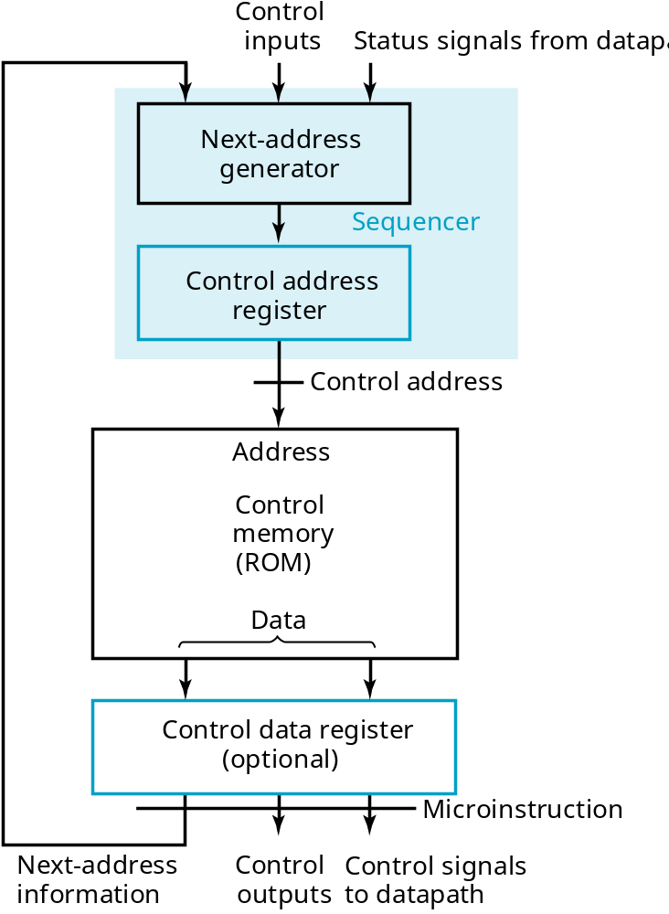
Microprogrammed Control (continued)

Slide 41
Terms of Use
© 2004 by Pearson Education,Inc. All rights reserved.
The following terms of use apply in addition to the standard Pearson Education Legal Notice.
Permission is given to incorporate these materials into classroom presentations and handouts only to instructors adopting Logic and Computer Design Fundamentals as the course text.
Permission is granted to the instructors adopting the book to post these materials on a protected website or protected ftp site in original or modified form. All other website or ftp postings, including those offering the materials for a fee, are prohibited.
You may not remove or in any way alter this Terms of Use notice or any trademark, copyright, or other proprietary notice, including the copyright watermark on each slide.
Return to Title Page

