Slide 1

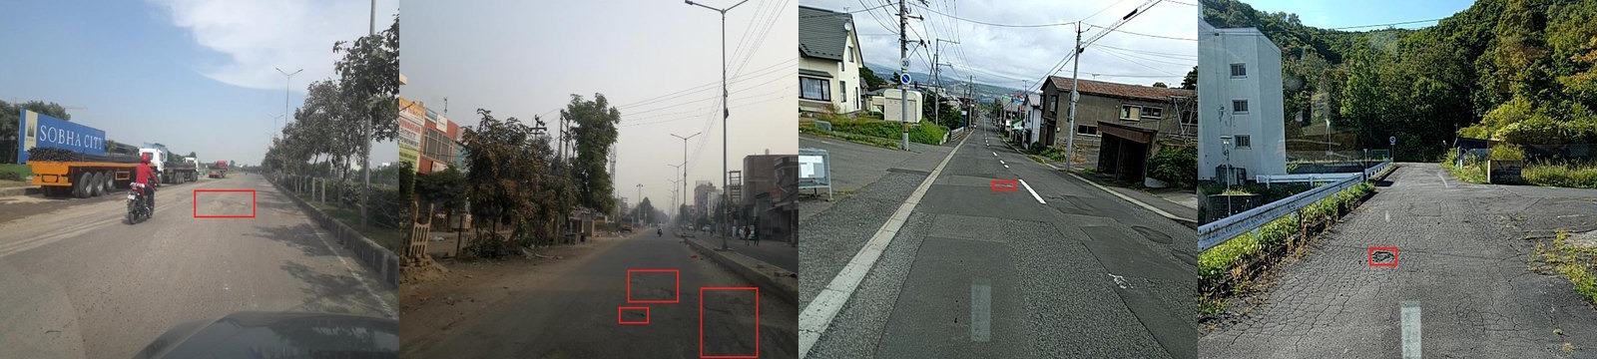
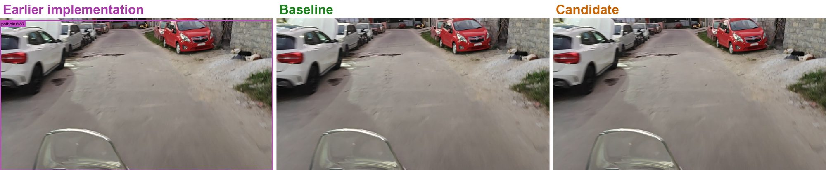
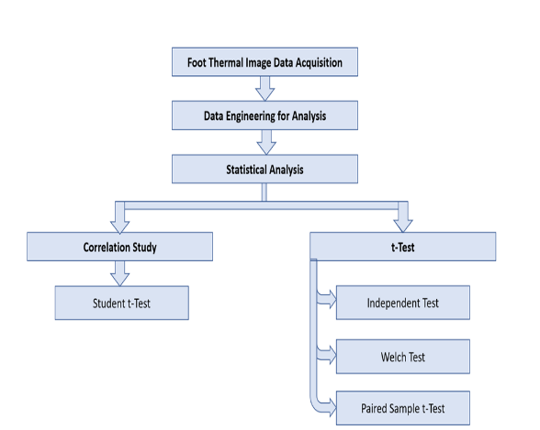
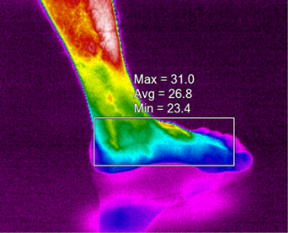
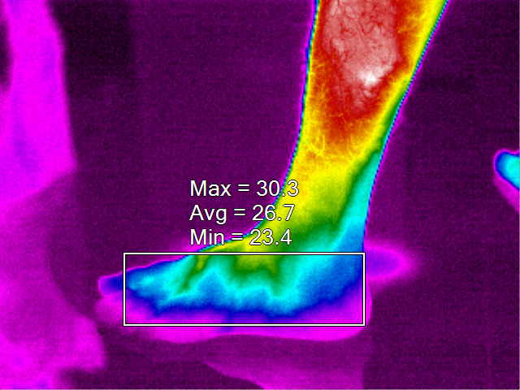
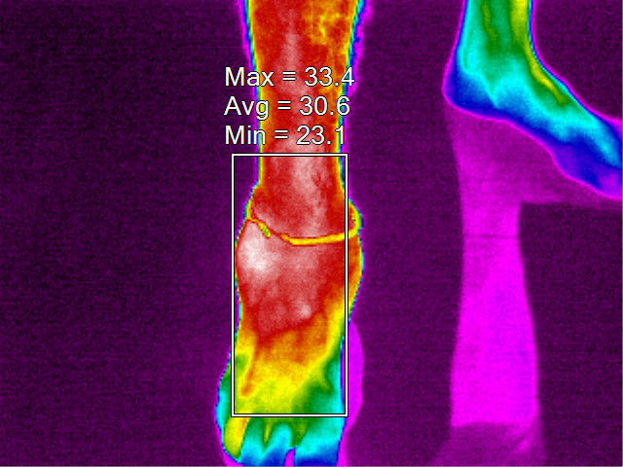
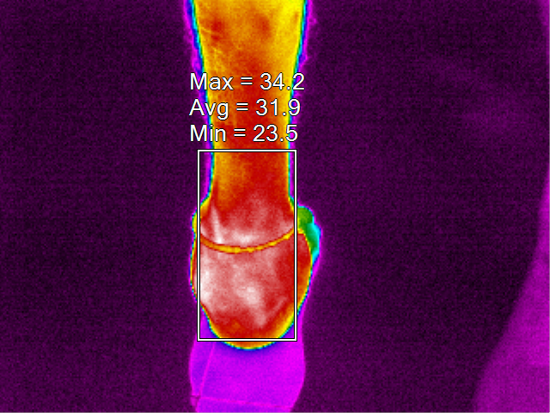
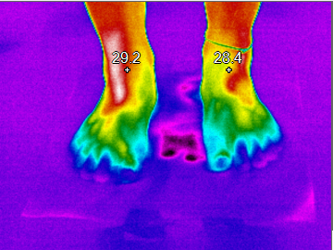
AI Powered Pothole Detection and Intelligent Route Optimization System
Zain Mahedi (1WA23CS056) Thanu George (1WA23CS019) Vikas Shashi (1WA23CS043) Tanish Agrawal (1WA23CS008) Department of Computer Science and Engineering | Under the guidance of Dr. Seema Patil Associate Professor, Department of CSE, BMSCE
Introduction
Methodology
Results
Potholes damage vehicles, slow traffic and cause accidents. India recorded 4,446 pothole-related road accidents and 1,856 deaths in 2022 (MoRTH). Most potholes are still found through citizen complaints and manual surveys, which are slow and rarely record the exact location, while navigation apps choose routes by distance and traffic alone.
This project detects potholes in road video, places them on an OpenStreetMap road graph, and recommends routes that trade a little extra distance for fewer expected potholes. It is a ground-up rebuild of our earlier segmentation-based prototype, with leakage-controlled data, a measured baseline and an evaluation protocol that reports uncertainty.
1) Dataset preparation
25×
higher mAP50 on forward-view HRP4K test (0.018 → 0.454)
3,107 → 0
whole-frame false boxes vs our earlier system
17 ms
per 1280 px frame on a laptop RTX 4060
1,101
automated tests passing
RDD2022 (pothole class D40) and HRP4K (4K forward-view frames) were merged into one pothole class. Near-duplicates were grouped by perceptual hash (Hamming distance ≤ 8) and each group kept in one split. Review only excluded images; no box was added or moved. A 203-image manhole set is evaluation-only.
Source | Train | Validation | Test
RDD2022 (images / boxes) | 8,220 / 5,017 | 2,784 / 477 | 2,784 / 503
HRP4K (images / boxes) | 3,973 / 4,709 | 825 / 922 | 811 / 836
Total | 12,193 / 9,726 | 3,609 / 1,399 | 3,595 / 1,339
Objectives
Prepare RDD2022 and HRP4K as one pothole class with near-duplicate grouping and leakage-free splits.
Train a reproducible YOLOv8s detection baseline and archive it with its configuration and hash.
Evaluate with thresholds fixed on validation data, group-bootstrap 95% intervals and paired comparisons.
Fine-tune on forward-view HRP4K footage at 1280 px and compare against the baseline on held-out test sets.
Build the detection-to-map pipeline: video and GPS in, tracked, geotagged and road-matched potholes out.
Recommend pothole-aware routes through a tested FastAPI backend, SQLite store and web interface.
Table 1. Final dataset after cleaning and leakage-controlled splitting.
Fig 2. RDD2022 examples with pothole boxes (India, Japan). RDD2022, CC BY-SA 4.0.
Fig 3. Fine-tuning on forward-view footage lifts every metric (95% intervals exclude zero).
Proposed System
2) Model training
Held-out test set (mAP50) | Baseline 640 | Candidate 1280 | Difference [95% CI]
HRP4K (forward view) | 0.018 | 0.454 | +0.435 [0.392, 0.479]
Manhole probe set | 0.368 | 0.427 | +0.058 [−0.027, 0.195]
RDD2022 | 0.497 | 0.453 | −0.045 [−0.086, −0.006]
 | Baseline (deployed) | Candidate (experimental)
Initialisation | YOLOv8s, COCO weights | Baseline checkpoint
Training data | RDD2022 | RDD2022 + HRP4K
Input size | 640 px | 1280 px
Optimiser | MuSGD, lr 0.01 | AdamW, lr 0.001, cosine
Epochs | 76 of 100 epochs run | 50; checkpoint picked on val.
Hardware | RTX 5090 (cloud) | RTX 5090, 79 min, about $0.77
Model development (offline)
Application (online)
RDD2022 + HRP4K
public road-damage datasets
Road video + GPS log
upload via web UI or CLI
Table 2. Paired comparison; thresholds chosen on validation, applied unchanged to test.
Clean, de-duplicate, split
perceptual hash, group-aware
Detect + track
YOLOv8s, motion-aware IoU tracker
Train YOLOv8s
baseline 640 px, candidate 1280 px
Geotag + cluster
GPS interpolation, 8 m merge
3) Evaluation protocol
Threshold fixed at max F1 on validation, then applied unchanged to held-out test.
95% intervals by group bootstrap (1,000 resamples); differences paired on identical resamples.
Per dataset: mAP50, mAP50-95, precision, recall, F1, false positives per image, manhole hits.
Evaluate
validation thresholds, bootstrap CIs
Snap to road graph
OpenStreetMap edges, 30 m
Fig 4. Our own Bengaluru drive: the earlier system boxes the whole street as a pothole (0.87); both new models correctly report nothing. Qualitative; no ground truth.
Deployed checkpoint
baseline (configs/app.yaml)
Pothole-aware routes
Dijkstra, up to 3 options
4) Detection-to-map pipeline and routing
Conclusion
Detections are linked across frames by a motion-aware IoU tracker, geotagged by interpolating the GPS log, merged into mapped potholes within 8 m and snapped to the nearest OpenStreetMap edge (2,996 nodes, 7,138 edges in Bengaluru). Dijkstra's algorithm returns up to three routes, each edge costed as:
We rebuilt the system end to end: leakage-controlled data, a reproducible YOLOv8s baseline (mAP50 0.497 on held-out RDD2022), a detection-to-map pipeline and pothole-aware routing behind a tested API. Fine-tuning at 1280 px makes the detector work on forward-view dashcam footage (mAP50 0.018 → 0.454) while still running in real time on a laptop GPU, at a training cost of about $0.77. Because it gives up some recall on RDD2022, the baseline stays deployed until labelled frames from our own roads decide between them.
Fig 1. System overview. Orange arrow: the deployed checkpoint drives the application's detector.
Road condition is summarised per road segment as potholes per 100 m of surveyed road, and each recommended route reports how much of it was actually surveyed (adequate, partial or insufficient evidence).
cost = L + a × 300 m × E, E = n + r (L − s) / 100
L length, a avoidance setting, n potholes seen, s surveyed length, r assumed rate on unsurveyed road

