Slide 1

AI Powered Pothole Detection and Intelligent Route Optimization System
Submitted by
Zain Mahedi (1WA23CS056) Thanu George (1WA23CS019)
Vikas Shashi (1WA23CS043) Tanish Agrawal (1WA23CS008)
Under the guidance of
Dr. Seema Patil
Associate Professor, Department of CSE, BMSCE
Department of Computer Science and Engineering
B.M.S. College of Engineering

Slide 2
Outline
Sustainable Development Goals and Collaboration
Problem Statement and Objectives
Existing System and Proposed System
High Level Design
Detailed Design
Implementation
Results: Datasets, Tables, Graphs and Snapshots of the Output
Conclusion and Future Enhancements
Paper Published
References

Slide 3
Sustainable Development Goals Addressed
3
SDG 3
Good Health and Well-being
9
SDG 9
Industry, Innovation and Infrastructure
11
SDG 11
Sustainable Cities and Communities
Target 3.6: fewer road injuries
Target 9.1: resilient infrastructure
Target 11.2: safe, sustainable transport
Potholes are a recorded cause of road accidents in India. A forward-facing camera records a pothole before a vehicle reaches it, and the route planner can steer around known ones. We provide information; no effect on accidents was measured.
Ordinary phone or dashcam video plus GPS becomes mapped potholes on road segments, each with its surveyed length and potholes per 100 m, so inspections can be directed without a survey vehicle.
The route planner offers up to three routes, from shortest to strongest pothole avoidance, with the potholes passed and how much of each route has actually been surveyed.

Slide 4
Collaboration
Project category
Field work
Community oriented project. Potholes affect every road user in Bengaluru; the system turns ordinary phone video into a pothole map that residents, road authorities and the city can use.
Multidisciplinary project. It combines computer vision (deep-learning detection), GPS and geospatial processing, road-network routing on OpenStreetMap, and a web application with a database.
We recorded 13 road videos on Bengaluru roads (13 and 22 October 2026) from a two-wheeler and on foot, each with a time-synchronised GPS log from our Android recorder app.
The recordings were processed end to end: detections placed on the map along the recorded route, and the three model versions compared on the same frames.
Collaborating organisation: [to be added by the team]

Slide 5
Problem Statement
Detect potholes in ordinary road video recorded from a phone or dashcam, place them on the road map using GPS, and recommend routes that avoid them, with results that are measured honestly on data the model has never seen.
1
Detection is manual
2
Navigation ignores the road surface
3
Our Phase 1 prototype was not trustworthy
Most potholes are found through citizen complaints and manual surveys, which are slow, occasional and rarely record the exact location.
Route planners choose by distance and traffic alone and tell drivers nothing about the condition of the road ahead.
It was evaluated only on its own data split. On our own recordings it boxed whole street scenes as potholes in 3,107 frames, and its severity rules were never calibrated.

Slide 6
Objectives
Prepare RDD2022 and HRP4K as one pothole class, with near-duplicate images grouped by perceptual hash and whole groups kept in one split, so no test image has a copy in training.
Train a reproducible YOLOv8s detection baseline with a fixed seed, recorded configuration and an archived, hashed checkpoint.
Evaluate with thresholds chosen on validation data only, 95% bootstrap confidence intervals and paired model comparisons.
Fine-tune the baseline on forward-view HRP4K footage at 1280 px and compare it with the baseline on held-out test sets.
Build the detection-to-map pipeline: video and GPS in; tracked, geotagged, road-matched potholes out.
Recommend pothole-aware routes through a tested backend (HTTP API, job queue, database) and a web interface.

Slide 7
Existing System and Proposed System
Aspect | Phase 1 prototype (existing) | Rebuilt system (proposed)
Model | YOLOv8s-seg masks, one pothole video dataset | YOLOv8s boxes, RDD2022 + HRP4K, single class
Data hygiene | Split by video only | Perceptual-hash near-duplicate groups, leakage guard
Evaluation | Scores on its own test split | Validation-fixed thresholds, bootstrap CIs, paired tests, external manhole set
Tracking | ByteTrack on every 5th frame | Motion-aware IoU tracker; every frame on vehicle drives
Road condition | Mild / Moderate / Severe rules, uncalibrated | Potholes per 100 m of surveyed road, per road segment
Routing | Public OSRM routes, potholes within 20 m | Own OpenStreetMap graph, Dijkstra with pothole cost; unsurveyed road treated as unknown
Engineering | FastAPI app, 50 Python tests | FastAPI + SQLite + job queue, 1,101 automated tests

Slide 8
High Level Design
Offline: model development
Public datasets
RDD2022, HRP4K
Clean and split
dedupe, group-aware
Train YOLOv8s
cloud GPU
Evaluate
val thresholds, CIs
Checkpoint
baseline deployed
Online: the application
Web UI / CLI
upload video + GPS
FastAPI + job queue
single worker
Session pipeline
detect, track, geotag
Map builder
cluster, snap, statistics
Route planner
Dijkstra, up to 3 routes
SQLite database (WAL)
sessions, tracks, mapped potholes, edge stats
OpenStreetMap road graph
2,996 nodes, 7,138 edges (Bengaluru)
One process serves the API and the web interface. An uploaded recording becomes a job: frames are analysed, potholes are tracked and geotagged, the map is rebuilt, and the route planner reads the updated per-road statistics. The orange arrow is the deployed checkpoint feeding the detector.

Slide 9
Detailed Design: Data and Evaluation Pipeline
Convert to one class
RDD2022 class D40 = pothole; HRP4K resized to 1280×720
Evaluation protocol
Confidence threshold set at maximum F1 on validation data, then applied unchanged to the held-out test sets.
Metrics per dataset: mAP50, mAP50-95, precision, recall, F1, false positives per image.
95% intervals from a group bootstrap (1,000 resamples); model differences paired on identical resamples.
An external 203-image set with intact manholes checks whether covers are mistaken for potholes.
Review annotations
exclusion only: drop doubtful images, never add or move boxes
Group near-duplicates
perceptual hash, Hamming distance ≤ 8
Group-aware split
a whole group goes to one split; leakage guard on val/test
Train and select
checkpoint chosen on validation only

Slide 10
Detailed Design: From Video to Mapped Potholes
Ingest
video + GPS CSV on one clock
Detect
YOLOv8s, conf 0.25, NMS 0.5
Track
IoU ≥ 0.2 to the predicted box
Geotag
GPS interpolated, gap ≤ 3 s
Cluster
sightings within 8 m merged
Snap
nearest OSM road edge ≤ 30 m
Vehicle and walking recordings
Road condition per segment
A session whose upper-quartile GPS speed is at least 2.5 m/s is a vehicle drive: every frame is analysed and a track needs 6 detections to count as a pothole.
Slower sessions analyse every 3rd frame and need 3 detections. Short tracks are dropped as noise.
Each road edge stores the potholes mapped on it, the length actually surveyed (GPS trace ± 5 m) and the rate per 100 m of surveyed road.
Road that no video covered is shown as unknown, never as pothole-free. No severity or depth is estimated.

Slide 11
Detailed Design: Pothole-Aware Route Scoring
cost = L + a × 300 m × E E = n + r × (L − s) / 100
L edge length, a avoidance setting (0 to 1), n potholes seen on the edge, s surveyed length, r assumed rate on unsurveyed road
Three routes
Unsurveyed road
Evidence level
Dijkstra's algorithm runs at avoidance 0, at the user's setting and at 1, giving the shortest route, the user's route and the strongest avoidance.
Its rate is the observed rate blended with an assumed 1.0 pothole per 100 m (weight of 500 m of survey), so unknown road is never treated as free of potholes.
Each route reports the share that was surveyed: adequate from 80%, insufficient below 20%, partial in between, so users know how far to trust it.

Slide 12
Implementation: Technologies and Modules
Area | Used in this project
Language | Python 3.10
Deep learning | PyTorch 2.14.1, Ultralytics 8.4.210 (YOLOv8s)
Video | OpenCV
Backend | FastAPI 0.162.4, single-worker job queue
Storage | SQLite (WAL), 9 tables
Maps and routing | OSMnx 2.0.7, networkx 3.4.2, Leaflet
Training GPU | RTX 5090 (rented, Vast.ai)
Development GPU | RTX 4060 Laptop GPU
Ingest and detection
Video and GPS reader, YOLOv8s wrapper that refuses any non single-class checkpoint
Tracking and mapping
Motion-aware tracker, GPS interpolation, 8 m clustering, road snapping, per-edge statistics
Routing
OSM graph stored as JSON, Dijkstra with the pothole-aware cost, up to three routes
API and interface
20 HTTP endpoints; web UI with Dashboard, Upload, Sessions, Detections and Route planner tabs

Slide 13
Implementation: Training, Evaluation and Testing
 | Baseline (deployed) | Candidate (experimental)
Starts from | YOLOv8s COCO weights | baseline checkpoint
Training data | RDD2022 | RDD2022 + HRP4K
Input size | 640 px | 1280 px
Optimiser | MuSGD, lr 0.01 | AdamW, lr 0.001, cosine
Epochs | 76 of 100 | 50 (checkpoint chosen on validation)
Training run | RTX 5090 | RTX 5090, 79 min, about $0.77
1,101
automated tests passing (pytest)
8.2 ms
per 640 px frame on the laptop GPU (baseline)
16.7 ms
per 1280 px frame (candidate), still real time
The cloud run was scripted end to end: upload of training and validation data only, training with a watchdog, checkpoint download, then the instance destroyed. Test data never left the laptop.

Slide 14
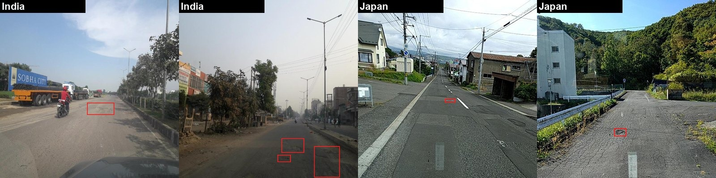
Results: Datasets Used
Source (images / boxes) | Train | Validation | Test
RDD2022 (India, Japan, Czech, US, China) | 8,220 / 5,017 | 2,784 / 477 | 2,784 / 503
HRP4K (forward-view 4K frames) | 3,973 / 4,709 | 825 / 922 | 811 / 836
Total | 12,193 / 9,726 | 3,609 / 1,399 | 3,595 / 1,339
Plus an evaluation-only set of 203 images (59 potholes, 196 intact manholes) to test manhole confusion.
Licences: RDD2022 CC BY-SA 4.0; HRP4K CC BY 4.0.
RDD2022 examples with pothole boxes (India, Japan).

Slide 15
Results: Held-Out Test Performance
Test set (mAP50) | Baseline | Candidate | Difference [95% CI]
HRP4K | 0.018 | 0.454 | +0.435 [0.392, 0.479]
Manhole set | 0.368 | 0.427 | +0.058 [−0.027, 0.195]
RDD2022 | 0.497 | 0.453 | −0.045 [−0.086, −0.006]
Fine-tuning at 1280 px makes the detector work on forward-view footage: mAP50 rises 25 times on HRP4K.
On RDD2022 it gives up some recall (−0.045 mAP50), and it does not reduce false positives on manholes.
So the baseline stays deployed and the 1280 px model stays experimental.
Thresholds chosen on validation, applied unchanged to test.

Slide 16
Results: What We Tested on Validation Data
1
Threshold tuning
2
Two-model ensemble
3
False-positive review
No threshold beat the pooled max-F1 threshold (0.24). F1 stays within 0.01 of its best over a 0.10 to 0.15 wide range. A higher threshold (0.37) halves false alarms per image (0.097 to 0.051) at the cost of recall.
Weighted Boxes Fusion of the baseline (640 px) and the candidate (960 px) matched the baseline on RDD2022 but scored below the candidate alone on HRP4K (mAP50 −0.044). No overall gain, at twice the compute.
Of 260 candidate false positives on HRP4K validation, about a fifth were boxes of the wrong size on real potholes and about 38% were tiny boxes. Manholes and drains were rare.
All choices here were made on validation data only; the held-out test sets were never used for tuning.

Slide 17
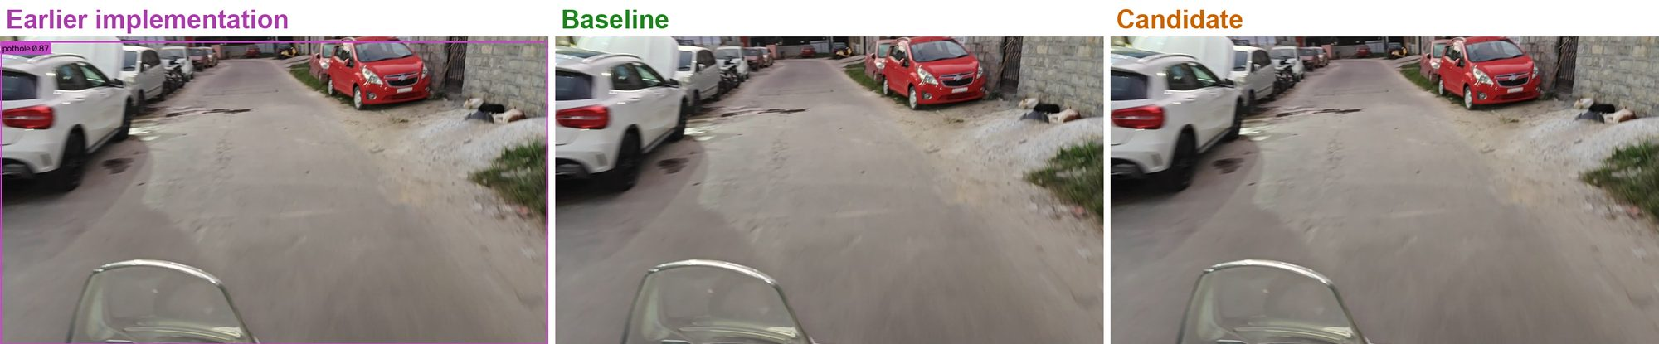
Results: Field Test on Bengaluru Roads
13 recordings, 9,711 frames | Phase 1 model | Baseline | Candidate
Frames with a detection | 77.3% | 15.9% | 21.7%
Total detections | 9,665 | 1,913 | 3,049
Whole-frame boxes (≥ 80% of frame) | 3,107 | 0 | 0
Same frame, three models: the Phase 1 model boxes the whole street as a pothole (0.87); both new models report nothing. No ground truth on our recordings, so this is a qualitative comparison.

Slide 18
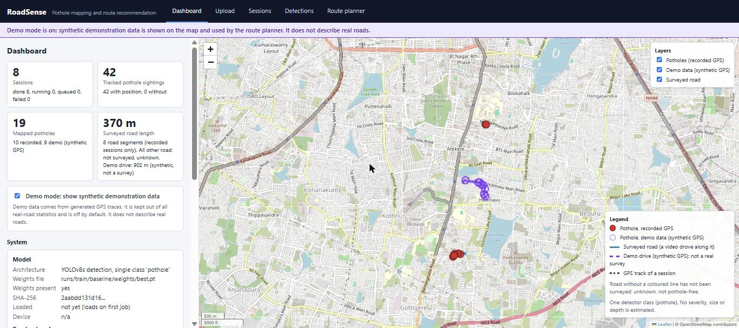
Results: Snapshots of the Application
Dashboard: sessions, tracked sightings, mapped potholes and surveyed road length, with the map of recorded potholes (red) and the demo drive (purple).

Slide 19
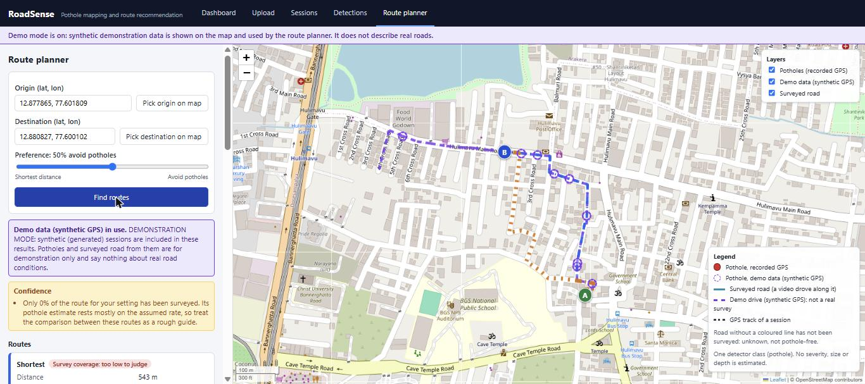
Results: Snapshots of the Route Planner
Route planner: the shortest route (blue) and a pothole-avoiding route (orange), with a confidence note on how much of each route was surveyed. Shown on the synthetic demonstration session, because our real recordings cover only about 1 km.

Slide 20
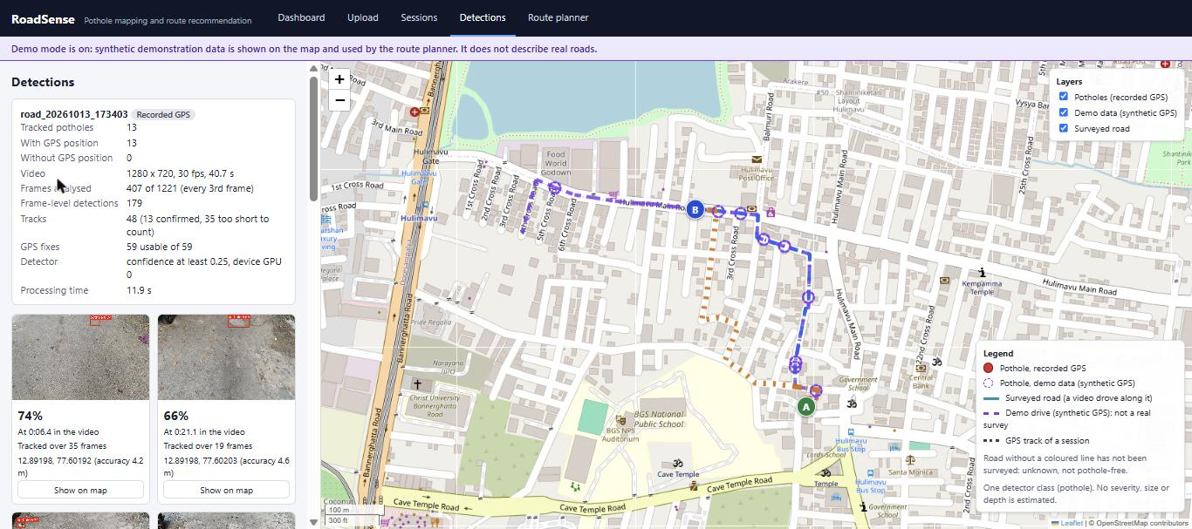
Results: Snapshots of the Output
Detections for one real drive (road_20261013_173403): 13 tracked potholes from 407 analysed frames, each with its time in the video, frame count and GPS position.

Slide 21
Conclusion
We rebuilt the system end to end: leakage-controlled data, a reproducible YOLOv8s baseline, a detection-to-map pipeline, pothole-aware routing, and a tested API with a web interface.
The deployed baseline reaches mAP50 0.497 on held-out RDD2022 test data and runs at about 8 ms per frame on a laptop GPU.
Fine-tuning at 1280 px fixes the baseline's blindness on forward-view dashcam footage (mAP50 0.018 → 0.454) but loses some recall on RDD2022, so it remains experimental.
Road condition is reported as potholes per 100 m of surveyed road; route comparison is shown on a synthetic session.
0.497
baseline mAP50, RDD2022 test
25×
mAP50 gain on forward-view HRP4K
1,101
automated tests passing
SDG 3 · 9 · 11
goals addressed

Slide 22
Future Enhancements
1
Label our own roads
2
Fixed operating point
3
Road condition scoring
About 200 to 300 labelled frames from Bengaluru, including manholes and patches, to decide between the two models.
Declare a false-alarm budget in advance and confirm it once on data not yet seen.
Move from pothole counts to a calibrated condition score with severity or size.
4
Real route comparison
5
Security and UI tests
6
More forward-view data
Record connected stretches of road so routes can be compared without synthetic data.
Add authentication to the API and automated tests for the web interface.
Fine-tune on dashcam footage from Indian roads to improve recall where RDD2022 lost it.

Slide 23
Paper Published
Item | Details
Authors | Zain Mahedi, Thanu George, Vikas Shashi, Tanish Agrawal (guide: Dr. Seema Patil)
Title | AI Powered Pothole Detection and Intelligent Route Optimization System
Conference | 2nd International Conference on Emerging Technologies in Computer Science for Interdisciplinary Applications (Track: Artificial Intelligence and Machine Learning)
Paper ID | 722, submitted 30 September 2026 via Microsoft CMT
Status | Under review

Slide 24
References
[1] D. Arya, H. Maeda, S. K. Ghosh, D. Toshniwal and Y. Sekimoto, "RDD2022: A multi-national image dataset for automatic road damage detection," Geoscience Data Journal, vol. 11, pp. 846-862, 2024.
[2] H. Chen, Z. Tu, Y. Zhao and J. Ye, "A high-resolution perspective-view road image dataset for pothole detection," Scientific Data, vol. 13, Art. 961, 2026.
[3] E. Giordani, L. Arcioni, M. Gil-Martín, G. L. Foresti and M. R. Marini, "Real-world road damage dataset with potholes, cracks, and maintenance holes," Scientific Reports, vol. 16, Art. 15318, 2026.
[4] J. Redmon, S. Divvala, R. Girshick and A. Farhadi, "You only look once: Unified, real-time object detection," in Proc. IEEE CVPR, 2016, pp. 779-788.
[5] G. Jocher, A. Chaurasia and J. Qiu, Ultralytics YOLOv8, software, 2023. https://github.com/ultralytics/ultralytics
[6] J. Yosinski, J. Clune, Y. Bengio and H. Lipson, "How transferable are features in deep neural networks?" in Advances in NeurIPS, vol. 27, 2014, pp. 3320-3328.
[7] B. Barz and J. Denzler, "Do we train on test data? Purging CIFAR of near-duplicates," Journal of Imaging, vol. 6, no. 6, Art. 41, 2020.
[8] B. Efron and R. J. Tibshirani, An Introduction to the Bootstrap, Springer, 1993.
[9] R. Solovyev, W. Wang and T. Gabruseva, "Weighted boxes fusion: Ensembling boxes from different object detection models," Image and Vision Computing, vol. 107, Art. 104117, 2021.
[10] G. Boeing, "OSMnx: New methods for acquiring, constructing, analyzing, and visualizing complex street networks," Computers, Environment and Urban Systems, vol. 65, pp. 126-139, 2017.
[11] E. W. Dijkstra, "A note on two problems in connexion with graphs," Numerische Mathematik, vol. 1, pp. 269-271, 1959.
[12] Ministry of Road Transport and Highways, Road Accidents in India 2022, Government of India, New Delhi, 2023.

Slide 25
Thank You
Questions?

