Slide 1
Efficiency of a Low power Adder
(Design and Optimization of Low-Power Adder Architectures)
Under the guidance of Dr.M.Vinodhini
Presented by:
Bh.Maheedhar (BL.EN.P2VLD23003)

Slide 2
AGENDA
Problem Statement
Objective
Introduction
Simulated results
Results
Conclusion
Future scope
Reference

Slide 3
Problem Statement
The demand for energy-efficient computing systems necessitates low-power digital circuits.
Adders, fundamental in arithmetic operations, significantly impact overall power consumption. The goal is to reduce adder power consumption through multiplexer-based optimizations.

Slide 4
Objective
The main objective is to design a multiplexer-based adder circuit to minimize power consumption and validate its energy efficiency and functionality by comparing performance metrics with conventional designs.

Slide 5
Introduction
Adders are fundamental building blocks in digital circuits, crucial for arithmetic operations in processors and other computational units.
The critical need for reducing power consumption in digital systems by proposing a novel design approach utilizing multiplexers within the full adder architecture.

Slide 6
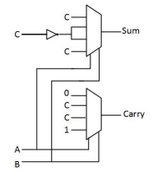
Proposed Design
A 4:1 mux-based full adder uses multiplexers to compute the sum and carry outputs.
The sum is calculated by a multiplexer that uses carry-in (C) to select between A ⊕ B and its inversion.
The carry output is generated by another multiplexer configured with A and B as control inputs to implement the carry logic.
This design can reduce circuit complexity and power consumption.

Slide 7
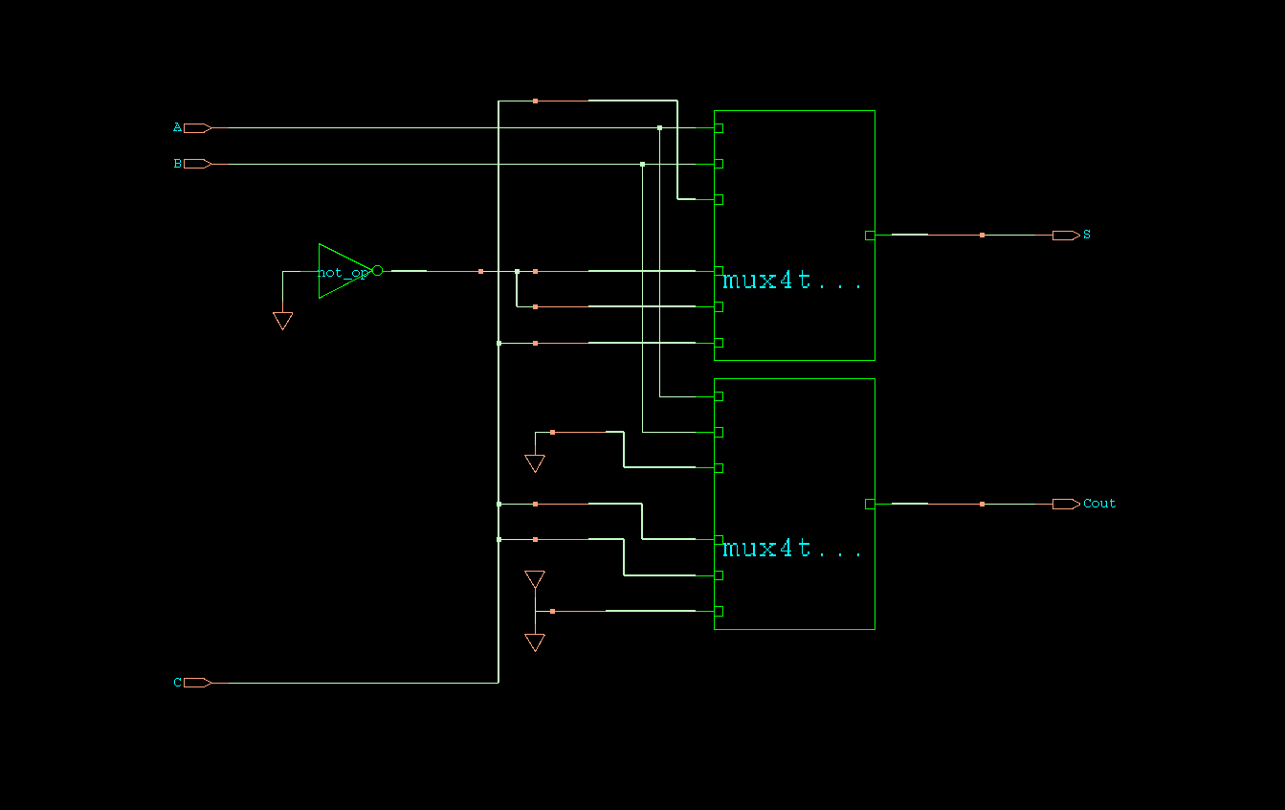
Schematic

Slide 8
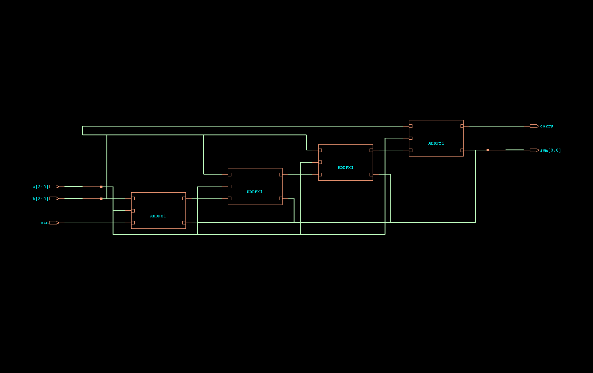
Ripple Carry Adder

Slide 9
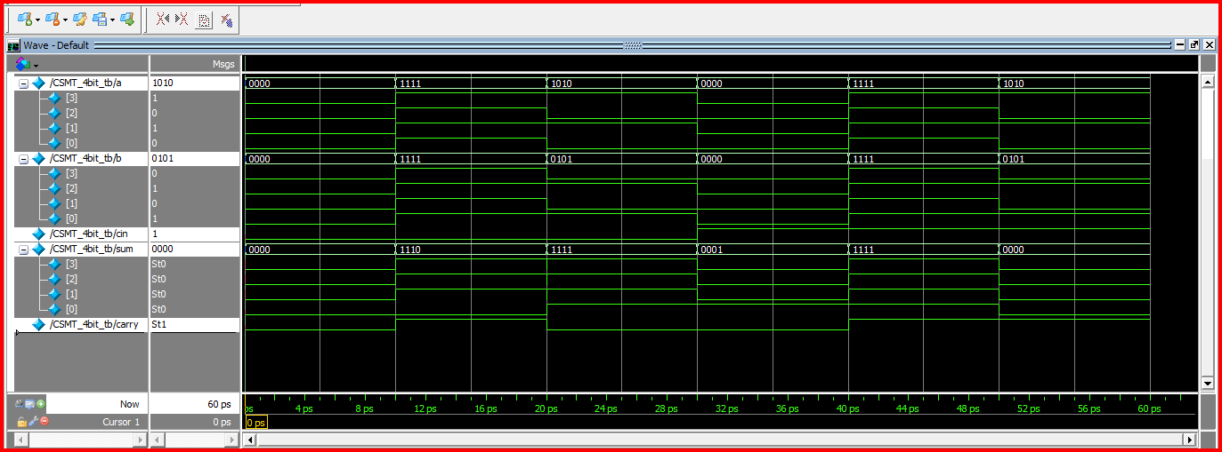
Simulated result using Vivado

Slide 10
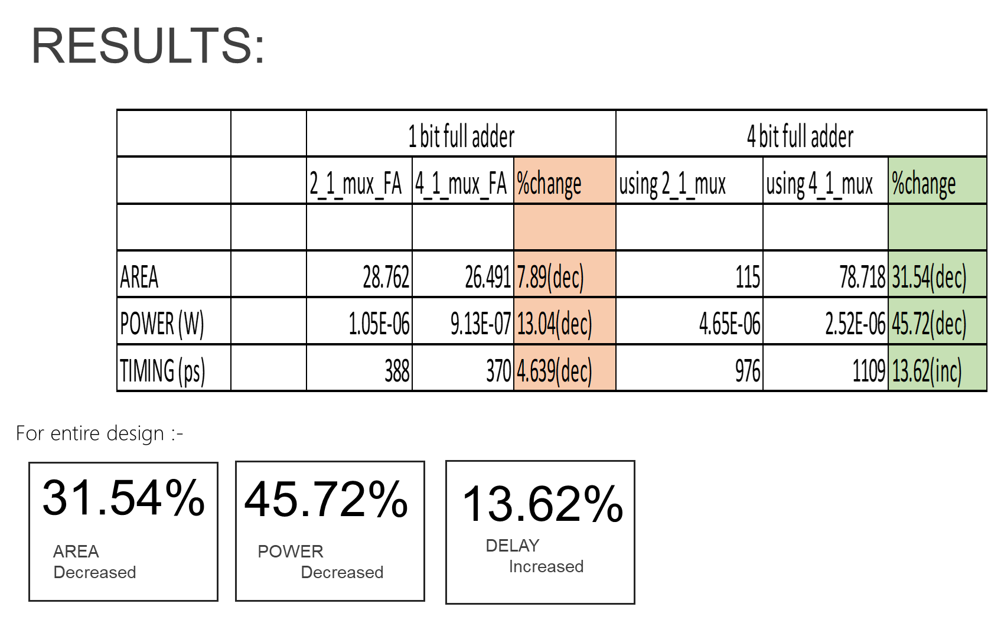

Slide 11
Conclusion
In conclusion, the use of multiplexers in the low-power adder design offers significant energy efficiency gains, promising enhanced performance for digital systems.
This highlights the importance of innovative circuit techniques in meeting the demand for energy-efficient computing solutions.

Slide 12
Future Scope
Exploring advanced optimization techniques and integration strategies can further improve the efficiency and applicability of low-power adder designs using multiplexers.

Slide 13
Reference
Priya, S. S. S., & Benita, B. (2018, March). A Design of low power Adders. In 2018 4th International Conference on Devices, Circuits and Systems (ICDCS) (pp. 245-249). IEEE.
Srikanth, S., Banu, I. T., Priya, G. V., & Usha, G. (2016, March). Low power array multiplier using modified full adder. In 2016 IEEE International Conference on Engineering and Technology (ICETECH) (pp. 1041-1044). IEEE.
Mohanty, B. K., & Patel, S. K. (2014). Area–delay–power efficient carry-select adder. IEEE transactions on circuits and systems II: express briefs, 61(6), 418-422.

