Slide 1
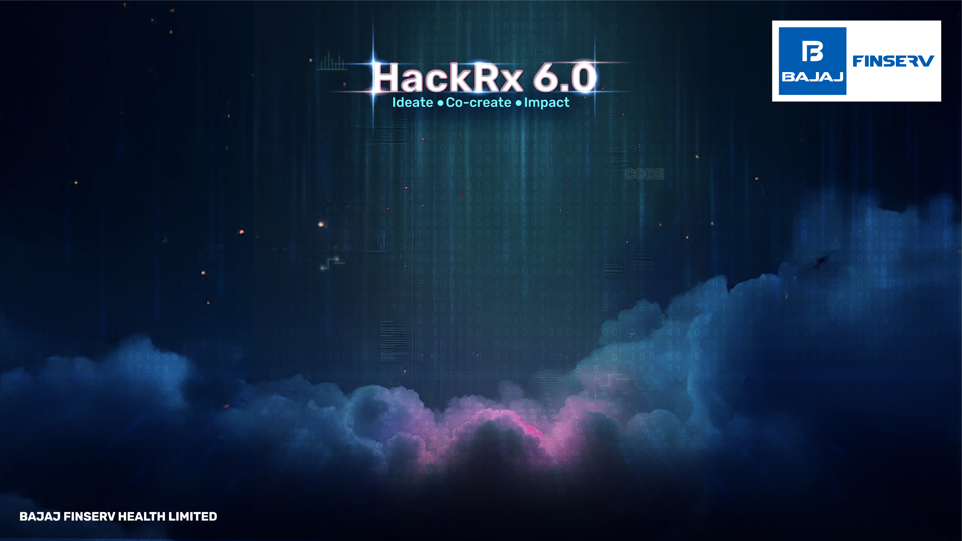
GoonOps
Maheen Meshram | 2027 | Symbiosis Institute of Technology, Nagpur
Tanvi Bandebuche | 2027 | Symbiosis Institute of Technology, Nagpur
Atharv Jaiswal | 2027 | Symbiosis Institute of Technology, Nagpur
Mrudang Wanjari | 2027 | Symbiosis Institute of Technology, Nagpur

Slide 2
Tell us a bit about yourself
We are an AI-promising automation enthusiast team. Other past endeavors we have had are:
Artificial Intelligence Code Debugger (these is automatic bug finding and correcting)
In-time Skin Defect Analyzer (YOLO + U-net Segmentation)
We are best in incorporating AI in real world applications and providing solutions that are production-ready.

Slide 3
Problem statement
Insurance, law, compliance and HR are all flooded with unstructured documents — policy PDFs, contracts, scanned agreements, and email trails.
Some major difficulties are:
Slow and Error-prone Retrieval -The context and meaning are lost when using traditional keyword searching.
Opaque Decision-Making Systems presently in use deliver outcomes that lack explainable reasoning.
Poor Query Tolerance- Users do not always have the opportunity to feed a perfectly structured search term.
Compliance Risks -There is failure to identify specific provisions upon which decisions are made which results into audit failures.

Slide 4
Tech Stack
Cloud: AWS (Textract, S3, Lambda, EC2)
Database: Supabase, PostgreSQL (symbolic index) + FAISS (semantic index)
Backend: Supabase, Python, FastAPI, LangChain
Frontend: React (review dashboard & annotation tools)
AI Models: GPT-4o, spaCy custom NER, SentenceTransformers embeddings
Deployment: Docker, Kubernetes for scaling

Slide 5
Detailed description of the solution
Cognivault AI is a document intelligence engine, specifically, an LLM-powered smart document searching and finding engine that retrieves correct decisions based on unstructured documents supported by accurate clauses based on natural language queries.
Interprets the queries of users and transforms unstructured data (age, location, procedure, policy information).
Accessed appropriate clauses through two-stage retrieval (semantic/symbolic).
Executes a Decision Reasoning Graph to approve/reject and settle pay outs.
Returns a JSON containing decision, payout amount, precise clause references and confidence score.

Slide 6
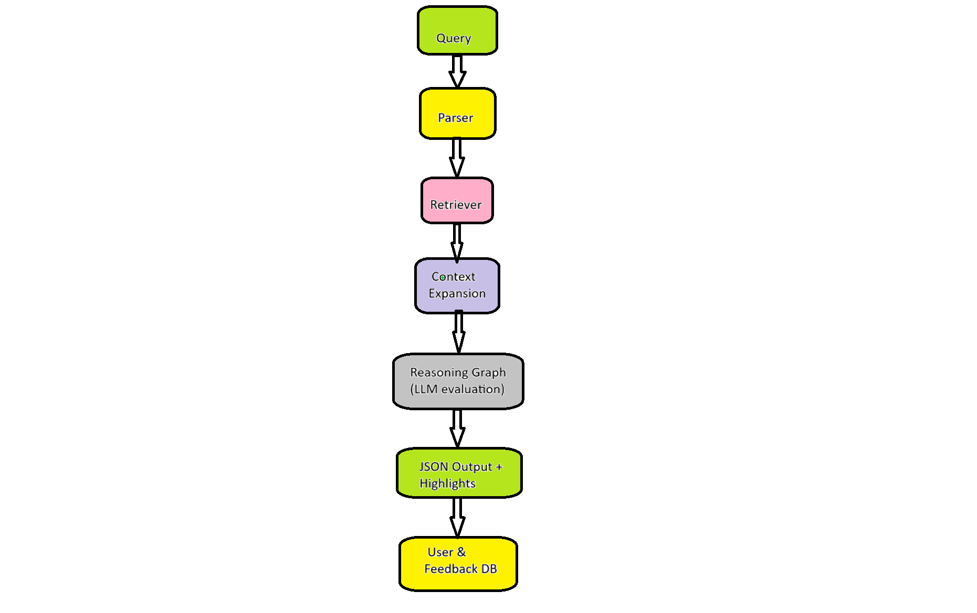
Data Flow Diagram

Slide 7
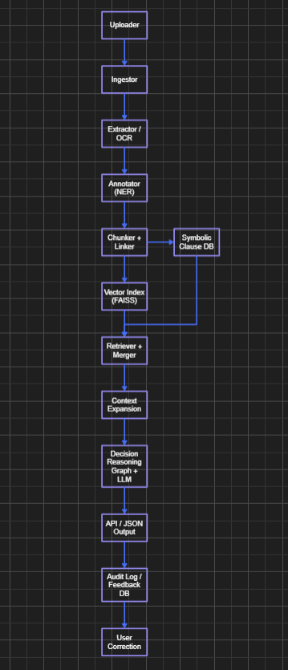
So, how if your solution different?
Cognivault AI seamlessly integrates semantic understanding with exact rule-based recall hence producing ample context-aware and exact decisions.
By decomposing evaluations into transparent steps, A Decision Reasoning Graph ensures an audit-ready way to validate all of their answers based on clause grounding.
Having confidence scoring and a self-learning feedback loop, the system is not only able to provide quicker, more confident results but also learn, bestowing on it a feature most current tools do not possess.
Architechture Diagram

Slide 8
Future possible enhancements
Multi-lingual & domain-tuned LLMs
ERP/CRM intergreations
Private deployments on-device
Analytics dashboard to clause pattern of usage

Slide 9
Risks/Challenges/Dependencies
OCR quality of bad scans (which is mitigated through AWS Textract)
LLM hallucinations (clause grounding mitigation)
Achieving millions determinants of vector DB

Slide 10
Acceptance Criteria Coverage
Reads indistinct human speak
Supports PDFs, Word documents and emails, images
Generates clause-linked, dense, explainable outputs
Audit-trail auditable decision logs

Slide 11
Anything Else?
Natural language queries, whether vague, incomplete or crafted in common language, are entered into the system and clear, explainable and auditable decisions are returned on the same.
Using both the AI reasoning and the verifiable evidence, Cognivault AI shortens the much longer decision-making time to seconds and removes any ambiguity of results and assumes compliance within the industry covered by regulation yet preserves the explainability on a human level.

Slide 12
THANK YOU!

