Slide 1

Nat v2.0 (Neat Assorting Technology)
By- Maheen Aftab, Rayna Young, Mehak Kaur

Slide 2
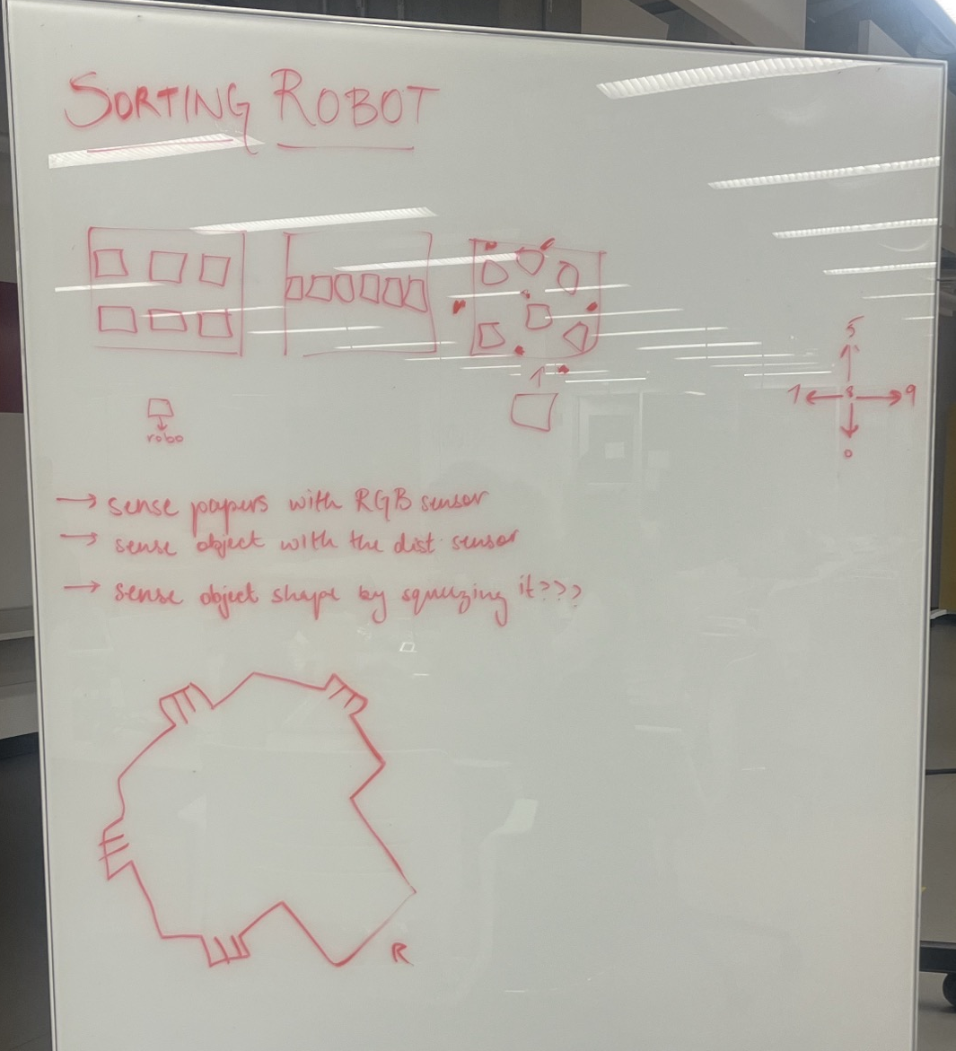
Team Strategy
Focus on the problem
Positions of compartments and shape of objects
Found resources
Made a plan
Started development

Slide 3
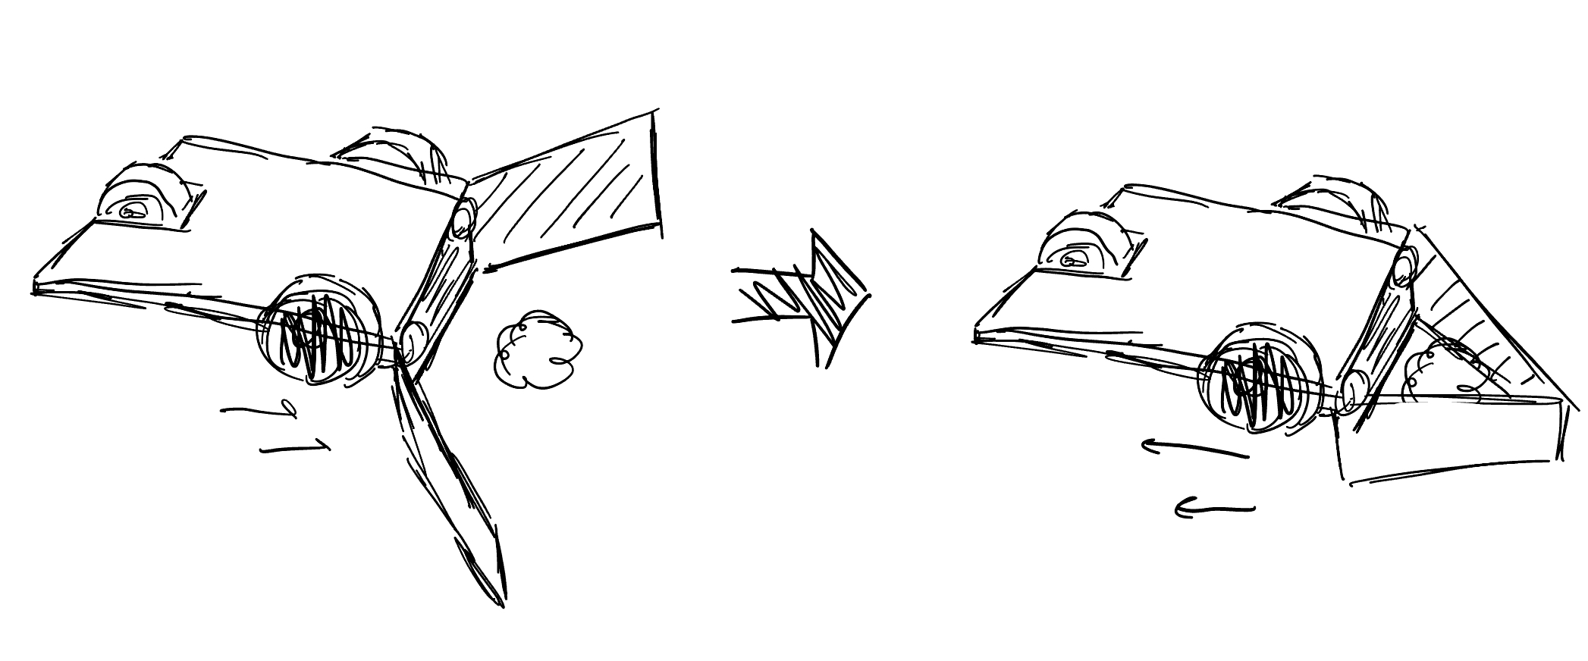
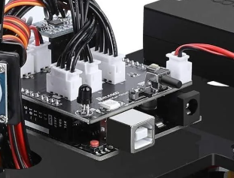
Step 1: Planning
Planned to use the SmartCar module with the Arduino Uno
For easy and quicker functionality

Slide 4
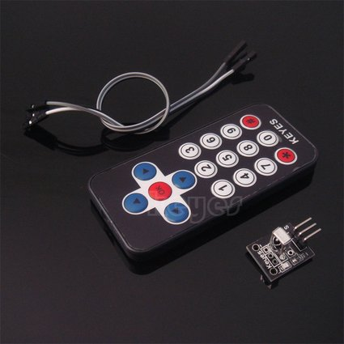
Step 2: Debugging
Decided to use the IR Remote control to achieve the base control
Then switch to sensors for an automated robot
Debugged for 5 hours
Received help from Samson Hua

Slide 5
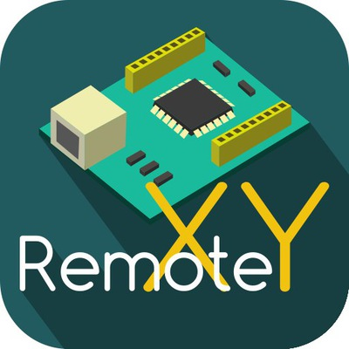
Step 4: Adjusted Strategies
Switched from using the IR Remote to the Remote Control module through our phones

Slide 6
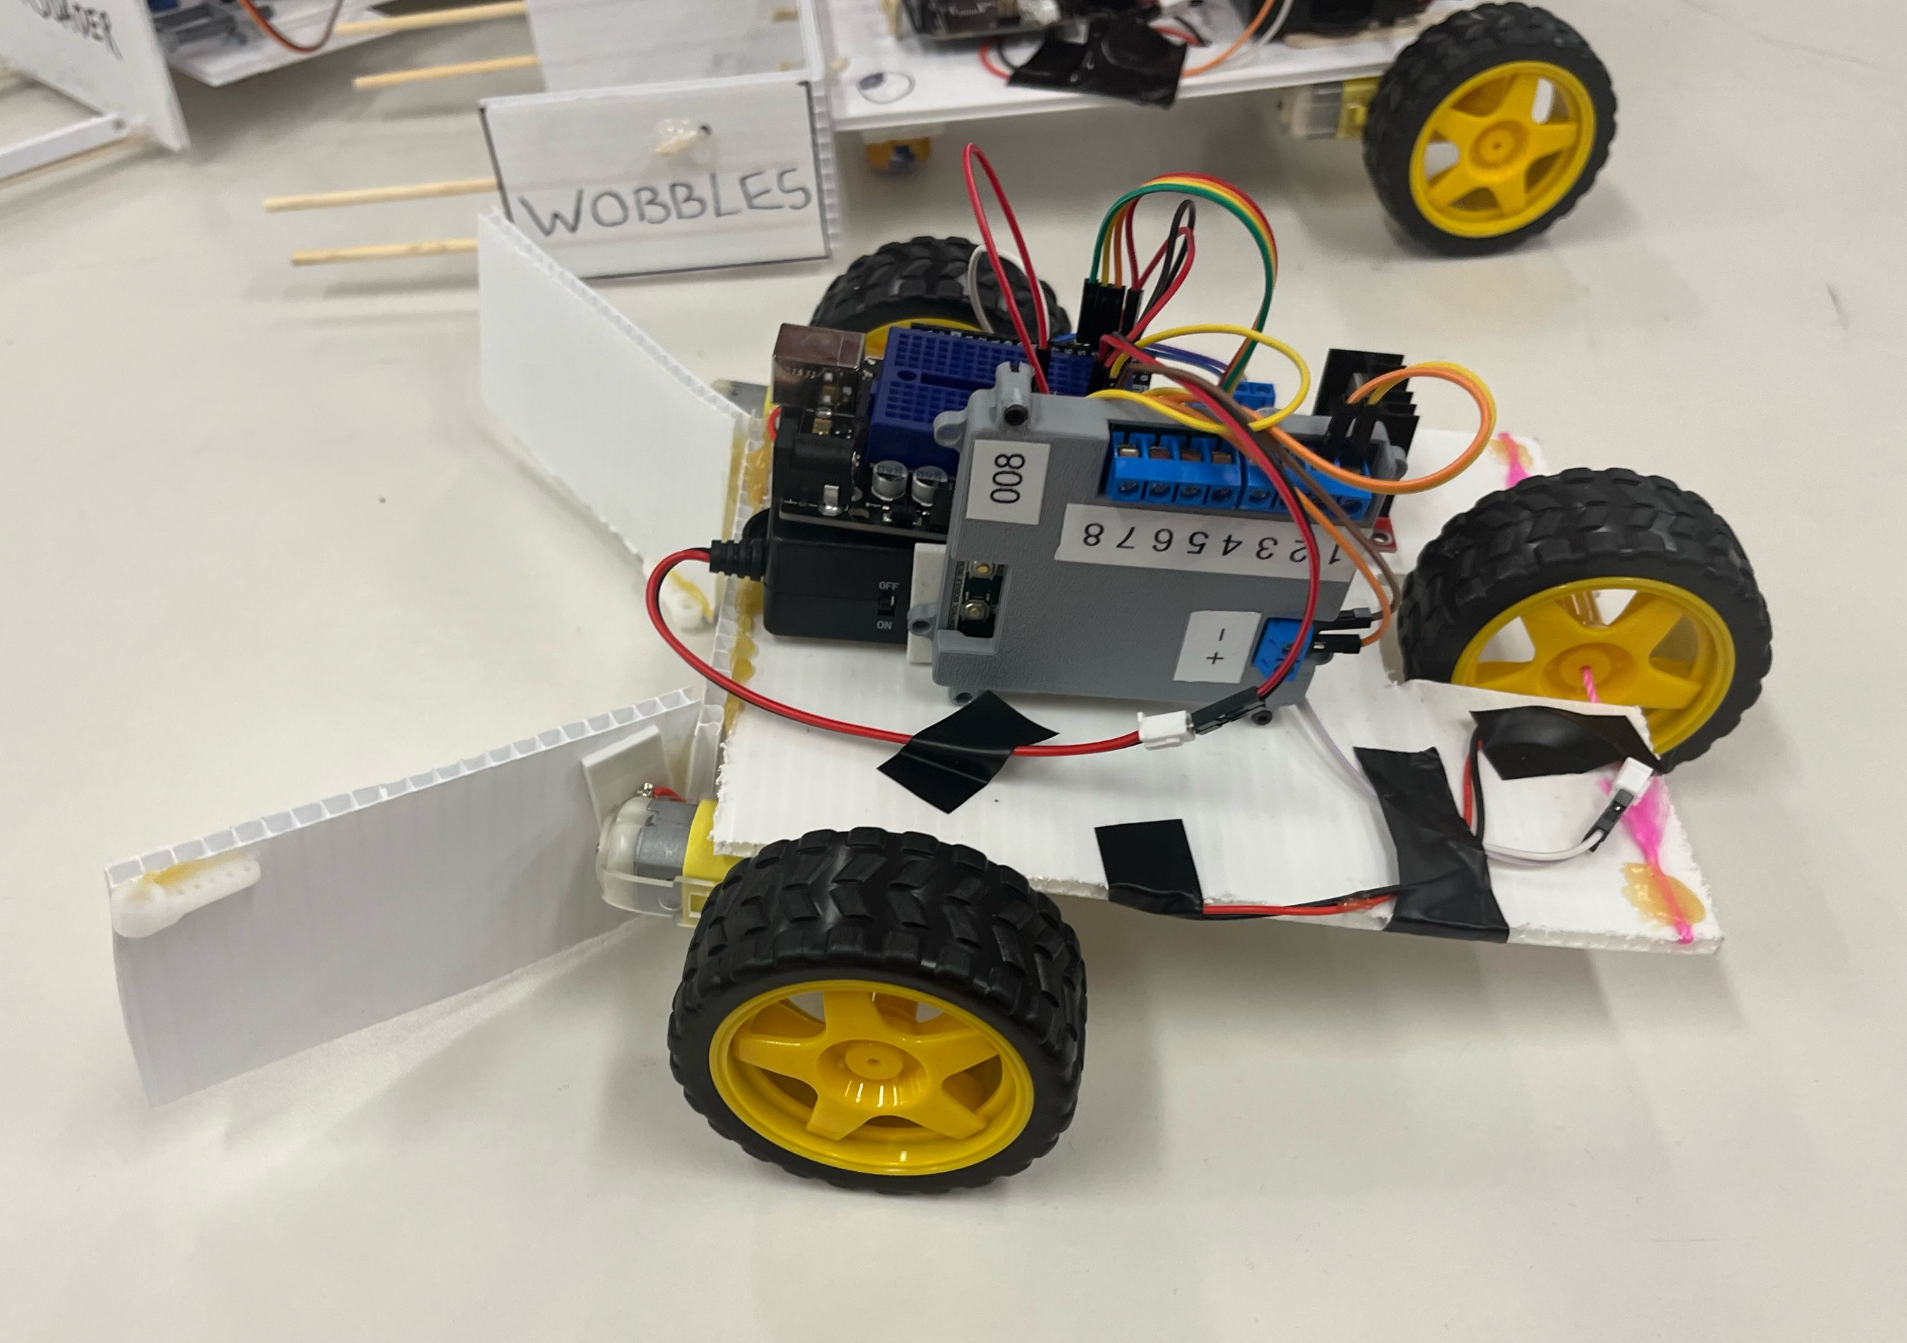
Step 5: Testing
Testing and Fine-tuning

Slide 7
Thank You!
Questions?

