Slide 1

Flight Delay Prediction and Visualization
Data Analysis and Insights using Python
Presented by:
Maheen Shahid
Hoor-ul-ain Wajid

Slide 2
.
Introduction
Flights are an important way for people to travel.
But sometimes, flights get delayed — this causes problems for both passengers and airlines.
Delays can happen because of bad weather, technical problems, or busy airports.
In this project, we will look at flight data to understand when and why delays happen.

Slide 3

Project Overview
Goal
Tools
Analyze and visualize flight delay data to identify
patterns and insights.
Python, Pandas, Matplotlib, Seaborn, and Scikit-learn.
Visualization (Plotly, Power BI)
Dataset
Key Focus Areas
U.S. domestic flight data (includes delay times, distances,
durations, etc.)
3 million flight records with 32 columns.
Delay causes and distributions
Correlation between numerical features
Handling missing data.
Insights through graph and heatmap

Slide 4
Dataset Description
Record Count
Columns
Missing Values
3 million flight records for analysis.
It includes 32 columns with both numerical and categorical data.
FL_DATE, AIRLINE, ORIGIN, DEST
Some delay columns have missing values (NaN) which mean no delay.
DEP_DELAY, ARR_DELAY, and 28 others

Slide 5




Data Cleaning Approach
Handled Missing Column
Delay reason columns (e.g., DELAY_DUE_WEATHER) had
many NaN values.
These were assumed to mean no delay, so we replaced NaN
with 0.
Used Imputation
For numeric columns with some missing values, we used the mean value to fill them
Used: SimpleImputer(strategy='mean') from Scikit-learn.
Filtered Data
Removed or adjusted invalid or extreme outliers (e.g.,
delays over 3000 minutes).

Slide 6
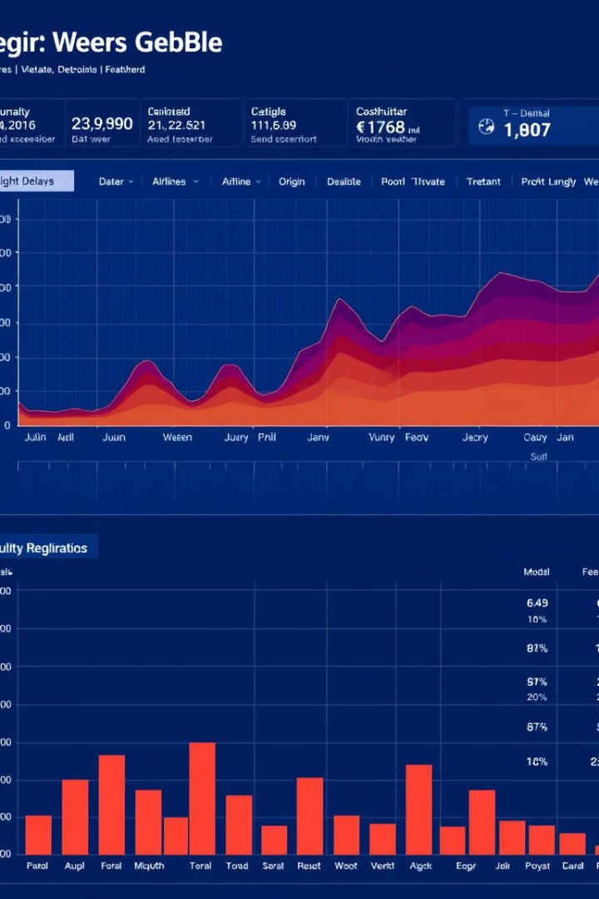
Correlation Heatmap
Strong Correlations
Related Features
ELAPSED_TIME correlates with AIR_TIME strongly.
DEP_DELAY closely aligns with ARR_DELAY.
Impact
Identifies key features for delay prediction models.

Slide 7
Arrival Delay Distribution
Delay Range
Skewness
Outliers
Most flights delayed between 0 and 50 minutes.
Distribution is right-skewed with few extreme delays.
Delays exceeding 1000 minutes are extremely rare.

Slide 8

Feature Engineering
1
Select Numerical Data
2
Create New Features
Focused on relevant numeric columns for models.
Transformed time and delay columns into impactful metrics.
3
Clean Features
Removed irrelevant and duplicate columns to avoid noise.

Slide 9

Model Building
Model Selection
Used XGBoost for prediction.
Training
Trained models on engineered features with labels.
Evaluation
Measured accuracy, precision, and recall for quality.

Slide 10

Insights & Observations
Main Causes
Key Predictor
Arrival Status
Late arrivals and weather are prime delay factors.
Departure delay strongly predicts arrival delay.
Most flights are on time or have minor delays.

Slide 11

Challenges Faced
Data Size
Missing Data
Large dataset caused memory handling difficulties.
Missing delay reason values required careful imputation.
Outliers
Extreme delay values (>3000 mins) posed analysis challenges.

