Slide 1
CS 101: Recursion
Jul-Nov 2018
Om Damani
(cs101-help@cse.iitb.ac.in)

Slide 2
Recursion
A function can call itself, just like any other function
Each call results in another activation frame getting created
OK, as long as this does not happen indefinitely
like loops, recursive calls must also terminate
int fac(int n) {
if (n == 0) return 1;
else return n * fac(n-1);
}
int gcd(int m, int n) {
if (n == 0) return m;
else return gcd(n, m % n);
}
int fib(int n) {
if (n < 2) return 1;
else return fib(n-1) + fib(n-2);
}

Slide 3
name | address | value
n | 100 | 5
name | address | value
n | 112 | 4
fac(5) calls
fac(4) calls
fac(3) calls
fac(2) calls
fac(1) calls
fac(0) returns 1
returns 1
returns 2
returns 6
returns 24
returns 120
name | address | value
n | 120 | 3
int fac(int n) {
if (n == 0) return 1;
else return n * fac(n-1);
}

Slide 4
Recursion
Without dividing by 9, check whether a +ve number is divisible by 9
Divisible, if the sum of the digits of the number is divisible by 9
Translate into function
bool divisibleBy9(int n) {
if divisibleBy9(sumOfDigits(n)) return true;
else return false;
}
Assume sumOfDigits is defined properly
Is divisibleBy9 correct?
bool divisibleBy9(int n) {
if (n < 10) return n == 9;
else return divisibleBy9(sumOfDigits(n));
}
ensure termination?

Slide 5
bool divisibleBy9(int n) {
if (n < 10) return n == 9;
else return divisibleBy9(sumOfDigits(n));
}
What if function modifies the parameter. Does it work?
bool divisibleBy9(int n) {
if (n < 10) return n == 9;
n = sumOfDigits(n);
return divisibleBy9(n);
}
Works, because every function call makes a copy of parameters.
Any change made to copy does not affect the original.

Slide 6
Recursion Overhead
int fib(int n) {
if (n < 2) return 1;
else return fib(n-1) + fib(n-2);
}
Just because you can use
recursion does not mean
you always should
memory limited,
higher copying
overhead
7
6
5
5
4
3
4
4
3
3
2
2
1
3
2
3
2
2
1
2
1
1
0
1
0
2
1
1
0
2
1
1
0
1
0
1
0
1
0
1
0

Slide 7
Towers of Bramha (Hanoi)
An ancient temple in India
A large room with 3 towers with total of 64 golden disks.
Disks are continuously moved by priests in the temple.
Priests have to move disks from start tower to end tower
When the last move is completed the world will end.
So, what is saving the world?
Luckily the priests have to follow some rules:
Only one disk can be moved at a time.
Top disk of one tower can be moved to top of any other tower
No disk can be placed on top of a smaller disk.

Slide 8
Towers of Brahma
How to move the disks?

Slide 9
Insertion Sort
while (i < N) {
// LI: a[0..i-1] is sorted
// insert a[i] in a[0..i-1]:
val = a[i]; l = i-1;
while (l>=0 && a[l]>val)
{ a[l+1] = a[l]; l--; }
a[l+1] = val;
i++;
}
void isort(int a[], int n){
if (n < 2) return;
isort(a, n-1);
insertLast(a,i);
}
Write the recursive version

Slide 10
insertLast: Pre and Post Conditions
void insertLast(int a[], int i){
//LI PreCond: a[0..i-1] is sorted
val = a[i]; l = i-1;
while (l>=0 && a[l]>val)
{ a[l+1] = a[l]; l--; }
a[l+1] = val;
i++;
// PostCond: a[0..i] is sorted
}
void isort(int a[],
int n){
if (n < 2) return;
isort(a, n-1);
insertLast(a,i);
}

Slide 11
Iteration vs Recursion
void isort(int a[], int n){
int i = 0;
while (i < n) {
// LI: a[0..i-1] sorted
insertLast(a,i);
i++;
}
}
void isort(int a[], int n){
if (n < 2) return;
isort(a, n-1);
//PostCond: a[0..n-1] sorted
insertLast(a,i);
}
Recursive version not particularly easier than iterative version??,
higher function call overhead
But recursion very useful in many problems

Slide 12
Iteration vs Recursion
All iterative programs can be written as a recursive one
All recursive programs can also be written as iterative one
- after all basic computer operations are iterative

Slide 13
Quicksort
5 | 1 | 9 | 2 | 6
Choose an arbitrary pivot
5 | 1 | 9 | 2 | 6
Sift elements to the order less than pivot, pivot, greater than pivot
Note that other elements are not sorted
2 | 1 | 5 | 9 | 6
Sort left and right segments
1 | 2 | 5 | 9 | 6
1 | 2 | 5 | 6 | 9

Slide 14
Quicksort: void qsort(int a[], int low, int high) {
if (high > low) {
5 | 1 | 9 | 2 | 6
Choose an arbitrary pivot
5 | 1 | 9 | 2 | 6
int m = partition(a, low, high);
Sift elements to the order less than pivot, pivot, greater than pivot
Note that other elements are not sorted
2 | 1 | 5 | 9 | 6
qsort(a, low, m-1);
qsort(a, m+1, high);
Sort left and right segments
1 | 2 | 5 | 9 | 6
}
}
1 | 2 | 5 | 6 | 9
Best know all round sorting algorithm: NlogN instead of N^2

Slide 15
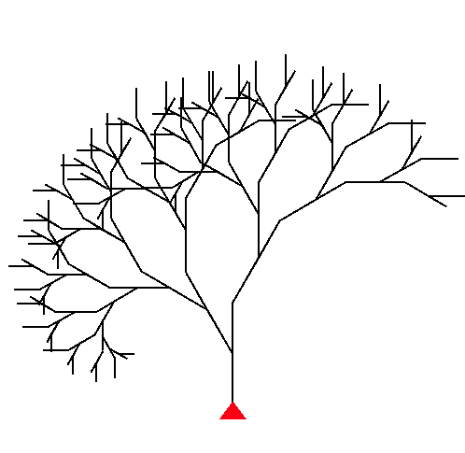
A Botanical Tree Drawn Using the Turtle in Simplecpp

Slide 16
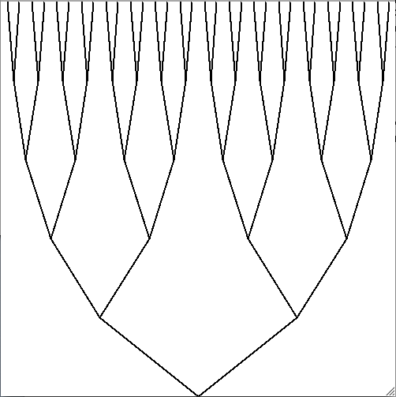
A More Stylized Tree Drawn Using simplecpp

Slide 17
1 Stylized Tree = 2 Small Stylized Trees + V
When a part of an object is of the same type as the whole, the object is said to have a recursive structure.

Slide 18
Drawing The Stylized Tree
Parts:
Root
Left branch, Left subtree
Right branch, Right subtree
Number of levels: number of times the tree has branched going from the root to any leaf.
Number of levels in tree shown = 5
Number of levels in subtrees of tree: 4

Slide 19
Drawing The Stylized Tree
General idea:
To draw an L level tree:
if L > 0{
Draw the left branch, and a Level L-1 on top of
it.
Draw the right branch, and a Level L-1 tree on
top of it.
}
We must give the coordinates where the lines are to be drawn
Say root is to be drawn at (rx,ry)
Total height of drawing is h.
Total width of drawing is w.
We should then figure out where the roots of the subtrees will be.

Slide 20
Drawing The Stylized Tree
Basic Primitive:
Drawing a line from (x1,y1) to (x2,y2)

Slide 21
Drawing The Stylized Tree
W
H
H/L
(rx,ry)
(rx-W/4,ry-H/L)
(rx+W/4,ry-H/L)

Slide 22
Drawing The Stylized Tree
Basic Primitive Required: Drawing a line
Create a named shape with type Line
Line line_name(x1,y1,x2,y2);
Draw the shape
line_name.imprint();

Slide 23
Drawing The Stylized Tree
void tree(int L, double rx, double ry,
double H, double W) {
if(L>0){
Line left(rx, ry, rx-W/4, ry-H/L); // line called left
Line right(rx, ry, rx+W/4, ry-H/L); // line called right
right.imprint(); // Draw the line called right
left.imprint(); // Draw the line called left
tree(L-1, rx-W/4, ry-H/L, H-H/L, W/2); // left subtree
tree(L-1, rx+W/4, ry-H/L, H-H/L, W/2);// right subtree
}
}

Slide 24
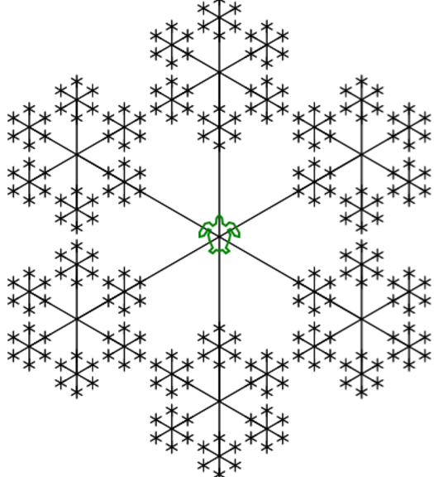
More fun drawings using recursion

Slide 25
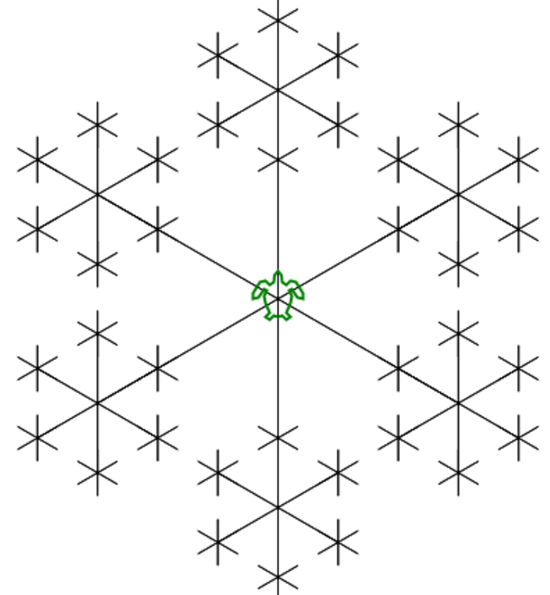
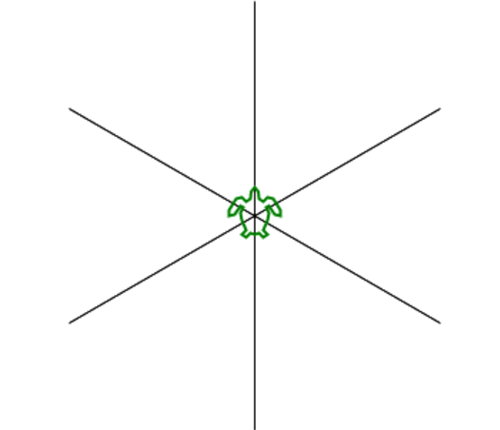
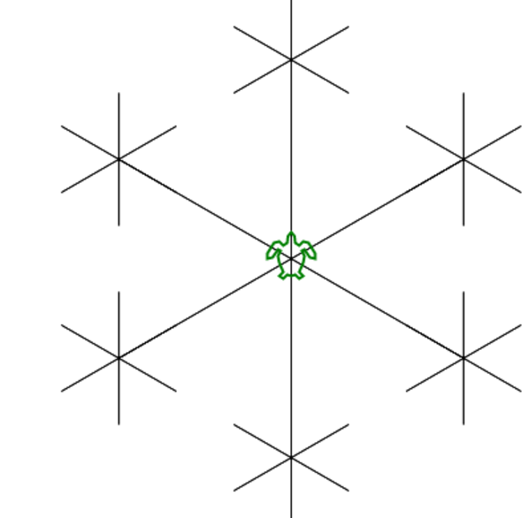
Fractals: self-similar patterns
Level 1
Level 2
Level 3
Level 4

