Slide 1
CS 101:
Vector and Generic Algorithms
Jul-Nov 2018
Om Damani
(cs101-help@cse.iitb.ac.in)

Slide 2
Word List
Needed for several applications:
  spelling check, game of scrabble e.t.c.
Simplest implementation
  string wordList[listSize]
  ifstream ifs(“someList”);
  for(i=0; i<listSize; i++){
  ifs >> wordList[i];
  }
Search whether a word is present in the list

Slide 3
Word List: Search a word
Needed for several applications:
  spelling check, game of scrabble e.t.c.
Simplest implementation
  string wordList[listSize]
  // look for string s
  bool found = false;
  while (!found && i < listSize){
  found = (wordList[i] == s);
  i++;
  }

Slide 4
Word List: Issues
What problems do you see with this implementation of Word List? Think of real life issues.
Maximum list size fixed in advance
Real life: list changes with time
Solution: use a vector

Slide 5
Word List: Array vs. Vector
  string wordList[listSize];
  ifstream ifs(“someList”);
  for(i=0; i<listSize; i++){
  ifs >> wordList[i];
  }
  vector<string>
  wordList(listSize);
  ifstream ifs(“someList”);
  for(i=0; i<listSize; i++){
  ifs >> wordList[i];
  }
We can use a vector just like an array
But vectors are more powerful than array
- we can grow them dynamically

Slide 6
Vector: Dynamic Sizing
  vector<string> wordList; // size 0
  ifstream ifs(“someList”);
  string word;
  while (ifs >> word) {
  // ‘>>’ returns a boolean indicating
  // success or failure
  wordList.push_back(word);
  // increase the size of vector by 1
  // add the new element at the end
  }

Slide 7
Searching in Vector: Built-in Function
  // look for searchWord
  bool found = false;
  while (!found && i < wordlist.size()){
  found = (wordList[i] == searchWord);
  i++;
  }
  search is a common operation. library function find
  #include<algorithm>
  find(wordList.begin(), wordList.end(),
  searchWord);

Slide 8
Iterators
A pair of iterators defines a sequence
  .begin() (points to the first element )
  .end() (points to the one-beyond-the-last element)
begin:
end:
…
  typedef vector<string>::iterator iter; // shorthand
  for(iter i = wordList.begin(); i != wordList.end();
    i++ ){ // ++ takes to next element
    cout << *i; // * gives value
  }
Stroustrup/Programming - Nov'13

Slide 9
Searching the Vector: Built-in Find
  vector<string>::iterator where =
  find(wordList.begin(), wordList.end(),
  searchWord);
  bool found = ( where != wordList.end() );
  // == says whether two iterators point to the same element?
  if (found) { cout << *where; }
  // * gives the element pointed to. print the word
What if we have to call find many times?

Slide 10
Built-in Binary Search
  vector<string>::iterator where = find( wordList.begin(), wordList.end(), searchWord);
  bool found = ( where != wordList.end() );
  bool found = binary_search(wordList.begin(), wordList.end(), searchWord);
But binary search requires sorted sequence
  sort( wordList.begin(), wordList.end() );
Sort by default sorts in ascending order: by ‘<‘
will see later how to sort differently

Slide 11
Headers and Declarations
#include <iostream>
#include <vector>
#include <algorithm>
#include <string>
#include <fstream>
using namespace std;
Real life needs more than just a word list

Slide 12
Fake Message Detection
  Large number of fake messages on Whatsapp, facebook etc.
  Some of them claim to be statements from Narayan Murthy or Dalai Lama etc.
How will you know that a given message is similar to other messages from a given person
Need a signature (unique identifier) of the message:
just the way a signature is used in banks.

Slide 13
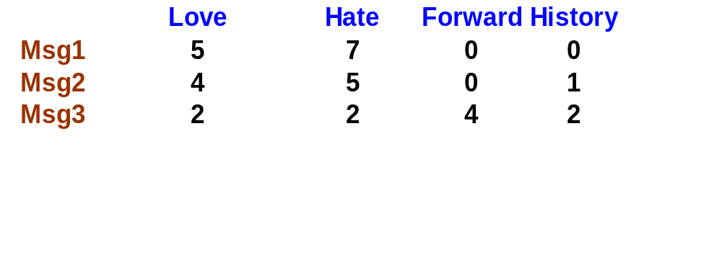
Signature in terms of word count
Sec. 6.2
How many times does a given word occurs in a given message
Requires us to keep track of word counts.
How to do it using vectors?
Actual fake message detection will need lot more work and
will be a research project but this idea will also be used.
How to implement this with vectors??

Slide 14
words and counts
Sec. 6.2
Two vectors:
  vector<string> words;
  vector<int> count;
How to update
  keep two vectors in sync
  when a new word is added, initialize count
  how to keep both vectors correctly sorted?
  need a customized sorting routine
why is it so complicated?

Slide 15
Keep Related Information together
Sec. 6.2
Instead of Two vectors:
  vector<string> words;
  vector<int> count;
Keep the word and its count together
  class wordStat {
  public: string word, int count;
  }
  vector<wordStat> wordList;
You still have to write your own find and sort but simpler than
using two vector

Slide 16
Generic Find and Sort
Sec. 6.2
  vector<wordStat> wordList;
  class wordStat {
  public: string word, int count;
  }
How will sort work:
  sort( wordList.begin(), wordList.end() );
how to compare two wordStat for ordering
  It is completely upto us, how to order them

Slide 17
Generic Sort
Sec. 6.2
  vector<wordStat> wordList;
  class wordStat {
  public: string word, int count;
  }
  // define a comparison function ignoring counts
  bool wordStatLessThan(const wordStat& w1, const wordStat& w2){
  return w1.word < w2.word; // our choice how to compare
  }
  sort( wordList.begin(), wordList.end(), wordStatLessThan );

Slide 18
A different Sort order: On Frequency
Sec. 6.2
  vector<wordStat> wordList;
  class wordStat {
  public: string word, int count;
  }
  bool wordStatLessThan2(const wordStat& w1, const wordStat& w2){
  // return w1.word < w2.word;
  return w1.count < w2.count;
  }
  sort( wordList.begin(), wordList.end(), wordStatLessThan2 );
Now we can print the word list in frequency order

Slide 19
Sec. 6.2
Generic Find and Binary Search: Out of Syllabus
  vector<wordStat> wordList;
  class wordStat {
  public: string word, int count;
  }
  bool wordStatLessThan(const wordStat& w1, const wordStat& w2){
  return w1.word < w2.word;}
  wordStat ws;
  binary_search( wordList.begin(), wordList.end(), ws, wordStatLessThan );
  but we want to look up a string not a wordStat

Slide 20
Look up a word in wordStat list: introduce constructor
Sec. 6.2
  vector<wordStat> wordList;
  class wordStat {
  public: string word, int count;
  wordStat(const string& s):word(s),count(0){}
  }
  bool wordStatLessThan(const wordStat& w1, const wordStat& w2){
  return w1.word < w2.word;}
  string s;
  binary_search( wordList.begin(), wordList.end(), s, wordStatLessThan ); // look up a word in wordStat list
  binary_search and find requires equality operator to be overloaded also
    not discussing it any further

Slide 21
Putting it all together: wordStat
class wordStat{
public:
string word;
int count;
wordStat(const string &s):word(s),count(0){}
wordStat(const string &s, int c): word(s),count(c){}
};

Slide 22
Putting it all together: reading words
int main(){
vector<wordStat> wordList;
ifstream ifs("someList");
string word;
while(ifs>>word){
// “>>” returns false when no more input
wordList.push_back(wordStat(word, 1));
}

Slide 23
all together: searching words
bool wordStatLessThan(const wordStat& w1,
const wordStat& w2){
return w1.word < w2.word;
}
int main(){...// read word list
string s; cin >> s;
sort(wordList.begin(), wordList.end(), wordStatLessThan);
bool found = binary_search(wordList.begin(),
wordList.end(), s, wordStatLessThan);
cout << found;
}

Slide 24
Object Oriented Programming
Sec. 6.2
vector<wordStat> wordList;
ifstream ifs(“list");
string word;
while(ifs>>word){
wordList.push_back(
wordStat(word, 1));
}
string s; cin >> s;
sort(wordList.begin(), ..);
bool found = binary_search
(wordList.begin(), ..);
cout << found;
wordStatList wordList;
ifstream ifs(“list");
string word;
while(ifs>>word){
wordList.add(word);
}
string s; cin >> s;
wordList.sort();
bool found = wordList.search();
cout << found;
Moving from program elements to real life elements

Slide 25
Further Hide C++
Sec. 6.2
wordStatList wordList;
ifstream ifs(“file");
string word;
while(ifs>>word){
wordList.add(word);
}
string s; cin >> s;
wordList.sort();
bool found = wordList.search();
cout << found;
wordStatList
wordList(“file");
// construct the word
// list from a file
string s; cin >> s;
wordList.sort();
bool found = wordList.search();
cout << found;
implement the wordStatList class

Slide 26
Class wordStatList
Sec. 6.2
class wordStatList{
vector<wordStat> wlist;
wordStatList(string& fname)
{ifstream ifs(fname);
string word;
while(ifs>>word){
wlist.push_back(
wordStat(word, 1));
}
void sort(){
sort(wlist.begin(),..);
wordStatList
wordList(“file");
string s; cin >> s;
wordList.sort();
bool found = wordList.search();
cout << found;

Slide 27
Allowing Duplicates
Sec. 6.2
class wordStatList{
vector<wordStat> wlist;
wordStatList(string& f)
{ifstream ifs(f);
string word;
while(ifs>>word){
wlist.push_back(
wordStat(word, 1));
}
wordStatList(string& f)
{ifstream ifs(f);
string word;
while(ifs>>word){
int index =
mySearch(word);
if (index != -1){
wlist[index].count++;
} else {
wlist.push_back(
wordStat(word,1));
}
}

Slide 28
Using wordStatList
Sec. 6.2
wordStatList msg1(“message_file1");
wordStatList msg2(“message_file2");
//if member function similar is defined
if (msg1.similar(msg2)){
....
}
Your main code now is the problem statement in English

