Slide 1
CS 101:
Computer Programming
Om Damani
(cs101-help@cse.iitb.ac.in)
Course webpage: http://www.cse.iitb.ac.in/~cs101/
Lecture 1: Introduction
Clip art and quote credits: Various sources found through Google Image Search
Notes:
Ever since the dawn of civilization, humans have invented one machine after another to accomplice their tasks --- we have radios to play music, television to show videos, an electric bulb to light things, and so on. Of these one of the most amazing machines is a computer. All earlier machines will designed to solve one task --- a computer is the only machine that is versatile enough to solve a diverse set of tasks.

Slide 2
About These Slides
Based on Chapter 1 of the book
  An Introduction to Programming Through C++
  by Abhiram Ranade (Tata McGraw Hill, 2014)
Original slides by Abhiram Ranade
  First update by Varsha Apte
  Second update by Uday Khedker
  Third update by Sunita Sarawagi
  Fourth update by Umesh Bellur
  Fifth update by Om Damani

Slide 3
What is a Computer
Compute: perform elaborate calculations
  Combination of mathematical and logical operations
Computer: a machine that can compute
You do not need to know how a scooter works to ride a scooter
Similarly, we can program a computer without knowing how the computer works – the electronics behind it

Slide 4

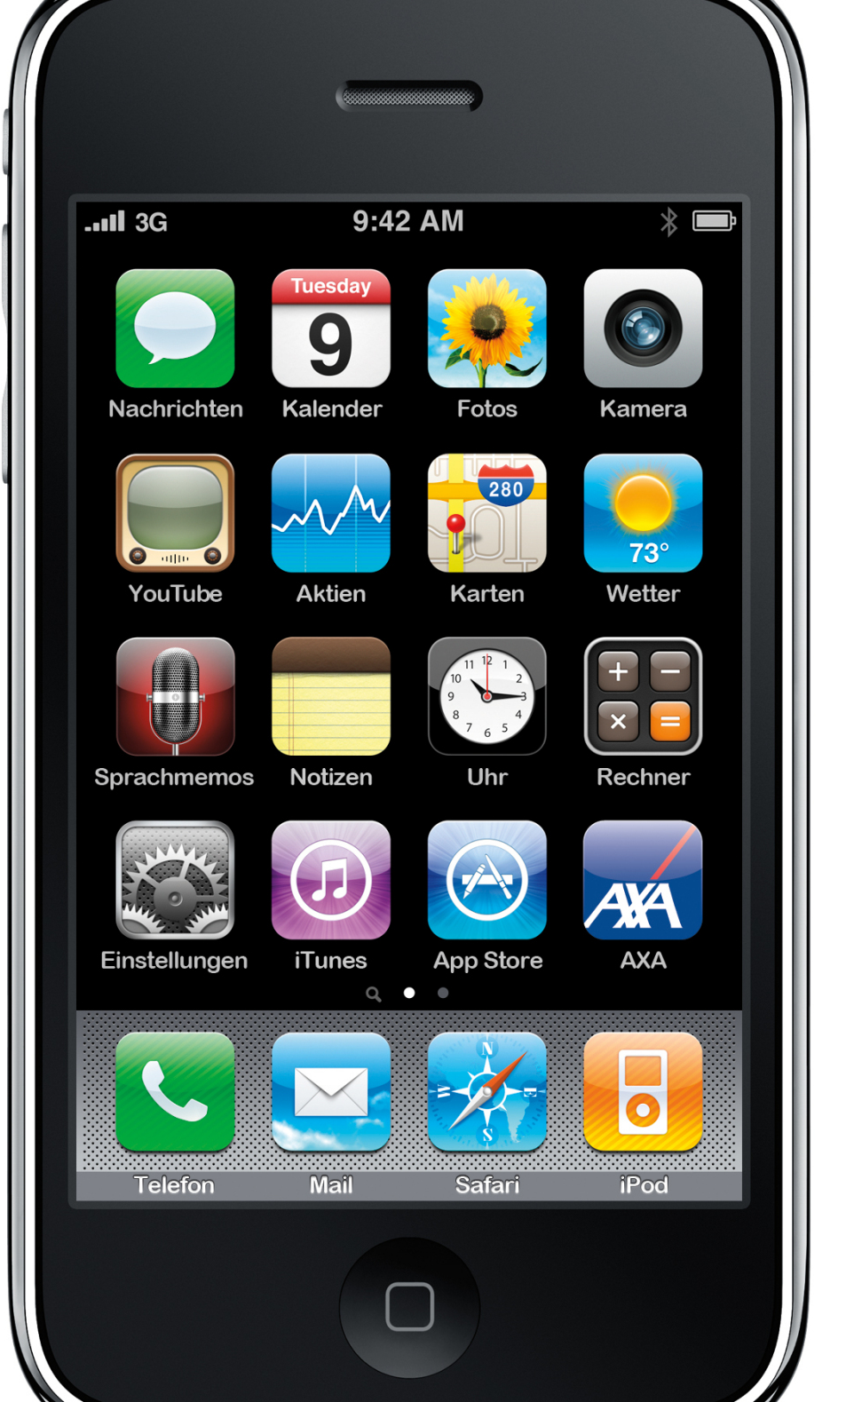
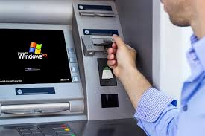
Electronic Computers are everywhere
So far all of us have used an electronic computer
  Calculator
  ATM
  Smartphone
  (is a computer)

Slide 5

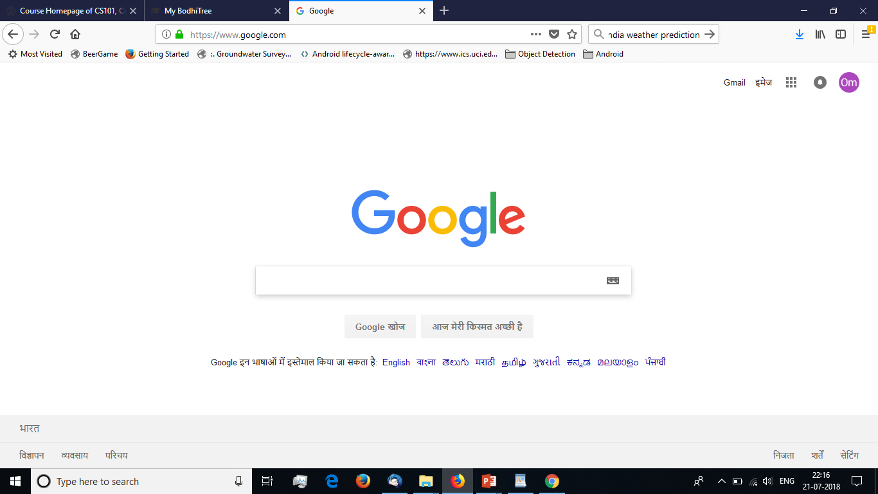
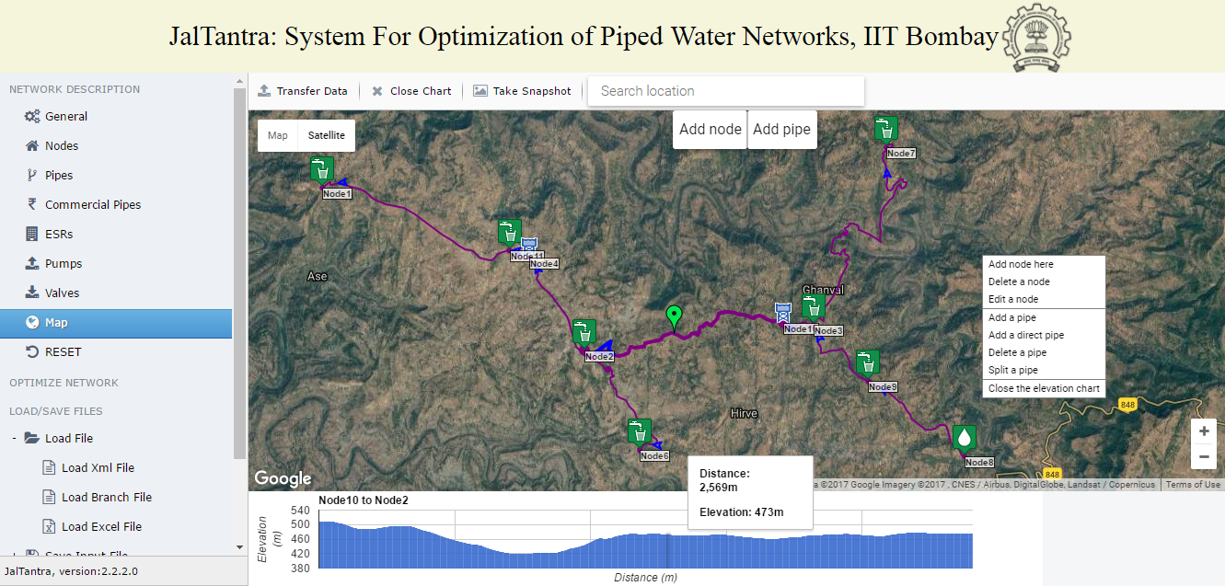
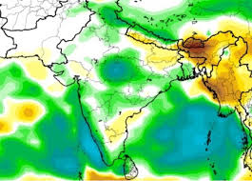
A Computer Can Do Many Things
Help book and manage tickets
Store and search documents
Weather prediction
Help design physical systems: say water network
How ?

Slide 6
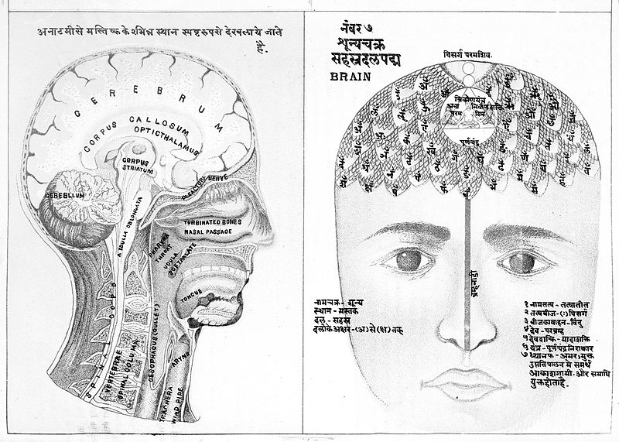
Most Popular Computer
We calculate all the time - make decisions all the time
Programming is translating our mental instructions in computer instructions
Hence, we all can program – Each one of us is computing all the time
But we will be very slow compared to an electronic computer
And computers do not get bored, tired, frustrated easily and hence do not commit errors

Slide 7
Using our mental computer
During the course, we will
  write programs on paper
  and execute them manually
  before passing them on to an electronic computer
Bring paper (roughly a4 size) and pen to all labs
All exams: mid-semester and end-semester will be paper and pencil based

Slide 8
All of us can program
If you can do calculations
If you can make decisions
If you can deal with unknown variable ‘x’ in algebra
You Can Program

Slide 9
તમે કમ્પ્યુટર પ્રોગ્રામિંગ કરી શકો છો
நீங்கள் கணினி நிரலாக்க செய்ய முடியும்
आपण संगणक प्रोग्रामिंग करू शकता
మీరు కంప్యూటర్ ప్రోగ్రామింగ్ చేయవచ్చు
আপনি কম্পিউটার প্রোগ্রামিং করতে পারেন
आप कंप्यूटर प्रोग्रामिंग कर सकते हैं
ನೀವು ಕಂಪ್ಯೂಟರ್ ಪ್ರೊಗ್ರಾಮಿಂಗ್ ಮಾಡಬಹುದು
You Can Do Computer Programming
നിങ്ങൾക്ക് കമ്പ്യൂട്ടർ പ്രോഗ്രാമിംഗ് ചെയ്യാൻ കഴിയും

Slide 10
You Can Program
Help and support will be provided in all languages
Do not hesitate in contacting us if are facing problem due to English
आप अंग्रेजी के कारण समस्या का सामना कर रहे हैं तो हमसे संपर्क करने में संकोच न करें
There will be one Teaching Assistant for every 12 students
Like a mini-instructor for you who will handhold you throughout the semester

Slide 11
Programs
Program = a precise description of the calculations we want the computer to perform
By feeding different programs to a computer you can make it do different calculations.
This course tells you how to construct (“write”) programs.
Special notation is to be used to write programs: “Programming Language”

Slide 12
Goal for today
Write some small programs using C++ programming language
The programs will draw pictures on the screen.
We “drive” a “turtle” on the screen!
Turtle has a pen, so it draws as it moves.
Drawing pictures may seem be fun, but if you master it, you have mastered a lot of programming
Will use simplecpp package developed by Prof Abhiram Ranade, based on Logo

Slide 13

Programming the turtle to draw a square
Instructions the turtle understands
forward (x): Move forward x pixels
  E.g. forward(50) moves the turtle forward 50 pixels
right (x): turn right by x degrees
left(x): turn left by x degrees
penUp()
  Will not draw while moving
penDown()
  Will draw while moving

Slide 14
Programming a turtle to draw a square (continued)
forward, right, left, penUp, penDown
With these instructions, make the turtle move in such a way that we will draw a square of length 200
What facts do we need to know before we can program
Note: by default, in the beginning,
the turtle faces towards east, and
the pen is down

Slide 15
A simplecpp program
Some magic abracadabra: ignore
the program will use the simplecpp package.
#include <simplecpp>
main_program {
turtleSim();
forward(200); right(90);
forward(200); right (90);
forward(200); right(90);
forward(200);
}
Your commands within these braces {..}.
Start the turtle simulator (open a window)
Move forward 200 units
Turn right 90 degrees
Program exits

Slide 16
General Ideas
#include<simplecpp>
main_program{
turtleSim();
  forward(200); right(90);
  forward(200); right(90);
  forward(200); right(90);
  forward(200);
  wait(10);
}
Commands or statements terminated by semicolon ";"
This sequence of commands in C++ is the program
Some commands need
additional information called
arguments
90 is the argument to the command right
200 is the argument to the command forward

Slide 17
General Ideas (contd)
#include<simplecpp>
main_program{
  turtleSim();
  forward(200);
  right(90);
  forward(200);
  right(90);
  forward(200);
  right(90);
  forward(200);
  wait(10);
  }
Commands are generally executed from top to bottom, left to right.

Slide 18
How to Draw An Octagon?
#include <simplecpp>
main_program{
  turtleSim();
  forward(100); right(45);
  forward(100); right(45);
  forward(100); right(45);
  forward(100); right(45);
  forward(100); right(45);
  forward(100); right(45);
  forward(100); right(45);
  forward(100); right(45);
  wait(10);
  }
Commands seem quite repetitive?
There's a better way!

Slide 19
A Better Way
#include <simplecpp>
main_program{
turtleSim();
repeat(8){
forward(100);
right(45);
}
}
repeat (n) {
some commands
}
The instructions within {...} are repeated n times
Each round of execution is called an iteration

Slide 20
How to Draw a Polygon
We have removed repeated occurrences of a command
Can we generalize it further to draw a polygon of any number of sides??
Yes! By using variables!
#include <simplecpp>
main_program{
turtleSim();
repeat(8){
forward(100);
right(45);
}
}

Slide 21
How to Draw a Polygon
#include <simplecpp>
main_program{
turtleSim();
repeat(8){
forward(10);
right(45);
}
}
#include <simplecpp>
main_program{
turtleSim();
repeat(num_sides){
forward(10);
right(360.0/num_sides);
}
}

Slide 22
How to Draw a Polygon
#include <simplecpp>
main_program{
turtleSim();
int num_sides;
repeat(num_sides){
forward(10);
right(360.0/num_sides);
}
}
Tell the computer: Reserve space in your memory where I can store an integer (int). I will refer to it by the name num_sides
We need some magic so that num_sides can have the right value
Divide the number 360 by the number stored in the space named num_sides and pass the result as an argument to this command

Slide 23
Explanation
#include <simplecpp>
main_program{
  turtleSim();
  int num_sides;
  cout << “No. of sides?”;
  cin >> num_sides;
  repeat(num_sides) {
    forward(200);
    right(360.0/num_sides);
  }
}
Print the sentence within the quotes on the screen
Read the number that the user types and store it into the space in memory named num_sides
Use the integer stored in the space in memory which is named num_sides

Slide 24
Formatting: Indentation, Grouping, Naming
#include <simplecpp>
main_program{
  turtleSim();
  int num_sides;
  cout << “No. of sides?”;
  cin >> num_sides;
  repeat(num_sides) {
    forward(200);
    right(360.0/num_sides);
  }
}
#include <simplecpp>
main_program{
turtleSim();
cout << “No. of sides?”;
int n;
cin >> n;
repeat(n) {
forward(200);
right(360.0/n);
}
}
You will lose marks for bad formatting

Slide 25
Can we improve the program further
main_program{
  turtleSim();
  int num_sides;
  cout << “No. of sides?”;
  cin >> num_sides;
  repeat(num_sides) {
    forward(200);
    right(360.0/num_sides);
  }
}
main_program{
  turtleSim();
  int num_sides;
  int side_length = 200;
  double exterior_angle;
  cout << “No. of sides?”;
  cin >> num_sides;
  exterior_angle = 360.0/num_sides;
  repeat(num_sides) {
    forward(side_length);
    right(exterior_angle);
  }
}

Slide 26
Can we improve the program further
  int num_sides;
  int side_length;
  double exterior_angle;
  double sum_exterior = 360;
  cout << “No. of sides?”;
  cin >> num_sides;
  cout << “Side length?”;
  cin >> side_length;
  exterior_angle = sum_exterior/num_sides;
  repeat(num_sides) {
    forward(side_length);
    right(exterior_angle);
  }
}
  int num_sides;
  int side_length = 200;
  double exterior_angle;
  cout << “No. of sides?”;
  cin >> num_sides;
  exterior_angle = 360.0/num_sides;
  repeat(num_sides) {
    forward(side_length);
    right(exterior_angle);
  }
}

Slide 27
Language syntax
Syntax = grammatical rules indicating how commands must be written.
Syntax of programming languages is very strict, e.g.
  “right(90);” cannot be written as “right 90;”.
  “penUp()” cannot be written as “penup()” or even “penUp”, i.e. without parentheses.
  We will later learn other kinds of statements which will have their own syntax which must be adhered to.
Lot of flexibility is still allowed, e.g.
  Wherever a number is acceptable, often an ”expression” such as 360/n is acceptable
  repeat statement is allowed wherever other statements are allowed, e.g. we can have a repeat inside another repeat.

Slide 28
Nested Repeat Statements
repeat(4){
  repeat(3){
  forward(50); penUp();
  forward(50); penDown();
  }
  right(90);
}
It will draw a square with dashed lines

Slide 29
What Does the Following Program Do?
#include <simplecpp>
main_program{
  cout << “a”;
  repeat(5){
    cout << “b”;
    repeat(2){ cout << “c”; }
    cout << “d”;
  }
}
abccdbccdbccdbccdbccd

Slide 30
Curly Braces group statements
repeat(4){
    forward(50);
    right(90);
    wait(2);
}
repeat(4)
    forward(50);
    right(90);
    wait(2);
repeat(4){
    forward(50);
    }
    right(90);
    wait(2);

Slide 31
More Commands/Functions
sqrt(x) : square root of x
Trigonometric functions,
  x is in radian: sin(x), cos(x), tan(x)
  x is in degree sine(x), cosine(x), tangent(x)
Also for arcsine, arccosine, arctangent etc.

Slide 32
Running/Executing the Program
Compiling a program:
  Translating it into a form that a computer can understand
The result of compilation: An executable file
Compiler used by us is called s++

Slide 33
Running a Program on Computer
Type in an editor (say, gedit)
Save the file (say prog.cpp)
Compile (s++ prog.cpp)
It generates an binary file a.out
Execute (./a.out )
Note that in case compilation fails with some error, existing a.out file is untouched

Slide 34
The Spirit of The Course
Learn C++ statements/concepts
    We have covered a lot of ground in this lecture, even if it doesn’t seem so
Learn how to express problems you want to solve using C++.
Goal: if you can solve a problem by hand, possibly taking an enormous amount of time, by the end of the course, you should be able to write a program for it
Learn new ways of solving problems!

Slide 35
How to master the course
Do not be afraid of using the computer
“What if I write xyz in my program instead of pqr?”
    Just do so and find out
Be adventurous.
But first write your logic on paper, think about how the computer will execute your instructions, and only then type them up

Slide 36
Why Picture Drawing?
Picture drawing requires calculation
      e.g. 360.0/num_sides
“Draw a triangle with sides of lengths 3, 4, 5 units”
      You will need to do trigonometric calculations to find out the angles between the sides
More interesting calculations will be needed to draw more interesting drawings

Slide 37
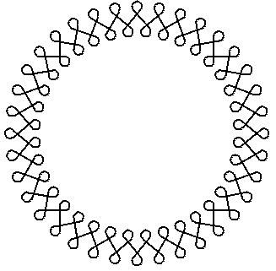
A pattern with 36 repetitions. You know enough to write a program to do this! Try it.

Slide 38

End of Lecture

