Slide 1
CS 101:
Computer Programming and Utilization
Jul-Nov 2018
Om Damani
(cs101-help@cse.iitb.ac.in)
Lecture 4: Program Design

Slide 2
Before we begin
Quiz Schedule
Graded vs ungraded labs
  Next weeks lab
  Learning vs grades
Resource Materials
Hindi lectures
What else can I do for you

Slide 3
A Program Design Example

Slide 4
How To Write Programs
Even simple programs, and indeed all programs, should be written with care
You must be confident that your program is correct
This is tricky even for slightly complex programs
As a professional programmer, you must remember that an incorrect program could cause a train crash, or an X-ray machine to supply the wrong amount of radiation: your program may be controlling such devices

Slide 5
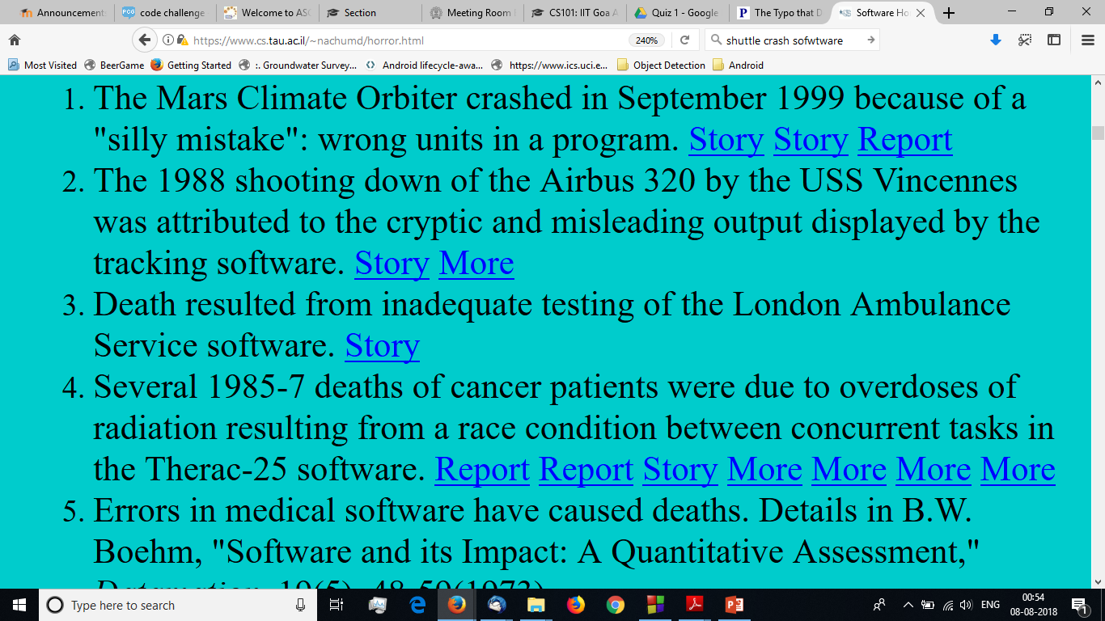
SOFTWARE HORROR STORIES

Slide 6
Program Development Strategy
  Writing specification
    Precise Problem Statement
  Constructing test cases
    May come from manual calculation, or alternative way of solving the problem, or alternate sources
  Thinking how to solve the problem on pencil and paper
  Writing out your ideas formally and making a plan
  Writing the program
  Writing your beliefs about program state

Slide 7
Program Development Strategy
  Checking your beliefs carefully
    In case of logical errors, either update code or update beliefs - iterate
  Running the test cases
    Your may make mistakes in checking your logic
    Code may have subtle issues: integer division, operator precedence, type casting, missing parenthesis
  Redoing steps if some test cases fail

Slide 8
Program Development Strategy
Write specification
(i.e. - exact input,
exact output)
Write the program
Check that the
program is correct,
by reasoning
Construct testcases
Figure out how you
would solve the
problem on a
paper and write the
steps
run testcases
Repeat steps if wrong

Slide 9
The Specification
Usually, the problem will be specified in real life terms, where there may be some ambiguity, or possibilities of confusion.
It is desirable to write to write down what is given and what is needed very precisely
Specification: A statement of what is the input and the corresponding output. Clear description of when the output is to be considered correct

Slide 10
The Problem
The following series approaches e as n increases:
e = 1/0! + 1/1! + 1/2! + … + 1/n!
Write a program which takes n as input and prints the sum of the above series

Slide 11
The Specification For Our Problem
Problem: Compute approximation of e
Input: an integer n, where n ≥ 0
Output: the sum 1/0! + … + 1/n!
This is simple enough, but note that we have made explicit that n cannot be a negative number
Also, it is worth reading this carefully yourself and asking, can something be misunderstood in this?
You may realize that carelessly, you may think of n as also being the number of terms to be added up.
The number of terms being added together is n+1.

Slide 12
Constructing Test Cases
Write down some specific input values, and the corresponding expected output values
This will help ensure that you understand the problem and cross-check the specification you wrote
3 test cases are enough for this simple problem
  For n=0, clearly the answer must be 1
  For n=1, answer = 1+1/1! = 2
  For n=2, answer = 1+1/1!+1/2! = 2.5
  We can put the test cases into a table:
Input (n) | 0 | 1 | 2
Output | 1 | 2 | 2.5

Slide 13
Constructing Test Cases
For the sqrt program
Input(n) | 0 | 1 | 2 | 3.4 | 1100 | .56
Output | 0 | 1 | 1.414 | 1.8439 | 33.166 | .748

Slide 14
Designing the Algorithm
Input: an integer n, where n ≥ 0
Output: The sum 1/0! + … + 1/n!
Solving the problem by pencil and paper
  Calculate the first term, 1/0!, which is just 1
  Calculate the second term, 1/1! which is just 1. Add to 1
  Calculate the third term, 1/2!, add to sum so far
  Calculate the fourth term 1/3! …
Clearly, you will need a repeat loop where you add one term at a time to sum so far

Slide 15
Designing the Algorithm
Input: an integer n, where n ≥ 0
Output: The sum 1/0! + … + 1/n!
Clearly, you will need a repeat loop where you add one term at a time to sum so far
  repeat(){
  sum = sum + term;
  }

Slide 16
Designing the Algorithm
Input: an integer n, where n ≥ 0
Output: The sum 1/0! + … + 1/n!
  repeat(){
  term = ??
  sum = sum + term;
  }
  repeat(){
  term = ?? // term = 1/t!
  sum = sum + term;
  }
Since t! is not a c++ expression,
we need a variable to hold the value of t!

Slide 17
Designing the Algorithm
Input: an integer n, where n ≥ 0
Output: The sum 1/0! + … + 1/n!
  repeat(){
  fac = ?? // fac = t!
  term = 1/fac; // term = 1/t!
  sum = sum + term;
  }
Because fac depends on t,
We need to know how t changes
  repeat(){
  t = t+1;
  fac = ?? // fac = t!
  term = 1/fac; // term = 1/t!
  sum = sum + term;
  }

Slide 18
Input: an integer n, where n ≥ 0
Output: The sum 1/0! + … + 1/n!
  repeat(){
  t = t+1;
  fac = ?? // fac = t!
  term = 1/fac; // term = 1/t!
  sum = sum + term;
  }
  repeat(){
  t = t+1;
  fac = fac*t // fac = t!
  term = 1/fac; // term = 1/t!
  sum = sum + term;
  }
  repeat(){// fac = t!, sum = 1/0! + .. + 1/t!
  t = t+1; // fac = (t-1)!, sum = 1/0! + .. + 1/(t-1)!
  fac = fac*t; // fac = t!
  term = 1/fac; // term = 1/t!
  sum = sum + term; // sum = 1/0! + .. + 1/t!
  }
Since t changes by 1,
We maintain fac
by multiplying it by t
In every round
Let us check if our guess of
Multiplying by t is correct.
Let us fill our belief about
program state
Complete the program now

Slide 19
Finalizing the Program
  int t, fac;
  double term, sum;
  repeat(n){ // fac = t!, sum = 1/0! + .. + 1/t!
  t = t+1; // fac = (t-1)!, sum = 1/0! + .. + 1/(t-1)!
  fac = fac*t; // fac = t!
  term = 1/fac; // term = 1/t!
  sum = sum + term; // sum = 1/0! + .. + 1/t!
  }
How should variables be initialized
They should be initialized so that they satisfy the loop invariant

Slide 20
Proper Initialization
  int t = 0; // t is ???
  int fac = 1; // = 1/t! = 1/0!
  double term = 1; // = 1/t! = 1/0!
  double sum = 1; // = 1/0! + .. 1/0! = 1/0!
  repeat(n){ // fac = t!, sum = 1/0! + .. + 1/t!
  t = t+1; // fac = (t-1)!, sum = 1/0! + .. + 1/(t-1)!
  fac = fac*t; // fac = t!
  term = 1/fac; // term = 1/t!
  sum = sum + term; // sum = 1/0! + .. + 1/t!
  }
They should be initialized so that they satisfy the loop invariant

Slide 21
Alternative Initialization
  int t = 1; // t is ???
  int fac = ??
  double term = ??
  double sum = ??
  repeat(n){ // fac = t!, sum = 1/0! + .. + 1/t!
  t = t+1; // fac = (t-1)!, sum = 1/0! + .. + 1/(t-1)!
  fac = fac*t; // fac = t!
  term = 1/fac; // term = 1/t!
  sum = sum + term; // sum = 1/0! + .. + 1/t!
  }
They should be initialized so that they satisfy the loop invariant
This program computes one extra term

Slide 22
Alternative: term does not use its old value it can be eliminated
  int t = 0; // t is ???
  int fac = 1; // = 1/t! = 1/0!
  double term = 1; // = 1/t! = 1/0!
  double sum = 1; // = 1/0! + .. 1/0! = 1/0!
  repeat(n){ // fac = t!, sum = 1/0! + .. + 1/t!
  t = t+1; // fac = (t-1)!, sum = 1/0! + .. + 1/(t-1)!
  fac = fac*t; // fac = t!
  term = 1/fac; // term = 1/t!
  sum = sum + term; // sum = 1/0! + .. + 1/t!
  }
Or term is kept and fac can be eliminated
Whatever you do update your belief and check

Slide 23
Code Review
It is useful to go over the code again to see that the values of the variables indeed satisfy what we say about them
Specially check: will the values of the variables agree with what we say about them on the t+1th iteration?
That is, does the loop invariant holds at the end of the loop

Slide 24
Testing
Next, compile and run the program for the test cases you generated.
Check if the program output agrees with what was in the table.
If the program does not agree, you are said to have a bug.
Now you must remove the bug, or debug.

Slide 25
Debugging
  int t = 0; // t is ???
  int fac = 1; // = 1/t! = 1/0!
  double term = 1; // = 1/t! = 1/0!
  double sum = 1; // = 1/0! + .. 1/0! = 1/0!
  repeat(n){ // fac = t!, sum = 1/0! + .. + 1/t!
  t = t+1; // fac = (t-1)!, sum = 1/0! + .. + 1/(t-1)!
  fac = fac*t; // fac = t!
  term = 1/fac; // term = 1/t!
  sum = sum + term; // sum = 1/0! + .. + 1/t!
  cout << t << “ “ << fac << “ “ << term << “ “ << sum << endl
  }
Ooops 1 1 0 1

Slide 26
Concluding Remarks
Transform your problem one step at a time into code
State your belief about program state at all times
If an expression cannot be directly computed, introduce a variable to hold that expression
In case you are unsure, think how you solve it by hand
As you calculate on paper, identify the numbers that are reused. These must be stored in a variable.
On updating variable, update your belief
After updating beliefs, check rest of the beliefs
In case of mismatch, either code or belief needs to be changed

