Slide 1
Lecture 5: Program Design, Comments, Loop Invariants, Initialization
Jul-Nov 2018
Om Damani
(cs101-help@cse.iitb.ac.in)

Slide 2
Bodhitree Autograder
25
25
Square is 25
Square is25
Square of 5 is 25

Slide 3
Outline
Many small things
Quotient and Remainder
Comment Less
Loop Invariant
Initialization

Slide 4
Finding Remainder
x % y computes the remainder of dividing x by y
Both x and y must be integer expressions
Example
d0 will equal 8 (the least significant digit of n)
d1 will equal 7 (the second least significant digit of n)
  int n=12345678, d0, d1;
  d0 = n % 10; // 8
  d1 = (n / 10) % 10; // 7

Slide 5
Common
Commenting Style
Recommended
Commenting Style
int i = 0, sq = 0;
repeat(n){ // sq is i square.
i=i-1; // decrement i
sq = sq - 2*i+1;
// sq is now i square
cout << sq << endl;
}
int i = 0, sq = 0;
repeat(n){ // sq = i*i
i=i-1; // sq = (i+1)*(i+1)
sq = sq - 2*i+1;
// sq = i*i
cout << sq << endl;
}

Slide 6
Common
Commenting Style
Recommended
Commenting Style
int i = 0, sq = 0;
repeat(n){ // sq is i square.
i=i-1; // decrement i
}
int i = 0, sq = 0;
repeat(n){ // sq = i*i
i=i-1; // sq = (i+1)*(i+1)
}
We must track the change in relation between variables
This relation changes with and only with
assignment to any of the variable in the relation

Slide 7
Easy to Spot Error
Recommended
Commenting Style
int i = 0, sq = 0;
repeat(n){ // sq = i*i
i=i-1; // sq = (i+1)*(i+1)
sq = sq - 2*i -1; // sq=i*i
}
int i = 0, sq = 0;
repeat(n){ // sq = i*i
i=i-1; // sq = (i+1)*(i+1)
sq = sq - 2*i+1; // sq=i*i
}

Slide 8
Makes code change easy
Introduce a new variable to avoid multiplication
int i = 0, sq = 0;
repeat(n){ // sq = i*i
i=i-1; // sq = (i+1)*(i+1)
sq = sq - 2*i -1; // sq=i*i
}
int i = 0, sq = 0;
repeat(n){ // sq = i*i
i=i-1; // sq = (i+1)*(i+1)
sq = sq - p; // sq=i*i
}

Slide 9
What should p represent
Introduce a new variable to avoid multiplication
int i = 0, sq = 0;
repeat(n){ // sq = i*i
i=i-1; // sq = (i+1)*(i+1)
p = ??? // p= 2*i +1
sq = sq - p; // sq=i*i
}
int i = 0, sq = 0;
repeat(n){ // sq = i*i
i=i-1; // sq = (i+1)*(i+1)
sq = sq - p; // sq=i*i
}

Slide 10
What should p represent
Add your belief about p to loop invariant
int i = 0, sq = 0;
repeat(n){ // sq = i*i
i=i-1; // sq = (i+1)*(i+1)
p = ??? // p= 2*i +1
sq = sq - p; // sq=i*i
}
int i = 0, sq = 0;
repeat(n){ // sq = i*I, p= 2*i +1
i=i-1; // sq = (i+1)*(i+1)
p = ??? // p= 2*i +1
sq = sq - p; // sq=i*i
}

Slide 11
Add to loop invariant
Update what p represents on change in i
int i = 0, sq = 0;
repeat(n){ // sq = i*I, p= 2*i +1
i=i-1; // sq = (i+1)*(i+1)
p = ??? // p= 2*i +1
sq = sq - p; // sq=i*i
}
int i = 0, sq = 0;
repeat(n){ // sq = i*I, p= 2*i +1
i=i-1; // sq = (i+1)*(i+1), p= 2*i +3
p = ??? // p= 2*i +1
sq = sq - p; // sq=i*i
}

Slide 12
Update p properly
Update what p represents on change in i
int i = 0, sq = 0, p=1;
repeat(n){ // sq = i*I, p= 2*i +1
i=i-1; // sq=(i+1)*(i+1), p=2*i +3
p = p - 2 // p= 2*i +1
sq = sq - p; // sq=i*i
}
int i = 0, sq = 0;
repeat(n){ // sq = i*I, p= 2*i +1
i=i-1; // sq = (i+1)*(i+1), p= 2*i +3
p = ??? // p= 2*i +1
sq = sq - p; // sq=i*i
}

Slide 13
Loop Invariant
int i = 0, sq = 0,p=1;
repeat(n){ // sq = i*i, p= 2*i +1
i=i-1; // sq=(i+1)*(i+1), p=2*i +3
p = p - 2 // p= 2*i +1
sq = sq - p; // sq=i*i
}

Slide 14
Loop Invariant
int i = 0, sq = 0;
repeat(n){
i=i-1;
sq = sq - 2*i+1;
cout << sq << endl;
}
// sq = i*i
// sq = (i+1)*(i+1)
// sq = i*i

Slide 15
Real Life Error
repeat(11){ //fac=n!,sum=x^0/0!+...+x^n/n!
n=__; //fac=(n-1)!,sum=x^0/0!+...+x^(n-1)/(n-1)!
fac=___; //fac=n!
term=__; //term=k/n!
sum=___; //sum=x^0/0!+x^1/1!+...x^n/n!//
k=___;
}
Student did not state the belief about k, it was considered trivial
And that’s where the error was

Slide 16
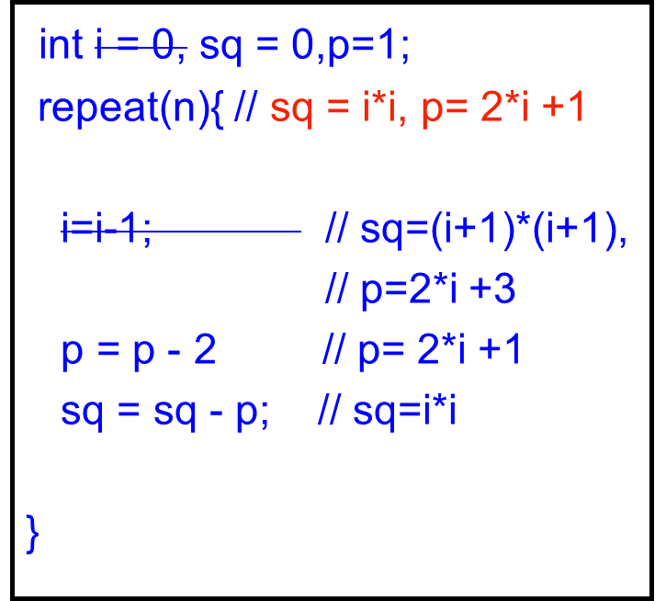
What is the role of i
int i = 0, sq = 0,p=1;
repeat(n){ // sq = i*i, p= 2*i +1
i=i-1; // sq=(i+1)*(i+1),
// p=2*i +3
p = p - 2 // p= 2*i +1
sq = sq - p; // sq=i*i
}
If we delete i then it can be considered a ghost variable
Useful only for understanding program correctness

Slide 17


Slide 18
What is a proper initialization
sum = x1 + x2 + .. + xn // repeatedly add xi to partial sum (x1..x(i-1))
prod = x1 * x2 *.. *xn // mult xi to partial prod (x1..x(i-1))
max = x1 max x2 max … xn // max xi with partial max (x1..x(i-1))
Think of the INIT value for
different OP
int term, s = INIT;
repeat(10){
cin >> term;
s = s OP term;
}
cout << s << endl;
For symmetric, associative
binary operators, such as +,*,max
INIT will be UNIT U of OP:
OP(x,U) = x;

Slide 19
What is a proper initialization
What is the Answer when the
  Execution is over empty Sequence
  when the repeat count is 0
INIT value is the UNIT of
OP represented by the loop
main_program{
int term, s = INIT;
repeat(10){
cin >> term;
s = s OP term;
}
cout << s << endl;
}
For symmetric, associative
binary operators, such as +,*,max
INIT will be UNIT U of OP:
OP(x,U) = x;

Slide 20
What is a proper initialization
What is the Answer when the
  Execution is over empty Sequence
  when the repeat count is 0
INIT value is the UNIT of
OP represented by the loop
main_program{
int term, s = INIT;
repeat(10){
cin >> term;
s = s OP term;
}
cout << s << endl;
}
And INIT values must satisfy
Loop Invariant

Slide 21
What is a proper initialization
What is the Answer when the
  Execution is over empty Sequence
  when the repeat count is 0
That answer must match common sense
  It should have some meaningful/possible physical interpretation
  If it has no correspondence with reality, then it maybe wrong

Slide 22
Elegance in Initialization

