Slide 1
CS 101:
Genereal Loops
Jul-Nov 2018
Om Damani
(cs101-help@cse.iitb.ac.in)

Slide 2
Grading Scheme
Theory: 70%
  In semester evaluation
  2 quizzes & midsem (call it quiz only) – total of 3 quizzes
    we will take best 2 out of 3 quizzes for every student
    each will have 15% weightage
  Endsem will have 40% weightage
Lab: 30%
  Two lab test of 10% weightage each
  Lab attendance: 10% weightage
    Attendance compulsory in all but one. You are expected to attend at least (N-1) labs out of N
    Every lab that you miss, after first miss, will cost you 2%
    Will not count first two labs of the semester, as registration was still going on

Slide 3
Quiz Solutions and Progarm Design
I would rather be unpopular and be harsh to you in
the short term so that the world can be kind to you
in the long term

Slide 4
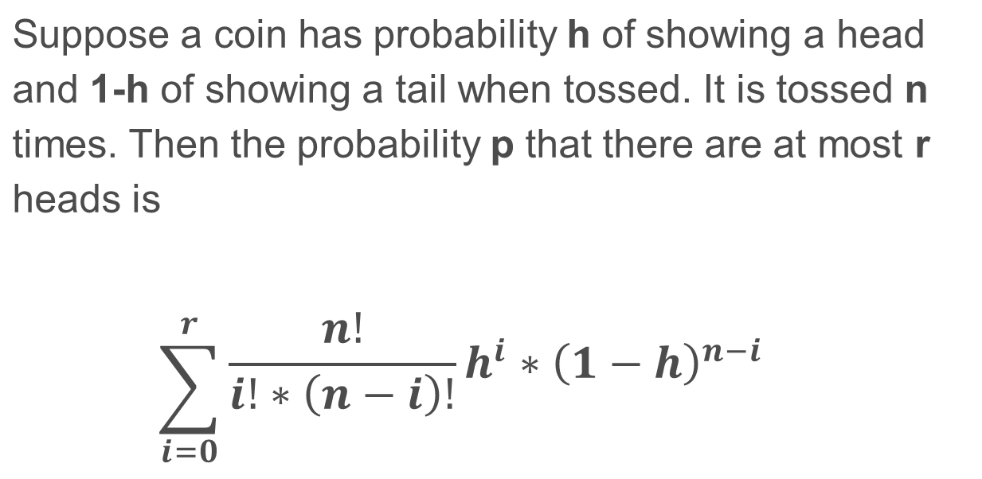
Coin Tossing
write a program to compute p given n,r,h as input.

Slide 5
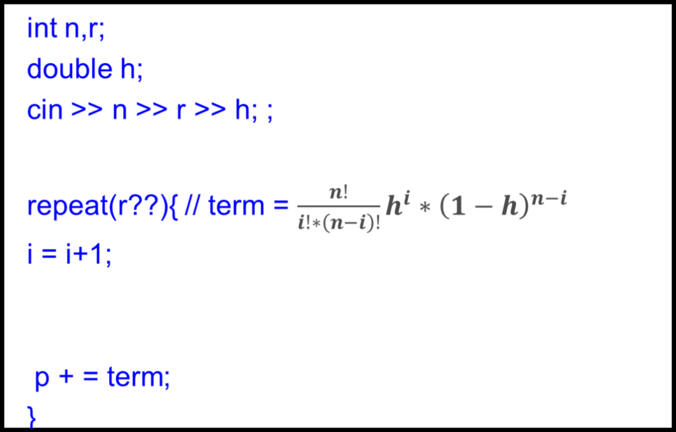
Coin Tossing: Step 1 – Write Strategy

Slide 6
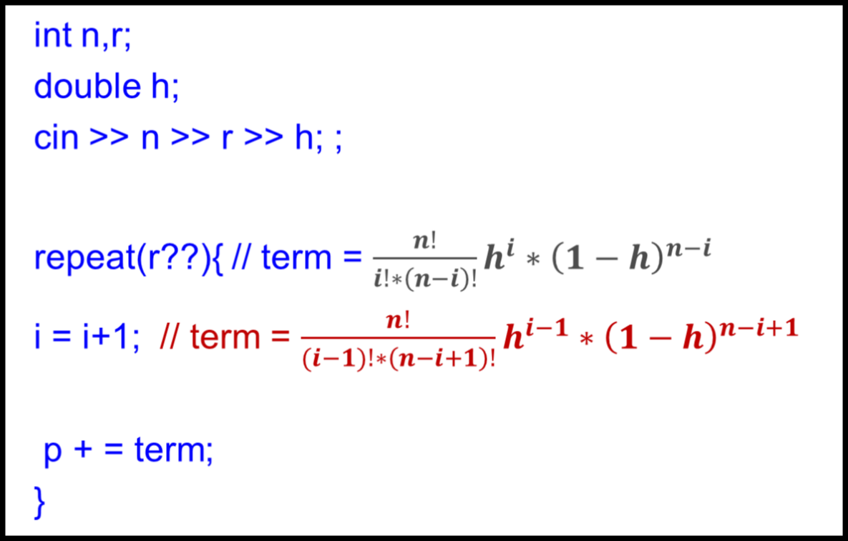
Step 2: Update relations after incrementing i

Slide 7
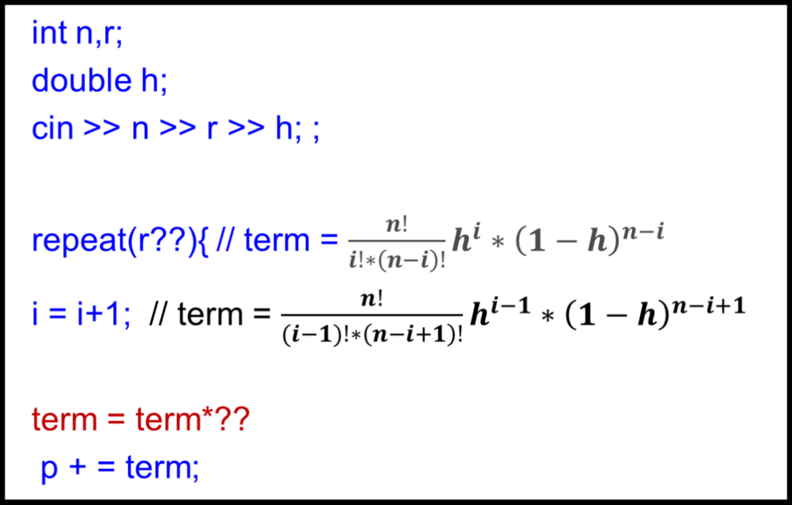
Step 3: Try Restoring Term

Slide 8
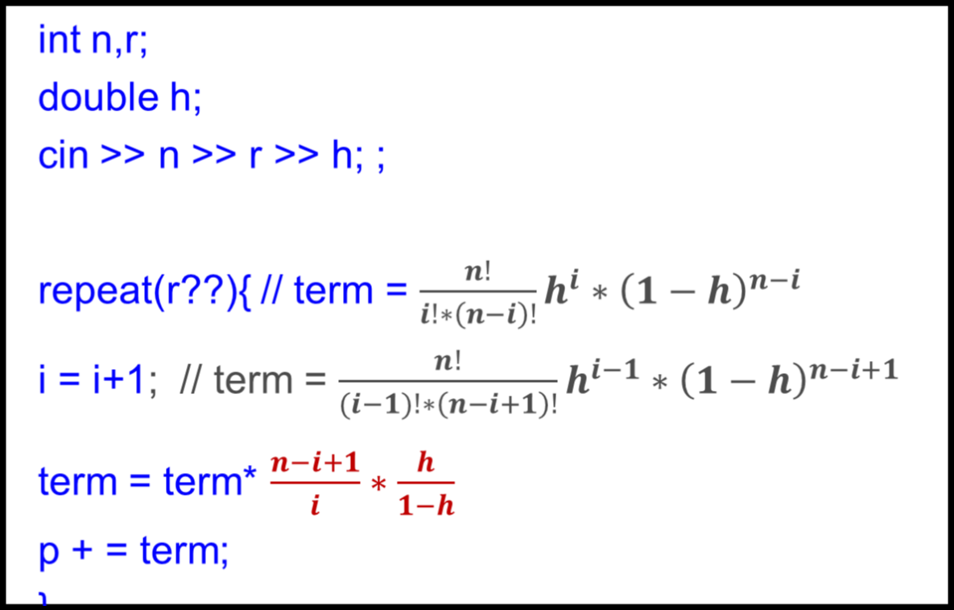
Step 4: Restoring Term

Slide 9
That’s it !!

Slide 10
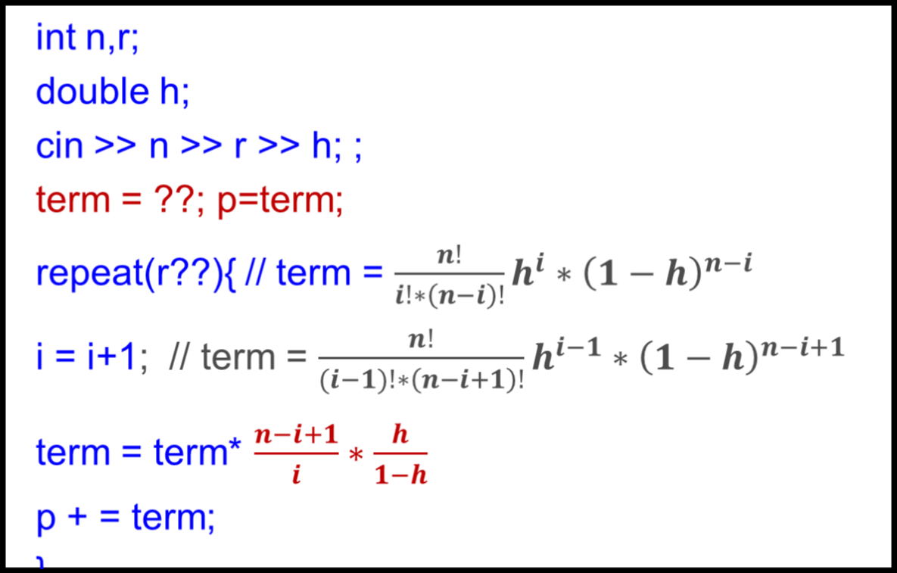
Step 5: Initialize

Slide 11
1st Step: Decide strategy, Introduce Loop Invariant
int i = 0;
int cube = 0;
int n; cin >> n;
repeat(n){ // cube = i*i*i
cout << i << " " << cube << endl;
}

Slide 12
2nd Step: Plan to Update Cube
int i = 0;
int cube = 0;
int n; cin >> n;
repeat(n){ // cube = i^3
cube = ??? // cube = (i+1)^3
cout << i << " " << cube << endl;
}

Slide 13
3rd Step: How to Update Cube
int i = 0;
int cube = 0;
int n; cin >> n;
repeat(n){ // cube = i^3
cube = cube + 3*i^2+3*i+1; // cube = (i+1)^3
cout << i << " " << cube << endl;
}

Slide 14
4th Step: Use Variables to capture unknown/notAllowed/complex expressions
int i = 0;
int cube = 0;
int n; cin >> n;
repeat(n){ // cube = i^3, p = 3*i^2+3*i+1
cube = cube + p; // cube = (i+1)^3
cout << i << " " << cube << endl;
}

Slide 15
5th Step: Plan to update p for i+1
int i = 0;
int cube = 0;
int n; cin >> n;
repeat(n){ // cube = i^3, p = 3*i^2+3*i+1
cube = cube + p; // cube = (i+1)^3
p = ??? // p = 3*(i+1)^2+3*(i+1)+1
cout << i << " " << cube << endl;
}

Slide 16
5th Step: Updating p
int i = 0;
int cube = 0;
int n; cin >> n;
repeat(n){ // cube = i^3, p = 3*i^2+3*i+1
cube = cube + p; // cube = (i+1)^3
p = p + 6*i+3+3; // p = 3*(i+1)^2+3*(i+1)+1
cout << i << " " << cube << endl;
}

Slide 17
6th Step: Use Variables to capture unknown/notAllowed/complex expressions
int i = 0;
int cube = 0;
int n; cin >> n;
repeat(n){ // cube = i^3, p = 3*i^2+3*i+1, s=6*i+6
cube = cube + p; // cube = (i+1)^3
p = p + s; // p = 3*(i+1)^2+3*(i+1)+1
cout << i << " " << cube << endl;
}

Slide 18
7th Step: Update s
int i = 0;
int cube = 0;
int n; cin >> n;
repeat(n){ // cube = i^3, p = 3*i^2+3*i+1, s=6*i+6
cube = cube + p; // cube = (i+1)^3
p = p + s; // p = 3*(i+1)^2+3*(i+1)+1
s = s + 6; // s = 6*(i+1) + 6
cout << i << " " << cube << endl;
}

Slide 19
8th Step: Update i
int i = 0;
int cube = 0;
int n; cin >> n;
repeat(n){ // cube = i^3, p = 3*i^2+3*i+1, s=9*i+3
cube = cube + p; // cube = (i+1)^3
p = p + s; // p = 3*(i+1)^2+3*(i+1)+1
s = s + 6; // s = 6*(i+1) + 6
i = i+1; // LI
cout << i << " " << cube << endl;
}

Slide 20
9th Step: Initialize
int i = 0;
int cube = 0;
int n; cin >> n;
p =1; s = 6;
repeat(n){ // cube = i^3, p = 3*i^2+3*i+1, s=6*i+6
cube = cube + p; // cube = (i+1)^3
p = p + s; // p = 3*(i+1)^2+3*(i+1)+1
s = s + 6; // s = 6*(i+1) + 6
i = i+1; // LI
cout << i << " " << cube << endl;
}

Slide 21
An Alternative Way to Develop
int i = 0;
int cube = 0;
int n; cin >> n;
p =1; s = 6;
repeat(n){ // cube = i^3, p = 3*i^2-3*i+1, s=6*i+6
i = i+1; //cube=(i-1)^3,p=3*(i-1)^2+3(i-1)+1,s=6*(i-1)+6
cube = cube + p; // cube = i^3
p = p + s; // p = 3*i^2+3*i+1
s = s + 6; // s = 6*i + 6
cout << i << " " << cube << endl;
}

Slide 22


Slide 23
The Need of a More General Loop
Keep monitoring temperature. Stop and raise alarm if it falls below 0.
  We need a more general statement than repeat
    start monitoring
    while ( normalTemp ) {
    // keep monitoring
    }
    raise alarm;

Slide 24
The WHILE Statement
while (condition) {
body
}
next_statement
Evaluate the condition
  If true,
  i. execute body.
    ii. go back and execute step 1
    (as in repeat end)
If false, execution of while statement ends and control goes to the next statement

Slide 25
Program to Compute Average
double next, sum = 0;
int count = 0;
cin >> next;
while(next >= 0){
sum = sum + next;
count = count +1;
cin >> next;
}
cout << sum/count << endl;

Slide 26
Correctness indicating Comments
Comments indicate our belief about program state at a given point in program
Given point means after the last executed statement or evaluated condition
Earlier statements;
Loop Initialization; // can be empty
// LI: loop invariant
while (C: condition){// LI /\ C
body;
}
// LI /\ !C

Slide 27
Loop Invariant
LI is supposed to be true before every evaluation of loop condition
1) After initialization : very first evaluation of loop condition
2) After every iteration – before the beginning of next iteration
3) This includes the end of loop when loop condition becomes false
LI will typically becomes false in the middle of loop.
In fact, it must become false. Else, nothing interesting is happening in loop
Earlier statements;
Loop Initialization;
// LI: loop invariant
while (C: condition) { // LI /\ C
body;
}
// LI /\ !C

Slide 28
Loop Invariants Help Establish Correctness
double next, sum = 0;
int count = 0; cin >> next;
// LI
while(next >= 0){
sum = sum + next;
count = count +1;
cin >> next;
}
cout << sum/count << endl;
What all variables should be mentioned in loop invariant?
sum is the sum of numbers read so far?
sum is total of all but last read number
count is the count of numbers read so far?
count is the count of +ve numbers read so far?
count is the count of non negative numbers read?
count is the number of numbers summed
next need not be mentioned in LI?
sum
count
next

Slide 29
Loop Invariant: Example
double next, sum = 0;
int count = 0;
cin >> next;
// LI: sum is total of all but last read number
// LI: count is the number of numbers summed
while(next >= 0){ // LI /\ C: simple enough that it need not be mentioned
sum = sum + next;
count = count +1;
cin >> next;
}
// LI /\ !condition: simple enough that it need not be mentioned
double average = sum/count; cout << average;

Slide 30
Program Design: check if a number is Prime
A number is prime if it is not divisible by any positive integer other than 1 and itself.
1 is not considered to be a prime.
Ask a sequence of questions
Is n = 1?
Is n divisible by 2?
Is n divisible by 3?
.......
Is n divisible by n-1?
In C++
n == 1?
n%2 == 0?
n%3 == 0?
......
n%(n-1) == 0?

Slide 31
Program Design: Loop is needed
Ask a sequence of questions
Is n = 1?
Is n divisible by 2?
.......
Is n divisible by n-1?
In C++
n == 1?
n%2 == 0?
......
n%(n-1) == 0?
while(....){
n%trialDivisor == 0
}

Slide 32
Program Design: check if a number is Prime
Ask a sequence of questions
Is n = 1?
Is n divisible by 2?
Is n divisible by 3?
.......
Is n divisible by n-1?
In C++
n == 1?
n%2 == 0?
n%3 == 0?
......
n%(n-1) == 0?
Stop as soon as
an answer is Yes
Need to keep track of answers so far, how?
Introduce a bool that captures answers so far

Slide 33
Program Design: Keeping Track of Answer So Far
bool prime;
// LI: prime - no divisor found so far
// (prime = true) = no divisor found so far
while( prime ){
n%trialDivisor == 0
}
How do we update prime?

Slide 34
Program Design: Updating prime
bool prime;
int trialDivisor;
// LI: prime - no divisor found so far
// LI: trialDivisor - last divisor tried
while( prime ){
prime = prime && (n%trialDivisor == 0);
}
OK?

Slide 35
Program Design: Updating prime
bool prime;
int trialDivisor;
// LI: prime - no divisor found so far
// LI: trialDivisor - last divisor tried
while( prime ){
prime = prime && (n%trialDivisor != 0);
}
How do we update trialDivisor?

Slide 36
Program Design: Updating trialDivisor
bool prime;
int trialDivisor;
// LI: prime - no divisor found so far
// LI: trialDivisor - last divisor tried
while( prime ){
prime = prime && (n%trialDivisor != 0);
trialDivisor = trialDivisor + 1;
}
Initialization??

Slide 37
Program Design: Initialization
bool prime = true;
int trialDivisor = 2;
// LI: prime - no divisor found so far
// LI: trialDivisor - last divisor tried
while( prime ){
prime = prime && (n%trialDivisor != 0);
trialDivisor = trialDivisor + 1;
}
Are our comments consistent?
No. last divisor tried is not 2
When faced with inconsistency, fix either code or belief/strategy
Let us try fixing code first

Slide 38
Program Design: Fixing code
bool prime = true;
int trialDivisor = 1;
// assume 1 does not divide for primality purpose
// LI: prime - no divisor found so far
// LI: trialDivisor - last divisor tried
while( prime ){
prime = prime && (n%trialDivisor != 0);
trialDivisor = trialDivisor + 1;
}
Does this work?
Invariant is not maintained.
trialDivisor is not the lastDivisor tried after the 1st iteration
n%1 == 0 problematic, should not try again with last divisor tried.
Fix?

Slide 39
Program Design: Change order
bool prime = true;
int trialDivisor = 1;
// assume 1 does not divide for primality purpose
// LI: prime - no divisor found so far
// LI: trialDivisor - last divisor tried
while( prime ){
trialDivisor = trialDivisor + 1;
prime = prime && (n%trialDivisor != 0);
}
How does the loop terminate
when trialDivisor becomes n:
sentinel: special value used to guarantee
loop termination
decide primality

Slide 40
Program Design: Decide Primality after Loop Exit
bool prime = true; int trialDivisor = 1;
// assume 1 does not divide for primality purpose
// LI: prime - no divisor found so far
// LI: trialDivisor - last divisor tried
while( prime ){
trialDivisor = trialDivisor + 1;
prime = prime && (n%trialDivisor != 0);
}
// !prime => divisor found
prime = ??
decide primality

Slide 41
Program Design: Decide Primality after Loop Exit
bool prime = true; int trialDivisor = 1;
// assume 1 does not divide for primality purpose
// LI: prime - no divisor found so far
// LI: trialDivisor - last divisor tried
while( prime ){
trialDivisor = trialDivisor + 1;
prime = prime && (n%trialDivisor != 0);
}
// !prime => divisor found
prime = ( n != trialDivisor );
cout << prime;
decide primality
Are we done?
prime is always false
Debug?

Slide 42
Program Design: Debug
bool prime = true; int trialDivisor = 1; int n; cin >> n;
// assume 1 does not divide for primality purpose
// LI: prime - no divisor found so far
// LI: trialDivisor - last divisor tried
while( prime ){
trialDivisor = trialDivisor + 1;
prime = prime && (n%trialDivisor != 0);
}
// !prime => divisor found
prime = ( n != trialDivisor );
cout << prime << “ “ << trialDivisor;
trialDivisor is n
Debug?

Slide 43
Program Design: Final
bool prime = true; int trialDivisor = 1; int n; cin >> n;
// assume 1 does not divide for primality purpose
// LI: prime - no divisor found so far
// LI: trialDivisor - last divisor tried
while( prime ){
trialDivisor = trialDivisor + 1;
prime = prime && (n%trialDivisor != 0);
}
// !prime => divisor found
prime = ( n == trialDivisor );
cout << prime << “ “ << trialDivisor;
Alternative design?

Slide 44
Alternative Program Design: Initialization
bool prime = true;
int trialDivisor = 2;
// LI: prime - no divisor found so far
// LI: trialDivisor - last divisor tried
while( prime ){
prime = prime && (n%trialDivisor != 0);
trialDivisor = trialDivisor + 1;
}
Are our comments consistent?
No. last divisor tried is not 2
When faced with inconsistency, fix either code or belief/strategy
Let us try fixing belief now

Slide 45
Program Design: Fixing Belief
bool prime = true;
int trialDivisor = 2;
// LI: prime - no divisor found so far
// LI: trialDivisor - next divisor to be tried
while( prime ){
prime = prime && (n%trialDivisor != 0);
trialDivisor = trialDivisor + 1;
}
Finish the code

Slide 46
Program Design: Finishing it
bool prime = true;
int trialDivisor = 2;
// LI: prime - no divisor found so far
// LI: trialDivisor - next divisor to be tried
while( prime ){
prime = prime && (n%trialDivisor != 0);
trialDivisor = trialDivisor + 1;
}
// !prime => divisor found
prime = ( n == trialDivisor );
cout << prime;
Debug
What happens when we run the code?
No number is found to be prime

Slide 47
Program Design: Running It
bool prime = true;
int trialDivisor = 2;
// LI: prime - no divisor found so far
// LI: trialDivisor - next divisor to be tried
while( prime ){
prime = prime && (n%trialDivisor != 0);
trialDivisor = trialDivisor + 1;
}
// !prime => divisor found
prime = ( n == trialDivisor );
cout << prime << “ “ << trialDivisor;
What happens when we run the code?
for 5, trialDivisor is 6
Fix it

Slide 48
Program Design: Final
bool prime = true;
int trialDivisor = 2;
// LI: prime - no divisor found so far
// LI: trialDivisor - next divisor to be tried
while( prime ){
prime = prime && (n%trialDivisor != 0);
trialDivisor = trialDivisor + 1;
}
// !prime => divisor found
prime = ( n == (trialDivisor – 1) );
cout << prime << “ “ << (trialDivisor-1);
What happens when we run the code?
It works ☺
Minor optimization

Slide 49
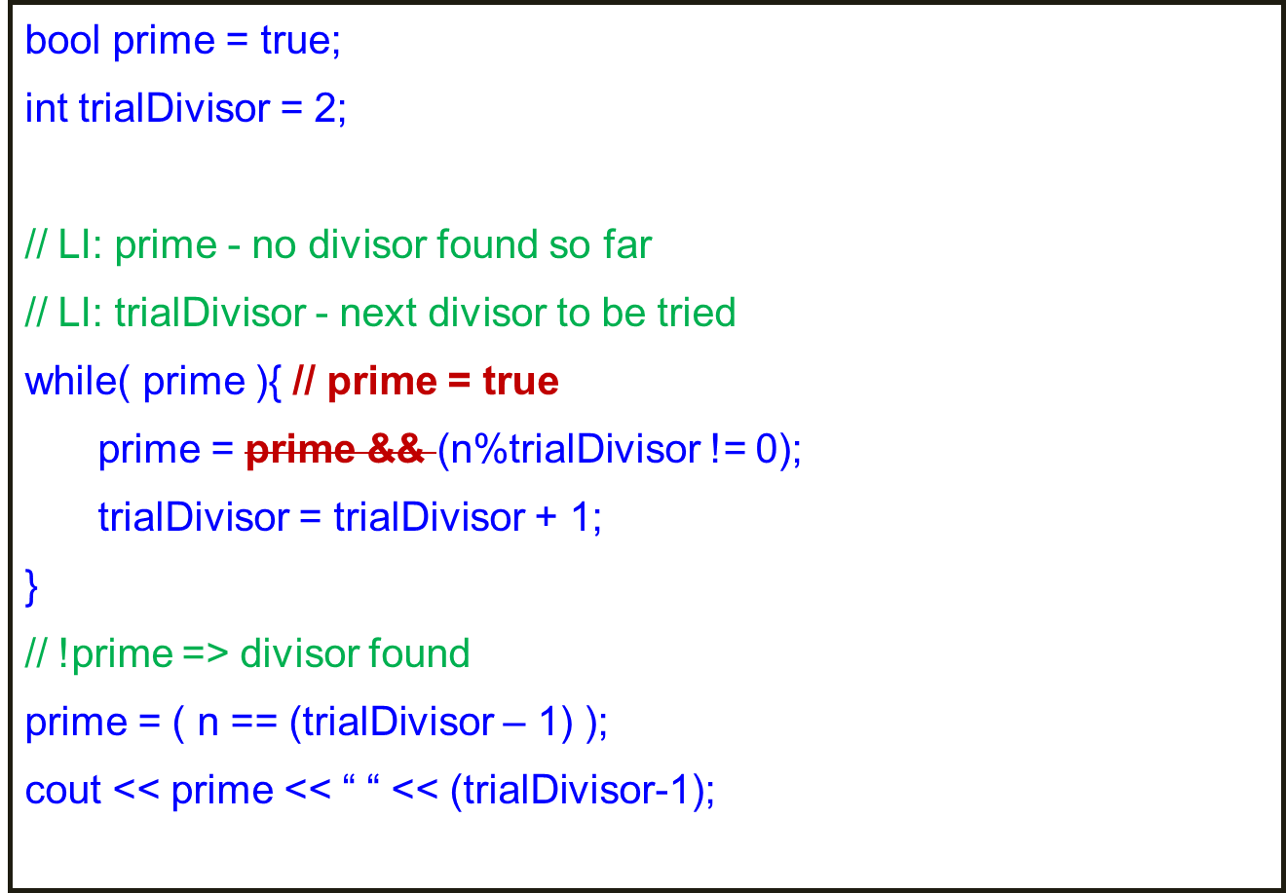
Program Design: Final

Slide 50
Program Design: Alternatives
bool prime = true; int trialDivisor = 1;
// assume 1 does not divide for primality purpose
// LI: prime - no divisor found so far
// LI: trialDivisor - last divisor tried
while( prime ){
trialDivisor = trialDivisor + 1;
prime = prime && (n%trialDivisor != 0);
}
// !prime => divisor found
prime = ( n == trialDivisor );
cout << prime << “ “ << trialDivisor;
bool prime = true;
int trialDivisor = 2;
// LI: prime - no divisor found so far
// LI: trialDivisor - next divisor to be tried
while( prime ){
prime = prime && (n%trialDivisor != 0);
trialDivisor = trialDivisor + 1;
}
// !prime => divisor found
prime = ( (n+1) == trialDivisor );
cout << prime << “ “ << (trialDivisor-1);
Which version is better?
Does it matter?
It certainly does in bigger programs
I prefer first program
Off by 1 errors very common

Slide 51
Program Design: Alternatives
int i = 0, fib = 1;
// LI: fib = n!
while( i < N ){
i = i+1;
fib = fib*n;
}
// n= N /\ fib = N!
int i = 1, fib = 1;
// LI: fib = (n-1)!
while( i <= N ){
fib = fib*n;
i = i+1;
}
// n = N+1 /\ fib = N!
Off by 1 errors very common
Doing an unnecessary computation that is not
needed later

