Slide 1


Slide 2
Title: Hobby Co-curricular and Extra-curricular (HCE) Elective
Course code: PEHCE1
Presenter: MAHEESH VARMA UGGE
HNO: 2303A52163
Date: 25/7/2024

Slide 3
Introduction
In this internship, we embarked on a comprehensive journey to master the art of web development. We started from the basics of web development, including HTML, CSS, and JavaScript, and progressed to building projects, such as a to-do list app while learning about front-end development. Through this course, we gained a solid understanding of web development fundamentals, developed problem-solving skills, and learned how to build responsive, interactive, and dynamic web applications. As a result, we became proficient in building web applications from scratch, developed projects, and earned a certification in web development, preparing us for a career in this exciting field.

Slide 4
Objective To gain hands-on experience in real-world web development projects, applying theoretical knowledge to practical scenarios. To enhance technical skills in web development, including HTML, CSS, JavaScript, and other relevant technologies. To explore the field of web development and understand its practical applications, helping to decide on a potential career path.

Slide 5
Description Reason for selection:
Pursuing a web development internship can be a great way to gain practical experience, build a professional network, and enhance your resume. Here are some useful tips and information to help you get the most out of a web development internship which help in potential job Opportunities in the future

Slide 6

Description of Activities:
I started watching videos of a web development course that explains HTML, CSS, and JavaScript. The course covers the basics of web development, including creating and styling web pages, and adding interactivity. I have completed several task exams to reinforce my learning. This hands-on experience has helped me understand key concepts and improve my coding skills. My next steps are to continue learning and work on more advanced projects.

Slide 7
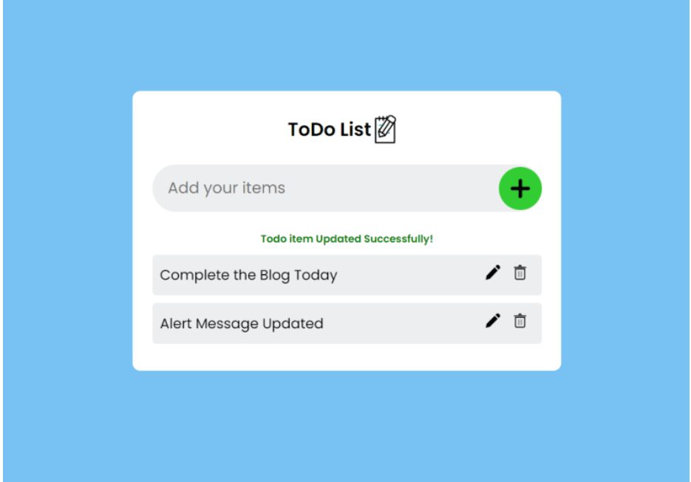
GITHUB: https://github.com/MaheeshVarma-Ugge/TODO-LIST.git

Slide 8
Knowledge Gained:
The subject explain about HTML the standed for is “Hyper Text Markup Language”. And HTML describle the structure of web pages and HTML elements describes a component our web page and HTML help us determine structure of a page
CSS (Cascading Style Sheets) is a cornerstone technology in web development, alongside HTML and JavaScript. It is used for describing the presentation of a document written in HTML or XML.

Slide 9

Certificate:

Slide 10


Slide 11
THANK YOU

