Slide 1
Sales Dashboard Summary
Power BI Interactive Report
Dataset: sales_data_sample.csv
By:- Mahek Kevlani

Slide 2
Objective
The objective of this dashboard is to analyze sales performance using interactive visuals, enabling business stakeholders to gain insights on total sales, country-wise distribution, product performance, deal sizes, and trends over time.

Slide 3
Dataset Description
The dataset 'sales_data_sample.csv' includes sales records containing fields such as:
- ORDERNUMBER, ORDERDATE, PRODUCTLINE
- SALES, STATUS, COUNTRY, DEALSIZE
- QTR_ID, MONTH_ID, YEAR_ID
The data reflects transactional-level sales data across multiple countries and product lines.

Slide 4
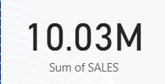
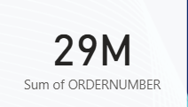
Key Performance Indicators (KPIs)
- Total Sales (Sum of SALES)
- Total Orders (Count of ORDERNUMBER)

Slide 5
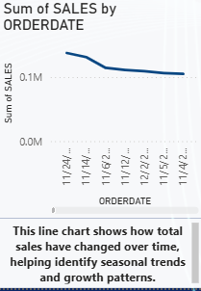
Sales Trend Over Time
A line chart was used to visualize total sales over time, identifying seasonal patterns and sales growth trends.

Slide 6
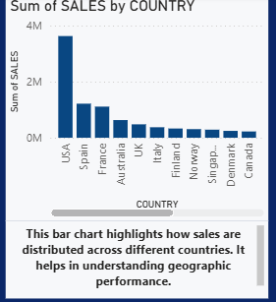
Sales by Country
A bar chart shows how sales are distributed across different countries, helping to pinpoint top-performing regions.

Slide 7
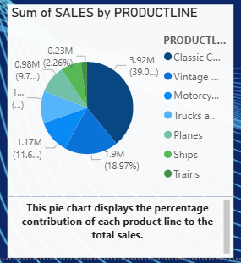
Product Line Contribution
A pie chart represents the percentage of total sales attributed to each product line.

Slide 8
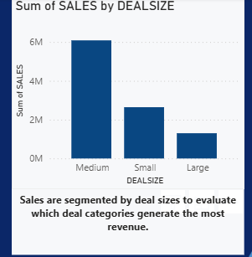
Deal Size Sales Performance
This bar chart breaks down total sales by deal size (Small, Medium, Large) to show which types contribute most to revenue.

Slide 9
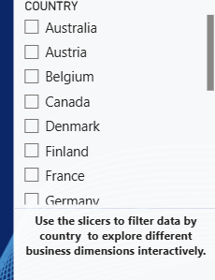
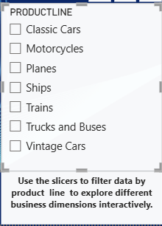
Filters and Interactivity
Slicers for Country and Product Line were added to allow dynamic filtering of the dashboard.

Slide 10
Key Insights
- Highest sales came from specific countries and product lines.
- Peak sales observed in certain months/years.
- Medium deal sizes contributed the most to total revenue.
- Line chart helped identify rising and falling trends.

Slide 11
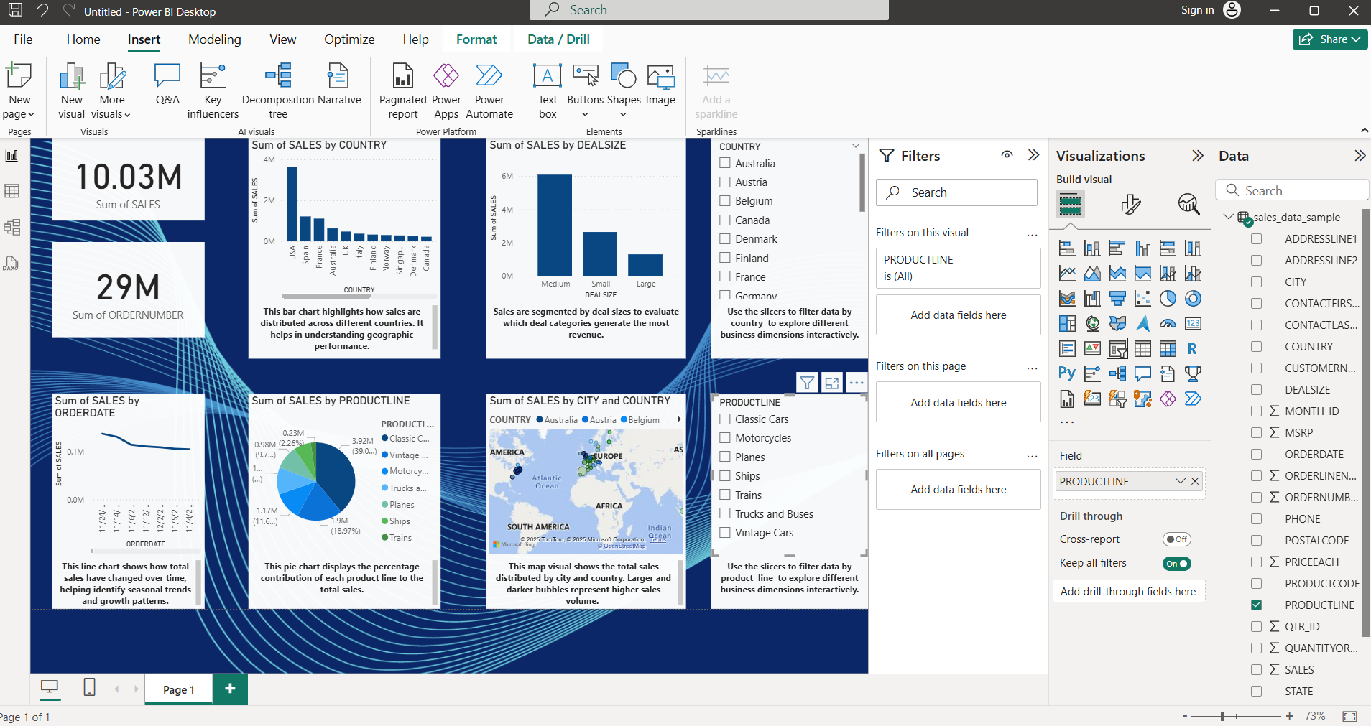
Screenshots of dashboard

Slide 12
Conclusion
The Power BI dashboard enables stakeholders to gain quick and actionable insights into sales data through interactive visuals and KPIs, enhancing decision-making.

