Slide 1

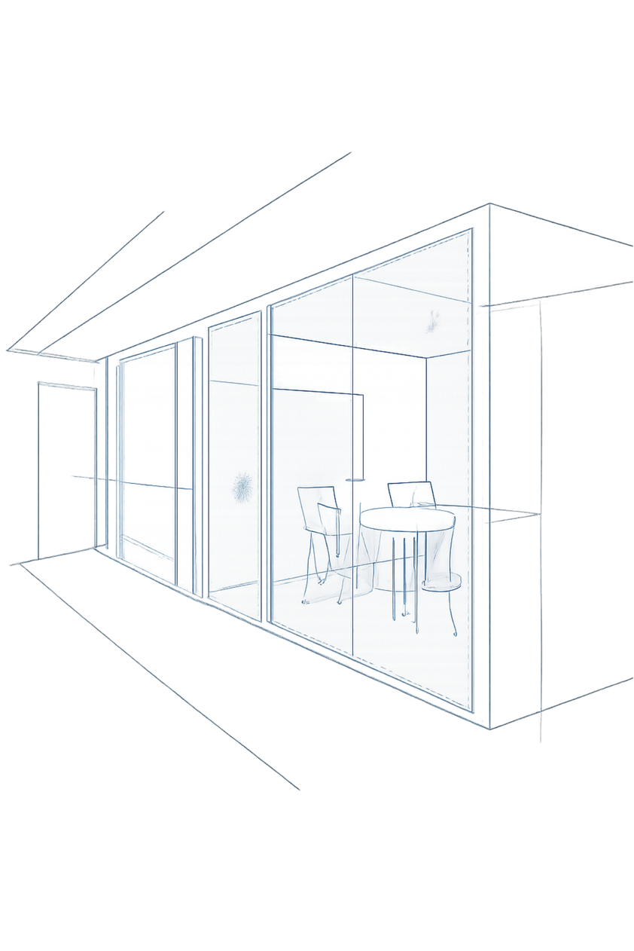

KOHLER Enterprise Intelligence Agent
Track 3: Unified Enterprise Conversational AI Agent Prototype — KOHLER‑MITWPU AI Research Lab case study. High‑impact executive summary of a permission‑aware copilot for enterprise governance.

Slide 2
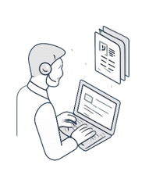
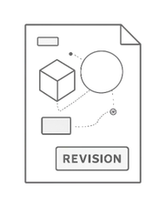

The Enterprise Challenge & Strategic Opportunity
Policy Fragmentation
Compliance Drift
Security Risks
Version confusion (e.g., $50/day in 2024 vs $75/day in 2026) causes erroneous filings and audit flags.
Generic chatbots lack deterministic access controls—sensitive policy data can leak if not filtered pre‑retrieval.
Governance rules scattered across HR, Finance, Support, Data Privacy, and Legal — employees spend hours cross‑referencing PDFs for routine decisions.
Opportunity: Deploy a unified agent for cross‑domain reasoning, deterministic RBAC filtering, temporal supersession handling, and multi‑format outputs (JSON, Excel, Email).

Slide 3
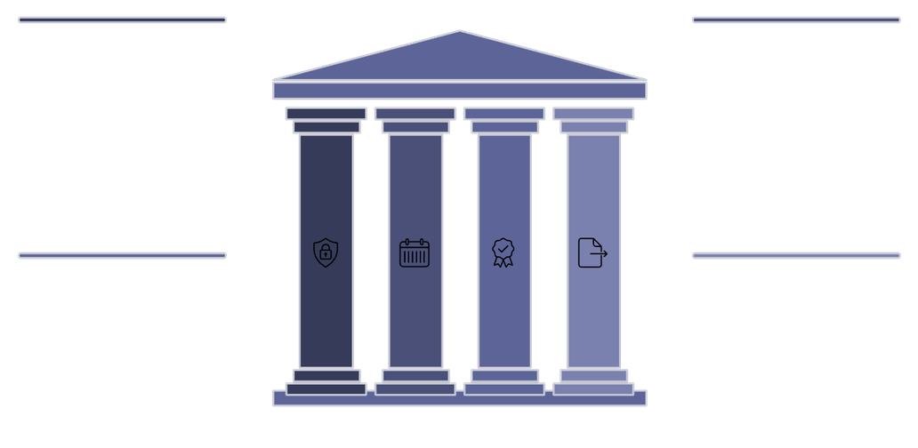
Architectural Innovation & Technical Moat
Deterministic RBAC Gate
Temporal Supersession Engine
Evaluates user roles against document access tiers before retrieval — prevents unauthorized context leakage.
Tracks metadata (supersedesId, effective date) to detect and enforce current policies (e.g., auto‑apply $75/day when 2024 rule is superseded).
Deterministic RBAC Gate
Supersession Engine
Pre-retrieval role check prevents data leaks
Policy conflict resolution with temporal rules
Observable Confidence Scoring
Artifact Synthesis
Observable Confidence Scoring
Artifact Synthesis
Dynamic generation in multiple formats
Generates schema‑validated JSON, binary .xlsx workbooks, and structured executive emails for downstream workflows.
Multi-factor signals produce trust scores
Composite, auditable score: Retrieval Relevance 30%, Authority 25%, Freshness 20%, Conflict Freedom 15%, Numerical Grounding 10%.

Slide 4






Empirical Validation & Scenario Performance
Test Coverage
Latency
8/8 case study scenarios passed — automated live executions across official scenarios.
Average execution latency ≈ 320 ms (measured in‑browser via performance.now()).
RBAC Containment
Structured Output Validity
100% deterministic containment — employees receive 0 restricted executive chunks.
100% valid: JSON parses and Excel generates as genuine binary workbook.
Estimated Savings
Hallucination Rate
Prototype estimate: ~1.8 hours saved per query compared to manual 5‑repository cross‑checks (modeled, not empirically measured).
Not measured — requires longitudinal human evaluation; transparently labeled N/A.
Live prototype demos: grounded $75/day calculation with citations; cross‑domain synthesis (Privacy, Legal, Support); deterministic RBAC tests; .xlsx generation; ReAct flows with human approval gates.

Slide 5
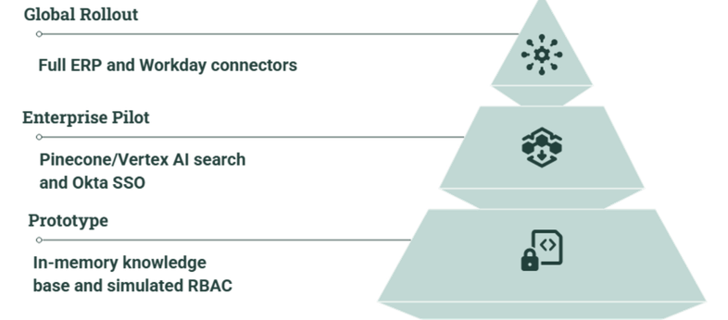


Business Impact & Production Roadmap
The KOHLER agent pairs foundation models with deterministic security, temporal reasoning, and human‑in‑the‑loop governance for a production‑ready enterprise AI.
1
2
3
Decision Velocity
Audit & Compliance
Workflow Automation
Replaces 1.5–2 hours of manual policy hunting with sub‑second verified answers.
Eliminates reliance on superseded policies and provides centralized audit logs of automated lookups.
Auto‑generates audit spreadsheets and procurement emails to reduce manager friction.
Takeaway: A mature vision for enterprise AI — deterministic access, temporal policy reasoning, and artifact synthesis enable secure, auditable, high‑value automation.

